Slide 1
SIMPLE VARIANT (ARI)

Slide 2
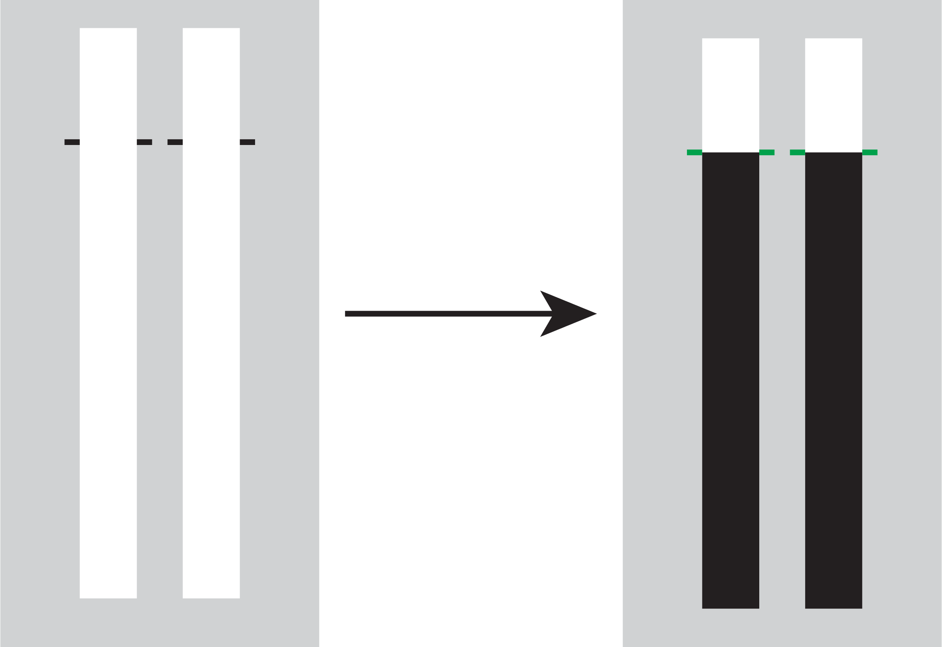
Selective Stopping Toolbox (SeleST)
Welcome! SeleST is designed to test your ability to respond and stop selectively.
Each trial starts with two empty bars that can fill from bottom to top. Most trials are ‘go’ trials during which both bars completely fill.
Your objective is to stop the bars as close as you can to the target by pressing the response keys.
KEY:
x
n
Press SPACE to continue

Slide 3

SeleST
You earn points by stopping the bars close to the target.
0 points
25 points
50 points
100 points
Let’s practice with a block of go trials.
Press SPACE to start practice block

Slide 4
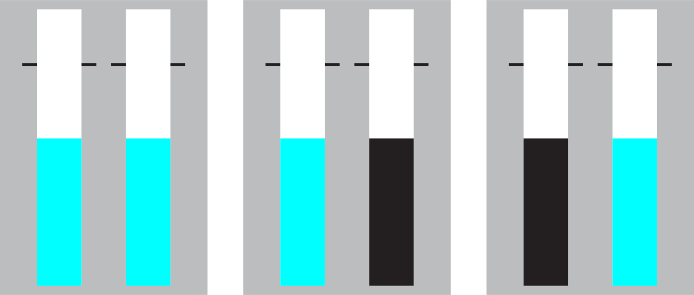
SeleST
One or more bars may change colour before the target on a small number of ‘stop’ trials.
stop-both
stop-left
stop-right
You earn points by not making a response to any bar that has changed colour.
You should avoid slowing your responses to prepare for a stop trial.
Press SPACE to start practice block of go and stop trials

Slide 5
SIMPLE VARIANT (SST)

Slide 6
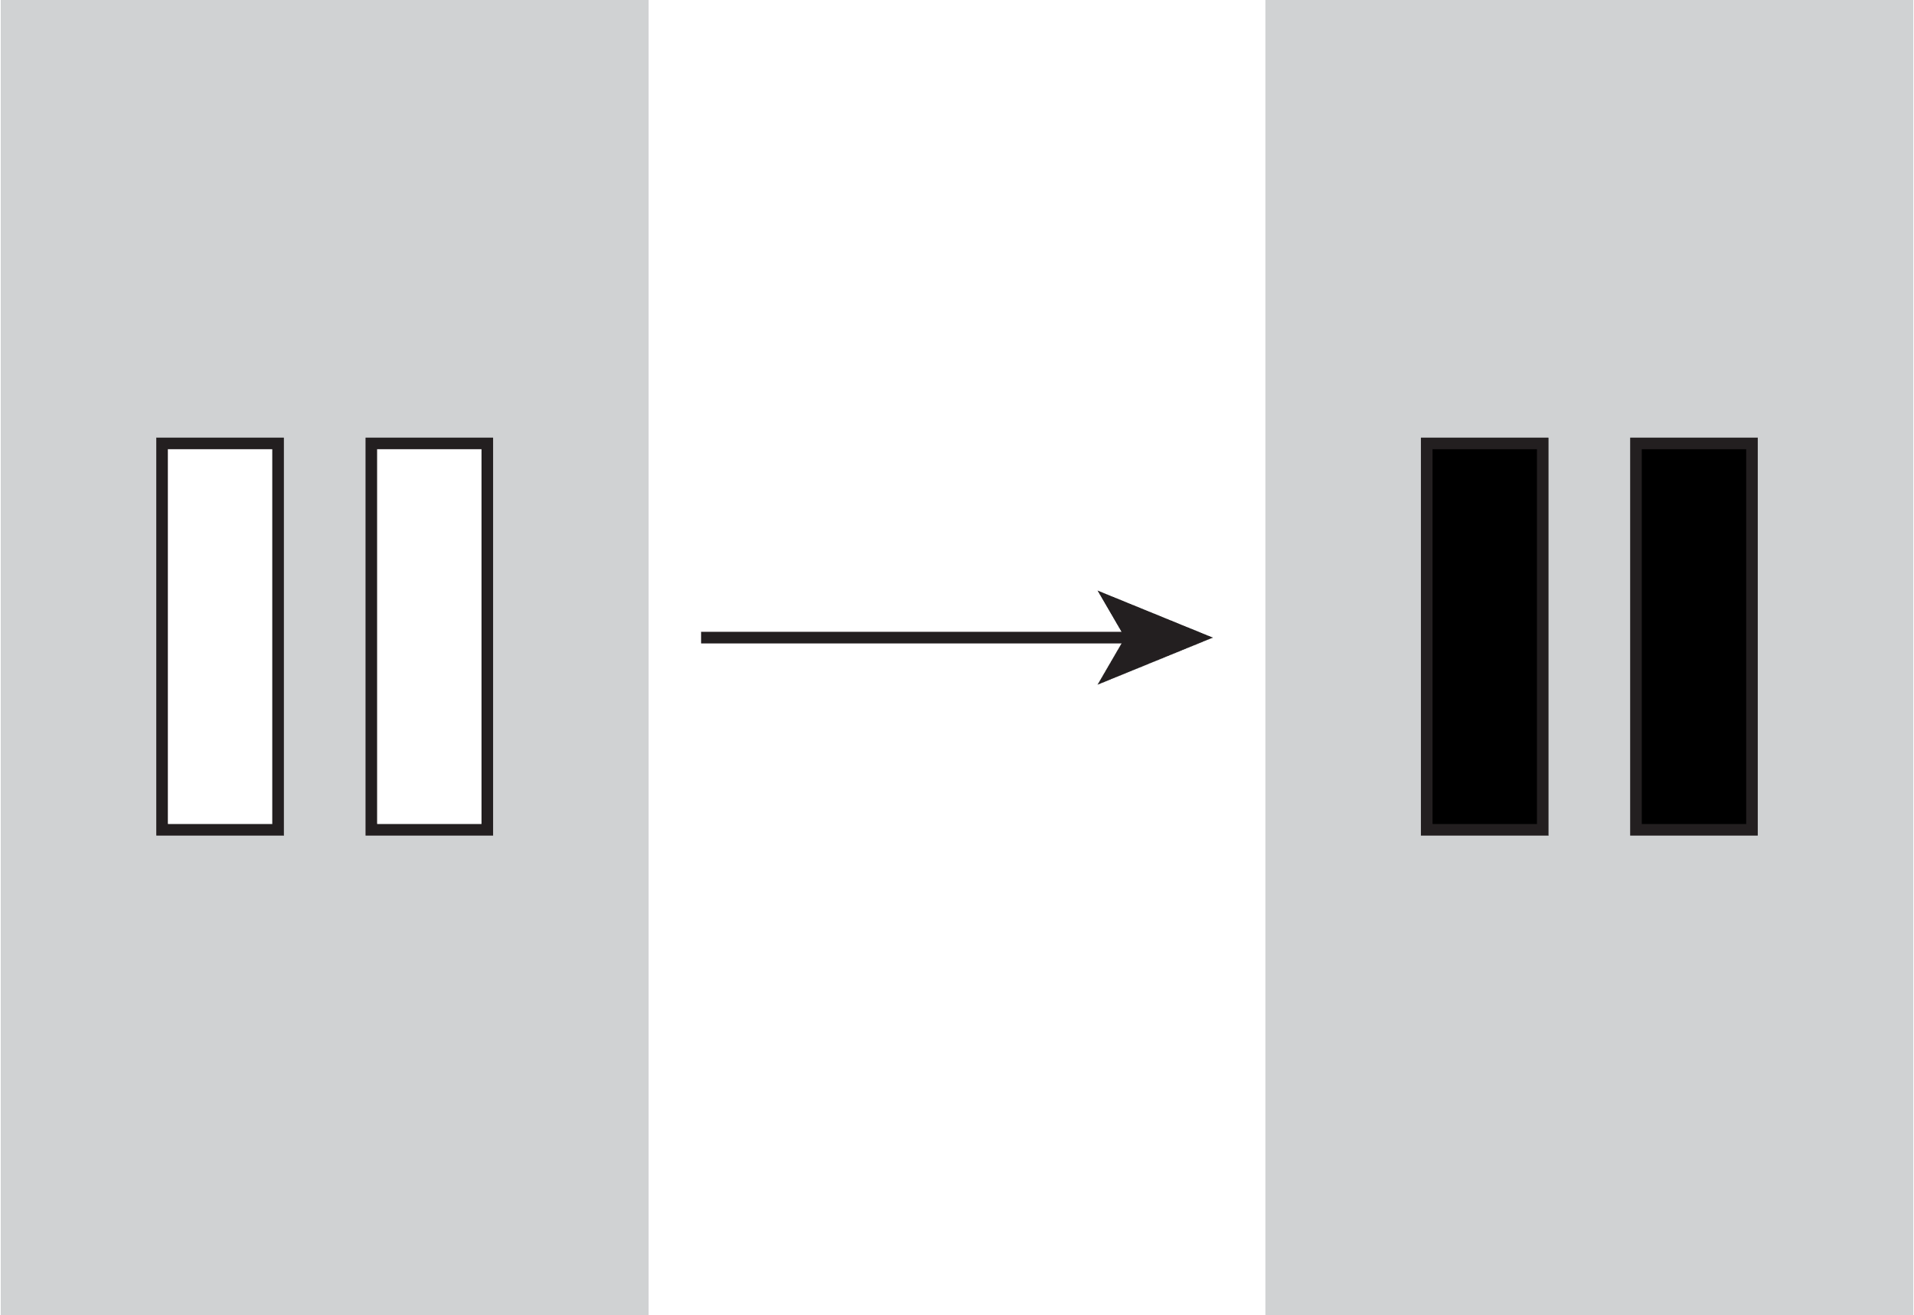
Selective Stopping Toolbox (SeleST)
Welcome! SeleSt is designed to test your ability to respond and stop selectively.
Each trial starts with two empty bars that can change colour. Most trials are ‘go’ trials during which both bars turn black
Your objective is to respond as fast as you can when the bars turn black by pressing the response keys
KEY:
x
n
Press SPACE to continue

Slide 7

SeleST
You earn points by responding fast.
0 points
25 points
50 points
100 points
Let’s practice with a block of go trials.
Press SPACE to start practice block

Slide 8
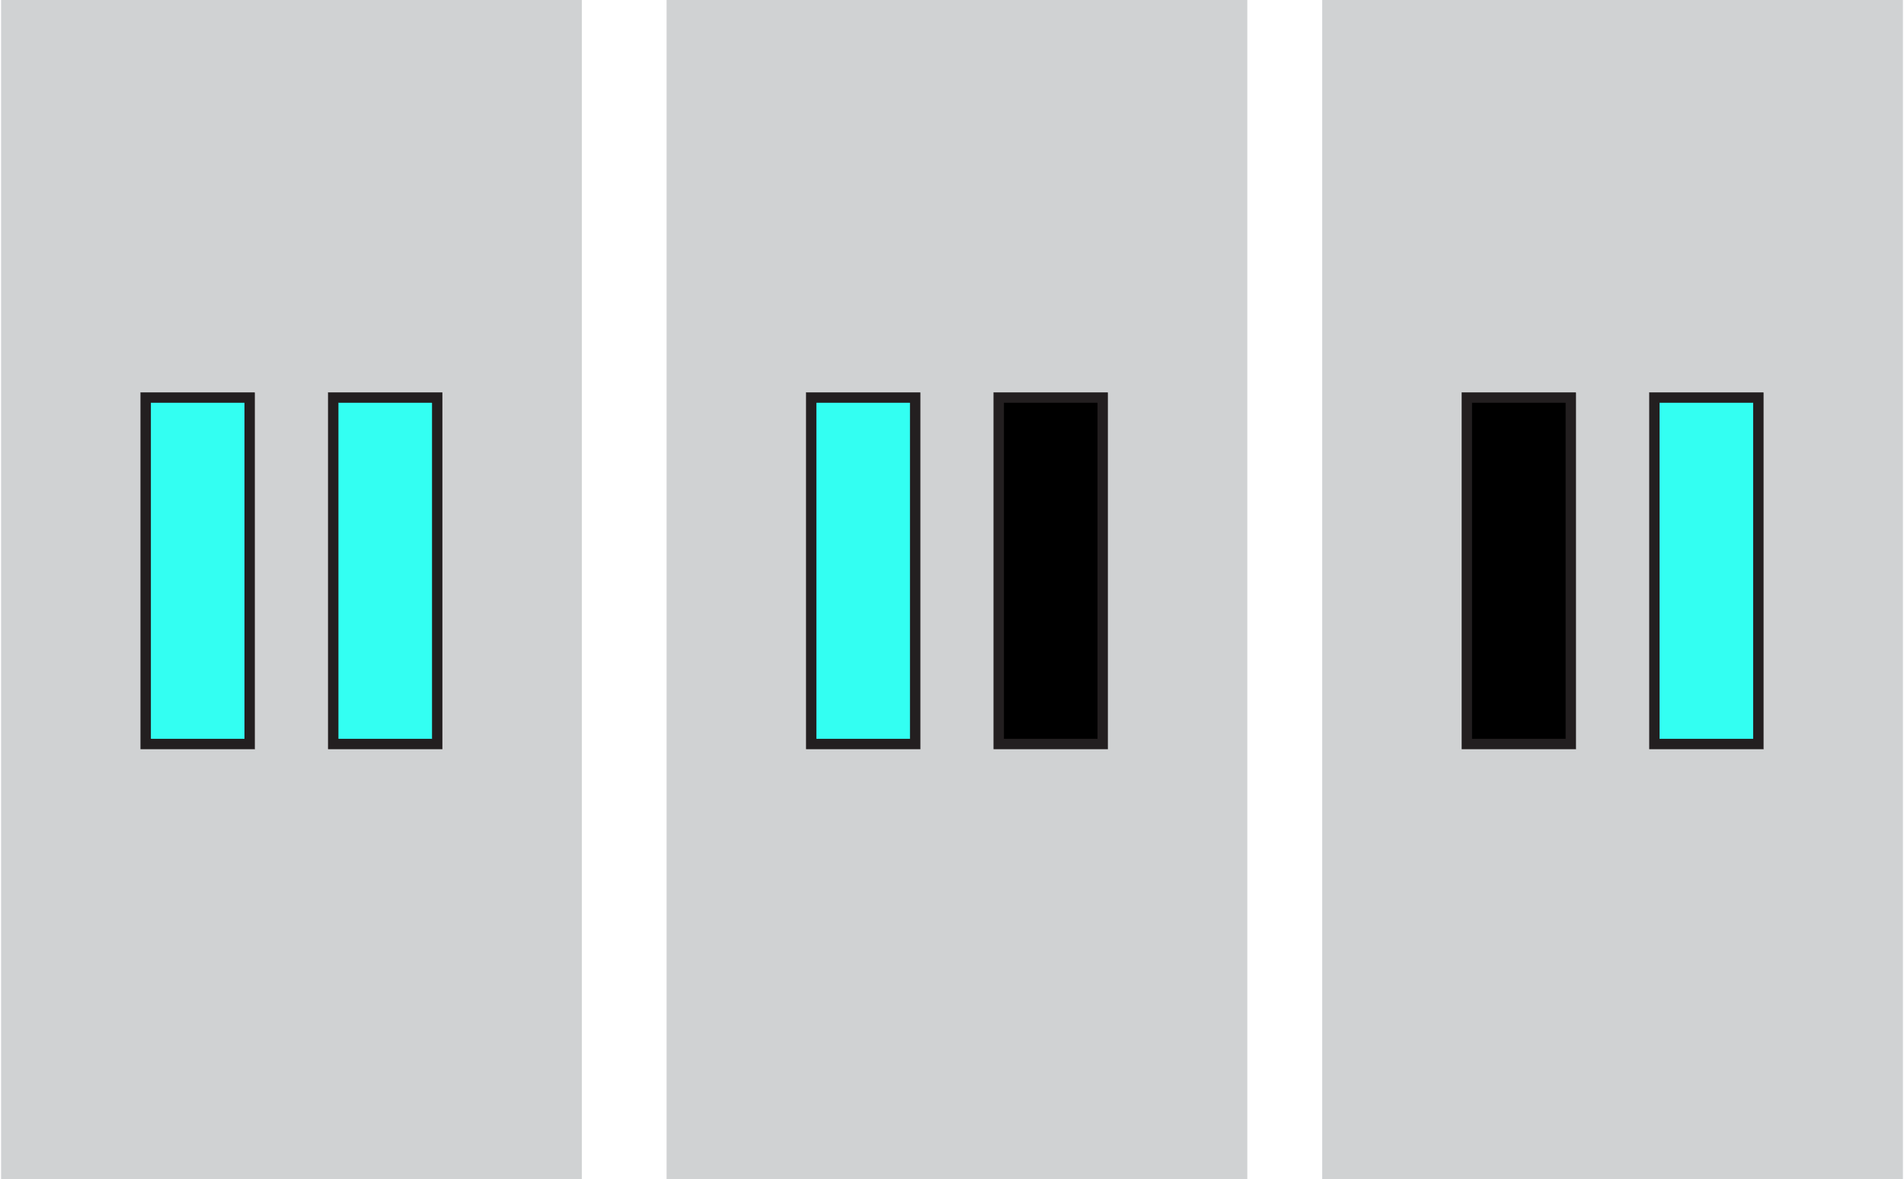
SeleST
stop-both
stop-left
stop-right
One or more bars may change colour again after turning black on a small number of ‘stop’ trials.
You earn points by not making a response to any bar that has changed colour.
You should avoid slowing your responses to prepare for a stop trial.
Press SPACE to start practice block of go and stop trials

Slide 9
CHOICE VARIANT (ARI)

Slide 10
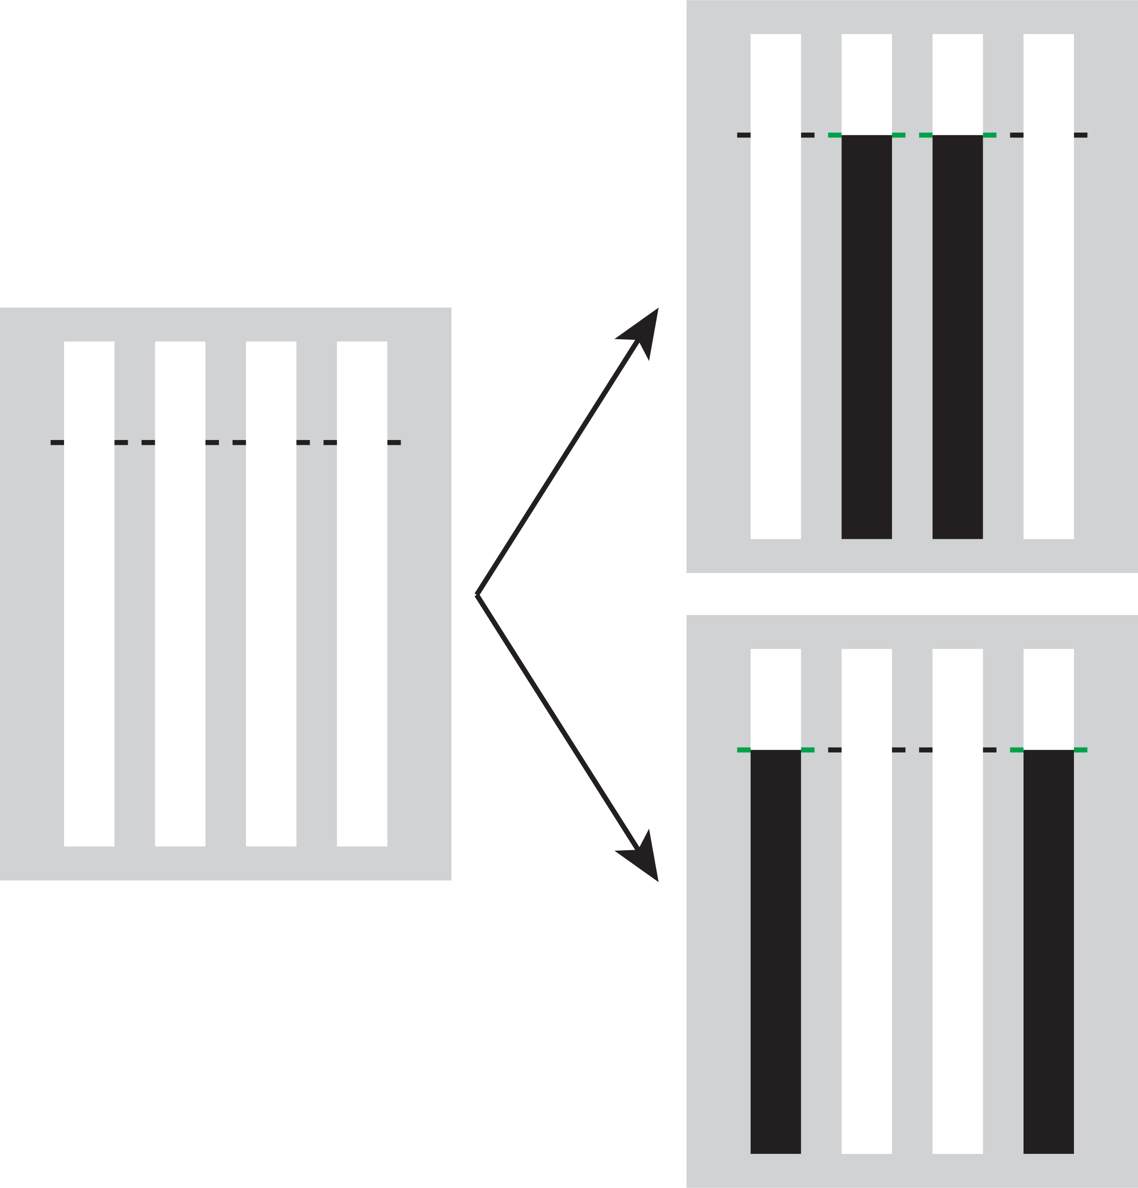
Selective Stopping Toolbox (SeleST)
Welcome! SeleSt is designed to test your ability to respond and stop selectively.
Each trial starts with four empty bars that can fill from bottom to top. Most trials are ‘go’ trials during which two bars completely fill.
Your objective is to stop the bars as close as you can to the target by pressing the correct response keys.
KEY:
z
x
n
m
Press SPACE to continue

Slide 11
SeleST
You earn points by stopping the bars close to the target.
0 points
25 points
50 points
100 points
Let’s practice with a block of go trials.
Press SPACE to start practice block

Slide 12
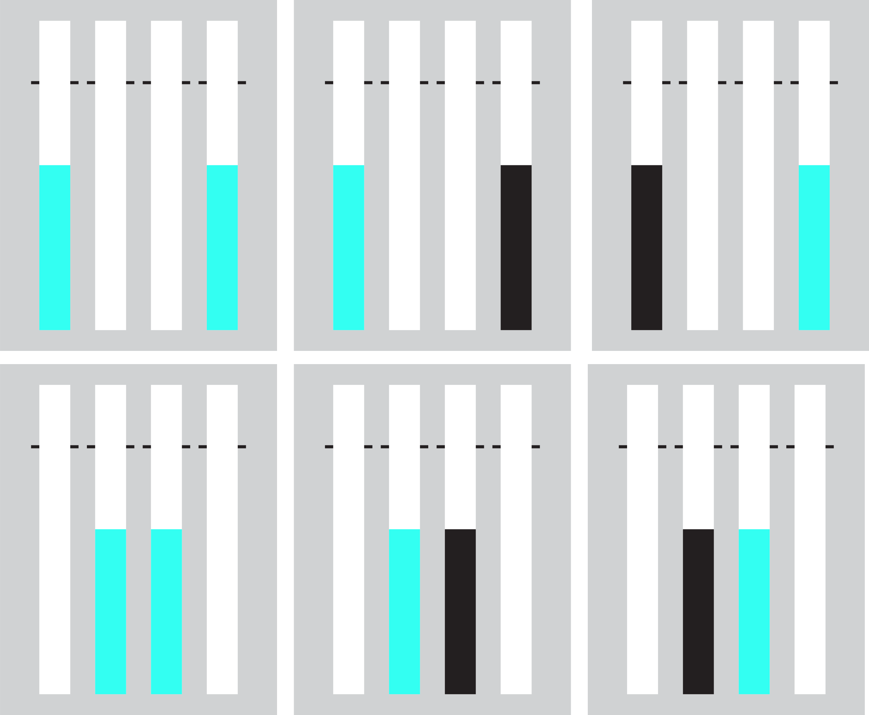
SeleST
stop-both
stop-left
stop-right
One or more bars may change colour before the target on a small number of ‘stop’ trials.
You earn points by not making a response to any bar that has changed colour.
You should avoid slowing your responses to prepare for a stop trial.
Press SPACE to start a practice block of go and stop trials

Slide 13
CHOICE VARIANT (SST)

Slide 14
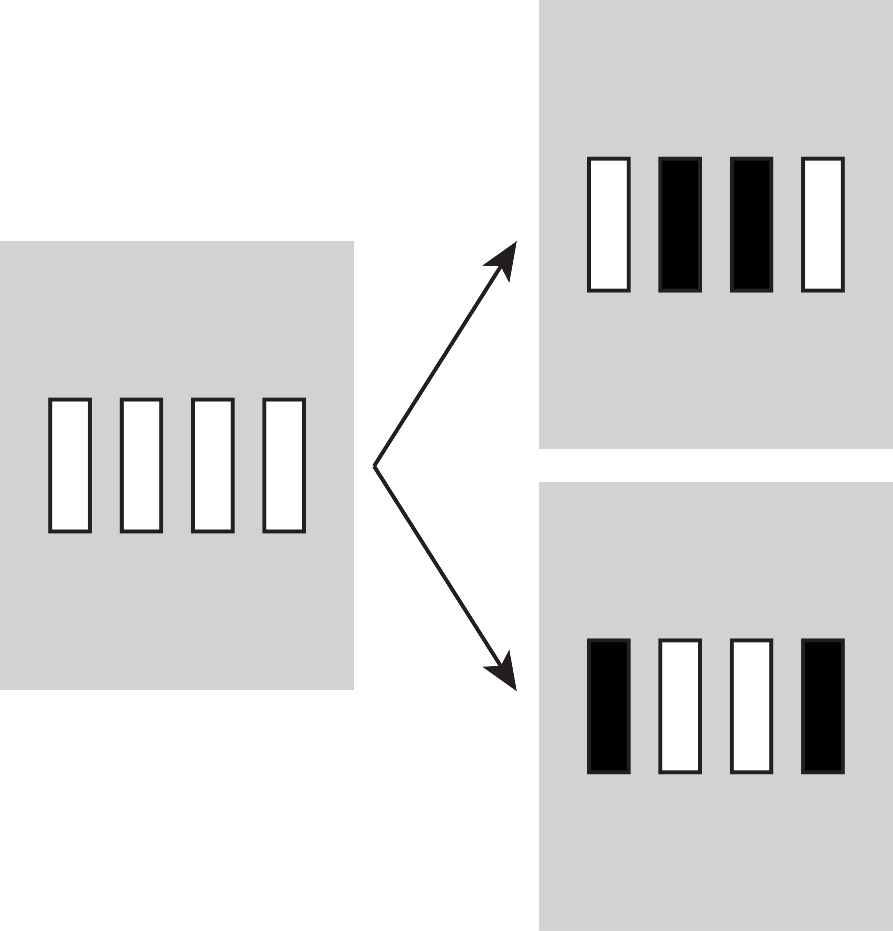
Selective Stopping Toolbox (SeleST)
Welcome! SeleSt is designed to test your ability to respond and stop selectively.
Each trial starts with four empty bars that can change colour. Most trials are ‘go’ trials during which two bars turn black.
Your objective is to respond as fast as you can when the bars turn black by pressing the correct response keys.
KEY:
z
x
n
m
Press SPACE to continue

Slide 15
SeleST
You earn points by responding fast.
0 points
25 points
50 points
100 points
Let’s practice with a block of go trials.
Press SPACE to start practice block

Slide 16
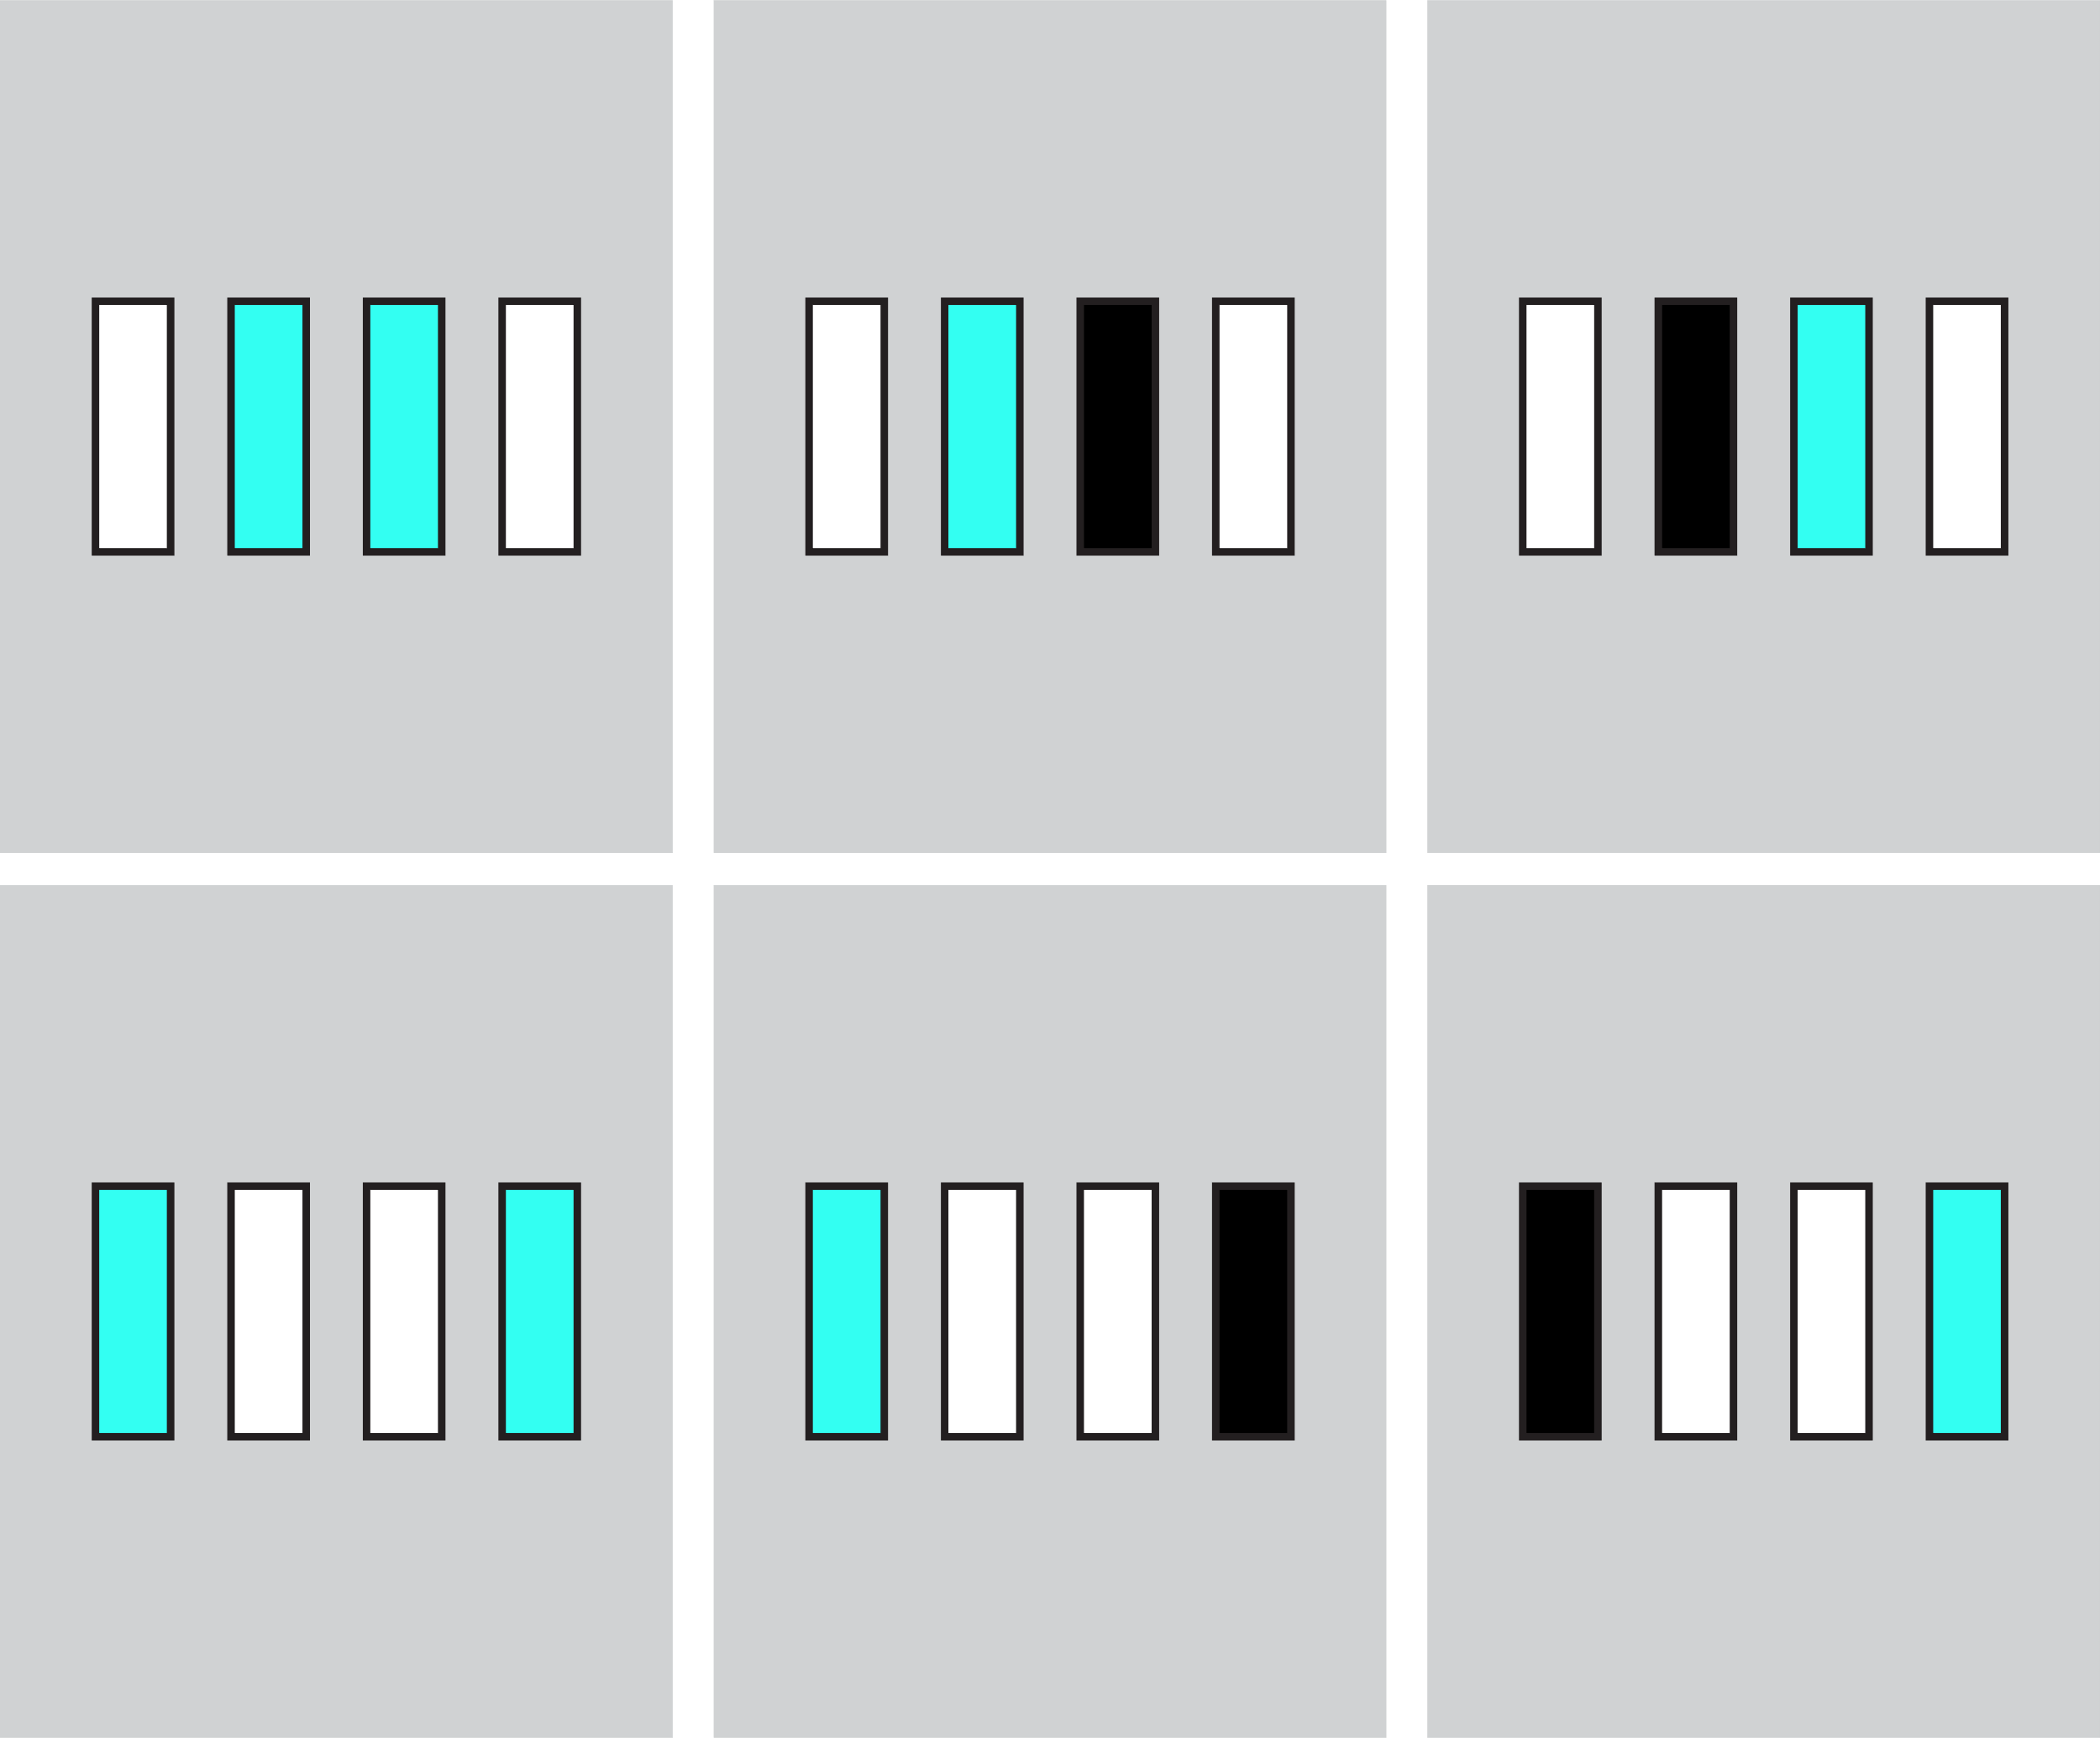
SeleST
stop-both
stop-left
stop-right
One or more bars may change colour again after turning black on a small number of ‘stop’ trials.
You earn points by not making a response to any bar that has changed colour.
You should avoid slowing your responses to prepare for a stop trial.
Press SPACE to start practice block of go and stop trials

Slide 17
PRE-TASK

Slide 18

SeleST
We are ready to start the experimental blocks.
Your goal is to earn as many points as possible.
Feel free to take breaks between blocks if you need them. You can press the ‘Esc’ or ‘Q’ key if you need to stop the task for any reason.
Press SPACE to start the experiment

Slide 19
END OF TASK

Slide 20
SeleST
Task complete! Thank you for your time.
Press SPACE to end the experiment

