Slide 1
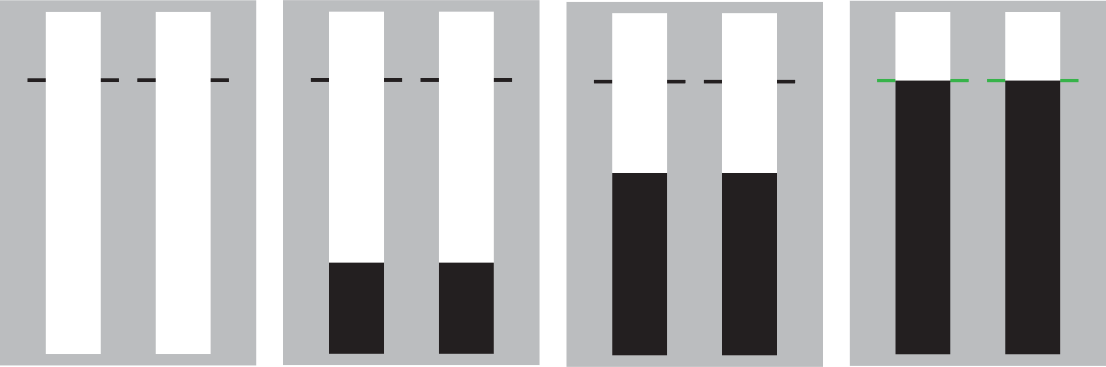
SeleSt
Welcome! SeleSt is designed to test your ability to respond and stop selectively.
Each trial will start with two empty bars that fill from bottom to top. The majority of trials will be ‘go’ trials during which the bars will completely fill.
Your objective during go trials is to stop the bars from rising as close as you can to the target lines.
You can stop the bars from rising by pressing the ‘N’ (left bar) or ‘M’ (right bar) keys with the index and middle finger of your dominant hand.
Press SPACE to continue

Slide 2
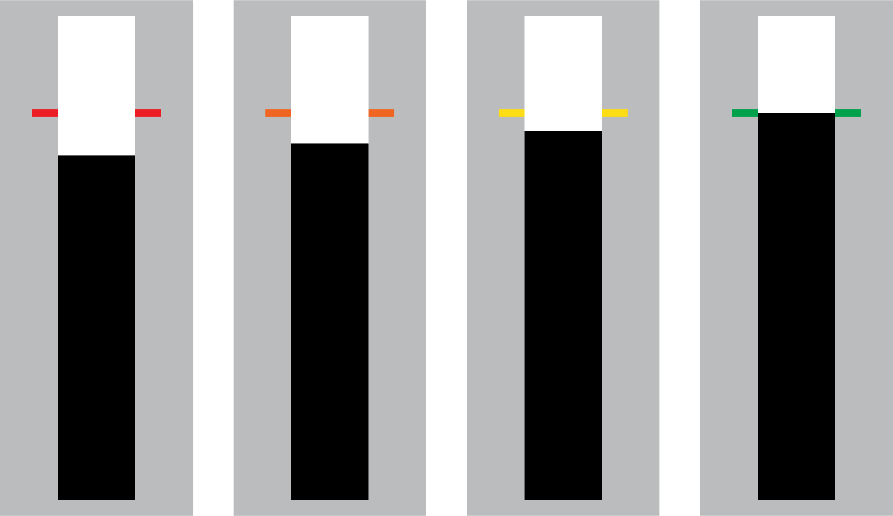
SeleSt
You will earn points throughout the task that will be displayed to you at the end of each block.
Points are awarded based on the accuracy of your response. Responses closer to the target will earn more points as signalled by the colour of the target lines at the end of a trial.
0 points
25 points
50 points
100 points
Let’s practice with a block of go trials
Press SPACE to start practice block

Slide 3
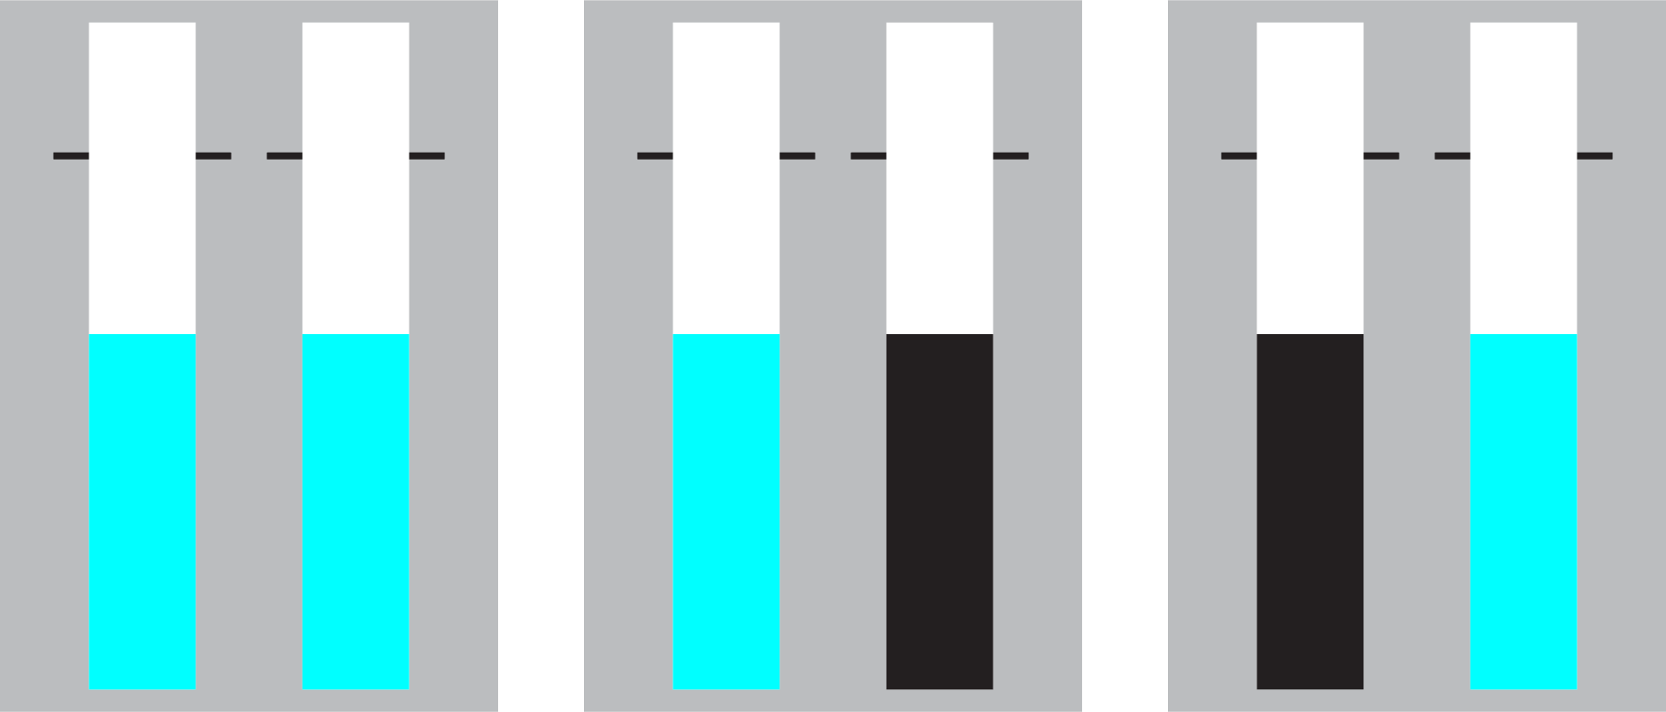
SeleSt
On a smaller number of trials either the left, right, or both bars may change colour while they are filling and before reaching the target lines.
Your objective during these ‘stop’ trials is to prevent yourself from making a response to any bar that has changed colour while filling.
stop-both
stop-left
stop-right
Stopping should be done reactively, meaning you should try your best to avoid predicting a bar changing colour
Press SPACE for a practice block of both go and stop trials

Slide 4

SeleSt
Nice work! We are now ready to start the experimental blocks.
The task is split into 12 blocks of 36 trials each (24 go + 12 stop). Feel free to take breaks between blocks if you need them.
Your primary goal is to earn as many points as possible during the task.
You can press the ‘Esc’ or ‘Q’ key if you need to stop the task for any reason.
Press SPACE to start the experiment

Slide 5


SeleSt
Welcome! SeleSt is designed to test your ability to respond and stop selectively.
Each trial will start with two empty triangles that turn black after a brief delay. The majority of trials will be ‘go’ trials.
Your objective during go trials is to respond as quickly as possible when the triangles turn black.
Responses are made using the ‘N’ (left triangle) and ‘M’ (right triangle) keys with the index and middle finger of your dominant hand.
Press SPACE to continue

Slide 6
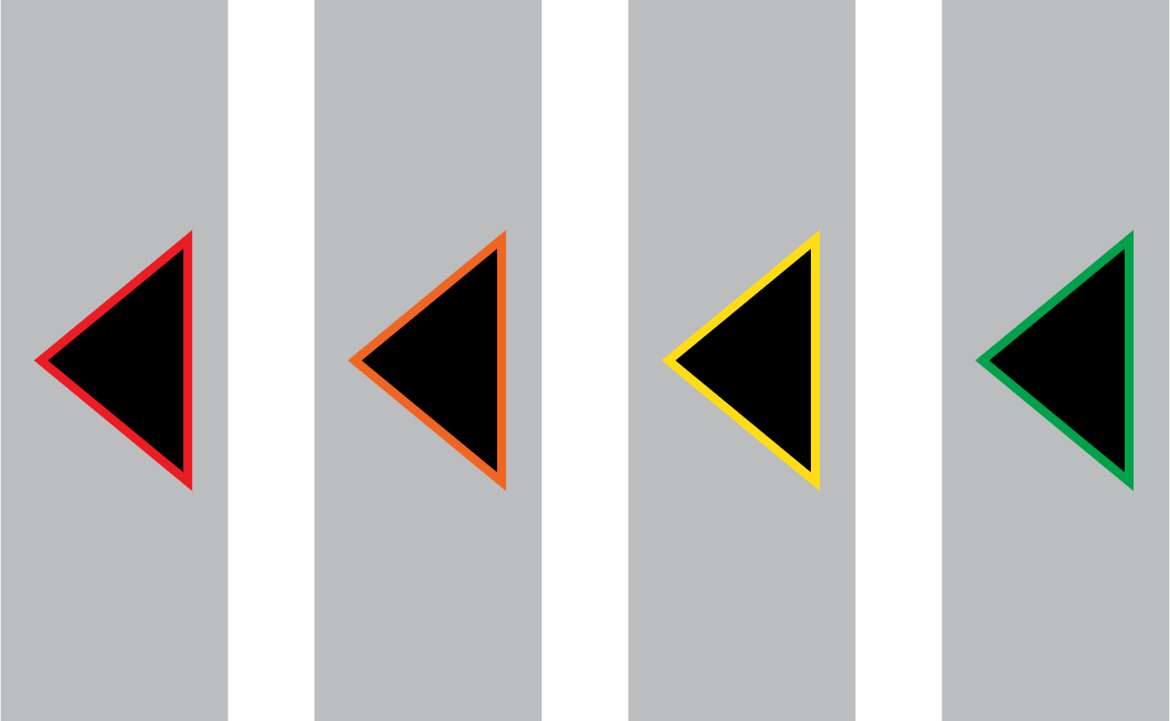
SeleSt
You will earn points throughout the task that will be displayed to you at the end of each block.
Points are awarded based on the speed of your response. Faster responses will earn more points as signalled by the colour of the target lines at the end of a trial.
0 points
25 points
50 points
100 points
Let’s practice with a block of go trials.
Press SPACE to start practice block

Slide 7



SeleSt
On a smaller number of trials either the left, right, or both triangles may change colour after they have filled
Your objective during these ‘stop’ trials is to prevent yourself from making a response to any triangle that has changed colour.
stop-both
stop-left
stop-right
Stopping should be done reactively, meaning you should try your best to avoid waiting for a triangle to change to the stop colour.
Press SPACE for a practice block of both go and stop trials

Slide 8
SeleSt
Nice work! We are now ready to start the experimental blocks.
The task is split into 12 blocks of 36 trials each (24 go + 12 stop). Feel free to take breaks between blocks if you need them.
Your primary goal is to earn as many points as possible during the task.
You can press the ‘Esc’ or ‘Q’ key if you need to stop the task for any reason.
Press SPACE to start the experiment

Slide 9
SeleSt
You have finished the SeleSt task – nice work!
Thank you for your time.
Press SPACE to end the experiment

