Slide 1
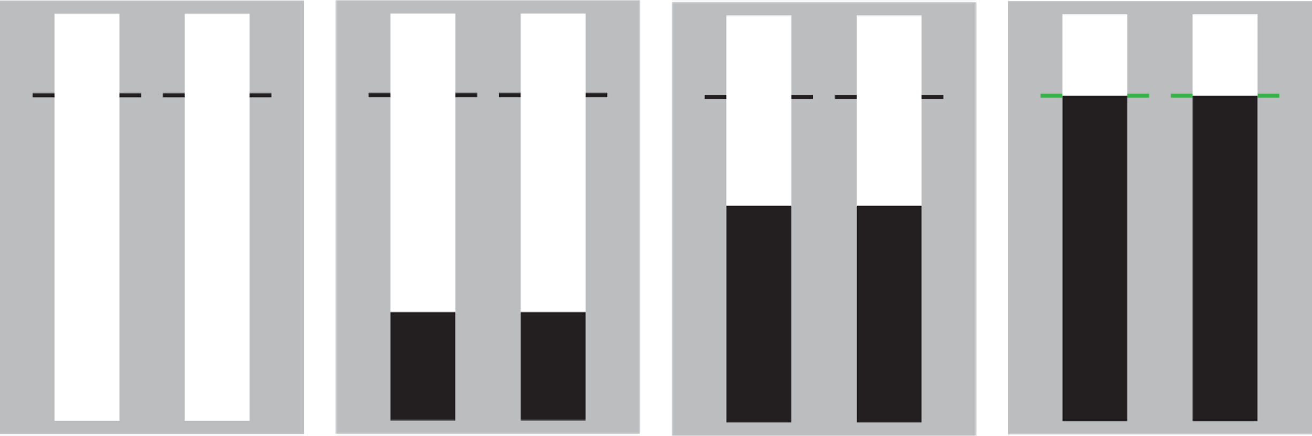
SeleSt
Welcome! SeleSt is designed to test your ability to respond and stop selectively.
Each trial starts with two empty bars that fill from bottom to top. Most trials are ‘go’ trials during which the bars completely fill.
Your objective is to stop the bars as close as you can to the target by pressing the response keys.
Press SPACE to continue

Slide 2

SeleSt
You earn points by stopping the bars close to the target.
0 points
25 points
50 points
100 points
Let’s practice with a block of go trials.
Press SPACE to start practice block

Slide 3
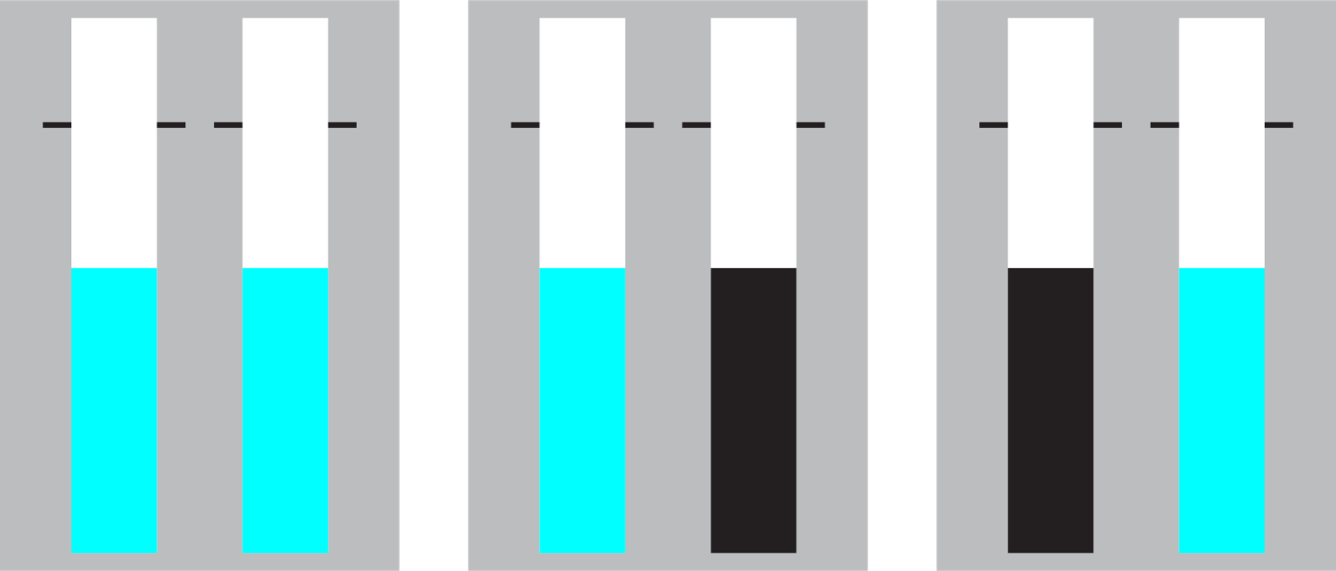
SeleSt
One or more bars may change colour before the target on a small number of ‘stop’ trials.
stop-both
stop-left
stop-right
You earn points by not making a response to any bar that has changed colour.
You should avoid slowing your responses to prepare for a stop trial.
Press SPACE to start practice block of go and stop trials

Slide 4


SeleSt
Welcome! SeleSt is designed to test your ability to respond and stop selectively.
Each trial starts with two empty triangles that fill after a brief delay. Most trials are ‘go’ trials during which the triangles will turn black.
Your objective is to respond as fast as you can when the triangles turn black by pressing the response keys.
Press SPACE to continue

Slide 5

SeleSt
You earn points by responding fast.
0 points
25 points
50 points
100 points
Let’s practice with a block of go trials.
Press SPACE to start practice block

Slide 6



SeleSt
One or more triangles may change colour after turning black on a small number of ‘stop’ trials.
stop-both
stop-left
stop-right
You earn points by not making a response to any triangle that has changed to the stop colour.
You should avoid slowing your responses to prepare for a stop trial.
Press SPACE to start practice block of go and stop trials

Slide 7

SeleSt
Nice work! We are now ready to start the experimental blocks.
Your goal is to earn as many points as possible.
Feel free to take breaks between blocks if you need them. You can press the ‘Esc’ or ‘Q’ key if you need to stop the task for any reason.
Press SPACE to start the experiment

Slide 8
SeleSt
SeleSt task complete. Thank you for your time.
Press SPACE to end the experiment

