Slide 1
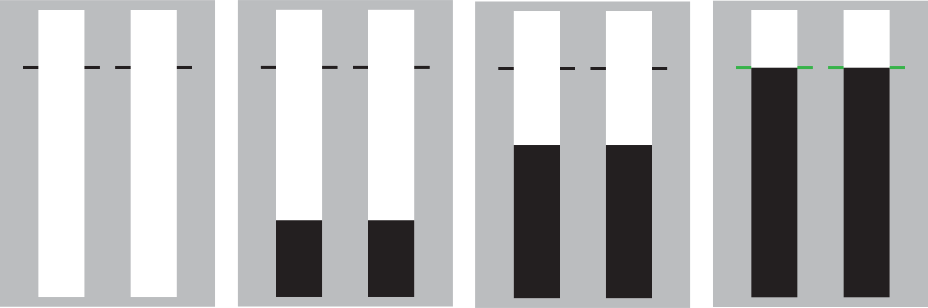
Selective Stopping (SeleSt) task
Welcome! This task is designed to test your ability to respond and stop selectively
Each trial will start with two empty bars that fill from bottom to top. The majority of trials will be ‘go’ trials during which the bars will completely fill.
Your objective during go trials is to stop the bars from rising as close as you can to the target lines
You can stop the bars from rising by pressing the ‘N’ (left bar) or ‘M’ (right bar) key during a trial
Press SPACE to continue

Slide 2
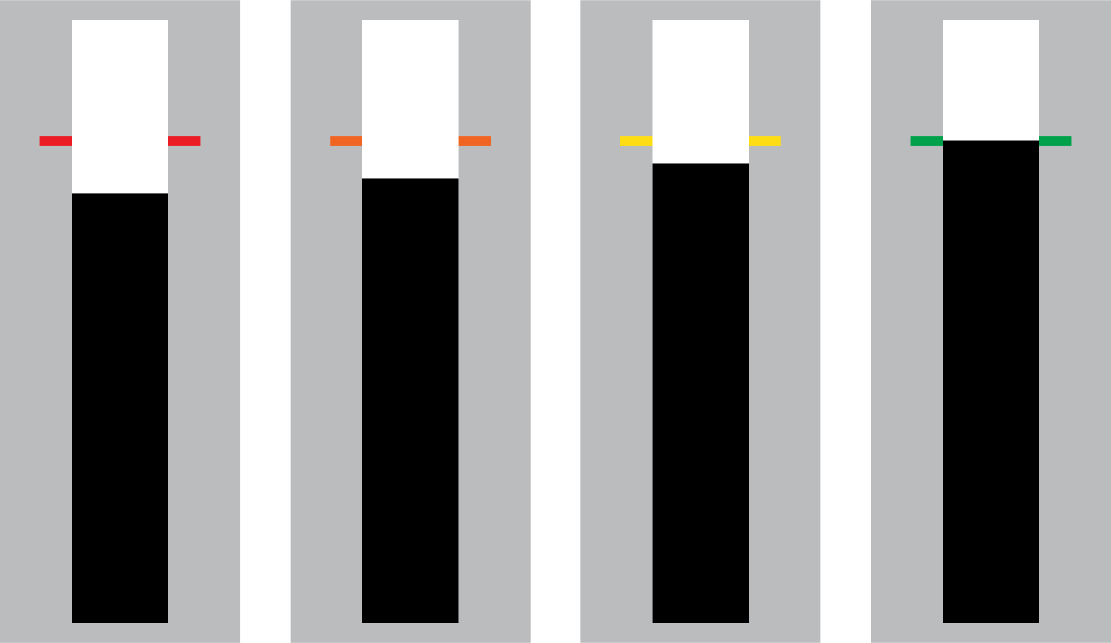
Selective Stopping (SeleSt) task
You will earn points throughout the task that will be displayed to you at the end of each block
Points are awarded based on the accuracy of your response. Responses closer to the target will earn more points as signalled by the colour of the target lines at the end of a trial
0 points
10 points
20 points
30 points
Let’s practice with a block of go trials
Press SPACE to start practice block

Slide 3
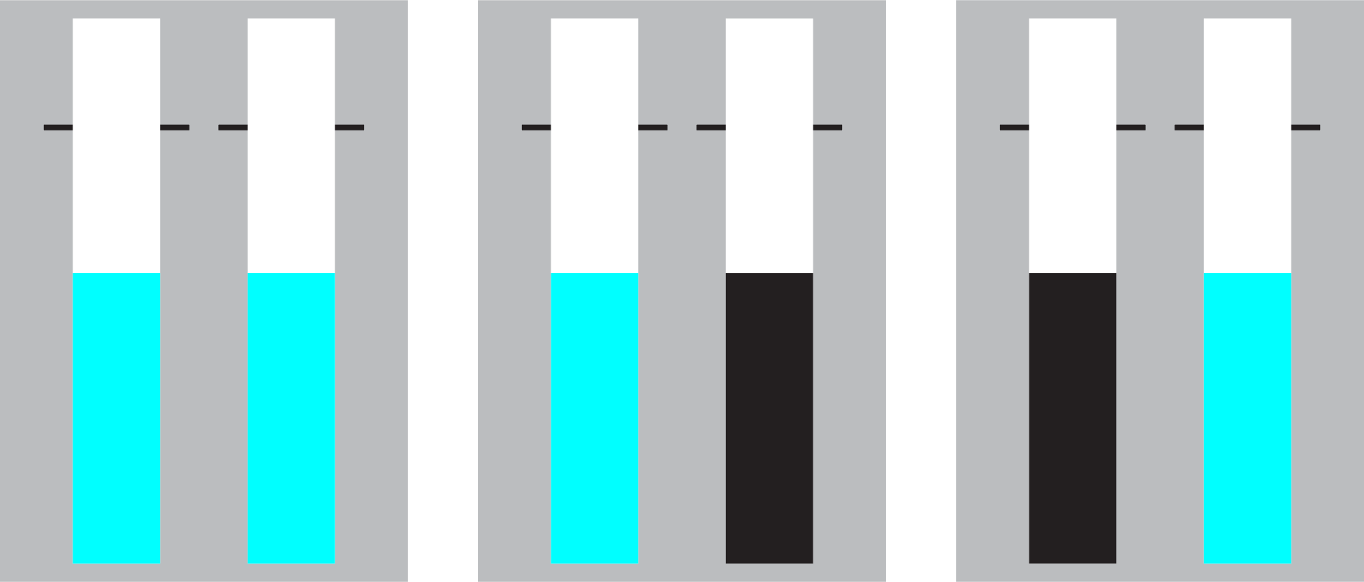
Selective Stopping (SeleSt) task
On a smaller number of trials either the left, right, or both bars may change colour while they are filling and before reaching the target lines.
Your objective during these ‘stop’ trials is to prevent yourself from making a response to any bar that has changed colour while filling
stop-both
stop-left
stop-right
Stopping should be done reactively, meaning you should try your best to avoid predicting a bar changing colour
Press SPACE for a practice block of both go and stop trials

Slide 4

Selective Stopping (SeleSt) task
Nice work! We are now ready to start the experimental blocks
The task is split into 12 blocks of 36 trials each (24 go + 12 stop). Feel free to take breaks between blocks if you need them
Your primary goal is to earn as many points as possible during the task
You can press the ‘Esc’ or ‘Q’ key if you need to stop the task for any reason
Press SPACE to start the experiment

Slide 5


Selective Stopping (SeleSt) task
Welcome! This task is designed to test your ability to respond and stop selectively
Each trial will start with two empty triangles that turn black after a brief delay.
The majority of trials will be ‘go’ trials
Your objective during go trials is to respond as quickly as possible when the triangles turn black
Responses are made using the ‘N’ (left triangle) and ‘M’ (right triangle) keys during a trial
Press SPACE to continue

Slide 6
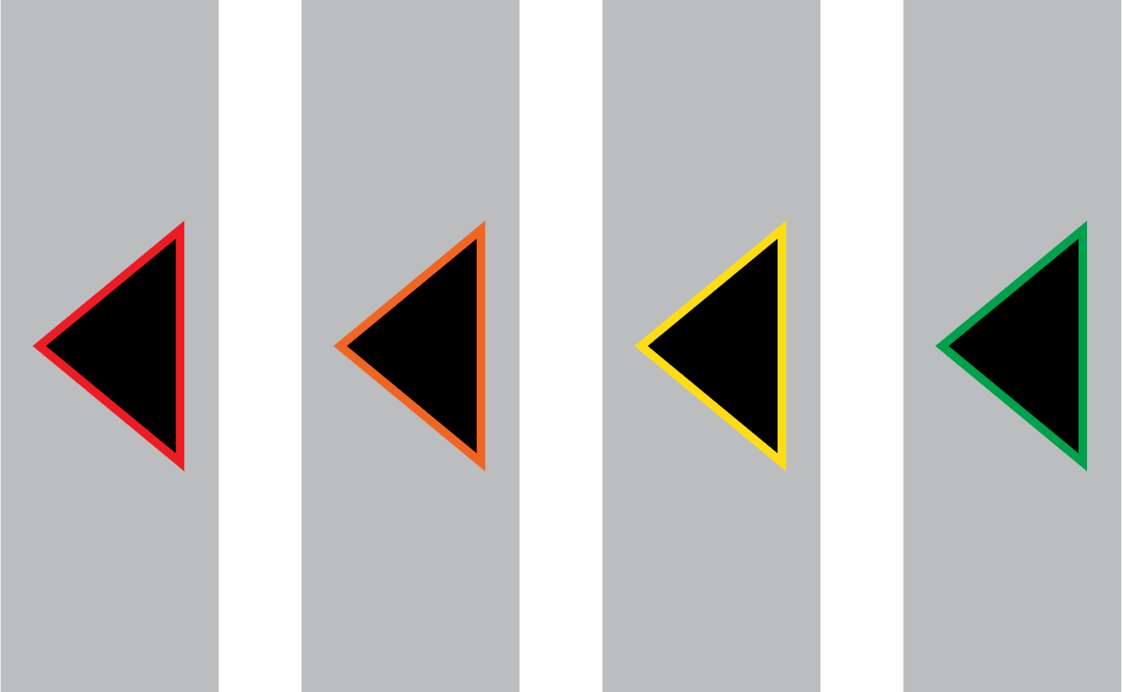
Selective Stopping (SeleSt) task
You will earn points throughout the task that will be displayed to you at the end of each block
Points are awarded based on the speed of your response. Faster responses will earn more points as signalled by the colour of the target lines at the end of a trial
0 points
10 points
20 points
30 points
Let’s practice with a block of go trials
Press SPACE to start practice block

Slide 7



Selective Stopping (SeleSt) task
On a smaller number of trials either the left, right, or both triangles may change colour after they have filled
Your objective during these ‘stop’ trials is to prevent yourself from making a response to any triangle that has changed colour
stop-both
stop-left
stop-right
Stopping should be done reactively, meaning you should try your best to avoid waiting for a triangle to change to the stop colour
Press SPACE for a practice block of both go and stop trials

Slide 8
Selective Stopping (SeleSt) task
Nice work! We are now ready to start the experimental blocks
The task is split into 12 blocks of 36 trials each (24 go + 12 stop). Feel free to take breaks between blocks if you need them
Your primary goal is to earn as many points as possible during the task
You can press the ‘Esc’ or ‘Q’ key if you need to stop the task for any reason
Press SPACE to start the experiment

Slide 9
Selective Stopping (SeleSt) task
You have finished the SeleSt task – nice work!
Thank you for your time.
Press SPACE to end the experiment

