Slide 1
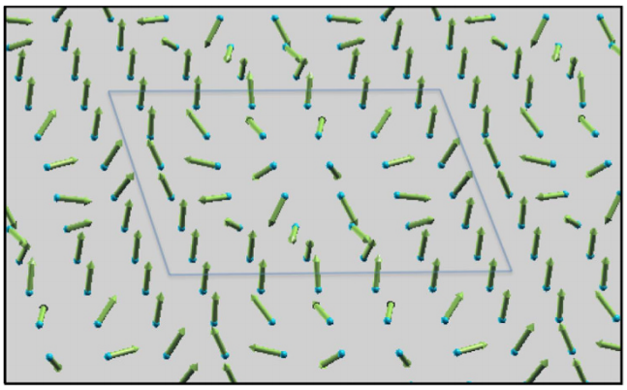
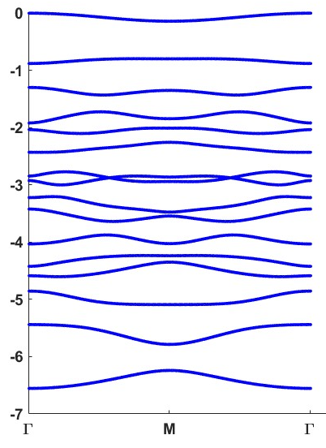
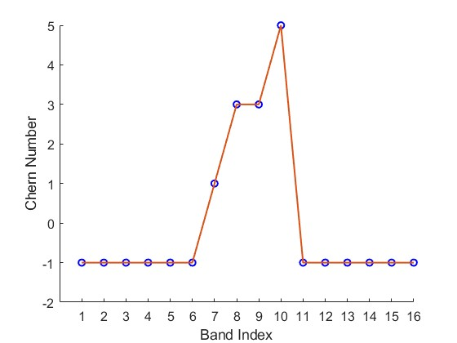
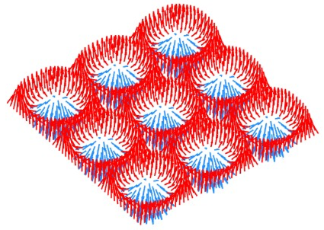
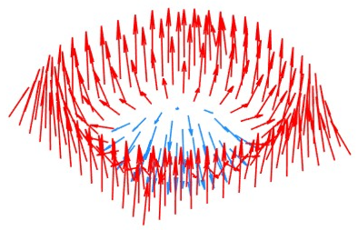
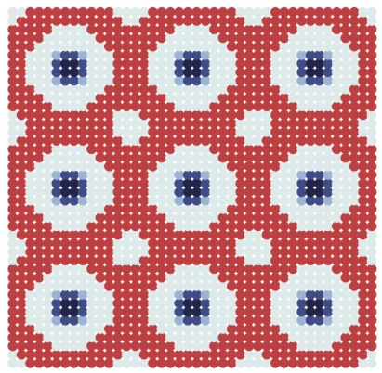
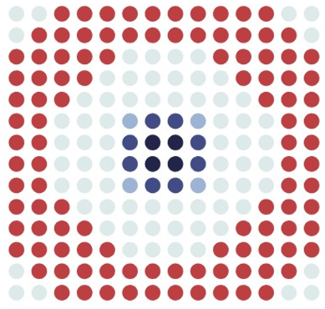

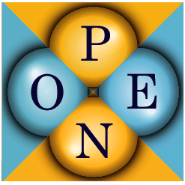
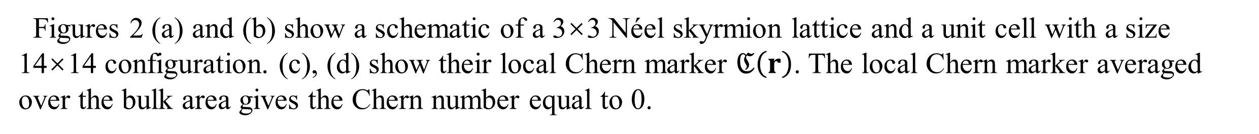
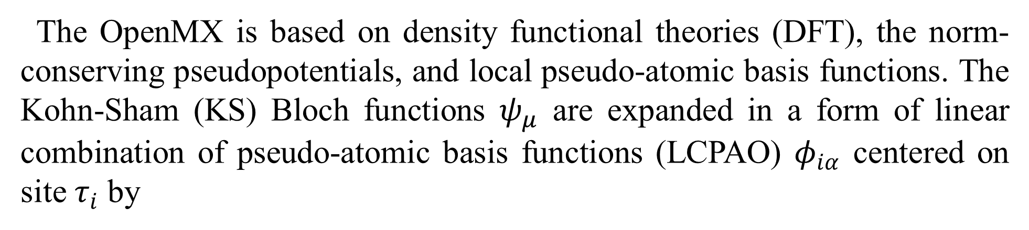
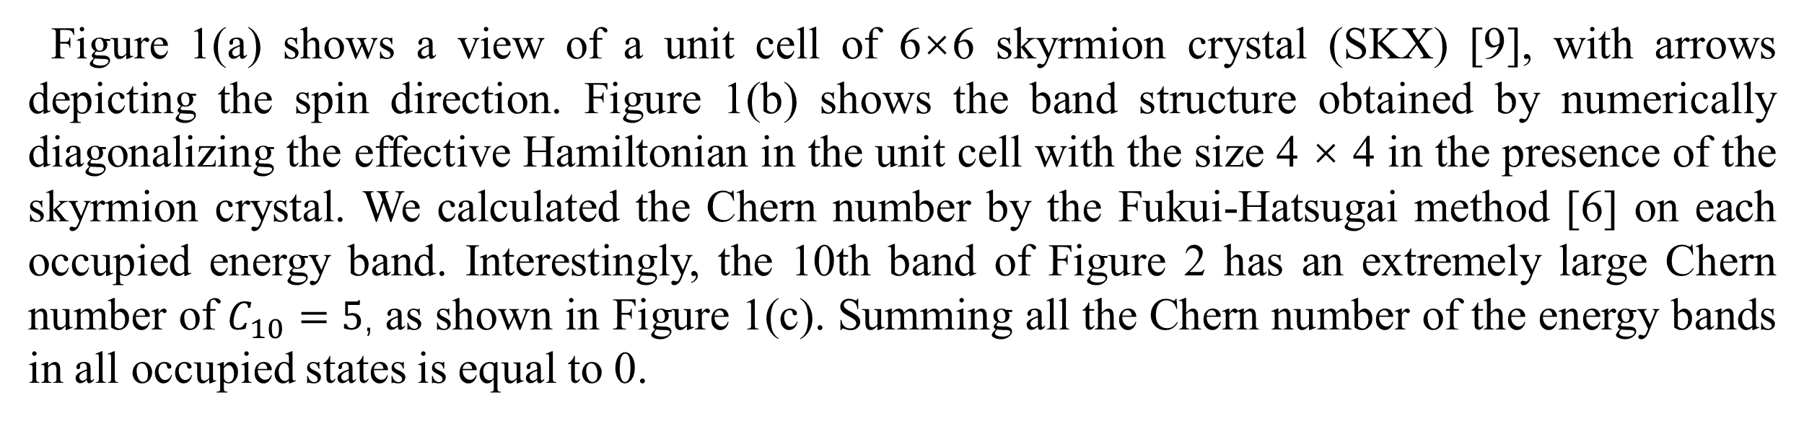
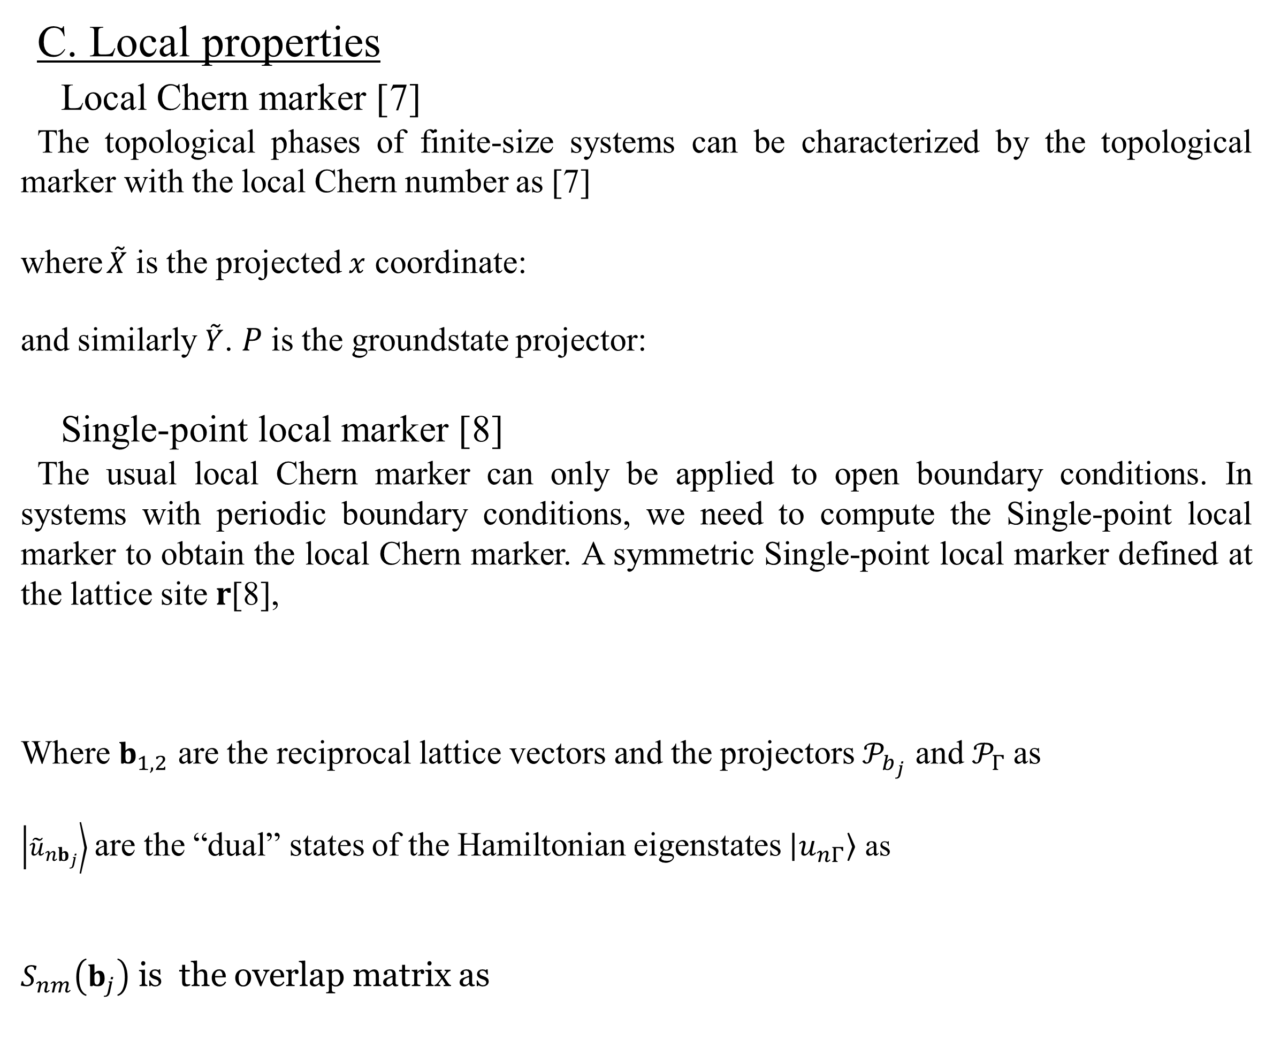
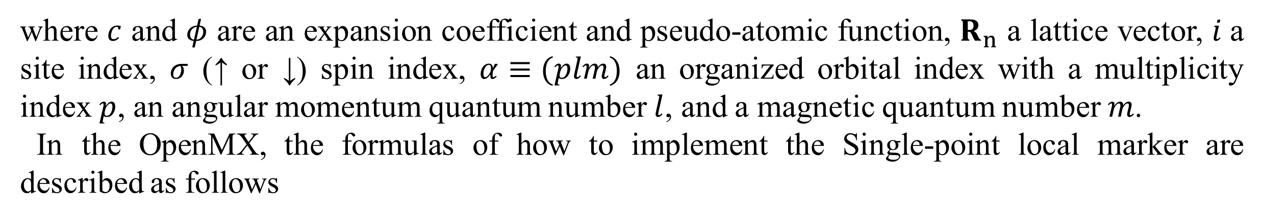
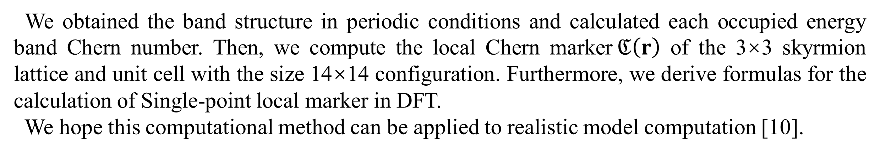

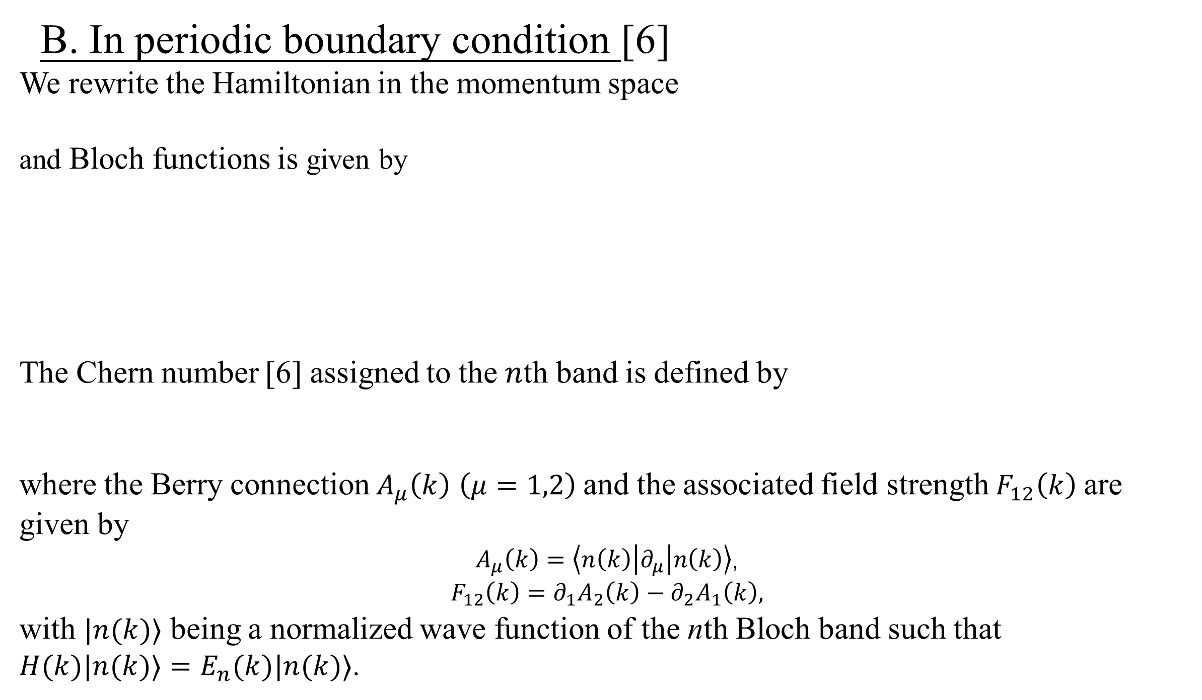
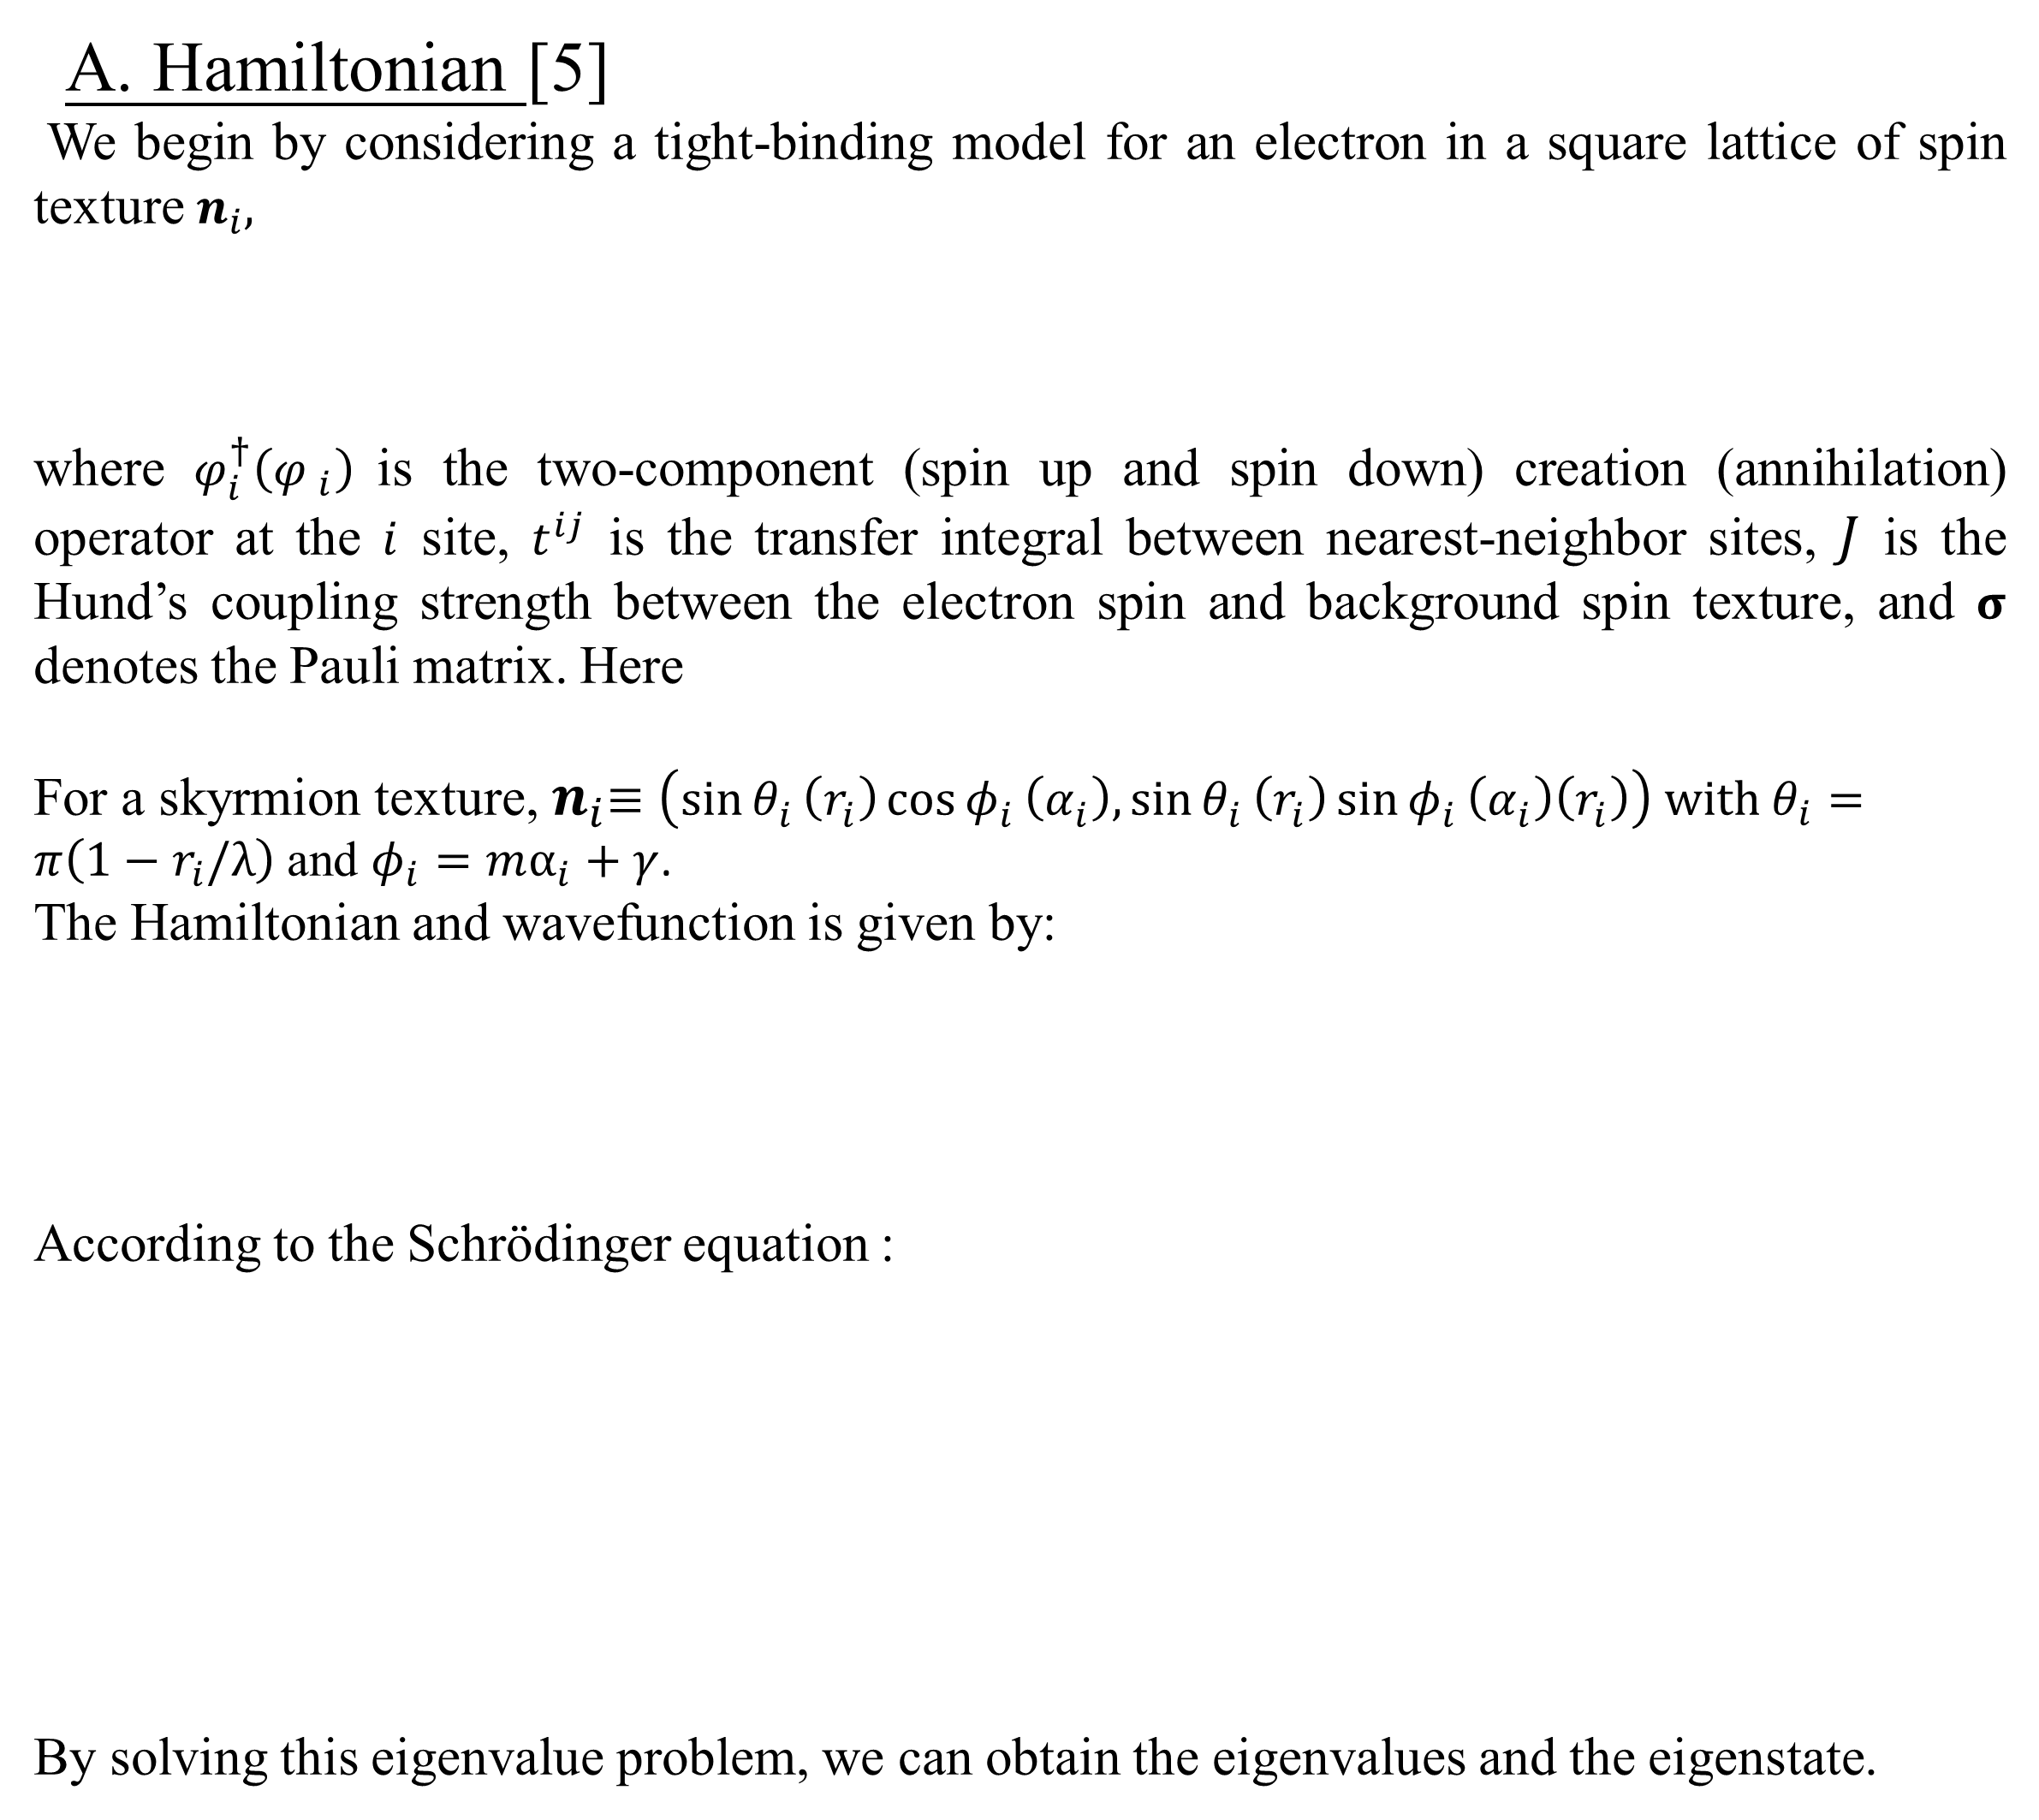
Real-space Visualization of Chern Number for Skyrmions
Jingwen Yang¹, Naoya Yamaguchi², Fumiyuki Ishii²
¹Graduate School of Natural Science and Technology, Kanazawa University, Kanazawa, 920-1192 Japan
²Nanomaterials Research Institute (NanoMaRi), Kanazawa University, Kanazawa 920-1192 Japan
1. Research purposes
3. Results and Discussion
Tony Skyrme initially predicted skyrmions [1] that are topologically stable field configurations with particle-like properties. Skyrmions are topological magnetic textures [2] that emerge as classical objects in most experimental systems. However, the discovery of skyrmions, characterized by a long lifetime, has generated interest in the quantum field on the nanoscale. Therefore, magnetic skyrmions are envisioned as building blocks of next-generation data storage and processing devices [3], leading to a surge in research activity to identify candidate materials after the early theoretical proposals in magnets [4].
To study topological order in finite systems, Bianco [7] introduced a “topological marker”: the local Chern number. In this research, we study the Chern number and local Chern marker of skyrmion.
Figure 1(a) shows a view of a unit cell of 6×6 skyrmion crystal (SKX) [9], with arrows depicting the spin direction. Figure 1(b) shows the band structure obtained by numerically diagonalizing the effective Hamiltonian in the unit cell with the size 4 × 4 in the presence of the skyrmion crystal. We calculated the Chern number by the Fukui-Hatsugai method [6] on each occupied energy band. Interestingly, the 10th band of Figure 2 has an extremely large Chern number of $C_{10}=5$, as shown in Figure 1(c). Summing all the Chern number of the energy bands in all occupied states is equal to 0.
(a)
(b)
(c)
2. Tight-binding approach
$$Energy/t$$
A. Hamiltonian [5]
We begin by considering a tight-binding model for an electron in a square lattice of spin texture $n_{i},$
where $φ_{i}^{†}\left({φ }_{i}\right)$ is the two-component (spin up and spin down) creation (annihilation) operator at the $i$ site, $t^{ij}$ is the transfer integral between nearest-neighbor sites, $J$ is the Hund’s coupling strength between the electron spin and background spin texture, and $σ$ denotes the Pauli matrix. Here
For a skyrmion texture,${ n}_{i}≡\left(\sin{θ_{i}}\left(r_{i}\right)\cos{φ_{i}}\left(α_{i}\right),\sin{θ_{i}}\left(r_{i}\right)\sin{φ_{i}}\left(α_{i}\right)\left(r_{i}\right)\right) with$ $θ_{i}=π\left(1−r_{i}/λ\right)$ and $φ_{i}=mα_{i}+γ$.
The Hamiltonian and wavefunction is given by:
According to the Schrödinger equation :
By solving this eigenvalue problem, we can obtain the eigenvalues and the eigenstate.
Figure 1. (a) A view of a unit cell of 6×6 SkX. (b) The band structure in the presence of SkX. The parameters $J / t=3.$ (c) The band index dependence of Chern number. The parameters $J / t=3.$
(1)
Figures 2 (a) and (b) show a schematic of a 3×3 Néel skyrmion lattice and a unit cell with a size 14×14 configuration. (c), (d) show their local Chern marker $ℭ\left(r\right)$. The local Chern marker averaged over the bulk area gives the Chern number equal to 0.
(a)
(b)
(2)
(c)
Unit cell
(d)
(3)
Figure 2. (a) (b) A schematic of the spin configuration of skyrmion. The colored arrows represent the orientation of magnetic moments. Red and blue represent the positive and negative out-of-plane orientations, respectively. (c) (d) The local Chern marker$ℭ\left(\text{r}\right)$of the 3×3 skyrmion lattice and a unit cell with the size 14×14 configuration. The skyrmion radius is $λ=\text{7}$. The parameters $J / t=3.$
(4)
4. Γ-point implementation of local marker in DFT code
B. In periodic boundary condition [6]
We rewrite the Hamiltonian in the momentum space
and Bloch functions is given by
The Chern number [6] assigned to the $n$th band is defined by
where the Berry connection $A_{μ}\left(k\right)$ $\left(μ=1,2\right)$ and the associated field strength $F_{12}\left(k\right)$ are given by
$A_{μ}\left(k\right)=\left\langle n\left(k\right)\left|∂_{μ}\right|n\left(k\right)\right\rangle$,
$$F_{12}\left(k\right)=∂_{1}A_{2}\left(k\right)−∂_{2}A_{1}\left(k\right),$$
with $|n(k)⟩$ being a normalized wave function of the nth Bloch band such that
$H(k)|n(k)⟩=E_{n}(k)|n(k)⟩$.
The OpenMX is based on density functional theories (DFT), the norm-conserving pseudopotentials, and local pseudo-atomic basis functions. The Kohn-Sham (KS) Bloch functions $ψ_{μ}$ are expanded in a form of linear combination of pseudo-atomic basis functions (LCPAO) $φ_{iα}$ centered on site $τ_{i}$ by
(5)
(16)
where $c$ and $φ$ are an expansion coefficient and pseudo-atomic function, $R_{n}$ a lattice vector, $i$a site index, $σ$ (↑ or ↓) spin index, $α≡(plm)$ an organized orbital index with a multiplicity index $p$, an angular momentum quantum number $l$, and a magnetic quantum number $m$.
In the OpenMX, the formulas of how to implement the Single-point local marker are described as follows
(6)
(7)
(17)
(8)
(18)
C. Local properties
Local Chern marker [7]
The topological phases of finite-size systems can be characterized by the topological marker with the local Chern number as [7]
where $\overset{˜}{X}$ is the projected $x$ coordinate:
and similarly $\overset{˜}{Y}$. $P$ is the groundstate projector:
Single-point local marker [8]
The usual local Chern marker can only be applied to open boundary conditions. In systems with periodic boundary conditions, we need to compute the Single-point local marker to obtain the local Chern marker. A symmetric Single-point local marker defined at the lattice site 𝐫[8],
Where $b_{1,2}$ are the reciprocal lattice vectors and the projectors $𝒫_{b_{j}}$ and $𝒫_{Γ}$ as
$\left|{\tilde{u}}_{nb_{j}}\right\rangle$are the “dual” states of the Hamiltonian eigenstates $\left|u_{nΓ}\right\rangle$ as
$S_{nm}\left(b_{j}\right)$ is the overlap matrix as
(9)
(19)
(10)
5. Summary and prospect
(11)
We obtained the band structure in periodic conditions and calculated each occupied energy band Chern number. Then, we compute the local Chern marker$ℭ\left(r\right)$ of the 3×3 skyrmion lattice and unit cell with the size 14×14 configuration. Furthermore, we derive formulas for the calculation of Single-point local marker in DFT.
We hope this computational method can be applied to realistic model computation [10].
(12)
Reference:
[1] T. H. R. Skyrme. Proc. Roy. Soc. London A Math. and Phys. 260, 127–138, (1961).
[2] N. Nagaosa, Y. Tokura. Nat. Nanotechnol. 8, 899-911, (2013).
[3] A. Fert, N. Reyren, V. Cros. Nat. Rev. Mater. 2, 1-15, (2017).
[4] A. Bogdanov, A. Hubert. J. Magn. Magn. Mater. 138, 255-269, (1994).
[5] K. Hamamoto, M. Ezawa, N. Nagaosa. PHYS REV B. 92, 115417, (2015).
[6] T. Fukui, Y. Hatsugai, H. Suzuki. J. Phys. Soc. Jpn. 74, 1674-1677, (2005).
[7] R. Bianco, R. Resta. PHYS REV B. 84, 241106, (2011).
[8] N. Baù, A. Marrazzo. PHYS REV B. 109, 014206, (2024).
[9] Y. P. Mizuta, F. Ishii. Sci. Rep. 6, 28076, (2016).
[10] Y. P. Mizuta, H. Sawahata, F. Ishii. PHYS REV B. 98, 205125, (2018).
(13)
(14)
(15)

