Slide 1
Applications of SCMDP

Slide 2
Domain 1: Task Assignment
1000 agents, initially at state #0
S: 11 states
A: choose which state to go (fully connected)
T: .9 success, .1 stay
States have different rewards and capacity bounds
Episodes: 50
Reward 0 +10 +9 +8 +7 +6 +5 +4 +3 +2 +1
Capacity Bound 1000 200 100 100 200 50 50 200 100 0 0

Slide 3
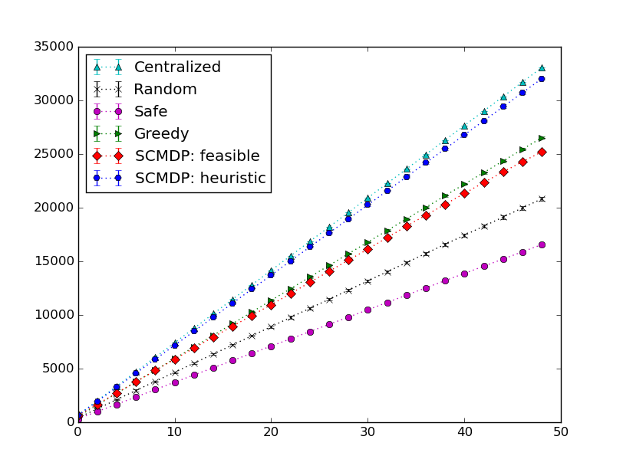
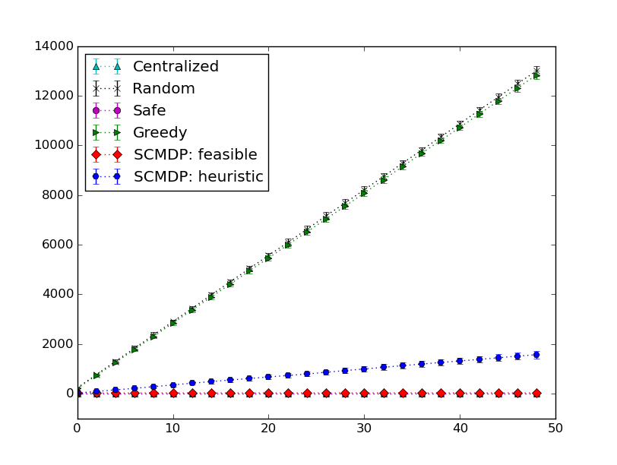
Domain 1 Results
Total collected reward over episodes
Error bar: 95% CI, 100 simulations per algorithm
Total violation count over episodes

Slide 4
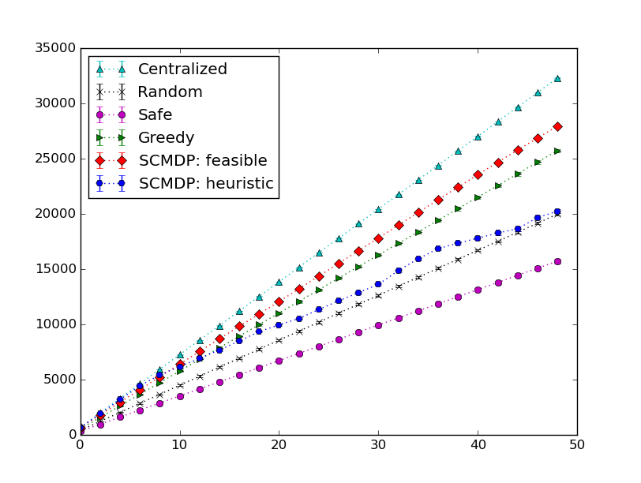
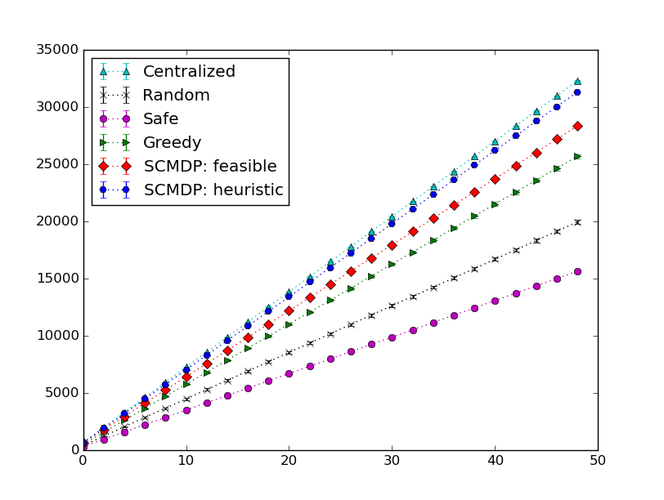
Domain 1 Results: Flow
- At each episode, an agent has .5 probability to be removed
- If this happens, a new agent enters at the starting state
- Policy matrix is 3D, the first dimension is the episode
- new agent clock starts at current episode vs. episode 0
- SCMDP can handle agent flow problem, new agents just have different clocks
New agent clock = current episode
New agent clock = 0
Total collected reward over episodes
Error bar: 95% CI, 100 simulations per algorithm
Total violation count over episodes

Slide 5
Domain 2: 2D Grid World (STP)

Slide 6
Domain 2: 2D Grid World (SCMDP)

Slide 7
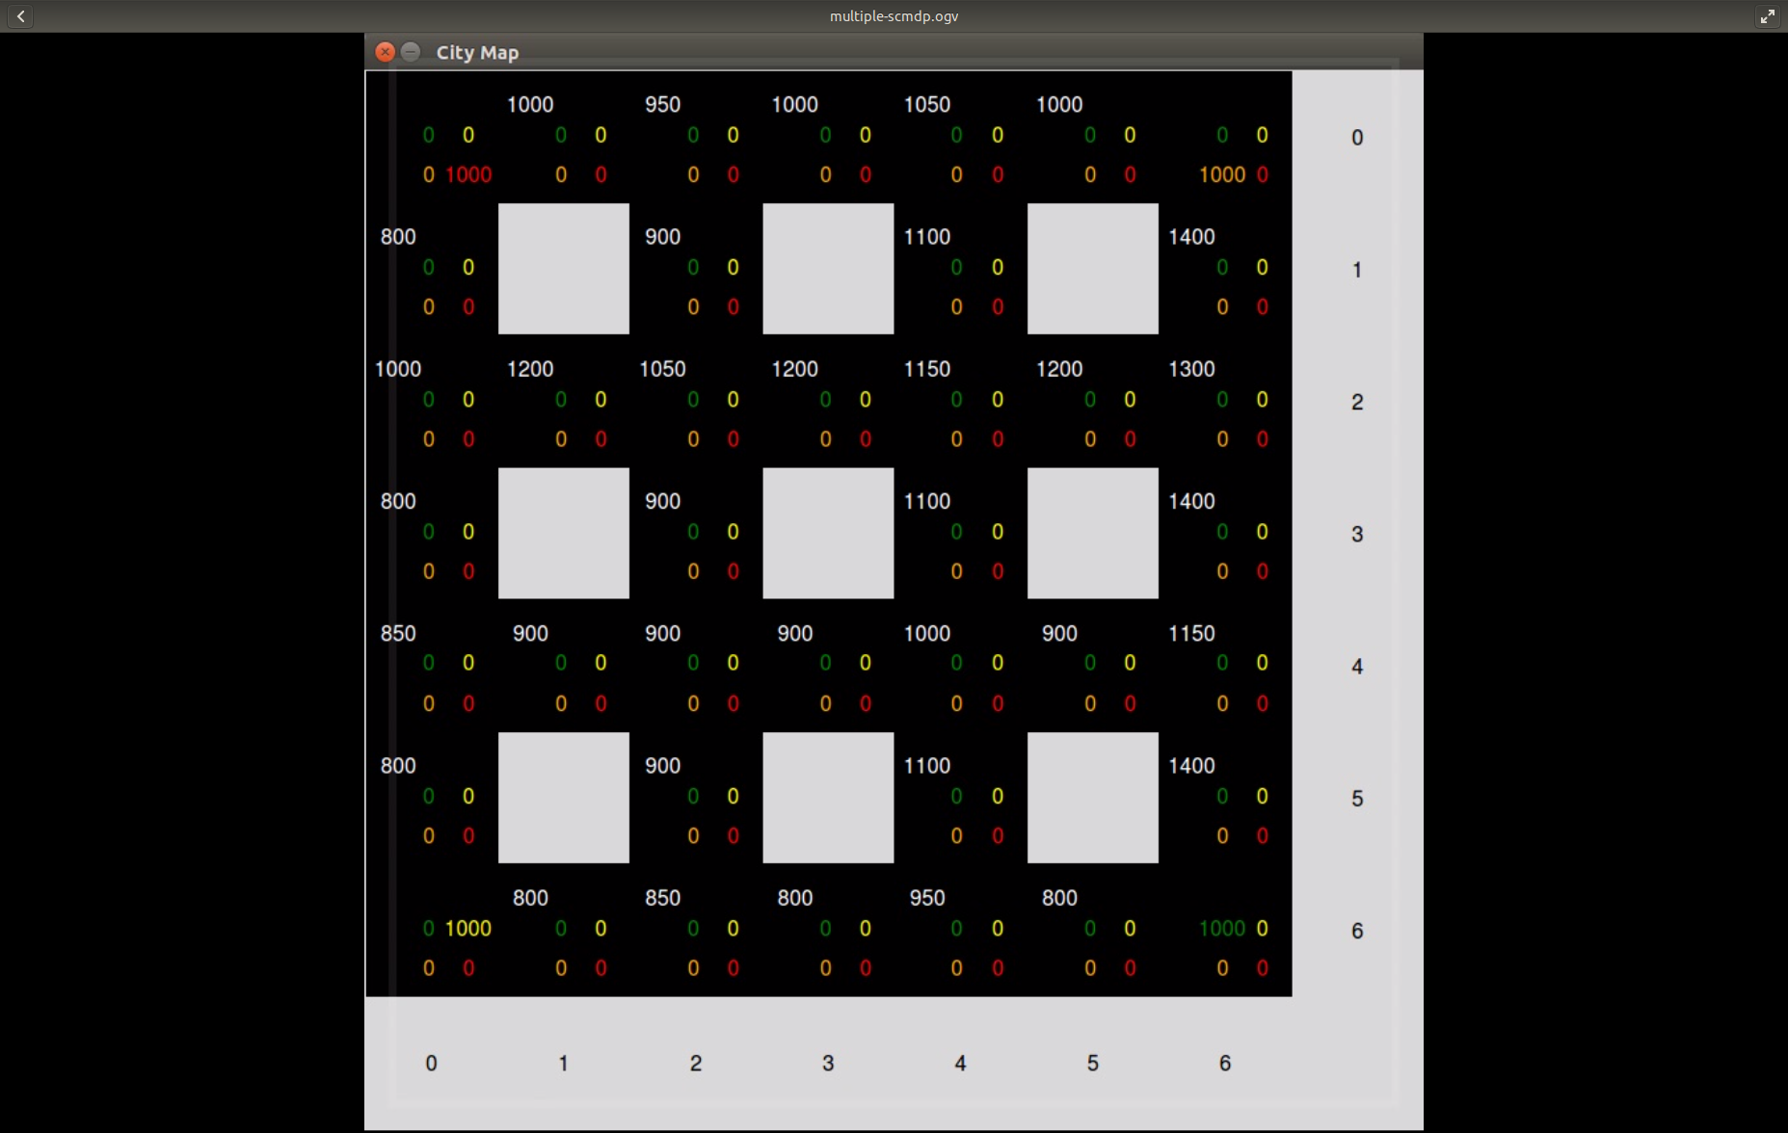
Domain 2: 2D Grid World
(Multiple Start and Destination Locs)

Slide 8
Domain 2: 2D Grid World
(Multiple Start and Destination Locs)

Slide 9
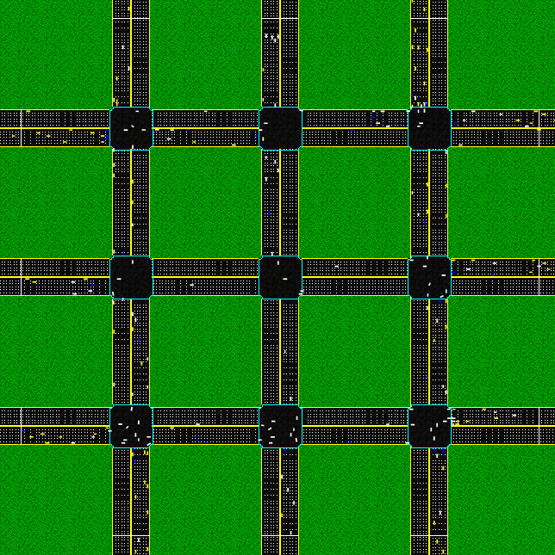
Domain 2: Future Work
The Automatic Intersection Manager (AIM)

Slide 10
Domain 2: Future Work
Two-direction flows
Cars with different capacities
Cars with different transition functions
States with different transition functions (rules)
Comparing to existing algorithms on efficiency
  Time based A*
  Reinforcement learning + Toll

