Slide 1
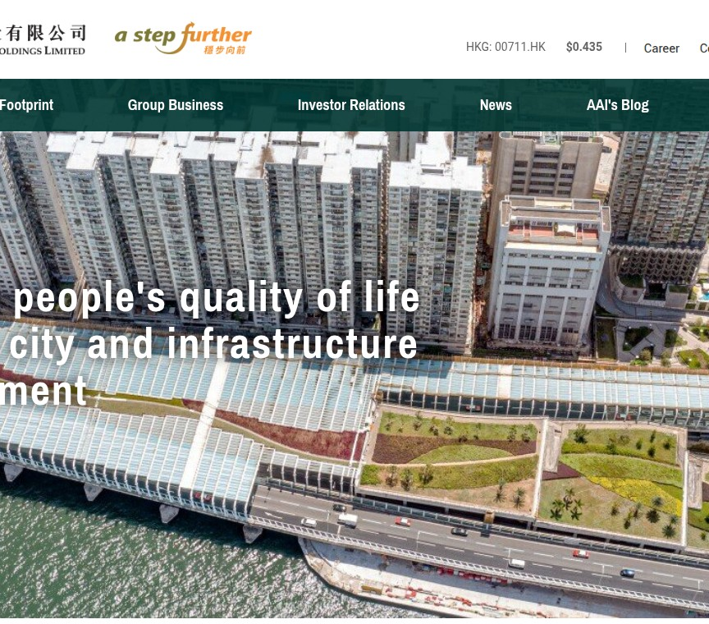
COMMON LOOK & FEEL
Complete UI Colour Foundation
18 semantic tokens 15 unique values 0 logo artwork tokens
Each token is mapped to a source screenshot, CSS evidence, accessibility correction or semantic alias.
Reference S1 · live homepage
https://www.asiaalliedgroup.com/en

Slide 2
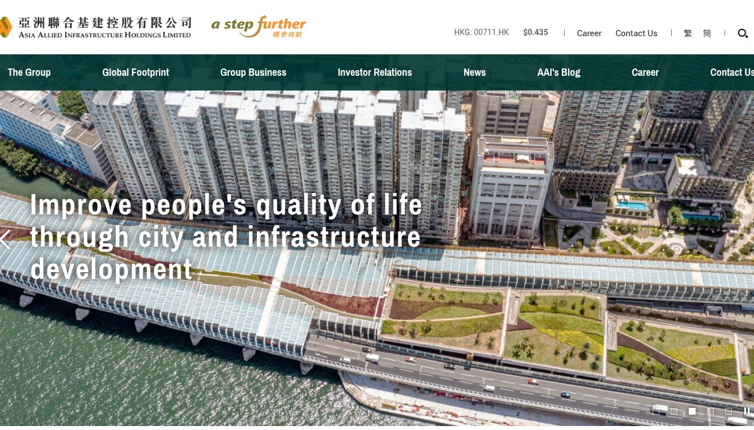
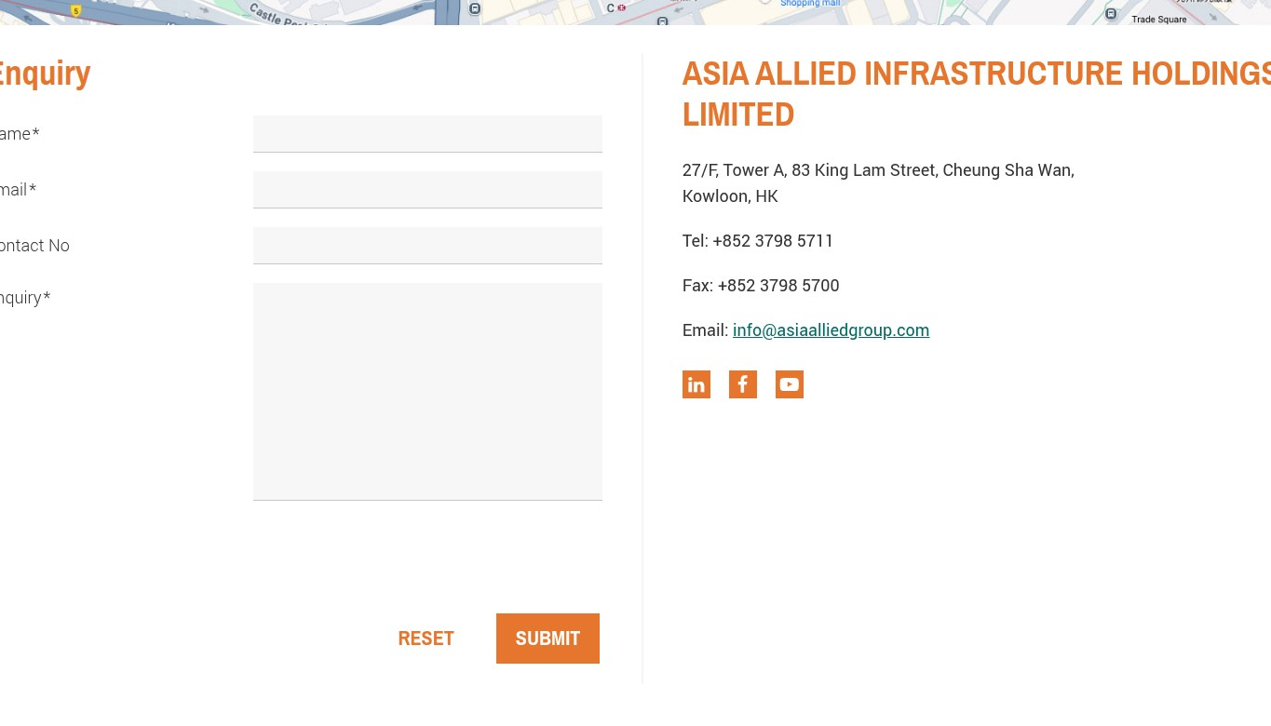
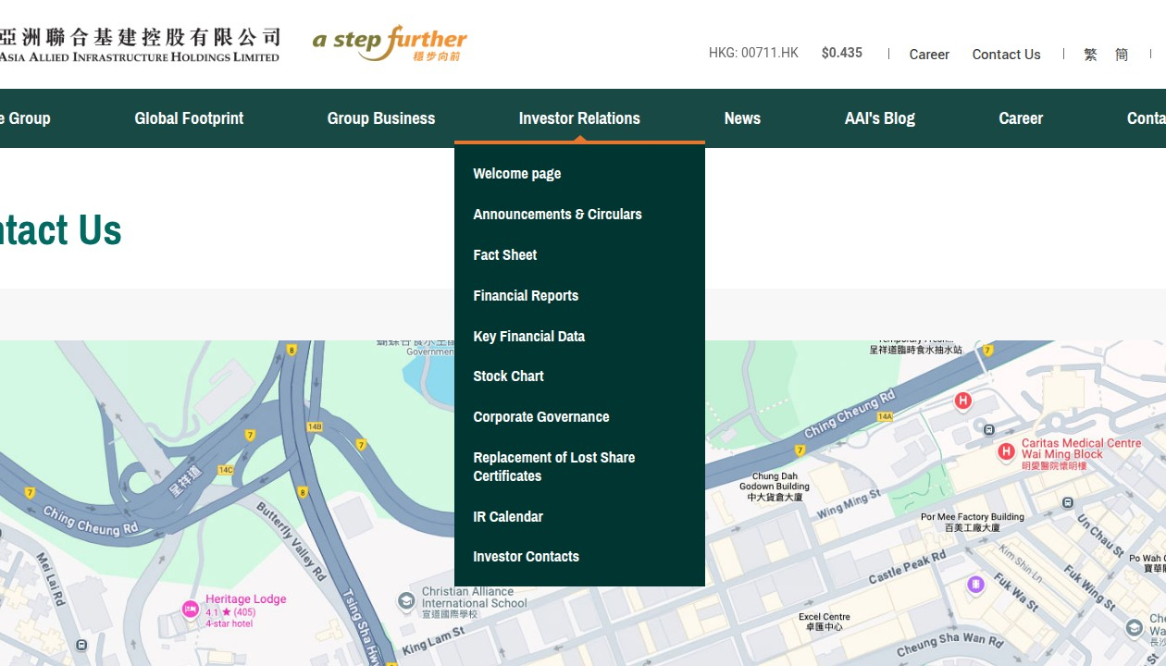
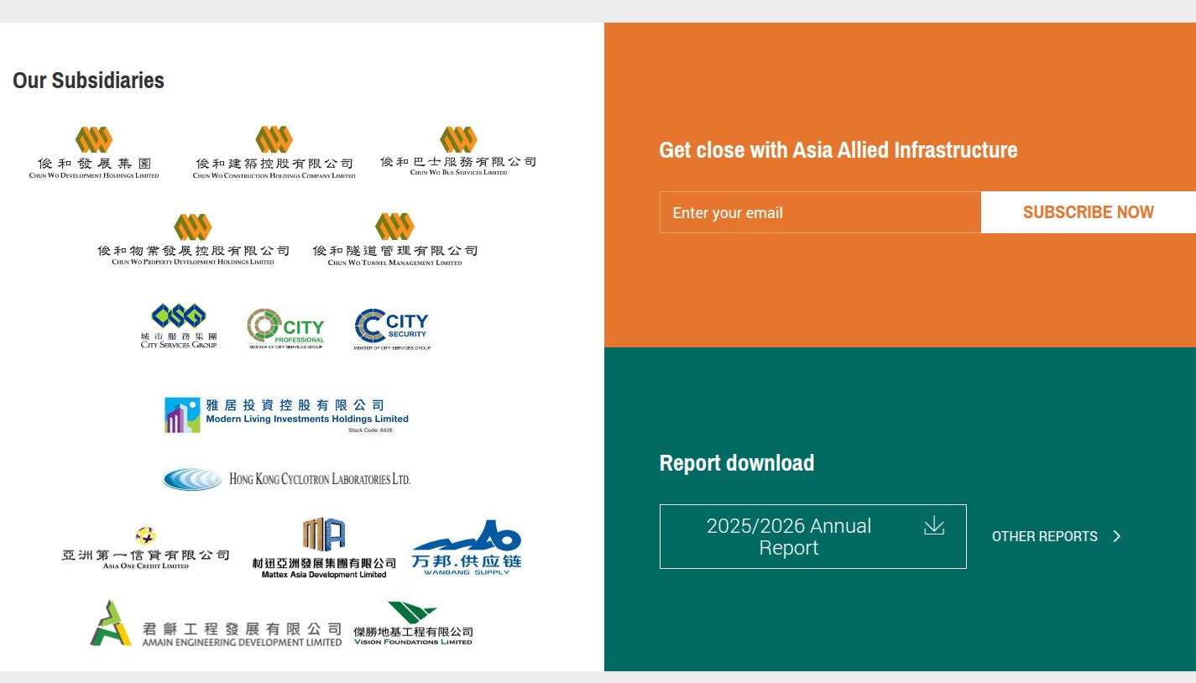
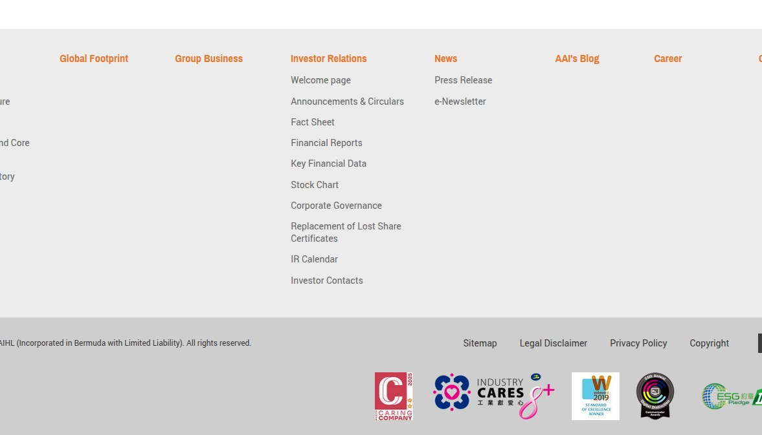
FIVE LIVE IMAGE REFERENCES · NO LOGO ASSETS
2
Evidence images and classification
S1 Homepage
S2 Contact form
S3 Open navigation
https://www.asiaalliedgroup.com/en
https://www.asiaalliedgroup.com/en/contact-us
https://www.asiaalliedgroup.com/en/contact-us
S4 Homepage panels
S5 Footer
https://www.asiaalliedgroup.com/en
https://www.asiaalliedgroup.com/en/contact-us
CSS = exact public stylesheet evidence · a11y = accessibility-led correction · semantic alias = same value, distinct product role
Common Look & Feel · 18 semantic UI tokens · logo artwork colors excluded
DESIGN.md is normative

Slide 3

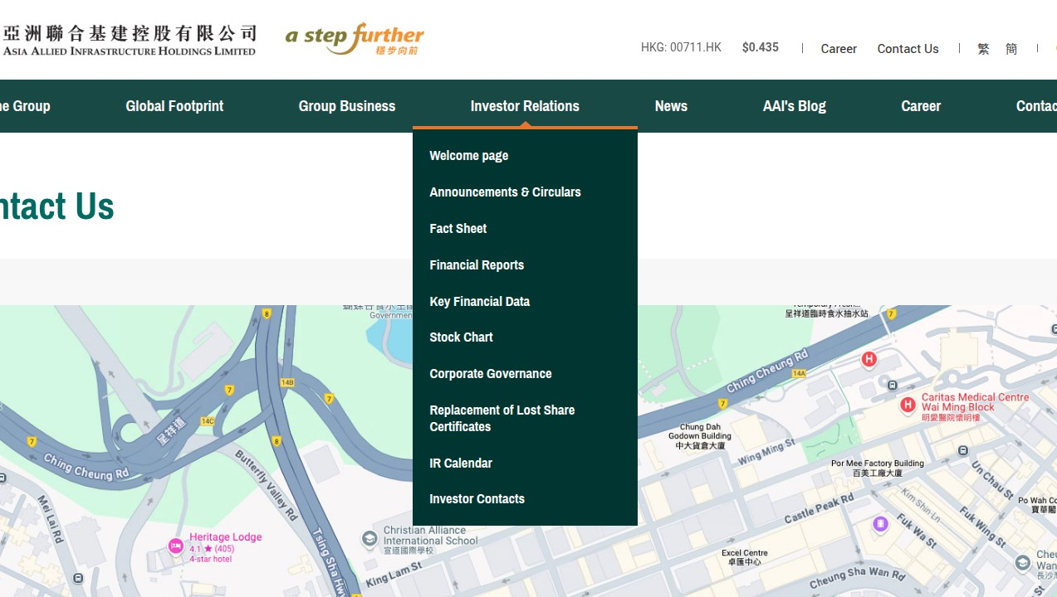
STRUCTURE, NAVIGATION AND PRESSED STATES
3
Core green roles
S1/CSS
primary
#006A63
Primary actions, links, selection
S3/CSS
primary-dark
#003531
Hover, pressed framing, navigation
S1 Homepage
S3 Open navigation
https://www.asiaalliedgroup.com/en
https://www.asiaalliedgroup.com/en/contact-us
CSS
primary-active
#001C19
Pressed state, stronger separation
Common Look & Feel · 18 semantic UI tokens · logo artwork colors excluded
DESIGN.md is normative

Slide 4

RAW ORANGE, ACCESSIBLE ORANGE AND SELECTED STATE
4
Accent and contrast roles
S2/S3
accent
#E6762D
Large headings, charts, decoration
CSS/a11y
accent-accessible
#B15315
Normal white-text actions
S2 Contact form
S3 Open navigation
https://www.asiaalliedgroup.com/en/contact-us
https://www.asiaalliedgroup.com/en/contact-us
CSS/a11y
accent-selected
#733208
Selected accent state with white
contrast
text-on-accent
#001C19
Dark text on raw accent
Common Look & Feel · 18 semantic UI tokens · logo artwork colors excluded
DESIGN.md is normative

Slide 5
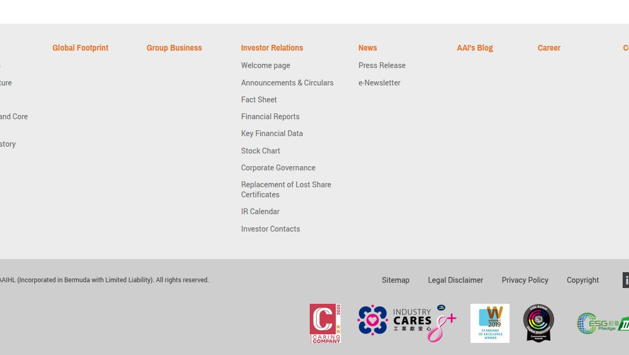
PRIMARY COPY AND SECONDARY METADATA
5
Text hierarchy
S2/CSS
text
#333333
Primary body and UI text
CSS
text-muted
#6C757D
Secondary metadata on white
S2 Contact form
S5 Footer
https://www.asiaalliedgroup.com/en/contact-us
https://www.asiaalliedgroup.com/en/contact-us
Common Look & Feel · 18 semantic UI tokens · logo artwork colors excluded
DESIGN.md is normative

Slide 6
CANVAS, DISABLED AND STRUCTURAL LAYERS
6
Surfaces, borders and table tint
S1/S2
surface
#FFFFFF
Main surface and cards
S2/CSS
surface-subtle
#F7F7F7
Page canvas, alternate rows
S2 Contact form
S5 Footer
https://www.asiaalliedgroup.com/en/contact-us
https://www.asiaalliedgroup.com/en/contact-us
CSS
surface-muted
#ECECEC
Muted structural regions
CSS
surface-disabled
#EAEAEA
Disabled controls
S5/CSS
border
#CECECE
Dividers and boundaries
CSS
table-header
#FFF2EA
Warm table/list header
Common Look & Feel · 18 semantic UI tokens · logo artwork colors excluded
DESIGN.md is normative

Slide 7
STATE TOKENS ALWAYS PAIR WITH VISIBLE TEXT OR ICON
7
Focus and semantic states
semantic alias
focus
#006A63
Existing focus indication color
CSS
danger
#DC3545
Error/destructive text and borders
S1 Homepage
S2 Contact form
https://www.asiaalliedgroup.com/en
https://www.asiaalliedgroup.com/en/contact-us
semantic alias
success
#006A63
Positive states with label/icon
Common Look & Feel · 18 semantic UI tokens · logo artwork colors excluded
DESIGN.md is normative

Slide 8
TOKEN → VALUE → ROLE → EVIDENCE REFERENCE
8
Complete 18-token map
S1/CSS
contrast
CSS
primary
text-on-accent
surface-disabled
#006A63
Primary actions, links, selection
#001C19
Dark text on raw accent
#EAEAEA
Disabled controls
S3/CSS
S2/CSS
S5/CSS
primary-dark
text
border
#003531
Hover, pressed framing, navigation
#333333
Primary body and UI text
#CECECE
Dividers and boundaries
CSS
CSS
CSS
primary-active
text-muted
table-header
#001C19
Pressed state, stronger separation
#6C757D
Secondary metadata on white
#FFF2EA
Warm table/list header
S2/S3
S1/S2
semantic alias
accent
surface
focus
#E6762D
Large headings, charts, decoration
#FFFFFF
Main surface and cards
#006A63
Existing focus indication color
CSS/a11y
S2/CSS
CSS
accent-accessible
surface-subtle
danger
#B15315
Normal white-text actions
#F7F7F7
Page canvas, alternate rows
#DC3545
Error/destructive text and borders
CSS/a11y
CSS
semantic alias
accent-selected
surface-muted
success
#733208
Selected accent state with white
#ECECEC
Muted structural regions
#006A63
Positive states with label/icon
Common Look & Feel · 18 semantic UI tokens · logo artwork colors excluded
DESIGN.md is normative

Slide 9
THE PALETTE IS COMPLETE; NOT EVERY COMBINATION IS VALID
9
Usage and accessibility rules
6.48:1
White on primary
13.52:1
White on primary-dark
Non-negotiable rules
PASS
PASS
1. Use semantic token names, not visual guesses.
3.00:1
White on raw accent
5.10:1
White on accent-accessible
2. Raw accent is decorative or large-text only.
FAIL normal text
PASS
3. Never use color as the sole status cue.
9.59:1
White on accent-selected
12.63:1
Text on white
4. Logo artwork colors are not UI tokens.
PASS
PASS
5. Consume approved logos as image assets.
6. PPT, DESIGN.md and skill templates must stay at 18 tokens.
4.69:1
Muted text on white
4.53:1
Danger on white
PASS
PASS narrowly
Normative source: DESIGN.md · Evidence: docs/design-system/source-evidence.md
Common Look & Feel · 18 semantic UI tokens · logo artwork colors excluded
DESIGN.md is normative

