Slide 1
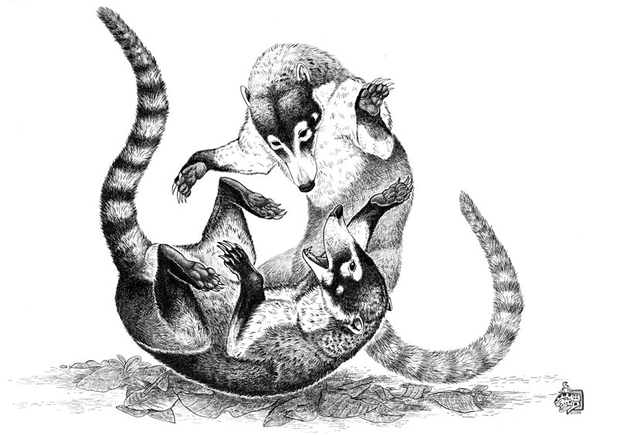
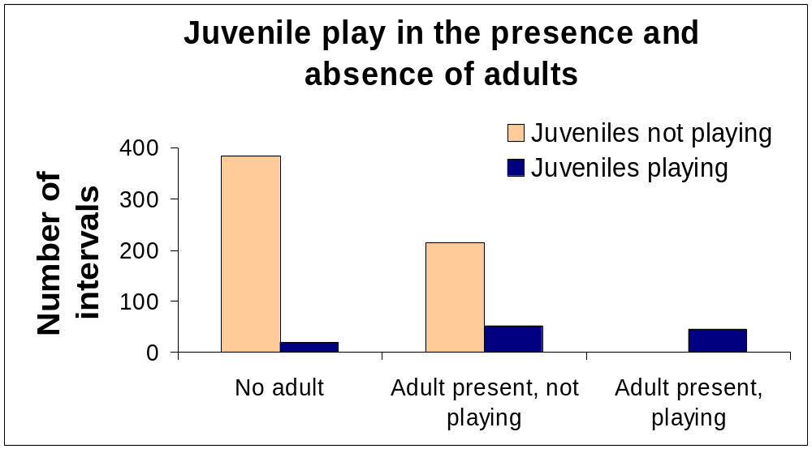
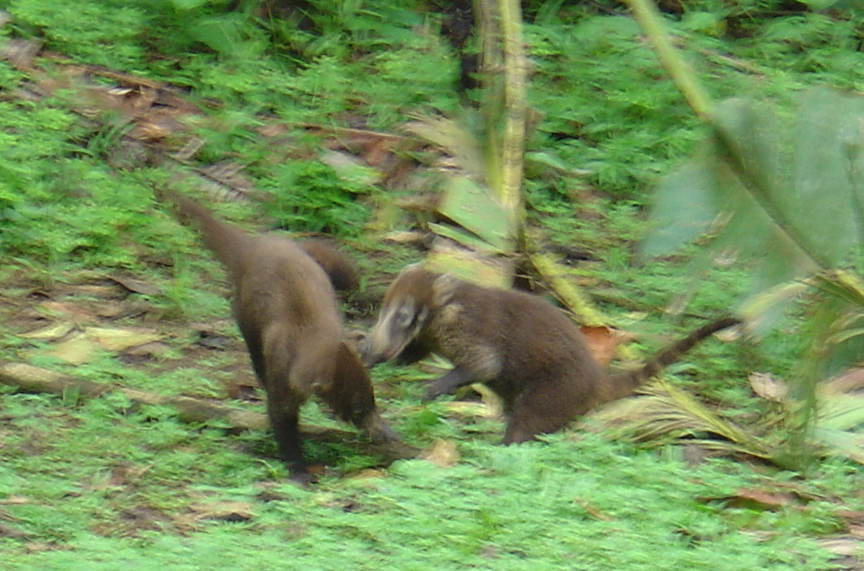
Coati play in Costa Rica
~
Corina J. Logan* and John T. Longino
The Evergreen State College, Olympia, Washington, 98505 U.S.A.
*Current address: Department of Experimental Psychology, University of Cambridge, England, U.K., itsme@CorinaLogan.com
INTRODUCTION
Why do organisms play? Play functions appear to differ among species due to unique life histories. Generalizations about the evolutionary origins of play are elusive, requiring further investigations of a wider range of taxa in order to identify trends.
This study examined general play behavior in Nasua narica (white-nosed coati), and the evolutionary significance of the age distribution of those who play. We tested two predictions proposed by Spinka, Newberry, and Bekoff (2001) who posit that the original function of play was to condition animals physically and emotionally for unexpected events.
Play can increase behavioral plasticity (Spinka et al. 2001), thus diversifying individual behavior which could enhance the ability of
the species to adapt to changing social and environmental conditions.
Predictions
1. Play occurs more in environmentally safe conditions through adult vigilance and by playing more on the ground than in trees. Safety is important for maximizing the variety of movements in play including awkward positions and losing control, which are instrumental in creating novel behaviors.
2. Play is contagious. Increasing the number of playmates increases environmental unpredictability, thus refining an individual’s ability to adapt to unexpected events.
METHODS
Study Species: N. narica (Carnivora: Procyonidae) is the most social member of the raccoon family (Kaufmann 1962). It is a common diurnal mammal occurring from Argentina to Arizona; bands include adult females and juveniles of both sexes; males become solitary around two years of age.
Study Site: The Organization for Tropical Studies’ La Selva Biological Station in Sarapiqui, Costa Rica (10°26’N, 83°59’W) includes 1,600 ha of lowland tropical wet forest (McDade et al. 1994).
Field Methods: One band of eight juveniles and two solitary males were followed during daylight hours (0500-1800 hours) from March to June 2004. Observation sessions were divided into five-minute sample intervals and lasted from 30 minutes to 10 hours. One-zero sampling was used to collect data while continuously scanning and recording the presence of predetermined states of behavior (Altmann 1974). Additional play data were collected using ad libitum sampling. Play behavior was recorded as either social (play fighting) or object (an individual playing with an inanimate object).
RESULTS
Play was present in 22% of all intervals (N=166/764). Social play (play fighting) was the predominant type of play, with four bouts of object play.
Adult males played with juveniles in 55% of the intervals in which play occurred; significantly more than expected for this age class combination (X²=115.59, p<0.001, Fig. 1).
Prediction 1: Play significantly increased in the presence of an adult (X²=88.54, p<0.001, Fig. 1). Play occurred more on the ground than in trees when compared with foraging (X²=32.96, p<0.001).
Prediction 2: Play was contagious in 46% of the play intervals (N=76/166).
Figure 1. Relationship among juvenile play, adult presence, and adult play. “Adult present, playing” has zero intervals of “Juveniles not playing” because adults only played with juveniles, thus juveniles were always playing.
DISCUSSION
Play fighting occurred in all age classes, and rather than being practice for serious fights, could serve the function of maintaining social relationships since sequences, timing, and movements differ between fighting and play (Pellis & Pellis 1998). Both juveniles and adults benefit from playing across age classes: juveniles gain from playing with a more experienced partner, and adults are playful, indicating that training for the unexpected may be a lifelong endeavor. There is no previous report of adult males playing with juveniles outside of the mating season.
Play occurred more in the presence of adult males, but adults were no more vigilant than the average band member and participated in most play sessions, thus rejecting the idea that adult presence increases safety. However, play did occur more on the ground than in trees, in accordance with the prediction for a safer physical environment. Environmental safety factors may be more important than social protections.
The popularity of contagious play could indicate that play is training for the unexpected.
We encourage further investigations of play in N. narica with an emphasis on genetic relationships and inter-population variation in behavior, which has not been studied on the Atlantic slope of Costa Rica or in a lowland tropical wet forest.
LITERATURE CITED
Altmann, J. 1974. Observational study of behaviour: sampling methods. Behaviour 49:227-267.
Kaufmann, J.H. 1962. Ecology and social behavior of the coati on Barro Colorado Island, Panama. University of California Publications in Zoology 60:95-222.
McDade, L.A., K.S. Bawa, H.A. Hespenheide, & G.S. Hartshorn. 1994. La Selva: Ecology and Natural History of a Neotropical Rainforest. Chicago, IL: University of Chicago Press.
Pellis, S.M. & V.C. Pellis. 1998. The structure-funtion interface in the analysis of play fighting. Pp. 115-140 in: Animal Play: Evolutionary, Comparative and Ecological Perspectives. Beckoff, M. & Byers, J.A. (Eds.). New York: Cambridge University Press.
Spinka, M., R.C. Newberry, & M. Bekoff. 2001. Mammalian play: Training for the Unexpected. Quarterly Review of Biology 76:141-168.
Coati illustration © Christopher Montero 2006; photo © Corina Logan 2004.
ACKNOWLEDGMENTS
Gracias to Evergreen State College colleagues and La Selva staff and researchers for coati spotting; and to Joel Sáenz, Ben Hirsch, Marek Spinka, Ruth Newberry, Christine Hass, Katherine McFadden, and Martin Dohrn for discussions and editing. The Evergreen State College Foundation and The Explorer’s Club provided partial funding. The Washington State Department of Natural Resources provided logistical support.
FURTHER INFORMATION
Contact: Corina Logan, itsme@CorinaLogan.com.
Access this poster online: www.CorinaLogan.com.

