Slide 1
Virtual Cards App
Final Project – Corina Radu

Slide 2
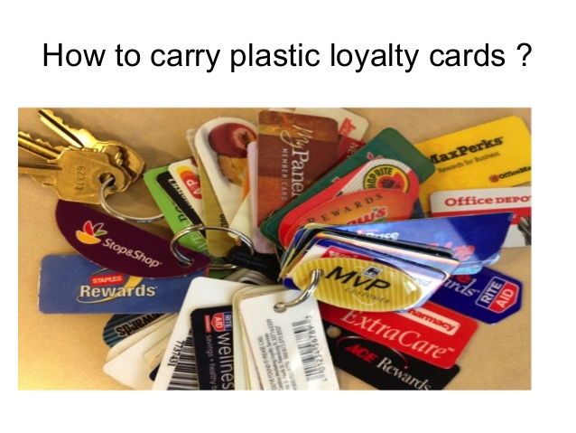

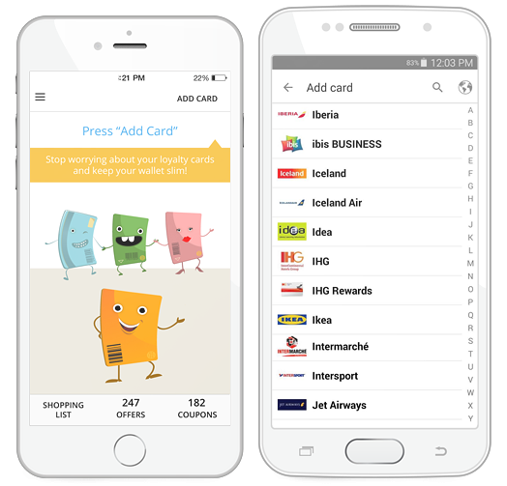

Short description
Virtual cards allows the user to register and manage loyalty cards and obtain discount coupons granted by merchants.

Slide 3


TESTING APPROACH
Objective:
Leave no bug unturned
Strategy:
Explore the app
Breakdown the functionalities
Create a test data set
Create and run testing scenarios
Report bugs
Create a test report

Slide 4

Used Tools
TestLink – Test Case Management
Mantis Bug Tracker – Bug Reporting
Xmind Tool – Mind Maps
QR Code & Barcode Scanner
PhotoScape – image editing

Slide 5
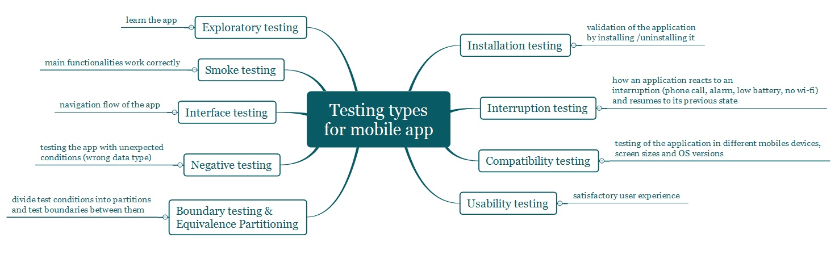
Testing types covered Manual, dynamic, black-box, functional testing types:

Slide 6
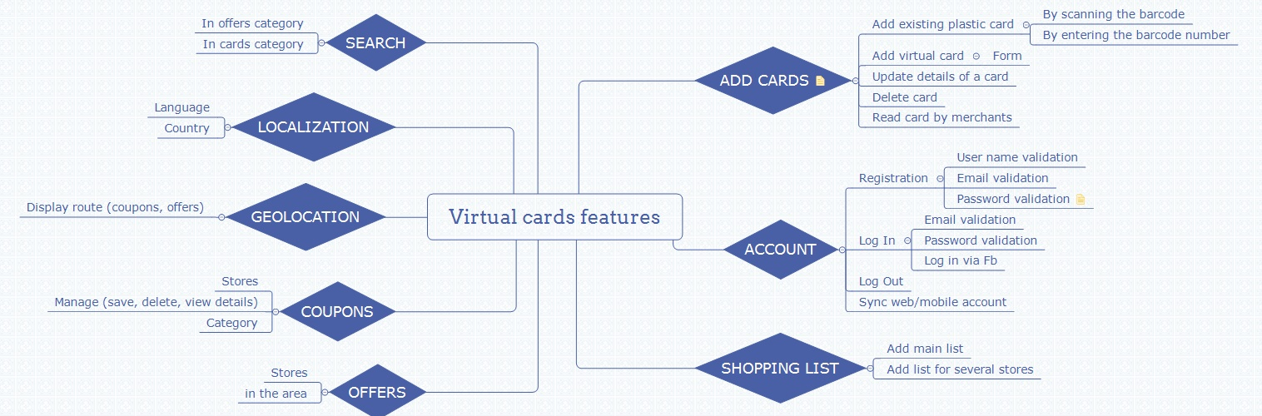
Test Cases Overview
Smoke test: 20 test cases

Slide 7
Smoke test cases result
Feature | No. of test cases | Passed | Failed | Defects
Install | 1 | 1 | 0
User experience | 3 | 3 | 0
Create account | 3 | 3 | 0
Log in | 4 | 3 | 0
Add card | 3 | 2 | 1 | 12252
Remove card | 1 | 1 | 0
Search card | 3 | 3 | 0
Uninstall | 1 | 1 | 0
Total | 19 | 18 | 1 | 1
Percentage | 100% | 94.7% | 5.3%

Slide 8
Bugs overview 12 bugs

Slide 9
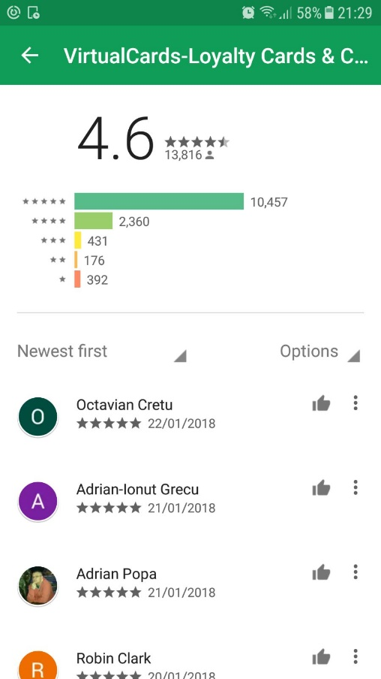
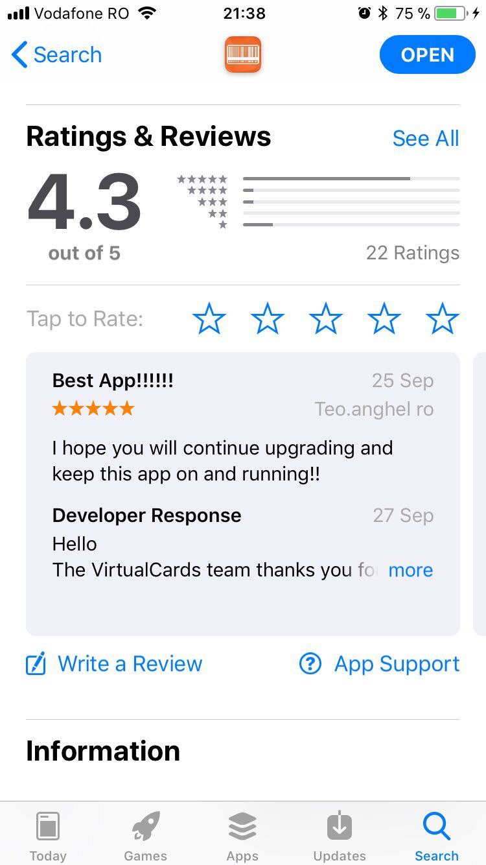

Conclusions
- 19 smoke test cases were executed: 18 passed and 1 failed
- 12 bug identified: 1 major, 11 normal
Virtual cards is a stable product, user friendly, helpful,
users like it!

Slide 10

Lessons learnt
Testing is an important phase on the software development life cycle in order to deliver a good product.
Testing is challenging (‘Testing is easy’ is a myth)
Testing requires high analytical skills in order to use minimum set of test cases with maximum test coverage
Testers need to be patient, creative, open-minded
Testers need to think and act with an end user perspective

