Slide 1
Virtual Cards App
Final Project – Corina Radu

Slide 2
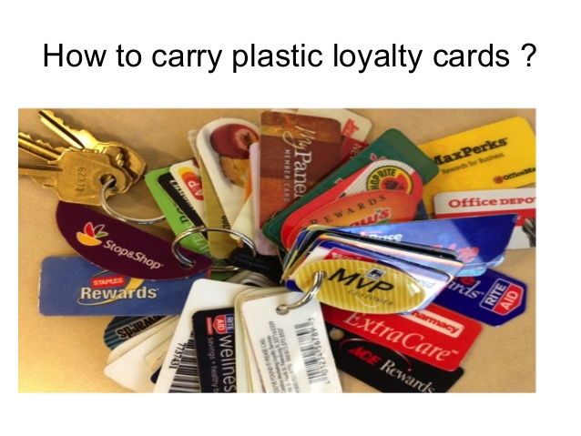

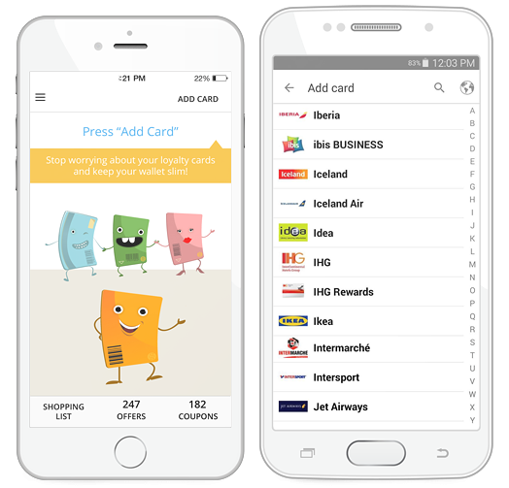

Short description
Virtual cards allows the user to register and manage loyalty cards and obtain discount coupons granted by merchants.

Slide 3

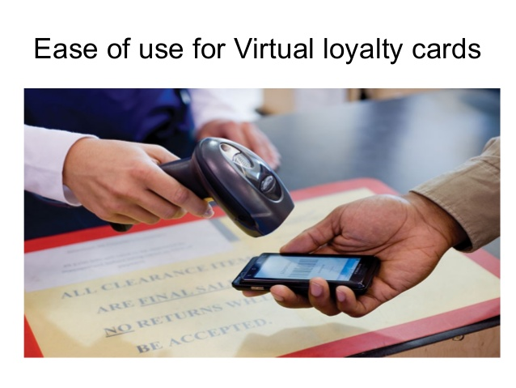
How to use Virtual cards app
- Scan or manually insert the card’s barcode
- Add as many cards as you want
- Use them to obtain discounts from participating vendors
- The app notifies the user about offers and coupons
- Display route feature helps the user to get to the nearest store
- Create and share shopping list

Slide 4


TESTING APPROACH
Objective:
Leave no bug unturned
Strategy:
Explore the app
Breakdown the functionalities
Create a test data set
Create and run test cases
Report bugs
Create a test report

Slide 5

Used Tools
TestLink – Test Case Management
Mantis Bug Tracker – Bug Reporting
Xmind Tool – Mind Maps
QR Code & Barcode Scanner
PhotoScape – image editing

Slide 6
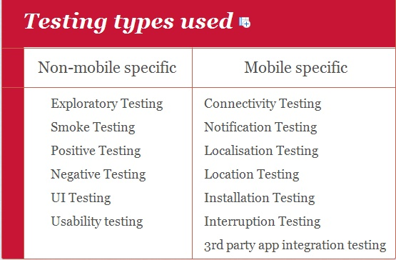
Testing types covered Manual, dynamic, black-box, functional testing types:

Slide 7
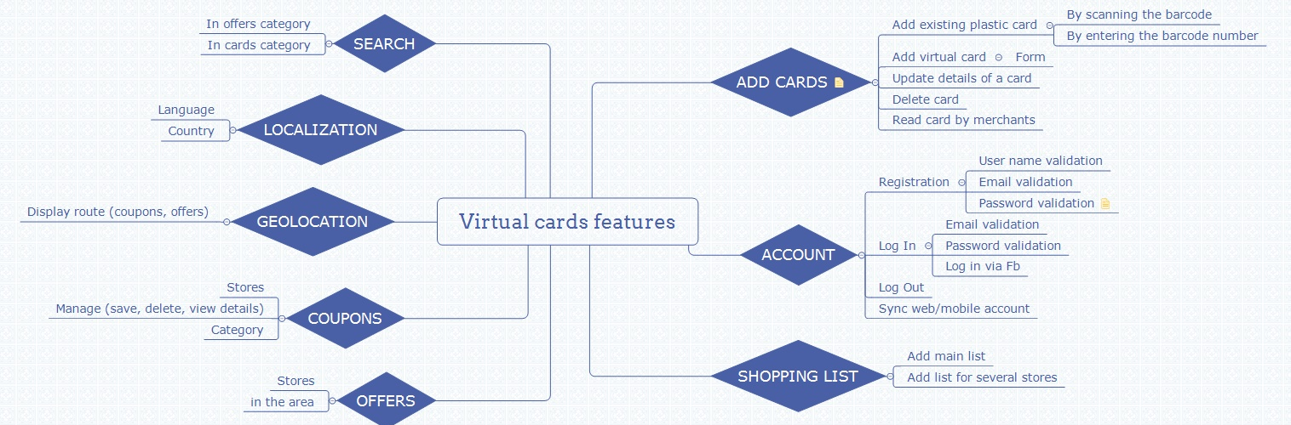
Test Cases Overview
Smoke test: 20 test cases

Slide 8
Smoke test cases result
Feature | No. of test cases | Passed | Failed | Defects
Install | 1 | 1 | 0
User experience | 3 | 3 | 0
Create account | 3 | 3 | 0
Log in | 4 | 3 | 0
Add card | 3 | 2 | 1 | 12252
Remove card | 1 | 1 | 0
Search card | 3 | 3 | 0
Uninstall | 1 | 1 | 0
Total | 19 | 18 | 1 | 1
Percentage | 100% | 94.7% | 5.3%

Slide 9
Feature | No. of bugs | Defects | Severity
Log in | 2 | 12259 12258 | major normal
User experience | 3 | 12260, 12261 12267 | normal improvement
Add card | 1 | 12252 | normal
Birthday calendar | 2 | 12255, 12432 | normal
Shopping list | 2 | 12265, 12266 | normal
Offers | 2 | 12262, 12264 | normal
Localization | 2 | 12257, 12428 | normal
Total | 14

Slide 10
Defects distribution 14 bugs
Feature | No. of bugs | Bug id | Severity
Log in | 2 | 12259 12258 | major normal
User experience | 3 | 12260, 12261 12267 | normal improvement
Add card | 1 | 12252 | normal
Birthday calendar | 2 | 12255, 12432 | normal
Shopping list | 2 | 12265, 12266 | normal
Offers | 2 | 12262, 12264 | normal
Localization | 2 | 12257, 12428 | normal
Total | 14

Slide 11
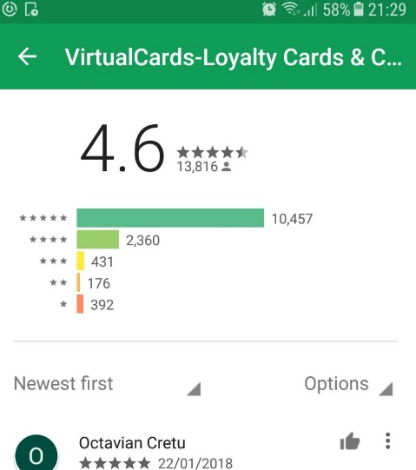
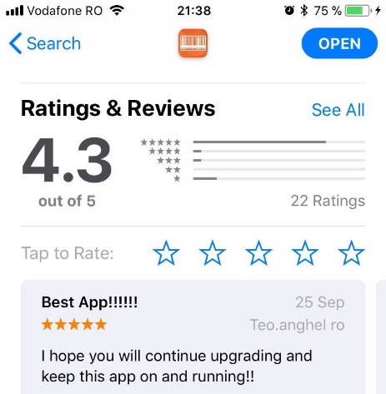
Conclusions
- 19 smoke test cases were executed: 18 passed and 1 failed
- 14 bugs identified: 1 major, 11 normal (most of them
found by performing Connectivity Testing and Location testing)
Virtual cards is a stable product, user friendly, helpful,
users like it!

Slide 12

Lessons learnt
Testing is an important phase on the software development
life cycle in order to deliver a good product.
Testing is challenging (‘Testing is easy’ is a myth),
it requires high analytical skills in order to use
minimum set of test cases with maximum test coverage
Testers need to be patient, creative, open-minded
Testers need to think and act with an end user perspective

