Slide 1
Virtual cards App
Final Project – Corina Radu

Slide 2
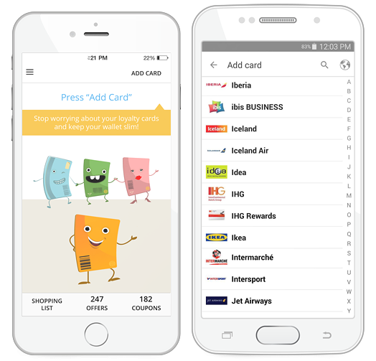
Virtual cards allows the user to register and manage loyalty cards and obtain discount coupons granted by merchants

Slide 3
TESTING APPROACH
Objective: leave no bug unturned
Break down the features
Methodical approach, which is based on failures.
Context-driven testing
Create and run testing scenarios
Test Techniques: Manual, dynamic, functional testing:
Exploratory testing, Component testing, system testing, Usability Testing

