Slide 1
Virtual Cards App
Final Project – Corina Radu

Slide 2
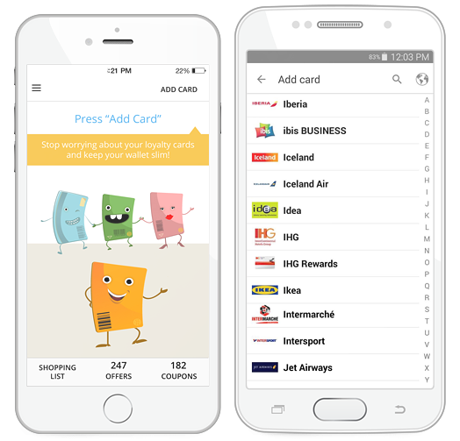



Short description
Virtual cards allows the user to register and manage loyalty cards and obtain discount coupons granted by merchants.

Slide 3


TESTING APPROACH
Objective:
Leave no bug unturned
Strategy:
Explore the app
Breakdown the functionalities
Create a test data set
Create and run testing scenarios
Report bugs
Create a test report

Slide 4

Used Tools
TestLink – Test Case Management
Mantis Bug Tracker – Bug Reporting
Xmind Tool – Mind Maps
QR Code & Barcode Scanner

Slide 5
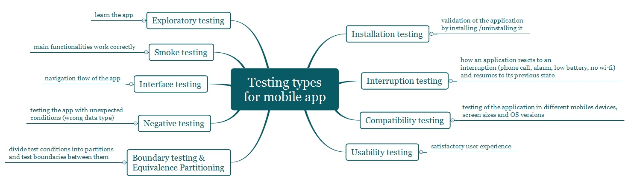
Testing types covered Manual, dynamic, black-box, functional testing types:

Slide 6
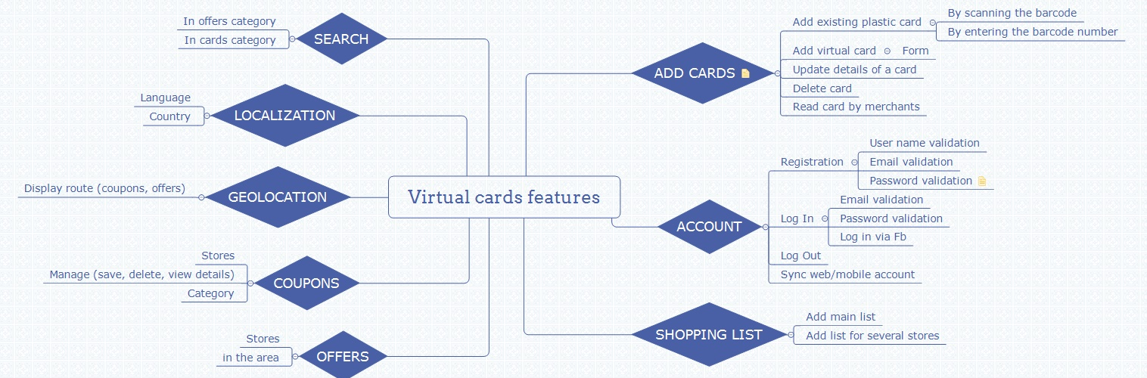
Test Cases Overview
Smoke test: 20 test cases

