Slide 1
Virtual Cards App
Final Project – Corina Radu

Slide 2
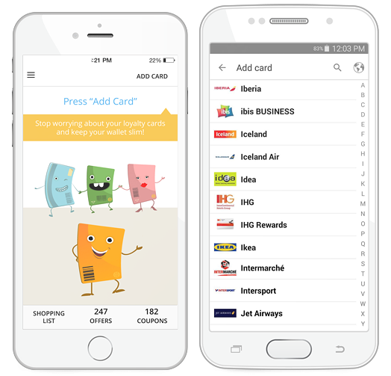
Short description
Virtual cards allows the user to register and manage loyalty cards and obtain discount coupons granted by merchants.

Slide 3


TESTING APPROACH
Objective:
Leave no bug unturned
Strategy:
Explore the app
Breakdown the functionalities
Create a test data set
Create and run testing scenarios
Report bugs
Create a test report

Slide 4

Used Tools
TestLink – Test Case Management
Mantis Bug Tracker – Bug Reporting
Xmind Tool – Mind Maps
QR Code & Barcode Scanner

Slide 5
Testing types covered
Exploratory testing
Component testing
System testing
Usability Testing
Interruption testing

