Slide 1
Virtual Cards App
Final Project – Corina Radu

Slide 2
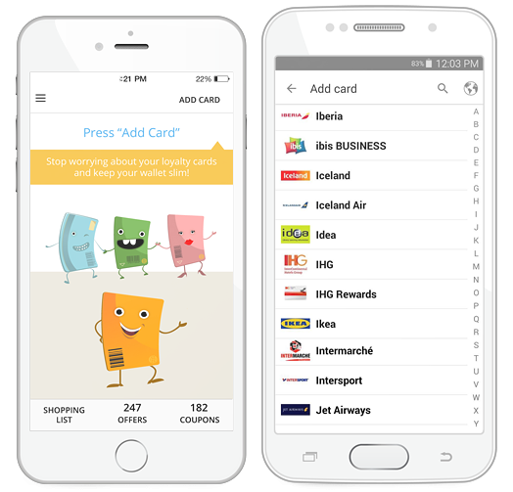
Short description
Virtual cards allows the user to register and manage loyalty cards and obtain discount coupons granted by merchants.

Slide 3

TESTING APPROACH
Objective:
leave no bug unturned
Strategy
Breakdown the functionalities
Identify the system inputs and outputs
Methodical approach, which is based on failures.
Context-driven testing
Create and run testing scenarios
Test Techniques: Manual, dynamic, black-box, functional testing:
Exploratory testing, Component testing, System testing, Usability Testing

Slide 4

Used Tools
TestLink – Test Case Management
Mantis Bug Tracker – Bug Reporting
Xmind Tool – Mind Maps
QR Code & Barcode Scanner

