Slide 1
Virtual Cards App
Final Project – Corina Radu

Slide 2
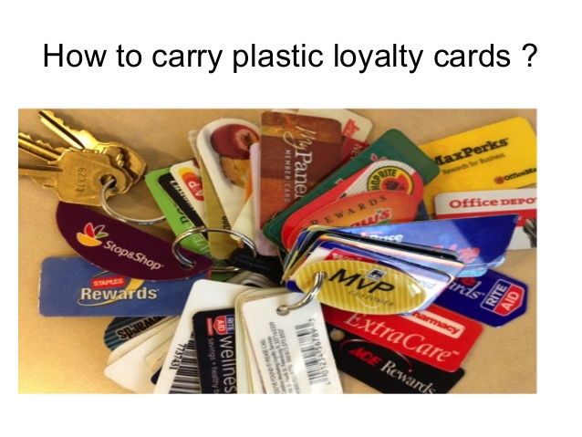

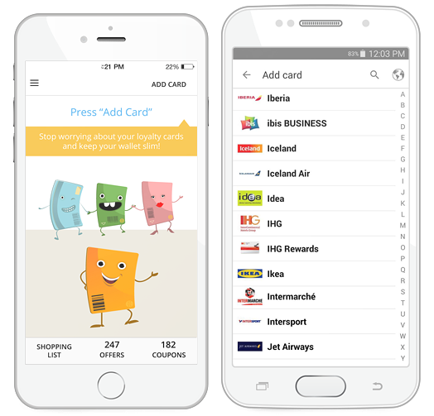

Short description
Virtual cards is a mobile app that allows the user to register and manage loyalty cards and obtain discount coupons granted by merchants.

Slide 3

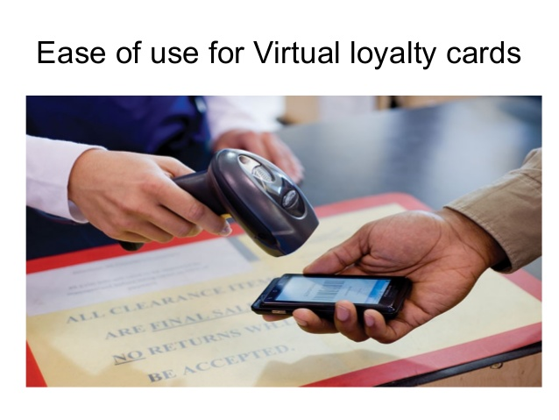
How to use Virtual cards app
Scan or manually insert the card’s barcode
- Add as many cards as you want
Use them to obtain discounts from participating vendors
The app notifies the user about offers and coupons
Display route feature helps the user to get to the nearest store
Create and share shopping list

Slide 4


TESTING APPROACH
Objective:
Leave no bug unturned
Strategy:
Learn the app by exploratory testing
Breakdown the functionalities and do Component testing then Integration testing.
Create a test data set
Create and run test cases
Report bugs
Create a test report

Slide 5

Used Tools
TestLink – Test Case Management
Mantis Bug Tracker – Bug Reporting
Xmind Tool – Mind Maps
QR Code & Barcode Scanner
PhotoScape – image editing

Slide 6
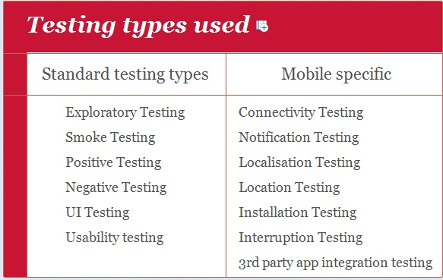
Testing types covered Manual, dynamic, black-box, functional testing types:

Slide 7
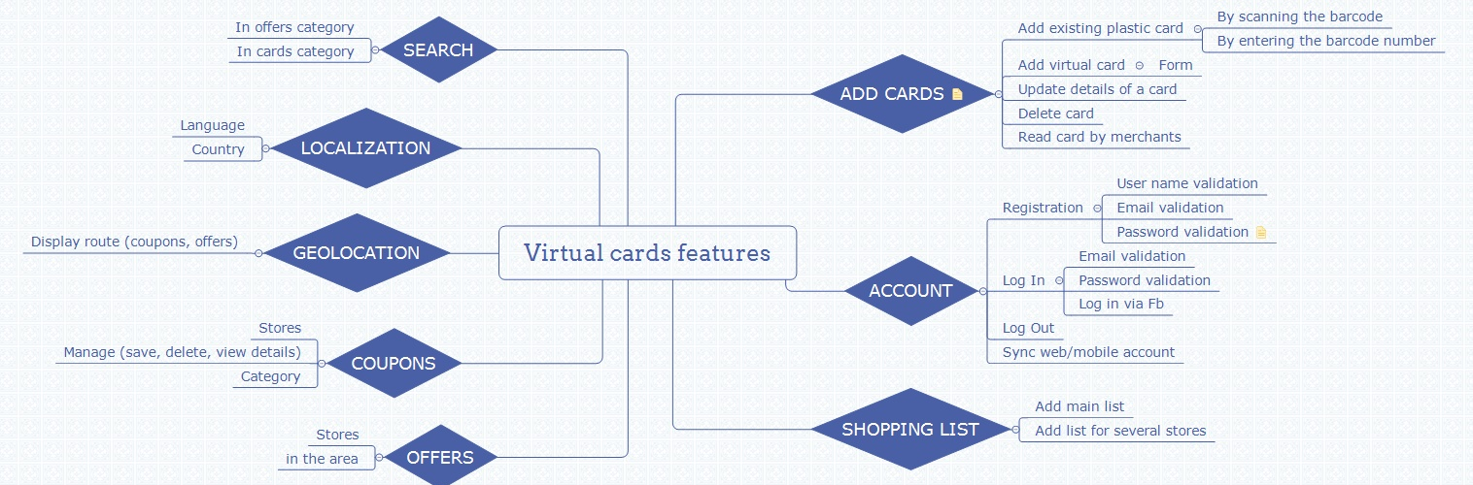
Test Cases Overview
Smoke test: 19 test cases

Slide 8
Smoke test cases result
Feature | No. of test cases | Passed | Failed | Defect ID
Install | 1 | 1 | 0
User experience | 3 | 3 | 0
Create account | 3 | 3 | 0
Log in | 4 | 3 | 0
Add card | 3 | 2 | 1 | 12252
Remove card | 1 | 1 | 0
Search card | 3 | 3 | 0
Uninstall | 1 | 1 | 0
Overall result | 19 | 18 | 1 | 1
Percentage | 100% | 94.7% | 5.3%

Slide 9
Defects distribution 13 bugs
Feature | No. of bugs | Bug id | Severity
Log in | 2 | 12259 12258 | major normal
User experience | 2 | 12260, 12261 | normal
Add card | 1 | 12252 | normal
Birthday calendar | 2 | 12255, 12432 | normal
Shopping list | 2 | 12265, 12266 | normal
Offers | 2 | 12262, 12264 | normal
Localization | 2 | 12257, 12428 | normal
Total | 13

Slide 10
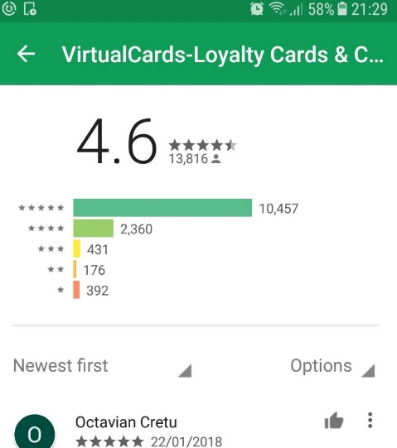
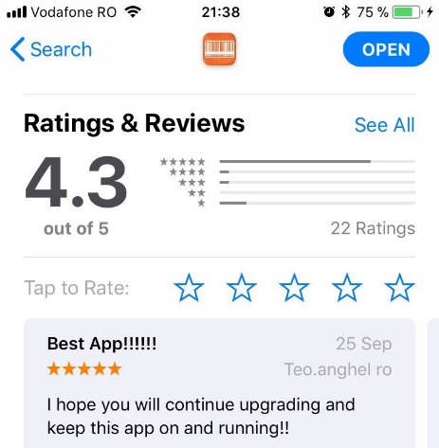

Conclusions
- 19 smoke test cases were executed: 18 passed and 1 failed
The failed test is related to mandatory fields from ‘Add card’ form
- 13 bugs identified: 1 major, 12 normal
most of them found by performing Connectivity Testing and Localization testing)
the major bug is related to the Login form while offline
Virtual cards is a stable product, user friendly, helpful,
users like it!

Slide 11

Lessons learnt
Testing is an important phase on the software development
life cycle in order to deliver a good product.
Testing is challenging (‘Testing is easy’ is a myth),
it requires high analytical skills in order to use
minimum set of test cases with maximum test coverage
Testers need to be patient, creative, open-minded
Testers need to think and act with an end user perspective

Slide 12


