Slide 1
MAPPING TO SUPPORT REDD+ PLANNING AND SECURE MULTIPLE BENEFITS
Toolbox
Tutorials for QGIS and ArcGIS
Guidance on how maps can help effective policy communication

Slide 2
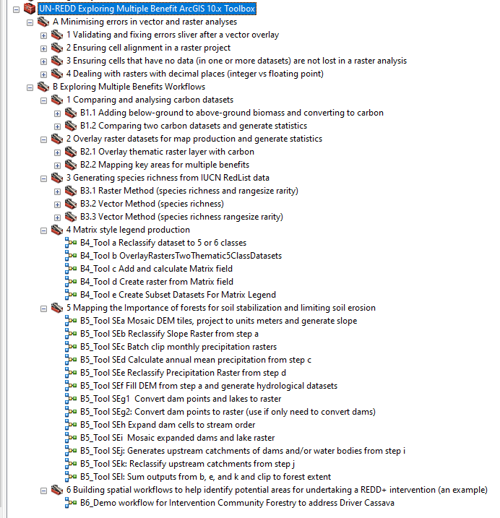
UN-REDD Exploring Multiple Benefit ArcGIS Toolbox
to assist technical staff to undertake spatial analysis to identify areas suitable for specific REDD+ policies and measures
http://bit.ly/GIStools-redd

Slide 3

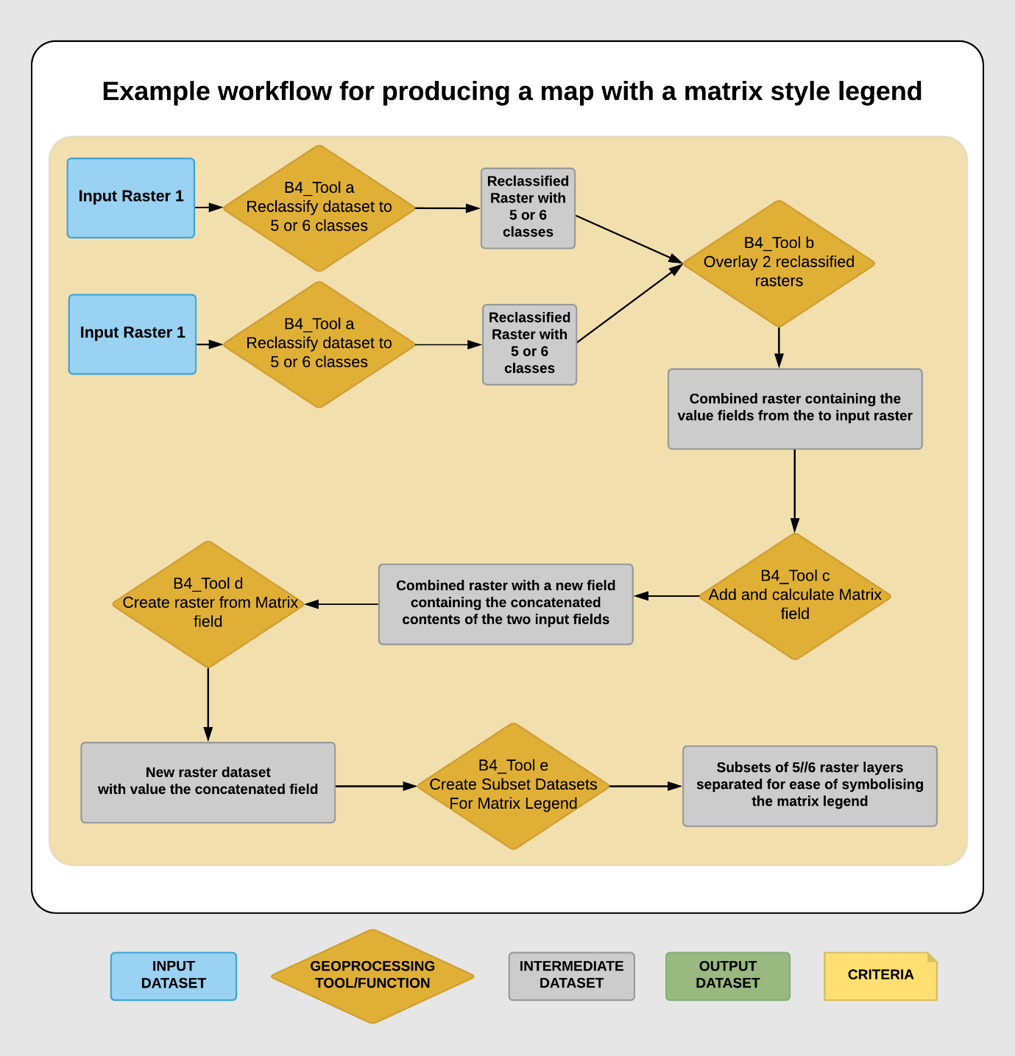
UN-REDD Exploring Multiple Benefit ArcGIS Toolbox
a suite of tools to help clean and prepare data
tools to undertake specific multiple benefits analyses
workflows to guide users
accompanying step-by-step tutorials
http://bit.ly/GIStools-redd

Slide 4
Step-by-step tutorials
importance of forests for wind erosion control
importance of forests for landslide mitigation
Overlaying thematic raster layer with carbon
Mapping key areas for multiple benefits
Matrix style legend production
Mapping the Importance of forests for soil stabilization and limiting soil erosion
Generating species richness from IUCN RedList data
Comparing and analysing carbon datasets
Building spatial workflows
http://bit.ly/GIStools-redd

Slide 5
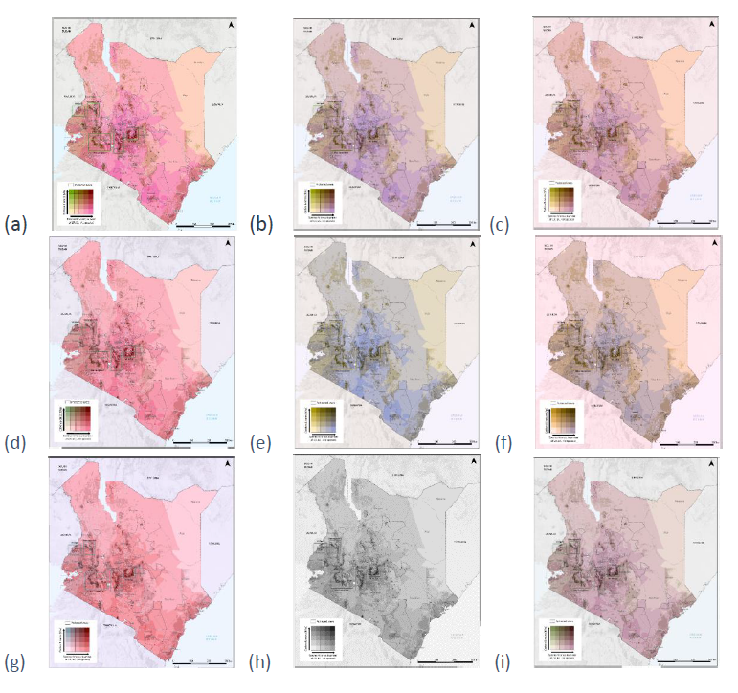
New guidance on mapping and other visuals
When should maps be chosen as a visualisation technique?
How can maps influence decision making?
The use of different types of maps
Guidance on data processing, generalisation and classification
Using colour and making colour blind friendly maps
Example REDD+ planning map shown in different colour-blindness views
http://bit.ly/GIStools-redd

