Slide 1
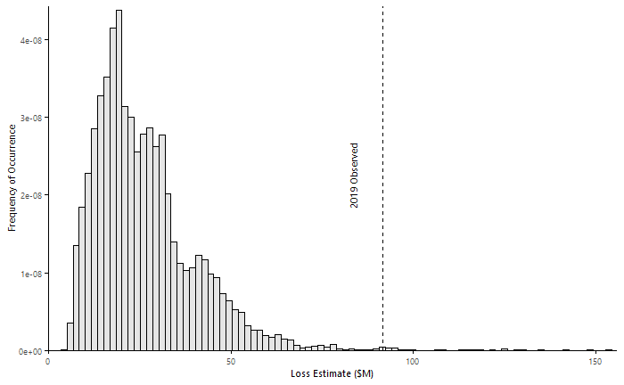
baseline: direct beta dist, nsi1.found, curve = beta
AAL = $106.6M (99.6th p.)

Slide 2
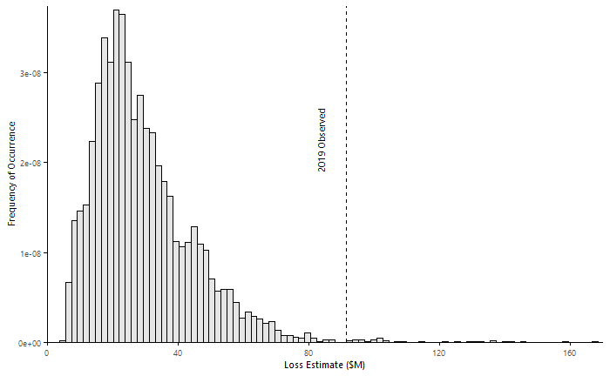
interpolated beta dist
AAL = $120.2M (99.5th p.)

Slide 3
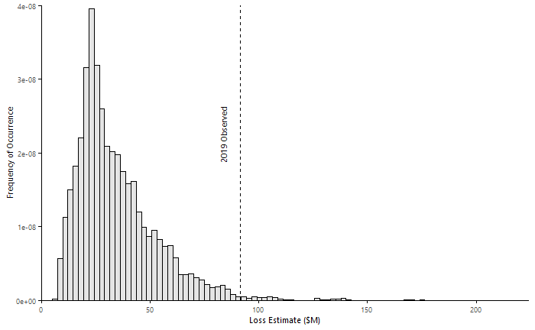
interpolated beta dist, nsi1.base
AAL = $140.9M (98.8th p.)

Slide 4
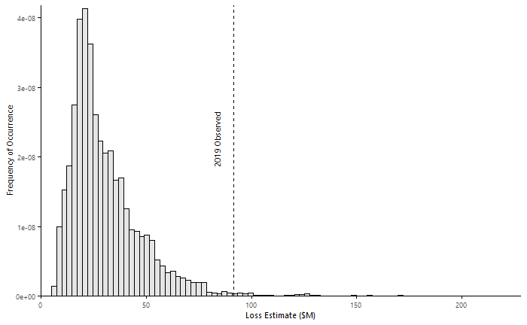
nsi1.base
AAL = $125.9M (99.1st p.)

Slide 5
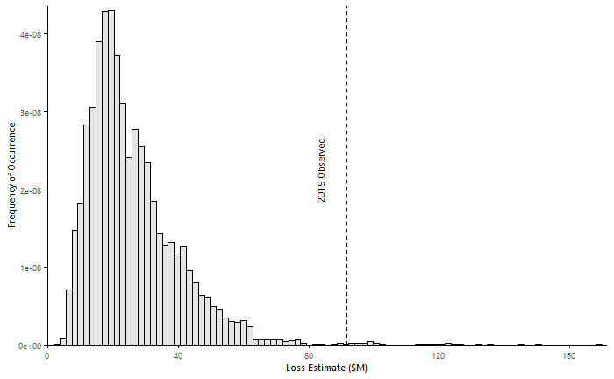
nsi1.edited
AAL = $107.6M (99.6th p.)

Slide 6
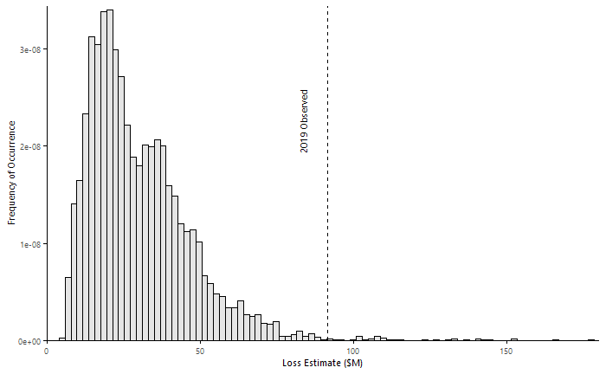
interpolated beta dist, nsi1.edited
AAL = $119.2M (99.5th p.)

Slide 7
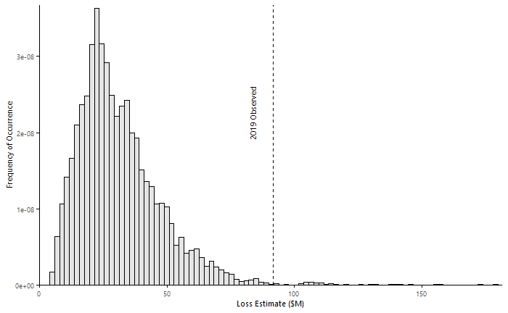
interpolated beta dist, nsi1.sample
AAL = $126.1M (99.5th p.)

Slide 8
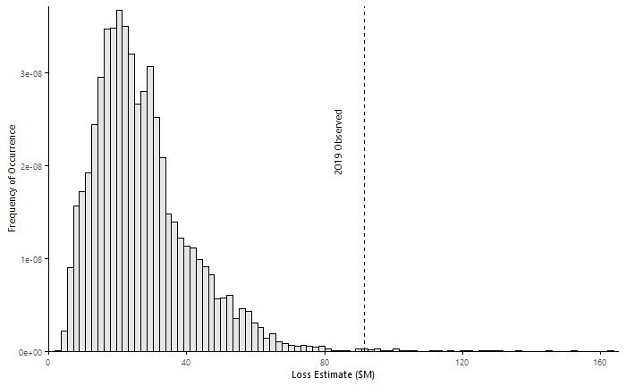
nsi1.sample
AAL = $108.7M (99.6th p.)

Slide 9
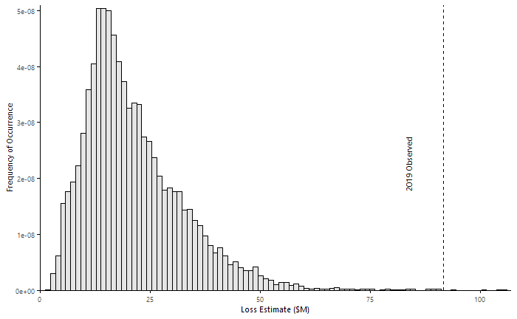
nsi1.sample, curve = sample(hazus, beta)
AAL = $84.6M (100.0th p.)

Slide 10
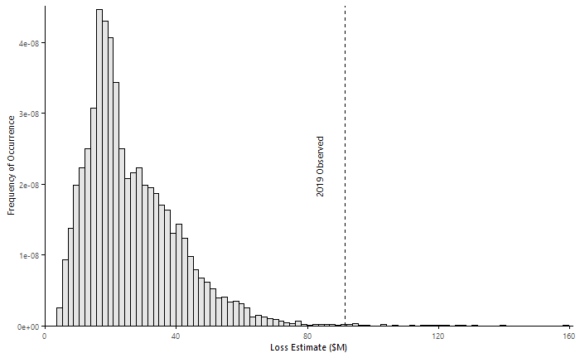
nsi1.base, interpolated beta dist, curve = sample(hazus, beta)
AAL = $105.7M (99.7th p.)

Slide 11
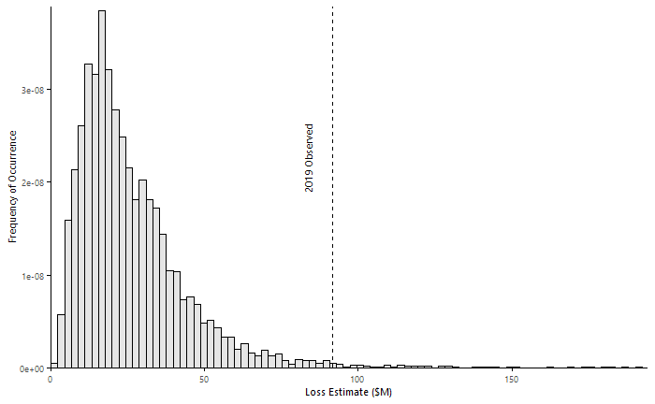
se.predict*3, curve = sample(hazus, beta)
AAL = $92.9M (99.2nd p.)

Slide 12
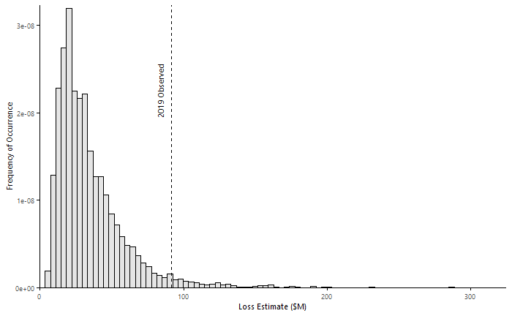
se.predict*3
AAL = $124.5M (97.2nd p.)

Slide 13
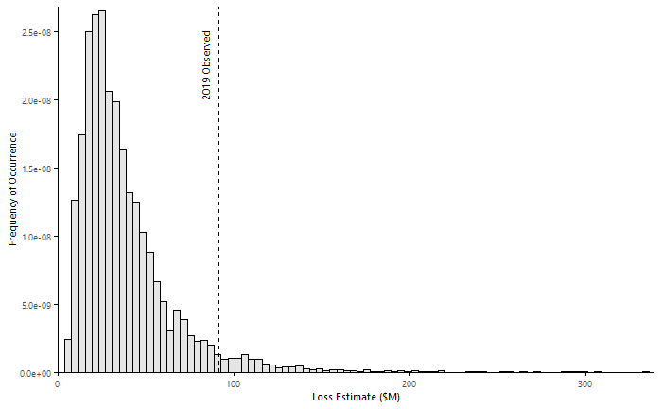
se.predict*3, interpolated beta dist
AAL = $148.7M (96.2nd p.)

Slide 14
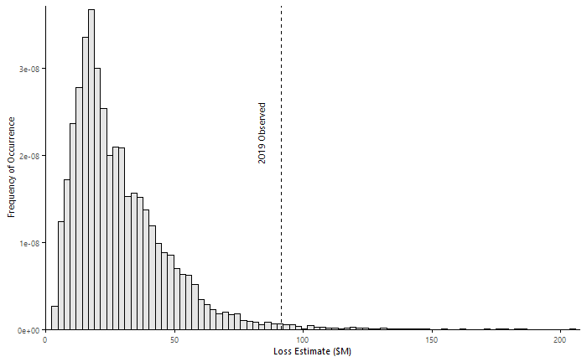
se.predict*3, interpolated beta dist, curve = sample(hazus, beta)
AAL = $103.6M (99.0th p.)

Slide 15
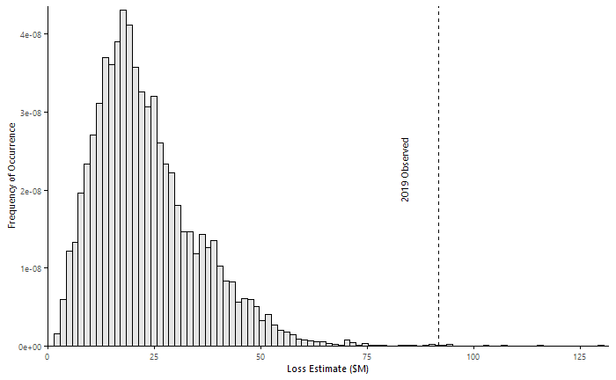
interpolated beta dist, curve = sample(hazus, beta)
AAL = $93.5M (99.9^{h} p.)

Slide 16
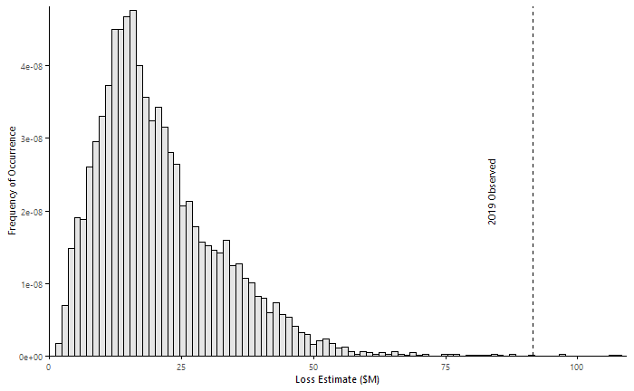
curve = sample(hazus, beta)
AAL = $83.8M (100.0th p.)

Slide 17
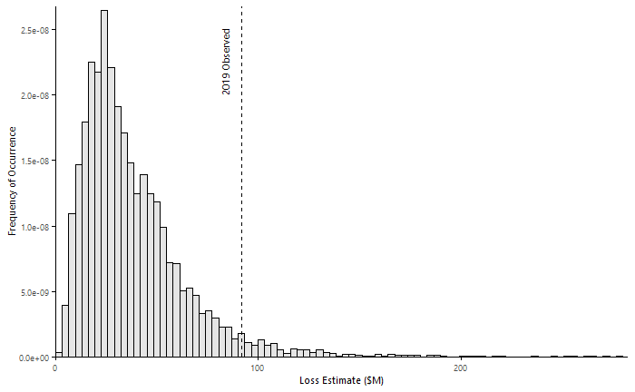
slide11 * 1.45
AAL = $135.0M (96.8th p.)

Slide 19
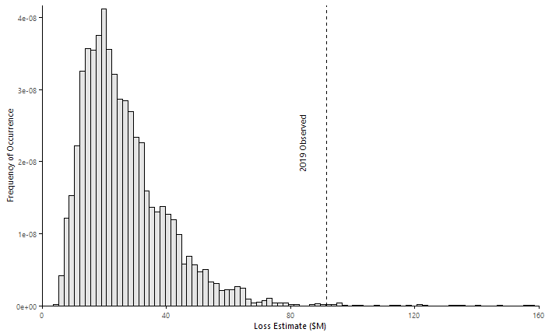
nsi.found/mft
AAL = $108.30M

Slide 20
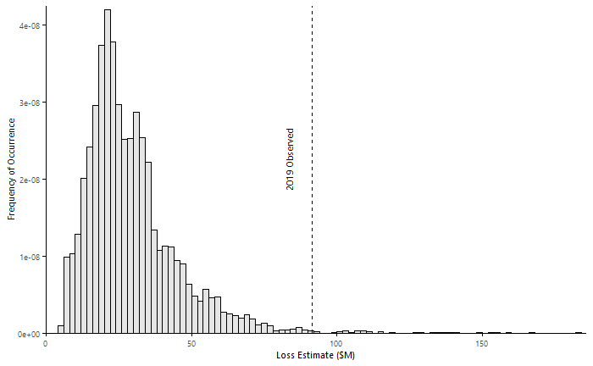
nsi.found/mft, interpolated beta dist
AAL = $126.86M

Slide 21
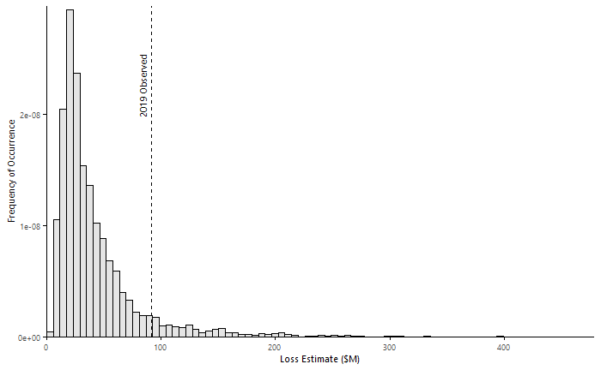
se.predict*4, nsi.found/mft
AAL = $146.35M

Slide 22
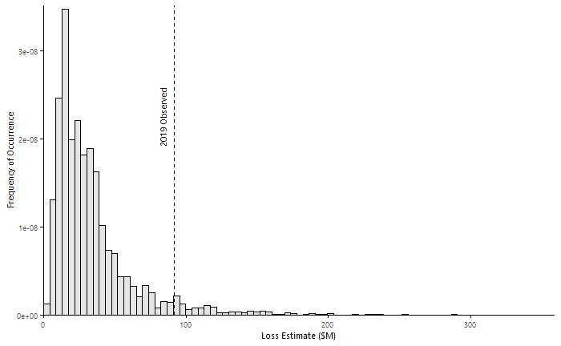
se.predict*4, nsi.found/mft, curve = mean(hazus, beta)
AAL = $114.40M

Slide 23
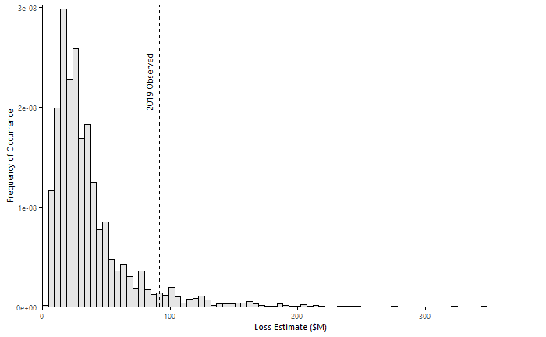
se.predict*4, nsi.found/mft, interpolated beta dist, curve = mean(hazus, beta)
AAL = $124.35M

Slide 24
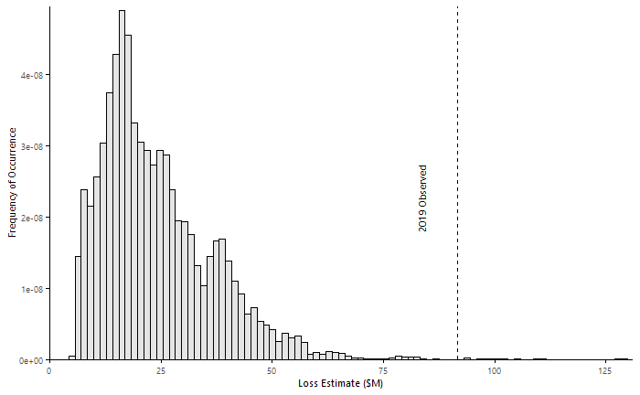
nsi.found/mft, interpolated beta dist, curve = mean(hazus, beta)
AAL = $93.54M

