Slide 1
Wildlife population & Harvest data
Dsc 530 Data exploration and analysis
Corinne Medeiros
11.16.2019

Slide 2
statistical questions / hypothesis
Data Source:
Wildlife population and harvest data for Forest Service 2010 RPA Assessment https://doi.org/10.2737/RDS-2014-0009
From this data source, I’m exploring which species have experienced the most dramatic population increases or decreases over time. I’m also looking to see if any of the species’ trends correlate with another species’ trends. For example, does an increase in one animal’s population relate to an increase or decline for another animal?

Slide 3

variables
Date - Date (dd-Mon-yy, where dd=day, Mon=month, and yy=year)
All species - Number of all species listed as threatened or endangered
All mammals - Number of mammals listed as threatened or endangered
All birds - Number of birds listed as threatened or endangered
All reptiles - Number of reptiles listed as threatened or endangered
All amphibians - Number of amphibians listed as threatened or endangered

Slide 4
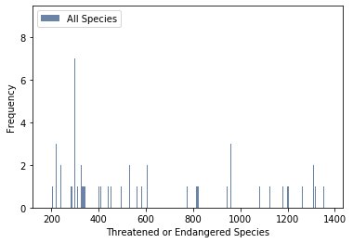

Histograms of variables
Mean: 592
Mode: 284
Variance: 151,995
Standard Deviation: 389
Tails extend to the right
All Species
(all_all)

Slide 5
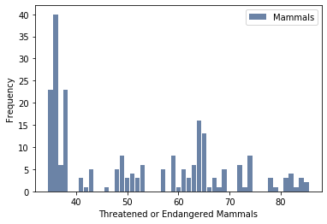

Histograms of variables
Mean: 52
Mode: 36
Variance: 239
Standard Deviation: 15
Tails extend to the right
All Mammals
(all_m)

Slide 6
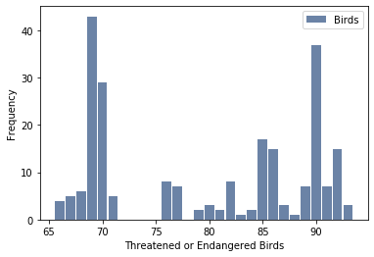

Histograms of variables
Mean: 80
Mode: 69
Variance: 88
Standard Deviation: 9
Tails extend to the left
All Birds
(all_b)

Slide 7
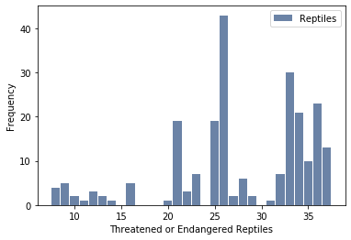

Histograms of variables
Mean: 28
Mode: 26
Variance: 56
Standard Deviation: 8
Tails extend to the left
All Reptiles
(all_r)

Slide 8
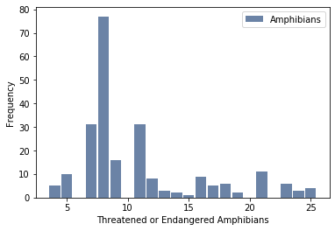
Histograms of variables
Mean: 11
Mode: 8
Variance: 26
Standard Deviation: 5
Tails extend to the right
All Amphibians
(all_am)

Slide 9

outliers
In this dataset, the highest and lowest values appear legitimate based on the source of the data. There doesn’t appear to be anything out of the ordinary that could throw off the analysis.

Slide 10
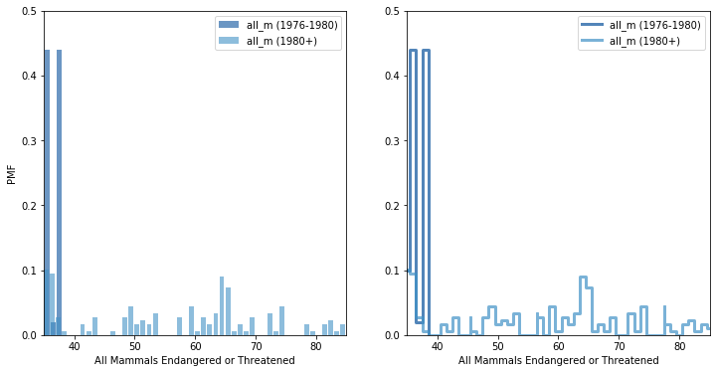
Probability mass function (PMF)
This PMF compares all mammals threatened or endangered during the early years (1976 – 1980) to other years as both a bar graph and a step function.
There is a much higher probability of seeing values below 40 during the early years (1976 - 1980) versus all other years.

Slide 11
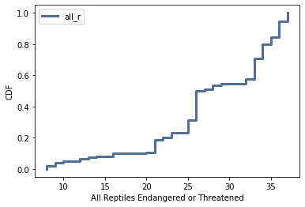
Cumulative distribution function (CDF)
Over the years, less than 10% of the assessments were below 10 reptiles endangered or threatened, the most common number was 26, and the highest values, in the mid 30s, are higher than or equal to about 80% of the assessments.
This graph can tell us how a specific reading for reptiles falls within the range of readings for all reptiles.

Slide 12
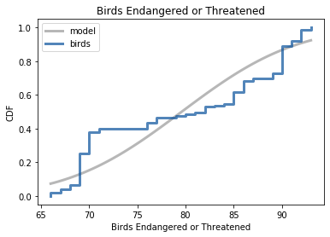
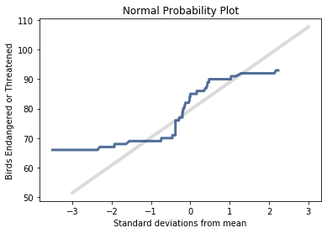
Analytical Distribution
Normal Distribution
The curves in the all birds data deviate from the normal curve of the expected model.
The majority of the lower numbers are between the 10th and 30th percentile rank while the most common higher value of 90 is in the 70th and 90th percentile rank.
The Normal Probability Plot confirms a lack of normality, with the tails deviating substantially from the model, and overall not a very straight line.

Slide 13
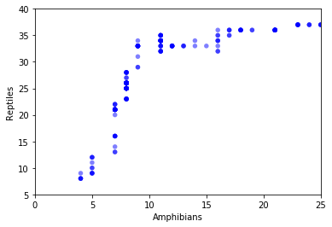
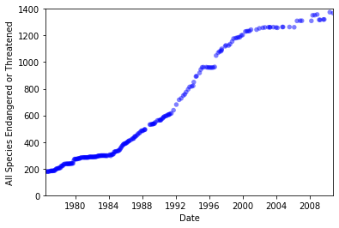

scatter plots
The scatter plots suggest strong positive correlation between the status of amphibians and reptiles, and also between dates and all species.
Covariance results are positive, and Pearson’s Correlation, Spearman’s Correlation, and correlation after variable conversion all result in strong positive correlations in both cases.
While these variables are strongly correlated, we can’t say that any one of them causes the other to increase. That would require additional experiments. Additionally, correlation is hard to measure when the variables like amphibians and reptiles come from different distributions.

Slide 14
Hypothesis testing
Null hypothesis:
There is no correlation between the endangered or threatened status of birds and mammals.
Using correlation as a hypothesis test, after 1000 iterations, the p-value is 0, which tells us that there wasn't a correlation more significant than the null hypothesis. The p-value proves that there is very little probability that we'd find a strong correlation within any given sample, so we can only conclude that the correlation between the endangered status of birds and mammals is probably not 0.
Correlation (actual): ~ 0.95
Correlation (highest value from simulations): ~ 0.25

Slide 15
Regression analysis
Formula: All Mammals ~ All Species
Results:
R^2: ~ 0.9
Intercept: ~ 29.65
Slope: ~ 0.04
p-value of slope estimate: 7.849550924033314e-117
With high R^2 values, the simple regression results support strong correlation and predictive power, with the status of all species significantly accounting for variation in the status of all mammals. However, there is the problem of multicollinearity, because these variables are highly correlated, which takes away from the statistical significance of the all species variable.

