Slide 1
Matplotlib

Slide 2
Introduction
Matplotlib is a low level graph plotting library in python that serves as a visualization utility.
Line, Scatter,Bar, Histogram, Pie Chart
Installation
pip install matplotlib
Import
import matplotlib
Use Cases: Creating charts, plots, and graphs for data visualization.
Primary Component: pyPlot for plotting graphs

Slide 3
Pyplot
Most of the Matplotlib utilities lies under the pyplot submodule, and are usually imported under the plt alias:
import matplotlib.pyplot as plt

Slide 4
Plot
The plot() function is used to draw points (markers) in a diagram.
By default, the plot() function draws a line from point to point.
The function takes parameters for specifying points in the diagram.
Parameter 1 is an array containing the points on the x-axis.
Parameter 2 is an array containing the points on the y-axis.

Slide 5
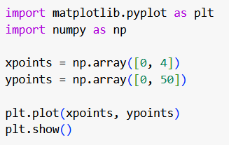
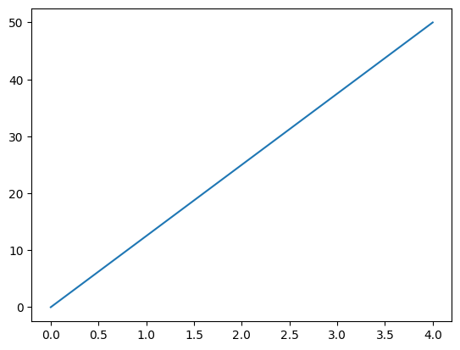
Example - Plotting x and y points - Line
Draw a line in a diagram from position (0,0) to position (4,50):

Slide 6
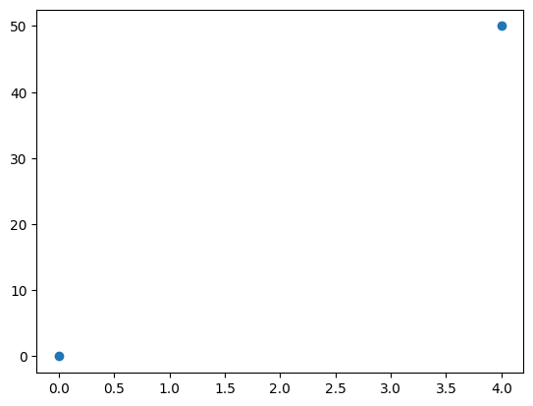
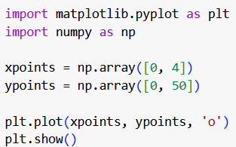
Example - Plotting x and y points - Without Line

Slide 7
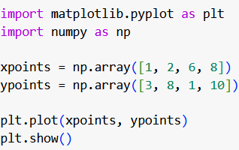
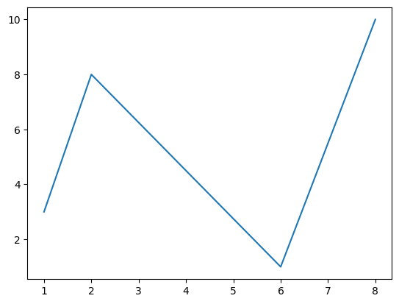
Example - Plotting Multiple Points

Slide 8
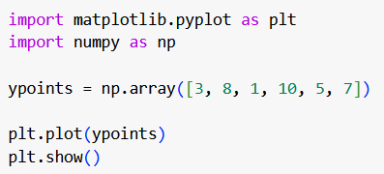
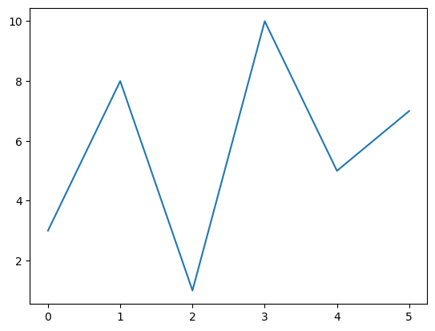
Example - Plotting with Default X-Points
If we do not specify the points on the x-axis, they will get the default values 0, 1, 2, 3 etc., depending on the length of the y-points.

Slide 9
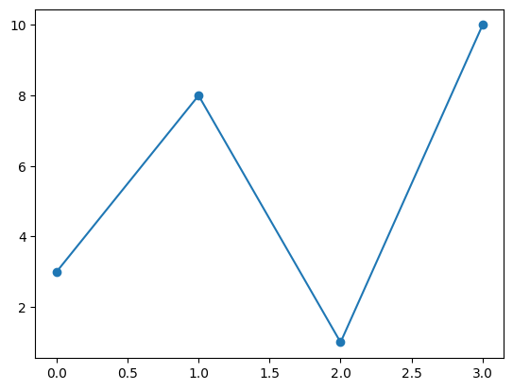
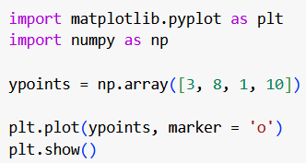
Example - Markers

Slide 10
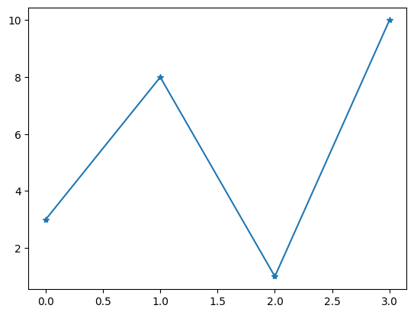
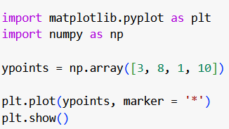
Example - Markers - Star

Slide 11
Marker | Description
'o' | Circle
'*' | Star
'.' | Point
',' | Pixel
'x' | X
'X' | X(filled)
'+' | Plus
'P' | Plus (filled)
's' | Square
'D' | Diamond
'd' | Diamond (thin)
'p' | Pentagon
Marker | Description
'H' | Hexagon
'h' | Hexagon
'v' | Triangle Down
'^' | Triangle Up
'<' | Triangle Left
'>' | Triangle Right
'1' | Tri Down
'2' | Tri Up
'3' | Tri Left
'4' | Tri Right
'I' | Vline
'_' | Hline

Slide 12
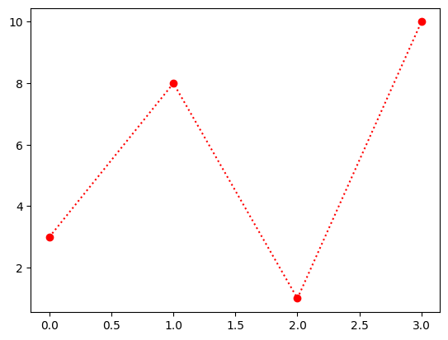
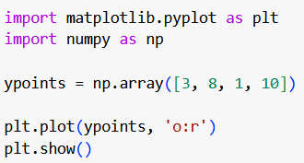
Example - Markers - Format Strings fmt
You can also use the shortcut string notation parameter to specify the marker.
This parameter is also called fmt, and is written with this syntax:
marker|line|color

Slide 13
Line Reference
Line Syntax | Description
'-' | Solid line
':' | Dotted line
'--' | Dashed line
'-.' | Dashed / dotted line

Slide 14
Color Reference
Color Syntax | Description
' r ' | Red
' g ' | Green
' b ' | Blue
' c ' | Cyan
' m ' | Magenta
' y ' | Yellow
' k ' | Black
' W ' | White

Slide 15
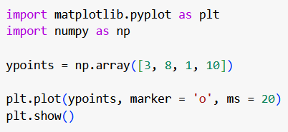
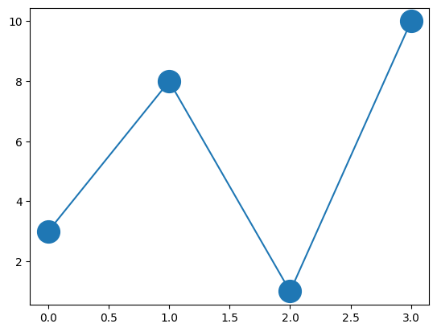
Example - Markers Size
Use the keyword argument markersize or the shorter version, ms to set the size of the markers

Slide 16
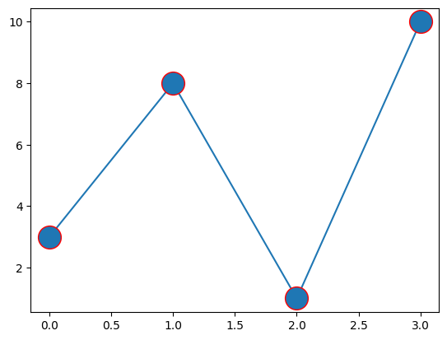
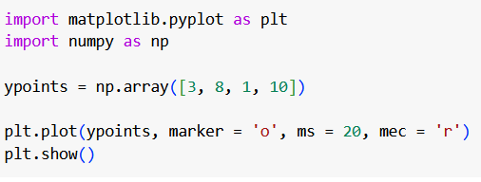
Example - Markers Color
Use the keyword argument markeredgecolor or the shorter mec to set the color of the edge of the markers

Slide 17
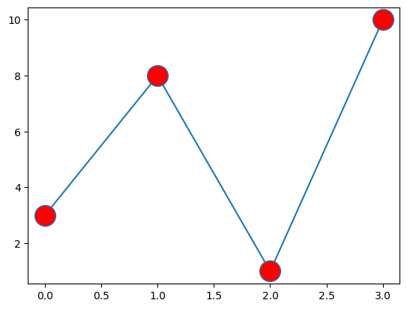
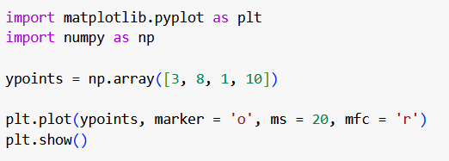
Example - Markers face Color
Use the keyword argument markerfacecolor or the shorter mfc to set the color inside the edge of the markers:

Slide 18
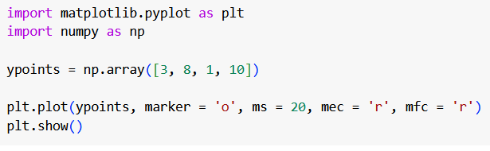

Example - Markers edge and face Color

Slide 19
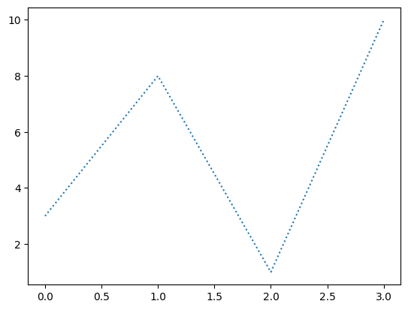
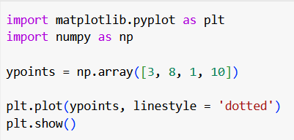
Example - Linestyle
Use the keyword argument linestyle, or shorter ls, to change the style of the plotted line

Slide 20
Linestyle
Style | Or
'solid' (default) | '-'
'dotted' | ':'
'dashed' | '--'
'dashdot' | '-.'
'None' | '' or ' '

Slide 21
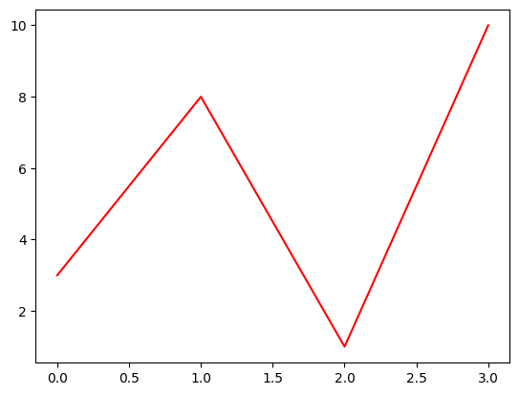
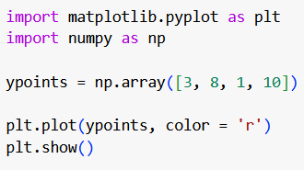
Example - Line Color

Slide 22
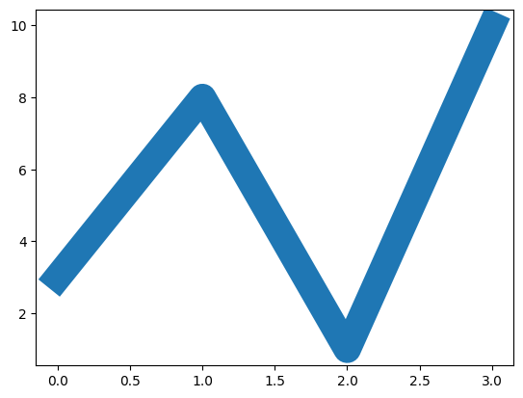
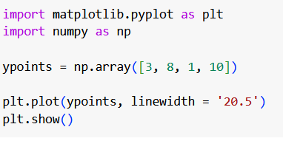
Example - Line Width

Slide 23
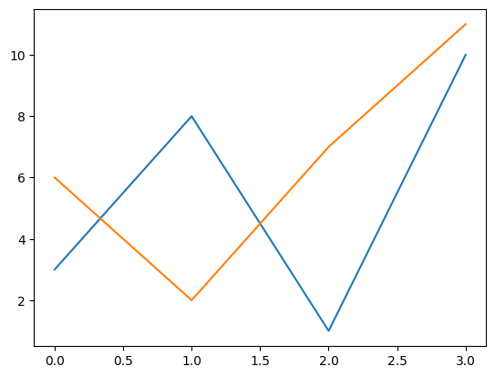
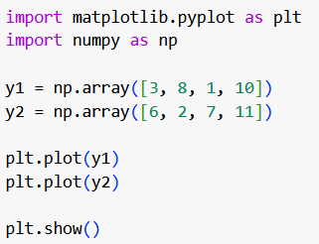
Example - Multiple Plots

Slide 24
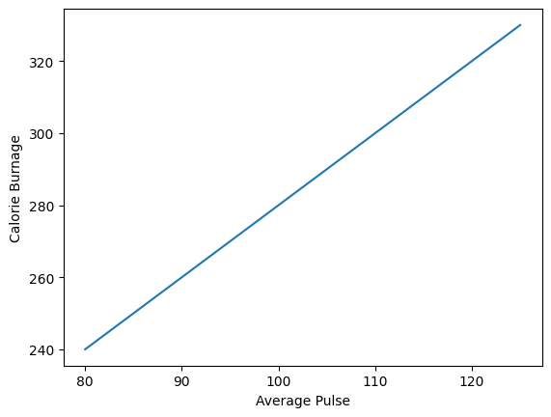
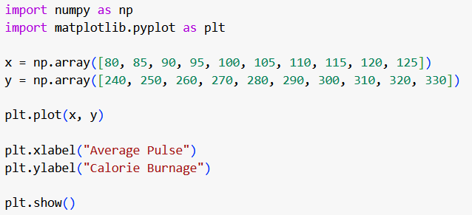
Example - Label
Use the xlabel() and ylabel() functions to set a label for the x- and y-axis

Slide 25
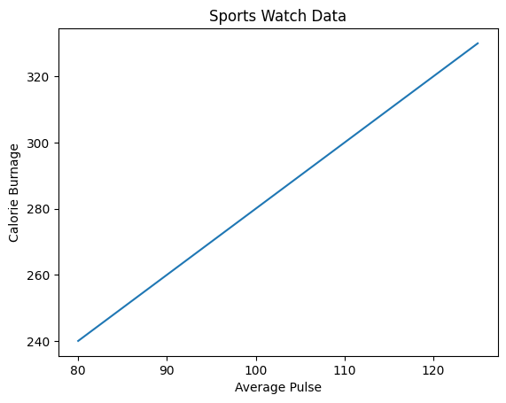
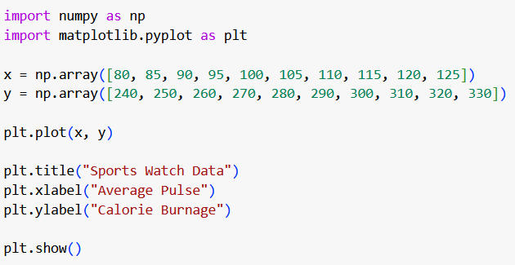
Example - Title
Use the title() function to set a title for the plot

Slide 26
Advanced visualization
Interactive plots using ion()
Animation using funcAnimation()

Slide 27
Matplotlib backend
A backend is the part of Matplotlib that manages how figures are displayed and how user interactions (like clicking or keyboard input) are handled.
Common backends:
Qt5Agg: Uses the Qt5 framework for rendering. Good for interactive applications.
TkAgg: Utilizes the Tkinter framework, which is built into Python and often used for simple GUI applications.
Usage:
Before importing pyplot, call matplotlib.use()
matplotlib.use(‘Qt5Agg’)

Slide 28
Animation
In Matplotlib, animation can be thought of in 2 different ways:
FuncAnimation: Generate data for first frame and then modify this data for each frame to create an animated plot.
ArtistAnimation: Generate a list (iterable) of artists that will draw in each frame in the animation.
FuncAnimation is more efficient in terms of speed and memory as it draws an artist once and then modifies it. On the other hand ArtistAnimation is flexible as it allows any iterable of artists to be animated in a sequence.

Slide 29
Basic Steps to Create an Animation
Import necessary libraries (matplotlib, numpy).
Create a figure and axes.
Define initial data for the plot.
Write an update function for animation.
Use FuncAnimation to generate the animation.

Slide 30
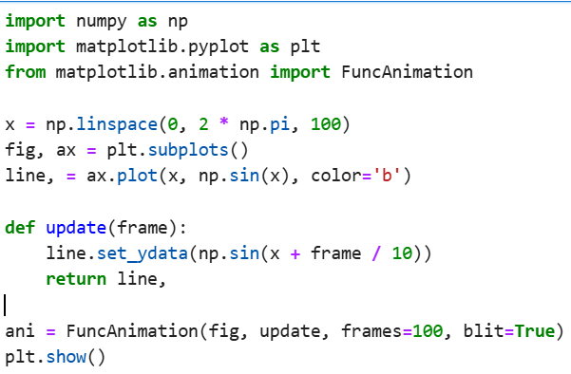
Animation

Slide 31
Pointers for more on visualization
Seaborn
Plotly
ipywidgets

