Slide 1
Object Oriented Programming in Python

Slide 2
Introduction
Definition: Object-Oriented Programming is a programming paradigm that uses "objects" to represent data and methods.
Key Principles:
Encapsulation,
Inheritance,
Polymorphism,

Slide 3
Classes and objects
Class: A blueprint for creating objects (e.g., class Vehicle:).
Object: An instance of a class (e.g., myCar= Vehicle()).

Slide 4
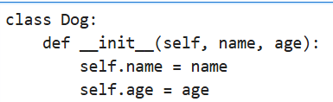
Defining a class
__init__(): It initializes instance attributes when an object is created
Self: refers to the instance calling the method

Slide 5
Creating an object
Object: An instance of a class (e.g.,
my_dog = Dog(‘Willy’, 5)

Slide 6
Dunder methods (double underscore methods)
method names (or attribute names) that start and end with two underscores
__init__: constructor method, called when creating a new instance of a class.
__str__: Defines how an object is represented as a string (when you use print()).

Slide 7
Types of attributes
Instance attributes:
Attributes that belong to a specific instance of a class.Creation.
Typically defined within the __init__ method.
Class attributes
Attributes that belong to the class itself, shared across all instances.
Defined directly within the class body.

Slide 8
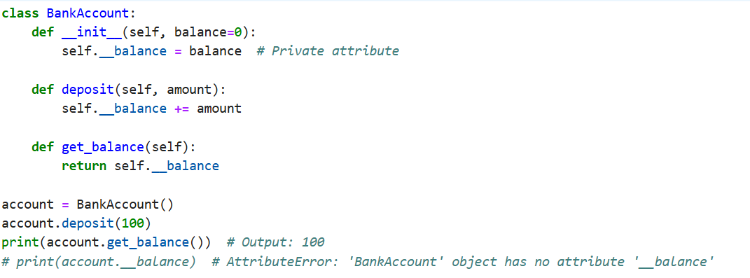
Encapsulation
Encapsulation limits direct access to some components of an object

Slide 9
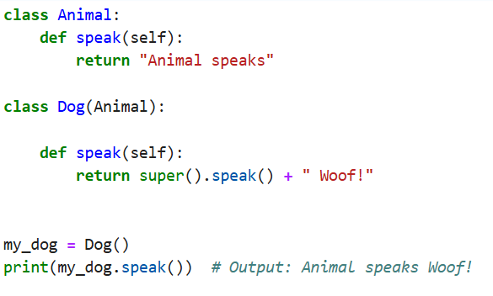
Inheritance
A way to form new classes using classes that have already been defined.
Code reusability and establishing a relationship between classes.

Slide 10
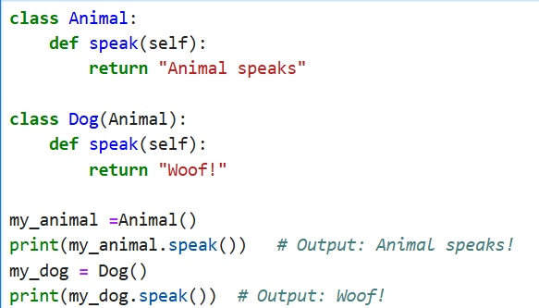
Polymorphism
Different classes implementing the same method.

