Slide 1
Scikit-learn in Python

Slide 2
Scikit-learn
Definition: Scikit-learn is a third party machine learning module for Python.
It features various classification, regression, and clustering algorithms.
Key Features: Simple and efficient tools for data analysis.
Built on NumPy, SciPy, and Matplotlib.

Slide 3
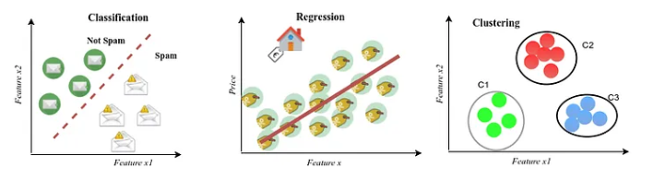
ML Problems formulated as:
ML problems broadly classified into:
Classification
Regression
Clustering

Slide 4
Classification
A supervised learning technique used to categorize data into predefined classes.
Examples:
Email spam detection
Image recognition
Algorithms: Decision Trees, Logistic Regression, Random Forests, SVM, Neural Networks.

Slide 5
Regression
A supervised learning technique used to predict a continuous output
A statistical method to model the relationship between a dependent variable and one or more independent variables.
Examples:
House price prediction
Sales forecasting
Algorithms: Linear Regression, Polynomial Regression, Lasso, Ridge.

Slide 6
Linear Regression with sklearn
Import LinearRegression
Fit method: trains the model on the provided data (training data)
Pedict() generates predictions on the trained model for unseen data (test data)
Coefficients: model parameters model.coef_ and model.intercept_

Slide 7
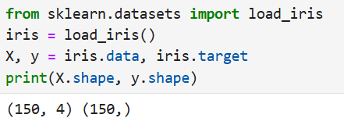
Loading data using sklearn.datasets
Provides functions to load datasets.
Examples: Built-in datasets (e.g., Iris, Boston Housing).

Slide 8
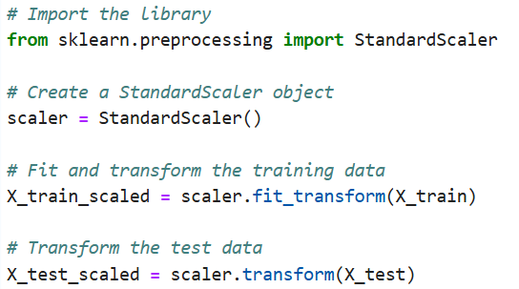
Data preprocessing
Preprocessing is essential to prepare data for machine learning models, ensuring they perform effectively.
Standardization (0 mean and unit variance)
Normalization default range [0-1]
Fit_transform(): Computes the mean and standard deviation for scaling.
transform(): Applies the scaling to the data.

Slide 9
Train/Test split
Parameters:
X: Features (input variables)
y: Target variable (output)
test_size: Proportion of the dataset to include in the test split (e.g., 0.2 for 20%)
train_size: Proportion of the dataset to include in the train split (optional)
random_state: Seed for random number generator (ensures reproducibility)
shuffle: Whether to shuffle the data before splitting (default is True).

Slide 10
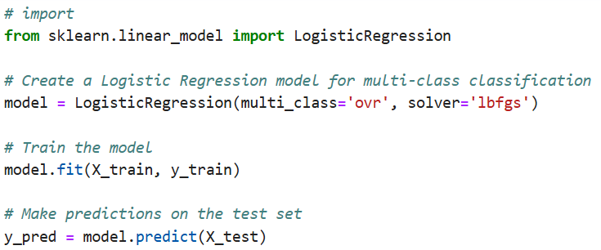
Sklearn.linear_model
A module in Scikit-learn for linear models that can perform regression and classification tasks.

Slide 11
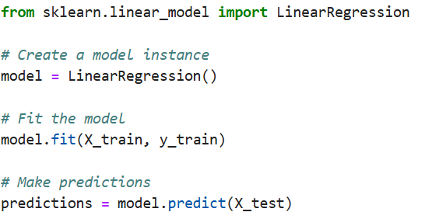
Sklearn.linear_model
Linear model for regression

Slide 12
Sklearn.metrics
Provides functions to evaluate the model performance
Key metrics:
Classification: accuracy, precision, recall, F1score
Regression: Mean absolute error, mean squared error

Slide 13
Evaluation metrics
To quantitatively assess model performance and make informed improvements.
Common Metrics:
Classification: Accuracy, Precision, Recall, F1 Score, Confusion Matrix
Regression: Mean Squared Error (MSE), Mean Absolute Error (MAE)

Slide 14

Accuracy
The ratio of correctly predicted data samples to the total samples.
Accuracy = $\frac{TP+TN}{TP+TN+FP+FN}$

Slide 15
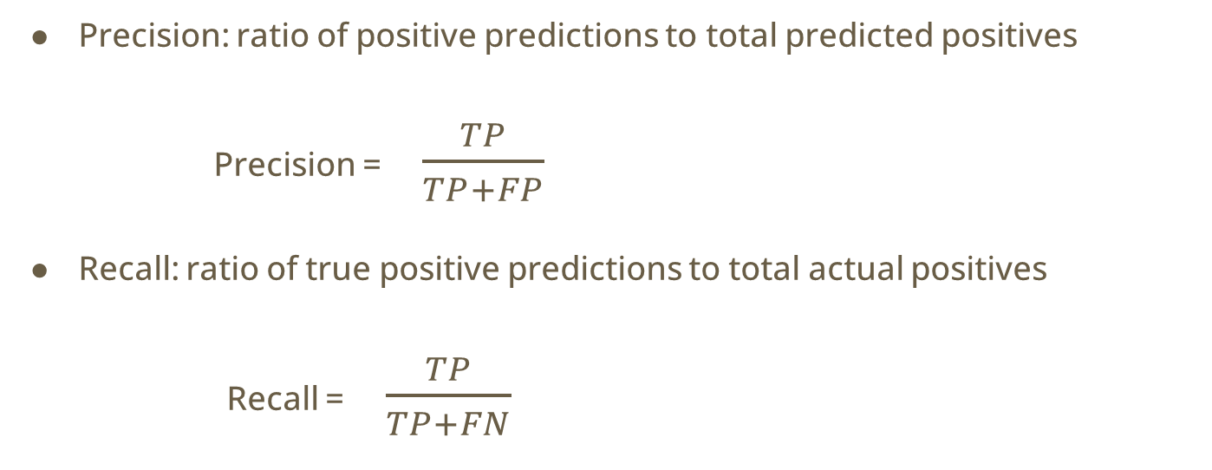
Precision and Recall
Precision: ratio of positive predictions to total predicted positives
Precision = $\frac{TP}{TP+FP}$
Recall: ratio of true positive predictions to total actual positives
Recall = $\frac{TP}{TP+FN}$

Slide 16

F1 score
The harmonic mean of precision and recall, balancing both the metrics
F1 Score= $2×\frac{Precision×Recall}{Precision+Recall}$
​

Slide 17

Regression Evaluation metrics
Mean squared error
MSE = $\frac{1}{n}\sum_{i=1}^{n}{{(y_{i} −{y′}_{i})}^{2}}$
MAE = $\frac{1}{n}\sum_{i=1}^{n}{{|\left(y_{i} −{y^{′}}_{i}\right)|}^{}}$

Slide 18
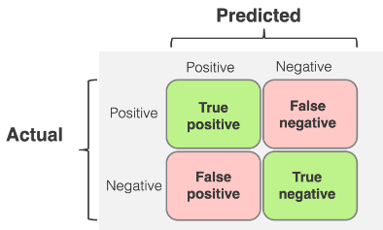
Confusion matrix
A table used to evaluate the performance of a classification model
Comonents: TP, TN, FP, FN

Slide 19
Using scikit learn: overview
Model
Input
Label
Model selection
Import model
Training the model: fit(X_train, y_train)
Prediction using the model: predict(X_test)
Performance evaluation
Visualization

Slide 20
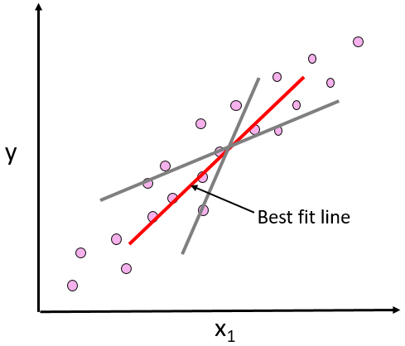
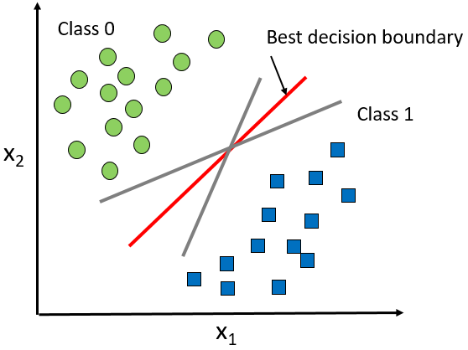
Regression and classification

Slide 21
Sklearn.linear_model
A module in Scikit-learn for linear models that can perform regression and classification tasks.

Slide 22
Sklearn.linear_model
A module in Scikit-learn for linear models that can perform regression and classification tasks.

Slide 23
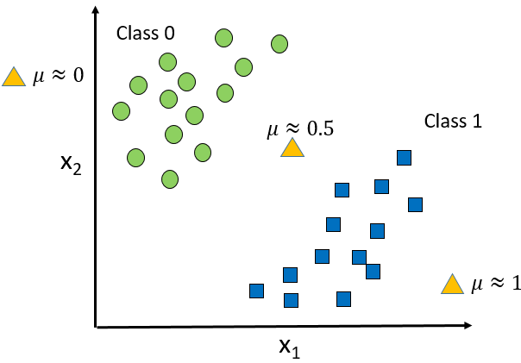
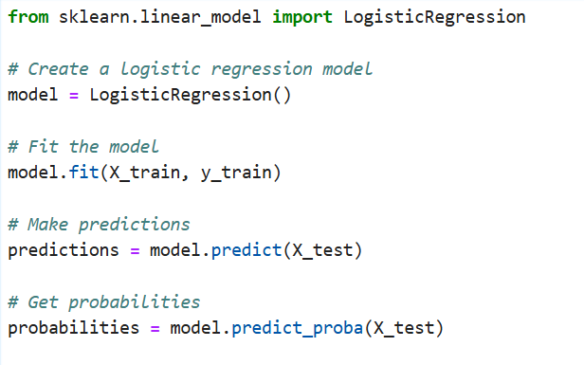
Logistic Regression

Slide 24
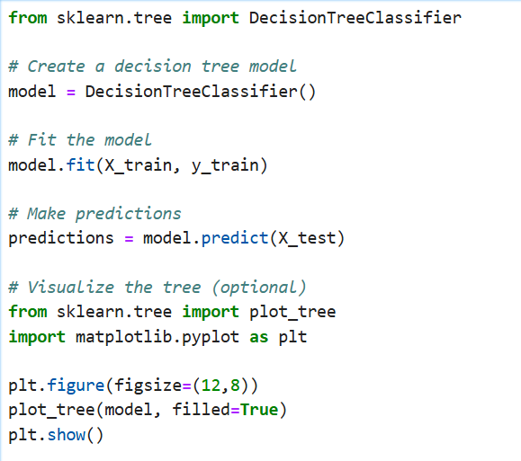
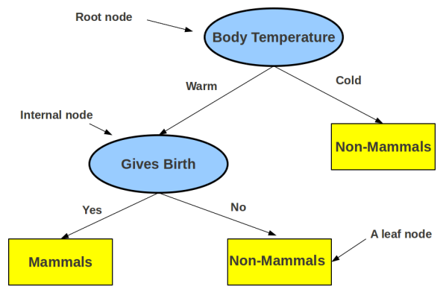
Decision Tree

Slide 25
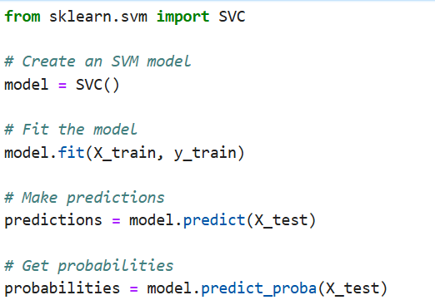
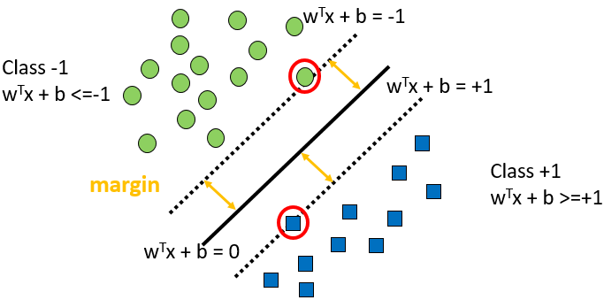
Support vector machine

