Slide 1

void setup()
{
}
void loop()
{
}

Slide 2
float getTemperature()
{
float value = …;
return value;
}

Slide 3
Serial.begin(115200);
Serial.print(“Hola Mundo”);
Serial.println(“Hola Mundo”);

Slide 4
void loop()
{
delay(500);
}

Slide 5
int pin = 0;
int value;
value = analogRead(pin);

Slide 6
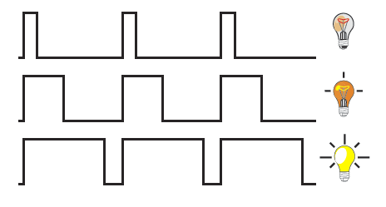
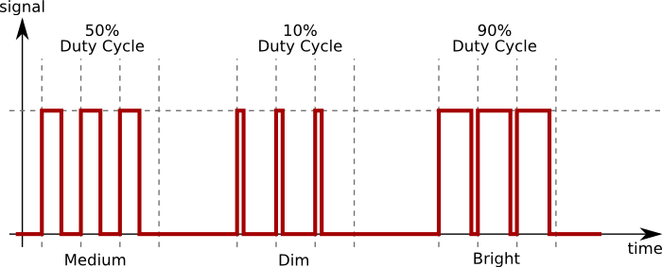

Slide 7

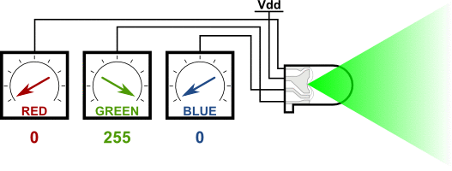

Slide 8
int pin = 0;
pinMode(pin, OUTPUT);
digitalWrite(pin, HIGH);
digitalWrite(pin, 255);

