Slide 1


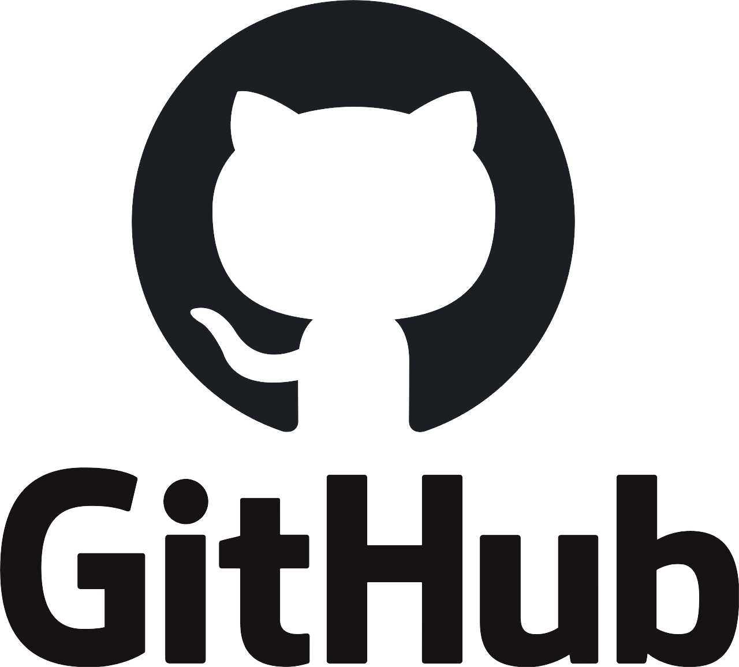
Frontend for backend developers

Slide 2
Table of contents
Start using JavaScript ‘correctly’
Installing Encore & Yarn
Adding scripts & links – the new way
Installing & using external libraries
Code splitting: free, smart optimization
Async code
Production build & Advantages
Q & A

Slide 3
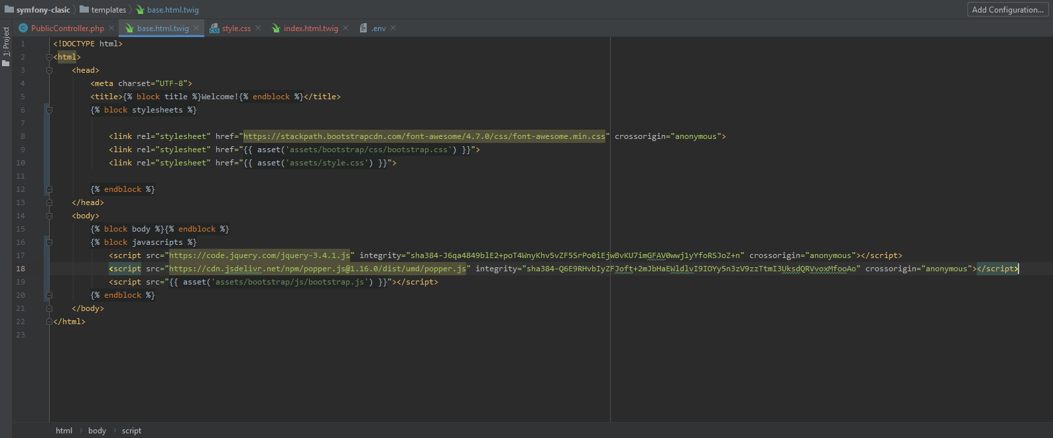
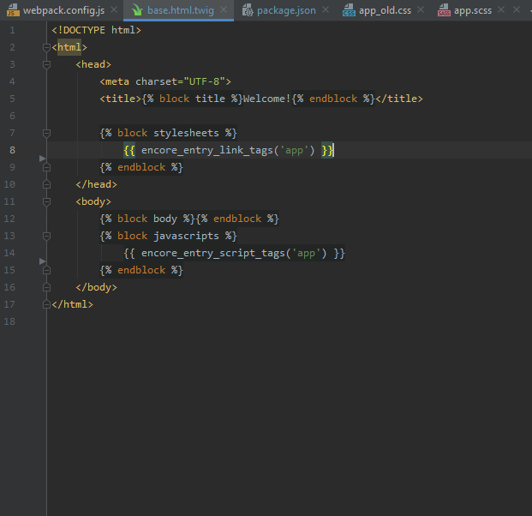
Start using JavaScript ‘correctly’
From this
To this

Slide 4
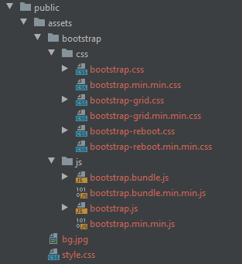
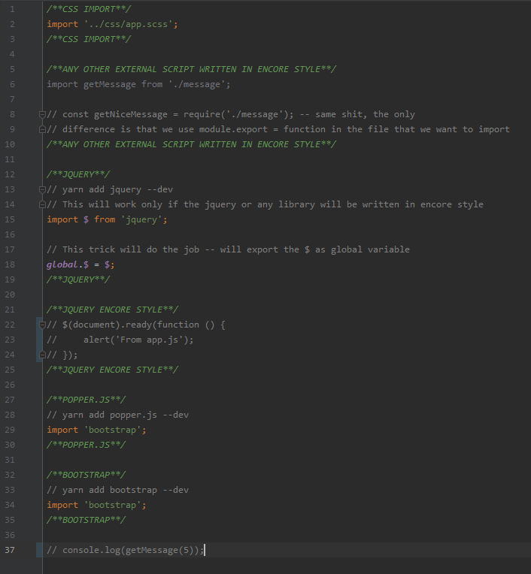
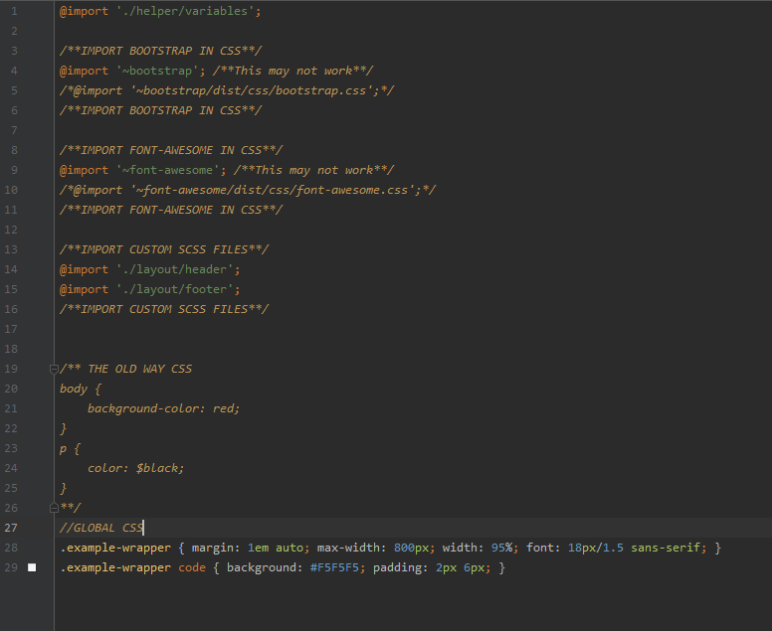
Start using JavaScript ‘correctly’
From this
(10 files)
To this
(2 files)

Slide 5
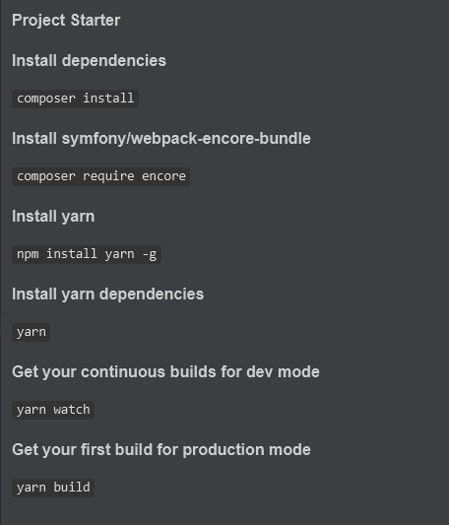
Encore & Yarn
- A complete guide of installing Syfmony along Encore & Yarn will be found in GitHub repository on the first page
- The power of webpack.config.js

Slide 6
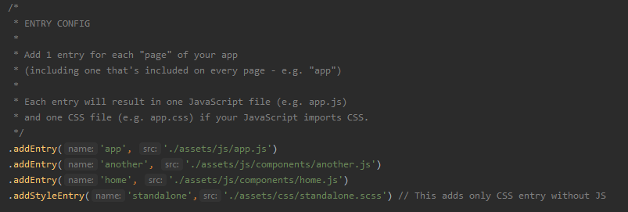
Adding scripts & links – the new way
Encore is smart enough to store a mapping between names of all external libraries and scripts that are included in the app entry-point.

Slide 7
Installing & using external libraries
/**JQUERY**/ // yarn add jquery --dev // This will work only if the jquery or any library will be written in encore style import $ from 'jquery'; // This trick will do the job -- will export the $ as global variable global.$ = $; /**JQUERY**/ /**POPPER.JS**/ // yarn add popper.js --dev import 'bootstrap'; /**POPPER.JS**/ /**BOOTSTRAP**/ // yarn add bootstrap --dev import 'bootstrap'; /**BOOTSTRAP**/
import $ from 'jquery'; /**CSS IMPORT**/ import '../../css/components/home.scss'; /**CSS IMPORT**/ $(document).ready(function () { alert('This alert comes from home.js'); });

Slide 8
Code splitting: free, smart optimization
All of this craziness happens without us even knowing or caring. This feature comes from a part of Webpack called the SplitChunksPlugin. On top, it explains the logic it uses to split. But you can configure all of this.
Free code optimization
Free versioning
Free minify & uglify
// When enabled, Webpack "splits" your files into smaller pieces for greater optimization. .splitEntryChunks()
// will require an extra script tag for runtime.js // but, you probably want this, unless you're building a single-page app // Modules are shared across application // .enableSingleRuntimeChunk() .disableSingleRuntimeChunk()

Slide 9
Async code
import $ from 'jquery'; import Dropzone from 'dropzone'; import 'dropzone/dist/dropzone.css' Dropzone.autoDiscover = false; $(document).ready(function() { const $autoComplete = $('.js-user-autocomplete'); if (!$autoComplete.is(':disabled')) { import('./components/algolia-autocomplete').then((autocomplete) => { autocomplete($autoComplete, 'users', 'email'); }); } });

Slide 10
Production build & Advantages
Now that we have these, optimized, versioned files, how can we deploy them up to production?
Run git pull on production and then clear the Symfony cache, you're probably going to need to install node on your production server, run yarn install, and then run yarn build up on production, each time you deploy. That's not ideal, but if you have a simple deployment system, that keeps it simple.

Slide 11
But …
The key thing to understand is that, once you've run yarn build, the only thing that needs to go to production is the public/build directory. So you could literally run yarn build on a different server - or even locally - and then just make sure that this build/ directory gets copied to production.

Slide 12
FOLLOW UP
Actually, there are more features inside Encore - many more, like enabling TypeScript, React or Vue support. But getting those all going should be easy for you now. Go try them team.

Slide 13
Advantages
Clean and optimized code
Each page has one entry script tag and one entry style tag
You get automatically file versioning
You get automatically old browsers support
You get automatically browser cache
And last but not least you learn something new

Slide 14
Q & a
Thank you for your attention

