Slide 1

WholeExpStructure (30 mins)
Press “→” to continue
Welcome
RDM instruction
RDM training & task
Schedule Matching
DM instruction
DM training & task
→
→
→
(2 min)
(1+2 mins)
(0.5 mins)
(4 mins)
(2+18 mins)
→
RDM: Random dot motion task;
DM: decision making task
16th March 2022

Slide 2
Welcome to the group competition game
This game is about working together with another person in a team. Your team is playing against another team of two people. To identify you, please enter your own initials (two letters) here via your keyboard: ________.
The game will take about 30 minutes and has two parts:
Part 1: Individual performance assessment (~5 min)
Part 2: The group competition task (~25 min)
(Press right arrow button to continue)

Slide 3
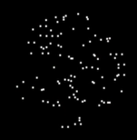
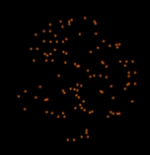
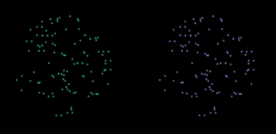
First of all, this is how we will display the two teams on screen:
??
Opponent1
(O1)
Partner (Pa)
Opponent2
(O2)
(Note: the abbreviations will be shown on this task)

Slide 4
Part1 – Individual performance assessment: Random dot motion task
We ask you to perform a “random dot motion” task, in which you will see dot motion clouds moving to the left or to the right at your position where your initials are.
Please press the “left” or “right” arrow button to indicate the correct direction.
Note that you will have to respond very quickly after the dots have appeared, otherwise you will see a “Miss” on the screen and the performance will be counted as incorrect.
We will collect your performance information when you do so.
Try it now! Press right arrow button to start.
Correct performance will be displayed as “ ”;
Incorrect performance will be displayed as “×”;

Slide 5
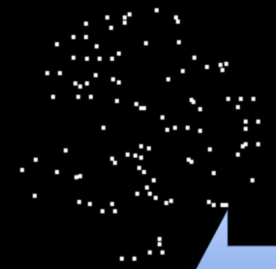
RDM training (@ Cormac)
×
(4 trials)
O1
press
Fb
??
O1
Pa
O2
O1
Pa
O2
Pa
O2
No press
O1
4 sec
Miss
1 sec or until press left/right arrow
Pa
O2
Show Feedback (fb, 0.5 sec)
4 trials in total
coherences [0.512, 0.032] (take coherence value, put a minus randomly in 50% of cases, indicating moving either leftwards or rightwards) .
dot coherences should be presented in the order from easy to difficult: [0.512, 0.512, 0.032, 0.032].
Participants need to see how to do it correctly during RDM training
- at least one yellow coin outcome, at least one red X outcome;
After 4 trials: Extra trials might be needed according to their performance
if correct trials == 0, then show another two easy trials with coherence = 0.512
if incorrect trials == 0, then show another two tough trials with coherence = 0.032
otherwise: stop == next screen
- Screen position/spacing details:
- default colors: [127 201 127 ; 190 174 212; 253 192 134; 255 255 153];
% the colors assigned should be counterbalanced across individuals
- position of agent: [-1/3 2/3; -1/3 4/3; 1/3 2/3; 1/3 4/3];
% relative to center
- performance feedback: always in the middle

Slide 6
Part 1 – Individual performance assessment: Random dot motion task
Well done! We ask you to do this task for approximately 2 minutes now. Try to pay your full attention and be as quick and accurate as possible.
Note that you won’t see performance feedback anymore. But we will still record your performance.
The better your performance, the better your starting conditions for part 2, the group competition task, so it is important for you to perform well.
All four players (your team and the other team) will do the performance assessment before part 2. You will see the performance of each of the players including your own performance in part 2.
Please try as hard as you can to get as many correct performances as possible! Press right arrow key to start when you are ready.

Slide 7
Formal RDM task (@ Cormac)
press
??
O1
O1
Pa
O2
Pa
O2
no press
O1
Miss
4 sec
1 sec or until press left/right arrow
Pa
O2
Show feedback (0.5 sec)
100 trials in total
coherences value
- 0.032 for 80 trials;
- 0.512 for 20 trials;
take coherence value, put a minus randomly in 50% of cases, indicating moving either leftwards or rightwards
it is important that the order of the trials and the sign of the coherences are fully randomised.
After 100 trials:
If %miss trials > 20%, then add 5 more trials (repeat this rule if % miss still>20%)
[during this process, please take same coherences as above]
Logfiles:
coherence (including sign -/+);
Performance: correct =1; incorrect=-1; miss =0;

