Slide 1
Houdini:
An Annotation Assistant for ESC/Java
Cormac Flanagan and K. Rustan M. Leino
Compaq Systems Research Center

Slide 2
Software QA via Testing
Useful (the dominant methodology), but ..
Costly
  half of development cost is testing
  finds errors late in development cycle
Incomplete
  often fails to ensure needed reliability
  hard to test all configurations

Slide 3
Software QA via Static Checking
Statically verify many correctness properties
Type systems catch many errors
  e.g. “Cannot multiply a number and a string”
Would like to catch additional errors
  e.g. “Array index out of bounds at line 10”
And verify other correctness properties
  assertions
  object invariants
  lightweight method specifications

Slide 4
Extended Static Checker Architecture
Java method + annotations
Translator
Verification conditions
Automatic theorem prover
Counterexamples
Post-processor
Warning messages
ESC/Java
The translator “understands” the semantics of Java.
A verification condition is a logical formula that, ideally, is valid if and only if the program is free of the kinds of error under consideration.
The automatic theorem prover is invisible to users.
Counterexamples are turned into precise warning messages.
Index out of bounds on line 218
Method does not preserve object invariant on line 223

Slide 5

ESC/Java Example
class Rational {
int num, denom;
Rational(int n, int d) {
num = n;
denom = d;
}
double getDouble() {
return ((double)num)/denom;
}
public static void main(String[] a) {
int n = readInt(), d = readInt();
if( d == 0 ) return;
Rational r = new Rational(d,n);
print( r.getDouble() );
}
...
}
//@ invariant denom != 0;
//@ requires d != 0;
Warning: invariant possibly not established
Warning: possible division by zero
Warning: precondition
possibly not established

Slide 6
ESC/Java Experience
Tested on 40 KLOC, caught a variety of defects
Ready for educational/research use? Yes!
  http://research.compaq.com/SRC/esc/
Ready for software engineering use? Not really.
  annotation overhead significant
  annotations increase program size by 10%
  requires 1 programmer-hour to annotate 300 lines of code
Need annotation inference for ESC/Java!

Slide 7
Houdini Architecture
Generate set
of candidate
annotations
Class A {
String s;
…
}
Class A {
String s;
//@ … …
…
}
Annotation
Refutation
Loop

Slide 8
Generating Candidate Annotations
Invariants generated heuristically from program text
  For fields int i,j guess
    //@ invariant i cmp j;
    //@ invariant i cmp 0;
    where cmp ∈ { <, <=, =, !=, >, >= }
  For field Object[] a guess
    //@ invariant a != null;
    //@ invariant a.length cmp i;
    //@ invariant (forall int k; 0 <= k &&
    k < a.length ==> a[k] != null);
Similar heuristics for preconditions and postconditions

Slide 9
Removing Invalid Annotations
Initial states
G
Refute some
annotations
Candidate set
...
Fixpoint
State Space
∅
Reachable states
Powerset Lattice

Slide 10
Houdini Architecture
Generate set
of candidate
annotations
Class A {
String s;
…
}
Class A {
String s;
//@ … …
…
}
ESC/Java
Annotation
Refutation
Loop
Warning:
Invariant not
established
Warning:
...
Annotation
remover

Slide 11
Houdini Example
No warnings refuting annotations
  Remaining annotations are valid
  Houdini algorithm terminates
class Rational {
int num, denom;
Rational(int n, int d) {
num = n;
denom = d;
}
double getDouble() {
return ((double)num)/denom;
}
public static void main(String[] a) {
int n = readInt(), d = readInt();
if( d == 0 ) return;
Rational r = new Rational(d,n);
print( r.getDouble() );
}
...
}
//@ invariant num != 0;
//@ invariant denom != 0;
//@ requires n != 0;
//@ requires d != 0;
Warning: invariant possibly not established
Warning: possible division by zero
Warning: precondition
possibly not established

Slide 12

Houdini Architecture
Generate set
of candidate
annotations
Class A {
String s;
…
}
Class A {
String s;
//@ … …
…
}
ESC/Java
NETSCAPE
Warning:
Invariant not
established
Warning:
...
/#* */
Class A
...
}
web page
generator
Annotation
remover

Slide 13
Finding the cause of a warning
class Rational {
int num, denom;
Rational(int n, int d) {
num = n;
denom = d;
}
double getDouble() {
return ((double)num)/denom;
}
public static void main(String[] a) {
int n = readInt(), d = readInt();
if( d == 0 ) return;
Rational r = new Rational(d,n);
print( r.getDouble() );
}
...
}
//@ invariant num != 0;
Hyperlink
//@ invariant denom != 0;
//@ requires n != 0;
//@ requires d != 0;
Warning: possible division by zero

Slide 14
Houdini Example (corrected)
No warnings refuting annotations
  Remaining annotations are valid
  Houdini algorithm terminates
No warnings about primitive operations
  Division by zero error is impossible
class Rational {
int num, denom;
Rational(int n, int d) {
num = n;
denom = d;
}
double getDouble() {
return ((double)num)/denom;
}
public static void main(String[] a) {
int n = readInt(), d = readInt();
if( d == 0 ) return;
Rational r = new Rational(n,d);
print( r.getDouble() );
}
...
}
//@ invariant num != 0;
//@ invariant denom != 0;
//@ requires n != 0;
//@ requires d != 0;
Warning: invariant possibly not established
Warning: precondition
possibly not established

Slide 15
Houdini Architecture
Library Spec
Class L {
//@ … …
…
}
Generate set
of candidate
annotations
Class A {
String s;
…
}
Class A {
String s;
//@ … …
…
}
ESC/Java
NETSCAPE
Warning:
Invariant not
established
Warning:
...
/#* */
Class A
...
}
web page
generator
Annotation
remover

Slide 16
Houdini is a Two-Level Analysis
Interprocedural analysis
  Uses ESC/Java (weakest preconditions, theorem proving)
  Precise, not scalable
Intraprocedural analysis
  Abstract interpretation based on powerset lattice
  Less precise, but more scalable
  Can add annotations manually
  Houdini’s heuristics are extensible
    Eg. to reason about whether int[][] a is rectangular, guess
    (forall int i,j; 0 <= i && i < a.length
    && 0 <= j && j < a.length
    ==> a[i].length == a[j].length);

Slide 17
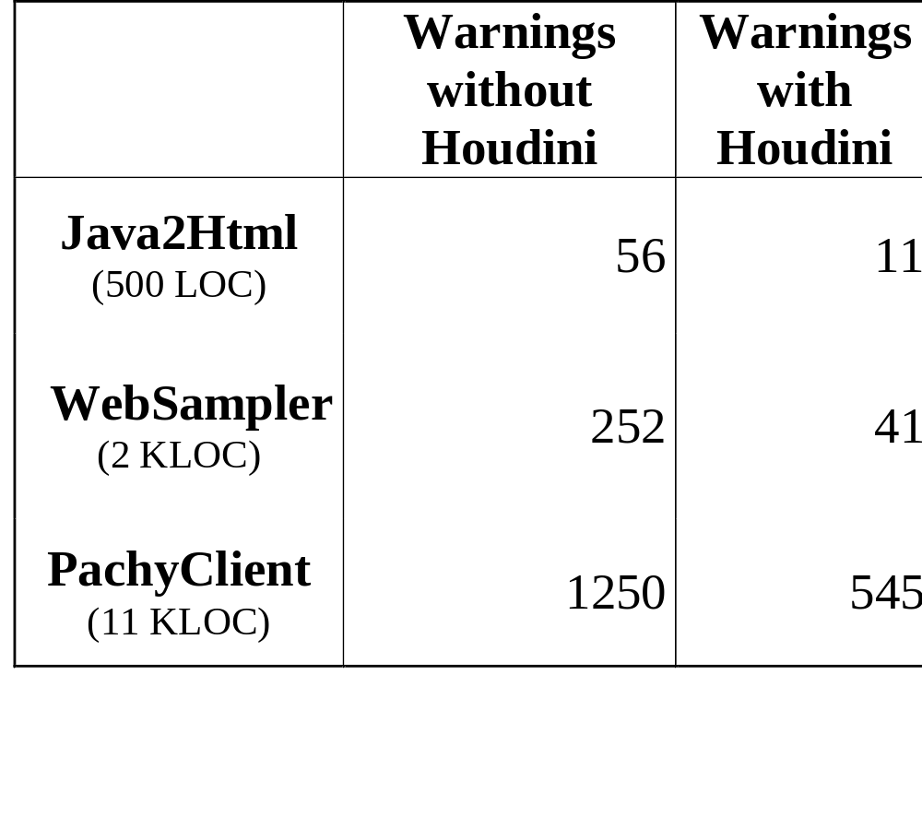
Evaluation

Slide 18
Houdini for Other Modular Checkers
Houdini originally designed for ESC/Java
But could be ported to other modular checkers
  Ported to rccjava (Race Condition Checker for Java)
    Requires new heuristics for guessing annotations
    Straightforward port
    Infers useful locking annotations
Houdini for your favorite modular checker?

Slide 19
Conclusions
Houdini is an effective annotation assistant
  Infers many useful annotations
  Significantly reduces number of ESC/Java warnings
Future work
  Refine guessing heuristics
    Guess fewer “useless” annotations
    Guess additional properties (aliasing, container classes)
  Refine user interface
  Check 500,000 LOC

