Slide 1
Analysis of Concurrent Software
Types for Race Freedom
Cormac Flanagan
UC Santa Cruz
Stephen N. Freund
Williams College
Shaz Qadeer
Microsoft Research

Slide 2
Moore’s Law
Transistors per chip doubles every 18 months
Single-threaded performance doubles every 2 years
  faster clocks, deep pipelines, multiple issue
  wonderful!

Slide 3
Moore’s Law is Over
Sure, we can pack more transistors ...
  ... but can’t use them effectively to make single-threaded programs faster
Multi-core is the future of hardware
Multi-threading is the future of software

Slide 4
Programming With Threads
Decompose program into parallel threads
Advantages
  exploit multiple cores/processors
  some threads progress, even if others block
Increasingly common (Java, C#, GUIs, servers)
Web Server
Thread 1
database
network
Thread 2

Slide 5
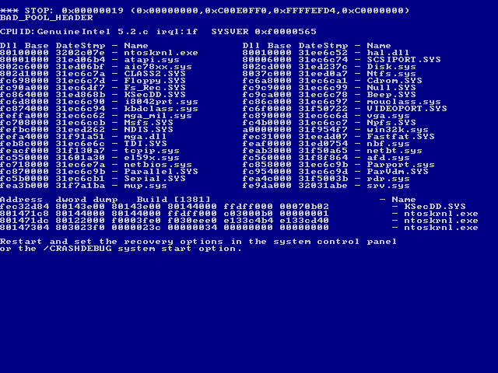

Slide 6

More BSOD Embarrassments

Slide 7


French Guyana, June 4, 1996
$800 million software failure

Slide 8

Economic Impact
NIST study
  On CNN.com - April 27, 2003
http://www.nist.gov/director/prog-ofc/report02-3.pdf
Notes:
Economic impact of bad quality software

Slide 9
Non-Determinism, Heisenbugs
Multithreaded programs are non-deterministic
  behavior depends on interleaving of threads
Extremely difficult to test
  exponentially many interleavings
  during testing, many interleavings behave correctly
  post-deployment, other interleavings fail
Complicates code reviews, static analysis, ...

Slide 10

Mars, July 4, 1997
Lost contact due to real-time priority inversion bug

Slide 11

400 horses
100 microprocessors

Slide 12
Bank Account Implementation
class Account {
private int bal = 0;
public void deposit(int n) {
int j = bal;
bal = j + n;
}
}

Slide 13
Bank Account Implementation
class Account {
private int bal = 0;
public void deposit(int n) {
int j = bal;
bal = j + n;
}
}
bal =
j1 + 10
bal =
j2 + 10
j1 = bal
j2 = bal
bal = 0
bal = 20
bal =
j1 + 10
bal =
j2 + 10
j1 = bal
j2 = bal
bal = 0
bal = 10

Slide 14
Bank Account Implementation
A race condition occurs if two threads access a shared variable at the same time, and at least one of the accesses is a write
bal =
j1 + 10
bal =
j2 + 10
j1 = bal
j2 = bal
bal = 0
bal = 20
bal =
j1 + 10
bal =
j2 + 10
j1 = bal
j2 = bal
bal = 0
bal = 10

Slide 15
Race Conditions
class Ref {
int i;
void add(Ref r) {
i = i
+ r.i;
}
}

Slide 16
Race Conditions
class Ref {
int i;
void add(Ref r) {
i = i
+ r.i;
}
}
Ref x = new Ref(0);
Ref y = new Ref(3);
x.add(y);
x.add(y);
assert x.i == 6;

Slide 17
Race Conditions
class Ref {
int i;
void add(Ref r) {
i = i
+ r.i;
}
}
Ref x = new Ref(0);
Ref y = new Ref(3);
parallel {
x.add(y); // two calls happen
x.add(y); // in parallel
}
assert x.i == 6;
Race condition on x.i
Assertion may fail

Slide 18
Lock-Based Synchronization
class Ref {
int i; // guarded by this
void add(Ref r) {
i = i
+ r.i;
}
}
Ref x = new Ref(0);
Ref y = new Ref(3);
parallel {
synchronized (x,y) { x.add(y); }
synchronized (x,y) { x.add(y); }
}
assert x.i == 6;
Every shared memory location protected by a lock
Lock must be held before any read or write of that memory location

Slide 19
When Locking Goes Bad ...
Hesienbugs (race conditions, etc) are common and problematic
  forget to acquire lock, acquire wrong lock, etc
  extremely hard to detect and isolate
Traditional type systems are great for catching certain errors
Type systems for multithreaded software
  detect race conditions, atomicity violations, ...

Slide 20
Verifying Race Freedom with Types
class Ref {
int i;
void add(Ref r) {
i = i
+ r.i;
}
}
Ref x = new Ref(0);
Ref y = new Ref(3);
parallel {
synchronized (x,y) { x.add(y); }
synchronized (x,y) { x.add(y); }
}
assert x.i == 6;

Slide 21
Verifying Race Freedom with Types
class Ref {
int i guarded_by this;
void add(Ref r) requires this, r {
i = i
+ r.i;
}
}
Ref x = new Ref(0);
Ref y = new Ref(3);
parallel {
synchronized (x,y) { x.add(y); }
synchronized (x,y) { x.add(y); }
}
assert x.i == 6;
check: this ∈ { this, r }
✓

Slide 22
Verifying Race Freedom with Types
class Ref {
int i guarded_by this;
void add(Ref r) requires this, r {
i = i
+ r.i;
}
}
Ref x = new Ref(0);
Ref y = new Ref(3);
parallel {
synchronized (x,y) { x.add(y); }
synchronized (x,y) { x.add(y); }
}
assert x.i == 6;
check: this ∈ { this, r }
✓
check: this[this:=r] = r ∈ { this, r }
✓
replace this by r

Slide 23
Verifying Race Freedom with Types
class Ref {
int i guarded_by this;
void add(Ref r) requires this, r {
i = i
+ r.i;
}
}
Ref x = new Ref(0);
Ref y = new Ref(3);
parallel {
synchronized (x,y) { x.add(y); }
synchronized (x,y) { x.add(y); }
}
assert x.i == 6;
check: this ∈ { this, r }
✓
check: this[this:=r] = r ∈ { this, r }
✓
replace formals this,r
by actuals x,y
check: {this,r}[this:=x,r:=y]  { x, y }
✓

Slide 24
Verifying Race Freedom with Types
class Ref {
int i guarded_by this;
void add(Ref r) requires this, r {
i = i
+ r.i;
}
}
Ref x = new Ref(0);
Ref y = new Ref(3);
parallel {
synchronized (x,y) { x.add(y); }
synchronized (x,y) { x.add(y); }
}
assert x.i == 6;
check: this ∈ { this, r }
✓
check: this[this:=r] = r ∈ { this, r }
✓
replace formals this,r
by actuals x,y
check: {this,r}[this:=x,r:=y]  { x, y }
✓
check: {this,r}[this:=x,r:=y]  { x, y }
✓
Soundness Theorem:
Well-typed programs are race-free

Slide 25
One Problem ...
  Object o;
  int x guarded_by o;
  fork { sync(o) { x++; } }
  fork { o = new Object();
  sync(o) { x++; }
  }
Lock expressions must be constant

Slide 26
Lock Equality
Type system checks if lock is in lock set
  r ∈ { this, r }
  same as r = this  r = r
Semantic equality
  e₁ = e₂ if e₁ and e₂ refer to same object
  need to test whether two program expressions evaluate to same value
  undecidable in general (Halting Problem)

Slide 27
Lock Equality
Approximate (undecidable) semantic equality by syntactic equality
  two locks exprs are considered equal only if syntactically identical
Conservative approximation
  class A {
  void f() requires this { ... }
  }
  A p = new A();
  q = p;
  synch(q) { p.f(); }
Not a major source of imprecision
this[this:=p] = p ∈ { q } X

Slide 28

RaceFreeJava
Concurrent extension of CLASSICJAVA
[Flatt-Krishnamurthi-Felleisen 99]
Judgement for typing expressions
Program Environment Lock set

Slide 29
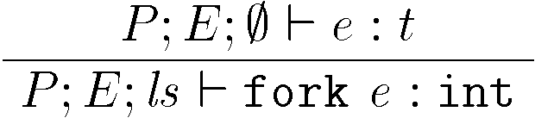
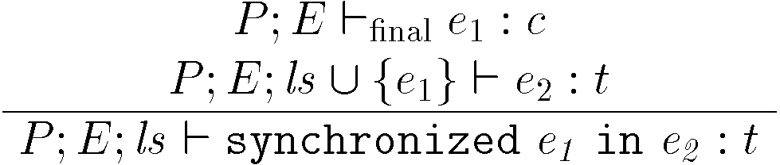
Typing Rules
Thread creation
Synchronization
lock is constant
add to lock set

Slide 30
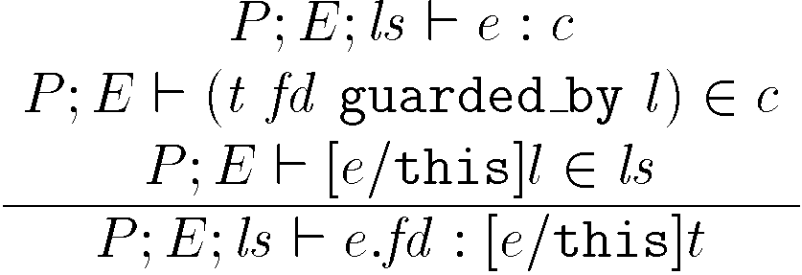
Field Access
e has class c
fd is declared in c
lock l is held

Slide 31
java.util.Vector
0 1 2
a
b
2
class Vector {
Object elementData[] /*# guarded_by this */;
int elementCount /*# guarded_by this */;
synchronized int lastIndexOf(Object elem, int n) {
for (int i = n ; i >= 0 ; i--)
if (elem.equals(elementData[i])) return i;
return -1;
}
int lastIndexOf(Object elem) {
return lastIndexOf(elem, elementCount - 1);
}
synchronized void trimToSize() { ... }
synchronized boolean remove(int index) { ... }
}

Slide 32
java.util.Vector
0
a
1
class Vector {
Object elementData[] /*# guarded_by this */;
int elementCount /*# guarded_by this */;
synchronized int lastIndexOf(Object elem, int n) {
for (int i = n ; i >= 0 ; i--)
if (elem.equals(elementData[i])) return i;
return -1;
}
int lastIndexOf(Object elem) {
return lastIndexOf(elem, elementCount - 1);
}
synchronized void trimToSize() { ... }
synchronized boolean remove(int index) { ... }
}

Slide 33
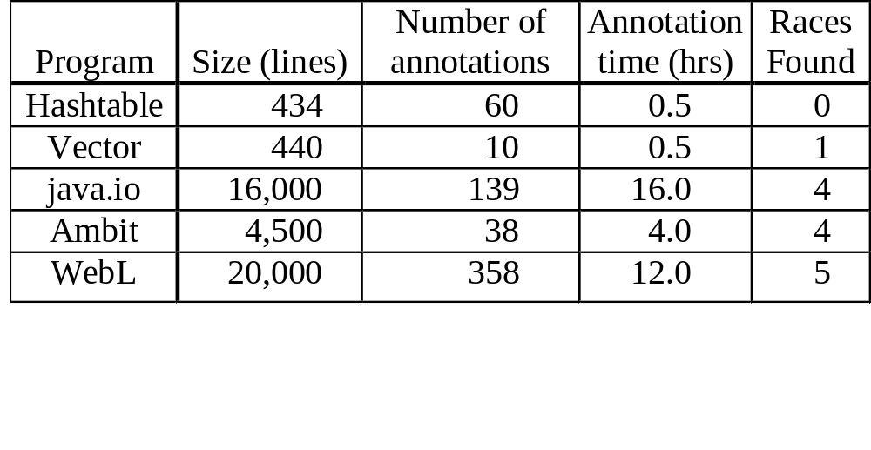
Validation of rccjava

Slide 34
Basic Type Inference
class Ref {
int i;
void add(Ref r) {
i = i + r.i;
}
}
Ref x = new Ref(0);
Ref y = new Ref(3);
parallel {
synchronized (x,y) { x.add(y); }
synchronized (x,y) { x.add(y); }
}
assert x.i == 6;

Slide 35
Basic Type Inference
static final Object m =new Object();
class Ref {
int i;
void add(Ref r) {
i = i + r.i;
}
}
Ref x = new Ref(0);
Ref y = new Ref(3);
parallel {
synchronized (x,y) { x.add(y); }
synchronized (x,y) { x.add(y); }
}
assert x.i == 6;
Iterative GFP algorithm:
[Flanagan-Freund, PASTE’01]
Start with maximum set of annotations

Slide 36
Basic Type Inference
static final Object m =new Object();
class Ref {
int i guarded_by this, m;
void add(Ref r) {
i = i + r.i;
}
}
Ref x = new Ref(0);
Ref y = new Ref(3);
parallel {
synchronized (x,y) { x.add(y); }
synchronized (x,y) { x.add(y); }
}
assert x.i == 6;
Iterative GFP algorithm:
[Flanagan-Freund, PASTE’01]
Start with maximum set of annotations

Slide 37
Basic Type Inference
static final Object m =new Object();
class Ref {
int i guarded_by this, m;
void add(Ref r) requires this, r, m {
i = i + r.i;
}
}
Ref x = new Ref(0);
Ref y = new Ref(3);
parallel {
synchronized (x,y) { x.add(y); }
synchronized (x,y) { x.add(y); }
}
assert x.i == 6;
Iterative GFP algorithm:
[Flanagan-Freund, PASTE’01]
Start with maximum set of annotations

Slide 38
Basic Type Inference
static final Object m =new Object();
class Ref {
int i guarded_by this, m;
void add(Ref r) requires this, r, m {
i = i + r.i;
}
}
Ref x = new Ref(0);
Ref y = new Ref(3);
parallel {
synchronized (x,y) { x.add(y); }
synchronized (x,y) { x.add(y); }
}
assert x.i == 6;
Iterative GFP algorithm:
[Flanagan-Freund, PASTE’01]
Start with maximum set of annotations
Iteratively remove all incorrect annotations
X
X

Slide 39
Basic Type Inference
static final Object m =new Object();
class Ref {
int i guarded_by this, m;
void add(Ref r) requires this, r, m {
i = i + r.i;
}
}
Ref x = new Ref(0);
Ref y = new Ref(3);
parallel {
synchronized (x,y) { x.add(y); }
synchronized (x,y) { x.add(y); }
}
assert x.i == 6;
Iterative GFP algorithm:
[Flanagan-Freund, PASTE’01]
Start with maximum set of annotations
Iteratively remove all incorrect annotations
Check each field still has a protecting lock
Sound, complete, fast
But type system too basic
X
X

Slide 40
Harder Example: External Locking
class Ref {
int i;
void add(Ref r) {
i = i + r.i;
}
}
Object m = new Object();
Ref x = new Ref(0);
Ref y = new Ref(3);
parallel {
synchronized (m) { x.add(y); }
synchronized (m) { x.add(y); }
}
assert x.i == 6;
Field i of x and y protected by external lock m
Not typable with basic type system
  m not in scope at i
Requires more expressive type system with ghost parameters

Slide 41
Ghost Parameters on Classes
class Ref {
int i;
void add(Ref r) {
i = i + r.i;
}
}
Object m = new Object();
Ref x = new Ref(0);
Ref y = new Ref(3);
parallel {
synchronized (m) { x.add(y); }
synchronized (m) { x.add(y); }
}
assert x.i == 6;

Slide 42
Ghost Parameters on Classes
class Ref<ghost g> {
int i;
void add(Ref r) {
i = i + r.i;
}
}
Object m = new Object();
Ref x = new Ref(0);
Ref y = new Ref(3);
parallel {
synchronized (m) { x.add(y); }
synchronized (m) { x.add(y); }
}
assert x.i == 6;
Ref parameterized by external ghost lock g

Slide 43
Ghost Parameters on Classes
class Ref<ghost g> {
int i guarded_by g;
void add(Ref r) {
i = i + r.i;
}
}
Object m = new Object();
Ref x = new Ref(0);
Ref y = new Ref(3);
parallel {
synchronized (m) { x.add(y); }
synchronized (m) { x.add(y); }
}
assert x.i == 6;
Ref parameterized by external ghost lock g
Field i guarded by g

Slide 44
Ghost Parameters on Classes
class Ref<ghost g> {
int i guarded_by g;
void add(Ref r) requires g {
i = i + r.i;
}
}
Object m = new Object();
Ref x = new Ref(0);
Ref y = new Ref(3);
parallel {
synchronized (m) { x.add(y); }
synchronized (m) { x.add(y); }
}
assert x.i == 6;
Ref parameterized by external ghost lock g
Field i guarded by g
g held when add called

Slide 45
Ghost Parameters on Classes
class Ref<ghost g> {
int i guarded_by g;
void add(Ref<g> r) requires g {
i = i + r.i;
}
}
Object m = new Object();
Ref x = new Ref(0);
Ref y = new Ref(3);
parallel {
synchronized (m) { x.add(y); }
synchronized (m) { x.add(y); }
}
assert x.i == 6;
Ref parameterized by external ghost lock g
Field i guarded by g
g held when add called
Argument r also parameterized by g

Slide 46
Ghost Parameters on Classes
class Ref<ghost g> {
int i guarded_by g;
void add(Ref<g> r) requires g {
i = i + r.i;
}
}
Object m = new Object();
Ref<m> x = new Ref<m>(0);
Ref<m> y = new Ref<m>(3);
parallel {
synchronized (m) { x.add(y); }
synchronized (m) { x.add(y); }
}
assert x.i == 6;
Ref parameterized by external ghost lock g
Field i guarded by g
g held when add called
Argument r also parameterized by g
x and y parameterized by lock m

Slide 47
Type Checking Ghost Parameters
class Ref<ghost g> {
int i guarded_by g;
void add(Ref<g> r) requires g {
i = i + r.i;
}
}
Object m = new Object();
Ref<m> x = new Ref<m>(0);
Ref<m> y = new Ref<m>(3);
parallel {
synchronized (m) { x.add(y); }
synchronized (m) { x.add(y); }
}
assert x.i == 6;
check: {g} [this:=x,r:=y, g:=m]  {m}
✓

Slide 48
Type Inference with Ghosts
HARD
  iterative GFP algorithm does not work
  check may fail because of two annotations
    which should we remove?
  requires backtracking search

Slide 49
Type Inference with Ghosts
class A
{
int f;
}
class B<ghost y>
...
A a = ...;
class A<ghost g>
{
int f guarded_by g;
}
class B<ghost y>
...
A<m> a = ...;
Type
Inference

Slide 50
Boolean Satisfiability
SAT
Solver
t1 = true
t2 = false
t3 = true
t4 = true
(t1 ∨ t2 ∨ t3) ∧
(t2 ∨ ¬t1 ∨ ¬t4) ∧
(t2 ∨ ¬t3 ∨ t4)

Slide 51
Reducing SAT to Type Inference
class A<ghost x,y,z> ...
class B ...
class C ...
A a = ...
B b = ...
C c = ...
Type
Inference
class A<ghost x,y,z>...
class B<ghost x,y,z>...
class C<ghost x,y,z>...
A<p1,p2,p3> a = ...
B<p1,n1,n4> b = ...
C<p2,n3,p4> c = ...
Construct Program From Formula
Construct Assignment From Annotations
SAT
Solver
t1 = true
t2 = false
t3 = true
t4 = true
(t1 ∨ t2 ∨ t3) ∧
(t2 ∨ ¬t1 ∨ ¬t4) ∧
(t2 ∨ ¬t3 ∨ t4)

Slide 52
Rcc/Sat Type Inference Tool
class A
{
int f;
..
}
...
A a = ...;
class A<ghost g>
{
int f guarded_by g;
..
}
...
A<m> a = ...;
Construct Formula From Program
Construct Annotations From Assignment
SAT
Solver
t1 = true
t2 = false
t3 = true
t4 = true
(t1 ∨ t2 ∨ t3) ∧
(t2 ∨ ¬t1 ∨ ¬t4) ∧
(t2 ∨ ¬t3 ∨ t4)

Slide 53
Reducing Type Inference to SAT
class Ref {
int i;
void add(Ref r)
{
i = i
+ r.i;
}
}

Slide 54
Reducing Type Inference to SAT
class Ref<ghost g1,g2,...,gn> {
int i;
void add(Ref r)
{
i = i
+ r.i;
}
}

Slide 55
Reducing Type Inference to SAT
class Ref<ghost g> {
int i;
void add(Ref r)
{
i = i
+ r.i;
}
}
Add ghost parameters <ghost g> to each class declaration

Slide 56
Reducing Type Inference to SAT
class Ref<ghost g> {
int i guarded_by ₁;
void add(Ref r)
{
i = i
+ r.i;
}
}
Add ghost parameters <ghost g> to each class declaration
Add guarded_by _{i} to each field declaration
  type inference resolves _{i} to some lock

Slide 57
Reducing Type Inference to SAT
class Ref<ghost g> {
int i guarded_by ₁;
void add(Ref<₂> r)
{
i = i
+ r.i;
}
}
Add ghost parameters <ghost g> to each class declaration
Add guarded_by _{i} to each field declaration
  type inference resolves _{i} to some lock
Add <₂> to each class reference

Slide 58
Reducing Type Inference to SAT
class Ref<ghost g> {
int i guarded_by ₁;
void add(Ref<₂> r)
requires 
{
i = i
+ r.i;
}
}
Add ghost parameters <ghost g> to each class declaration
Add guarded_by _{i} to each field declaration
  type inference resolves _{i} to some lock
Add <₂> to each class reference
Add requires _{i} to each method
  type inference resolves _{i} to some set of locks

Slide 59
Reducing Type Inference to SAT
class Ref<ghost g> {
int i guarded_by ₁;
void add(Ref<₂> r)
requires 
{
i = i
+ r.i;
}
}
Constraints:
₁  { this, g }
₂  { this, g }
  { this, g, r }
₁  
₁[this := r, g:= ₂]  

Slide 60
Reducing Type Inference to SAT
class Ref<ghost g> {
int i guarded_by ₁;
void add(Ref<₂> r)
requires 
{
i = i
+ r.i;
}
}
Constraints:
₁  { this, g }
₂  { this, g }
  { this, g, r }
₁  
₁[this := r, g:= ₂]  
Encoding:
₁ = (b1 ? this : g )
₂ = (b2 ? this : g )
 = { b3 ? this, b4 ? g, b5 ? r }
Use boolean variables
b1,...,b5 to encode
choices for _{1,} _{2,} 

Slide 61
Reducing Type Inference to SAT
class Ref<ghost g> {
int i guarded_by ₁;
void add(Ref<₂> r)
requires 
{
i = i
+ r.i;
}
}
Constraints:
₁  { this, g }
₂  { this, g }
  { this, g, r }
₁  
₁[this := r, g:= ₂]  
Encoding:
₁ = (b1 ? this : g )
₂ = (b2 ? this : g )
 = { b3 ? this, b4 ? g, b5 ? r }
Use boolean variables
b1,...,b5 to encode
choices for _{1,} _{2,} 
₁[this := r, g:= ₂]  

Slide 62
Reducing Type Inference to SAT
class Ref<ghost g> {
int i guarded_by ₁;
void add(Ref<₂> r)
requires 
{
i = i
+ r.i;
}
}
Constraints:
₁  { this, g }
₂  { this, g }
  { this, g, r }
₁  
₁[this := r, g:= ₂]  
Encoding:
₁ = (b1 ? this : g )
₂ = (b2 ? this : g )
 = { b3 ? this, b4 ? g, b5 ? r }
Use boolean variables
b1,...,b5 to encode
choices for _{1,} _{2,} 
₁[this := r, g:= ₂]  
(b1 ? this : g ) [this := r, g:= ₂]  

Slide 63
Reducing Type Inference to SAT
class Ref<ghost g> {
int i guarded_by ₁;
void add(Ref<₂> r)
requires 
{
i = i
+ r.i;
}
}
Constraints:
₁  { this, g }
₂  { this, g }
  { this, g, r }
₁  
₁[this := r, g:= ₂]  
Encoding:
₁ = (b1 ? this : g )
₂ = (b2 ? this : g )
 = { b3 ? this, b4 ? g, b5 ? r }
Use boolean variables
b1,...,b5 to encode
choices for _{1,} _{2,} 
₁[this := r, g:= ₂]  
(b1 ? this : g ) [this := r, g:= ₂]  
(b1 ? r : ₂)  

Slide 64
Reducing Type Inference to SAT
class Ref<ghost g> {
int i guarded_by ₁;
void add(Ref<₂> r)
requires 
{
i = i
+ r.i;
}
}
Constraints:
₁  { this, g }
₂  { this, g }
  { this, g, r }
₁  
₁[this := r, g:= ₂]  
Encoding:
₁ = (b1 ? this : g )
₂ = (b2 ? this : g )
 = { b3 ? this, b4 ? g, b5 ? r }
Use boolean variables
b1,...,b5 to encode
choices for _{1,} _{2,} 
₁[this := r, g:= ₂]  
(b1 ? this : g ) [this := r, g:= ₂]  
(b1 ? r : ₂)  
(b1 ? r : (b2 ? this : g ))  { b3 ? this, b4 ? g, b5 ? r }

Slide 65
Reducing Type Inference to SAT
class Ref<ghost g> {
int i guarded_by ₁;
void add(Ref<₂> r)
requires 
{
i = i
+ r.i;
}
}
Constraints:
₁  { this, g }
₂  { this, g }
  { this, g, r }
₁  
₁[this := r, g:= ₂]  
Encoding:
₁ = (b1 ? this : g )
₂ = (b2 ? this : g )
 = { b3 ? this, b4 ? g, b5 ? r }
Use boolean variables
b1,...,b5 to encode
choices for _{1,} _{2,} 
Clauses:
(b1 ⇒ b5)
(¬b1  b2 ⇒ b3)
(¬b1  ¬b2 ⇒ b4)
₁[this := r, g:= ₂]  
(b1 ? this : g ) [this := r, g:= ₂]  
(b1 ? r : ₂)  
(b1 ? r : (b2 ? this : g ))  { b3 ? this, b4 ? g, b5 ? r }

Slide 66
Overview of Type Inference
Add Unknowns:
class Ref<ghost g> {
int i guarded_by ₁ ;
...
Constraints:
₁  { this, g }
...
SAT problem:
(b1 ⇒ b5)
...
b1,... encodes
choice for _{1,...}
Unannotated Program:
class Ref {
int i;
...
Chaff
SAT solver
Error:
potential race
on field i
unsatisfiable
satisfiable
Annotated Program:
class Ref<ghost g> {
int i guarded_by g;
...
Constraint
Solution:
₁ = g
...
SAT soln:
b1=false
...

Slide 67
Performance
Program | Size (LOC) | Time (s) | Time/Field (s) | Number Constraints | Formula Vars | Formula Clauses
elevator | 529 | 5.0 | 0.22 | 215 | 1,449 | 3,831
tsp | 723 | 6.9 | 0.19 | 233 | 2,090 | 7,151
sor | 687 | 4.5 | 0.15 | 130 | 562 | 1,205
raytracer | 1,982 | 21.0 | 0.27 | 801 | 9,436 | 29,841
moldyn | 1,408 | 12.6 | 0.12 | 904 | 4,011 | 10,036
montecarlo | 3,674 | 20.7 | 0.19 | 1,097 | 9,003 | 25,974
mtrt | 11,315 | 138.8 | 1.5 | 5,636 | 38,025 | 123,046
jbb | 30,519 | 2,773.5 | 3.52 | 11,698 | 146,390 | 549,667
Inferred protecting lock for 92-100% of fields
Used preliminary read-only and escape analyses

Slide 68
Reducing SAT to Type Inference
class A<ghost x,y,z> ...
class B ...
class C ...
A a = ...
B b = ...
C c = ...
Type
Inference
class A<ghost x,y,z>...
class B<ghost x,y,z>...
class C<ghost x,y,z>...
A<p1,p2,p3> a = ...
B<p1,n1,n4> b = ...
C<p2,n3,p4> c = ...
Construct Program From Formula
Construct Assignment From Annotations
SAT
Solver
t1 = true
t2 = false
t3 = true
t4 = false
(t1 ∨ t2 ∨ t3) ∧
(t2 ∨ ¬t1 ∨ ¬t4) ∧
(t2 ∨ ¬t3 ∨ t4)

Slide 69
Complexity of Restricted Cases
O(2^{n})
...
O(n³)
O(n²)
O(n log n)
O(n)
O(1)
# Params:
3
2
1
0
???

Slide 70
Summary
Multithreaded heisenbugs notorious
  race conditions, etc
Rccjava
  type system for race freedom
Type inference is NP-complete
  ghost parameters require backtracking search
Reduce to SAT
  adequately fast up to 30,000 LOC
  precise: 92-100% of fields verified race free

Slide 72
Improved Error Reporting
class Ref<ghost y> {
int c guarded_by ;
void f1() requires y { c = 1; }
void f2() requires y { c = 2; }
void f3() requires this { c = 3; }
}

Slide 73
Improved Error Reporting
class Ref<ghost y> {
int c guarded_by ;
void f1() requires y { c = 1; }
void f2() requires y { c = 2; }
void f3() requires this { c = 3; }
}
Constraints
  { y, this, no_lock }
  { y, this }
  { y, no_lock }
  { y, no_lock }
  { this, no_lock }

Slide 74
Improved Error Reporting
class Ref<ghost y> {
int c guarded_by ;
void f1() requires y { c = 1; }
void f2() requires y { c = 2; }
void f3() requires this { c = 3; }
}
Constraints
  { y, this, no_lock }
  { y, this }
  { y, no_lock }
  { y, no_lock }
  { this, no_lock }
Possible Error Messages:
 = y: | Lock 'y' not held on access to 'c' in f3().

Slide 75
Improved Error Reporting
class Ref<ghost y> {
int c guarded_by ;
void f1() requires y { c = 1; }
void f2() requires y { c = 2; }
void f3() requires this { c = 3; }
}
Constraints
  { y, this, no_lock }
  { y, this }
  { y, no_lock }
  { y, no_lock }
  { this, no_lock }
Possible Error Messages:
 = y: | Lock 'y' not held on access to 'c' in f3().
 = this: | Lock 'this' not held on access to 'c' in f1()&f2().

Slide 76
Improved Error Reporting
class Ref<ghost y> {
int c guarded_by ;
void f1() requires y { c = 1; }
void f2() requires y { c = 2; }
void f3() requires this { c = 3; }
}
Constraints
  { y, this, no_lock }
  { y, this }
  { y, no_lock }
  { y, no_lock }
  { this, no_lock }
Possible Error Messages:
 = y: | Lock 'y' not held on access to 'c' in f3().
 = this: | Lock 'this' not held on access to 'c' in f1()&f2().
 =no_lock: | No consistent lock guarding 'c'.

Slide 77
Weighted Constraints
class Ref<ghost y> {
int c guarded_by ;
void f1() requires y { c = 1; }
void f2() requires y { c = 2; }
void f3() requires this { c = 3; }
}
Constraints Weights
  { y, this, no_lock }
  { y, this } 2
  { y, no_lock } 1
  { y, no_lock } 1
  { this, no_lock } 1
Find solution that:
  satisfies all un-weighted constraints, and
  maximizes weighted sum of satisfiable weighted constraints

Slide 78
Weighted Constraints
class Ref<ghost y> {
int c guarded_by ;
void f1() requires y { c = 1; }
void f2() requires y { c = 2; }
void f3() requires this { c = 3; }
}
Constraints Weights
  { y, this, no_lock }
  { y, this } 2 
  { y, no_lock } 1 
  { y, no_lock } 1 
  { this, no_lock } 1 X
Solution:
 = y: | Lock 'y' not held on access to 'c' in f3().

Slide 79
Weighted Constraints
class Ref<ghost y> {
int c guarded_by ;
void f1() requires y { c = 1; }
void f2() requires y { c = 2; }
void f3() requires y { c = 3; }
void f4() requires this { c = 1; }
void f5() requires this { c = 2; }
void f6() requires this { c = 3; }
}
Constraints Weights
  { y, this, no_lock }
  { y, this } 2 X
  { y, no_lock } 1 
  { y, no_lock } 1 
  { y, no_lock } 1 
  { this, no_lock } 1 
  { this, no_lock } 1 
  { this, no_lock } 1 
Solution:
 =no_lock: | No consistent lock guarding 'c'.

Slide 80
Implementation
Translate weighted constraints into a MAX-SAT problem
  example:
(t1 ∨ t2 ∨ t3) 2
(t2 ∨ ¬t1 ∨ ¬t4) 1
(t2 ∨ ¬t3 ∨ t4) 1
(t5 ∨ ¬t1 ∨ ¬t6)
(t2 ∨ ¬t4 ∨ ¬t5)
  find solution with PBS [Aloul et al 02]

Slide 81
Implementation
Typical weights:
  field access: 1
  declaration: 2-4
Scalability
  MAX-SAT intractable if more than ~100 weighted clauses
  check one field at a time (compose results)
  only put weights on field constraints

Slide 82
Related Work
Reduction
  [Lipton 75, Lamport-Schneider 89, ...]
  other applications:
    type systems [Flanagan-Qadeer 03, Flanagan-Freund-Qadeer 04]
    model checking [Stoller-Cohen 03, Flanagan-Qadeer 03]
    dynamic analysis [Flanagan-Freund 04, Wang-Stoller 04]
Atomicity inference
  type and effect inference [Talpin-Jouvelot 92,...]
  dependent types [Cardelli 88]
  ownership, dynamic [Sastakur-Agarwal-Stoller 04]

