Slide 1
Analysis of Concurrent Software
Types for Atomicity
Cormac Flanagan
UC Santa Cruz
Stephen N. Freund
Williams College
Shaz Qadeer
Microsoft Research

Slide 2
Race Conditions
class Ref {
int i;
void inc() {
int t;
t = i;
i = t+1;
}
}
Ref x = new Ref(0);
parallel {
x.inc(); // two calls happen
x.inc(); // in parallel
}
assert x.i == 2;
A race condition occurs if
two threads access a shared variable at the same time
at least one of those accesses is a write

Slide 3
Lock-Based Synchronization
class Ref {
int i; // guarded by this
void inc() {
int t;
synchronized (this) {
t = i;
i = t+1;
}
}
}
Ref x = new Ref(0);
parallel {
x.inc(); // two calls happen
x.inc(); // in parallel
}
assert x.i == 2;
Field guarded by a lock
Lock acquired before accessing field
Ensures race freedom

Slide 4
Limitations of Race-Freedom
class Ref {
int i; // guarded by this
void inc() {
int t;
synchronized (this) {
t = i;
i = t+1;
}
}
}
Ref x = new Ref(0);
parallel {
x.inc(); // two calls happen
x.inc(); // in parallel
}
assert x.i == 2;
Ref.inc()
race-free
behaves correctly in a multithreaded context

Slide 5
Limitations of Race-Freedom
class Ref {
int i;
void inc() {
int t;
synchronized (this) {
t = i;
}
synchronized (this) {
i = t+1;
}
}
...
}
Ref.inc()
race-free
behaves incorrectly in a multithreaded context
Race freedom does not prevent errors due to unexpected interactions
between threads

Slide 6
Limitations of Race-Freedom
class Ref {
int i;
void inc() {
int t;
synchronized (this) {
t = i;
i = t+1;
}
}
synchronized
void read() { return i; }
...
}

Slide 7
Limitations of Race-Freedom
class Ref {
int i;
void inc() {
int t;
synchronized (this) {
t = i;
i = t+1;
}
}
void read() { return i; }
...
}
Ref.read()
has a race condition
behaves correctly in a multithreaded context
Race freedom is not necessary to prevent errors due to unexpected interactions
between threads

Slide 8
Race-Freedom
Race-freedom is neither necessary nor sufficient to ensure the absence of errors due to unexpected interactions between threads

Slide 9
Atomicity
The method inc() is atomic if concurrent threads do not interfere with its behavior
Guarantees that for every execution
there is a serial execution with same behavior
acq(this)
x
t=i
y
i=t+1
z
rel(this)








acq(this)
x
y
t=i
i=t+1
z
rel(this)








x
y
acq(this)
t=i
i=t+1
rel(this)
z









Slide 10
Motivations for Atomicity
Stronger property than race freedom

Slide 11
Motivations for Atomicity
Stronger property than race freedom
Enables sequential reasoning

Slide 12
Sequential Program Execution
inc()
precond.
void inc() {
..
..
}
postcond.

Slide 13
Multithreaded Execution
void inc() {
..
..
}

Slide 14
Multithreaded Execution
void inc() {
..
..
}

Slide 15
Multithreaded Execution
Atomicity
guarantees concurrent threads do not interfere with atomic method

Slide 16
Motivations for Atomicity
Stronger property than race freedom
Enables sequential reasoning
Simple, powerful correctness property

Slide 17
Model Checking of
Software Models
Specification
for
filesystem.c
Model
Checker
✓
✗
// filesystem.c
void create(..) {
...
}
void unlink(..) {
...
}
filesystem
model
Model
Construction

Slide 18
Model Checking of Software
Specification
for
filesystem.c
Model
Checker
✓
✗
// filesystem.c
void create(..) {
...
}
void unlink(..) {
...
}

Slide 19
Experience with Calvin Software Checker
Specification
for
filesystem.c
x
Calvin
theorem
proving
✓
expressed in terms of
✗
// filesystem.c
void create(..) {
...
}
void unlink(..) {
...
}
concrete
state

Slide 20
Experience with Calvin Software Checker
?
abstract
state
Specification
for
filesystem.c
x
Calvin
theorem
proving
✓
Abstraction
Invariant
✗
// filesystem.c
void create(..) {
...
}
void unlink(..) {
...
}
concrete
state

Slide 21
Experience with Calvin Software Checker
/*@ global_invariant (\forall int i; inodeLocks[i] == null ==>
0 <= inodeBlocknos[i] && inodeBlocknos[i] < Daisy.MAXBLOCK) */
//@ requires 0 <= inodenum && inodenum < Daisy.MAXINODE;
//@ requires i != null
//@ requires DaisyLock.inodeLocks[inodenum] == \tid
//@ modifies i.blockno, i.size, i.used, i.inodenum
//@ ensures i.blockno == inodeBlocknos[inodenum]
//@ ensures i.size == inodeSizes[inodenum]
//@ ensures i.used == inodeUsed[inodenum]
//@ ensures i.inodenum == inodenum
//@ ensures 0 <= i.blockno && i.blockno < Daisy.MAXBLOCK
static void readi(long inodenum, Inode i) {
i.blockno = Petal.readLong(STARTINODEAREA + (inodenum * Daisy.INODESIZE));
i.size = Petal.readLong(STARTINODEAREA + (inodenum * Daisy.INODESIZE) + 8);
i.used = Petal.read(STARTINODEAREA + (inodenum * Daisy.INODESIZE) + 16) == 1;
i.inodenum = inodenum;
// read the right bytes, put in inode
}

Slide 22
The Need for Atomicity
// filesystem.c
void create(..) {
...
}
void unlink(..) {
...
}
Sequential case:
code inspection &
testing mostly ok
// filesystem.c
void create(..) {
...
}
void unlink(..) {
...
}

Slide 23
The Need for Atomicity
// filesystem.c
void create(..) {
...
}
void unlink(..) {
...
}
Sequential case:
code inspection &
testing ok
// filesystem.c
atomic void create(..) {
...
}
atomic void unlink(..) {
...
}
Atomicity
Checker
✓
✗

Slide 24
Motivations for Atomicity
Stronger property than race freedom
Enables sequential reasoning
Simple, powerful correctness property

Slide 25
Atomicity
Canonical property
  (cmp. serializability, linearizability, ...)
Enables sequential reasoning
  simplifies validation of multithreaded code
Matches practice in existing code
  most methods (80%+) are atomic
  many interfaces described as “thread-safe”
Can verify atomicity statically or dynamically
  atomicity violations often indicate errors
  leverages Lipton’s theory of reduction

Slide 26
Reduction [Lipton 75]
acq(this)
X
t=i
Y
i=t+1
Z
rel(this)








acq(this)
X
Y
t=i
i=t+1
Z
rel(this)








X
Y
acq(this)
t=i
i=t+1
Z
rel(this)








X
Y
acq(this)
t=i
i=t+1
rel(this)
Z









Slide 27
Movers
right-mover
  lock acquire
acq(this)
x
S₀
S₁
S₂
x
acq(this)
S₀
T₁
S₂

Slide 28
Movers
right-mover
  lock acquire
left-mover
  lock release
z
rel(this)
S₅
S₆
S₇
rel(this)
z
S₅
T₆
S₇

Slide 29
Movers
r=bal
y
S₂
S₃
S₄
right-mover
  lock acquire
left-mover
  lock acquire
both-mover
  race-free field access
y
r=bal
S₂
T₃
S₄
S₂
x
S₃
r=bal
S₄
r=bal
x
S₂
T₃
S₄

Slide 30
Movers
x
r=bal
y
right-mover
  lock acquire
left-mover
  lock acquire
both-mover
  race-free field access
non-mover (atomic)
  access to "racy" fields
S₁
S₂
S₃
S₄

Slide 31
Code Classification
right: lock acquire
left: lock release
(both) mover: race-free variable access
atomic: conflicting variable access
acq(this)
j=bal
bal=j+n
rel(this)
right mover mover left
atomic
composition rules:
right; mover = right right; left = atomic
right; atomic = atomic atomic; atomic = cmpd

Slide 32
Composing Atomicities
void deposit(int n) {
int j;
synchronized(this) { j = bal; }
synchronized(this) { bal = j + n; }
}
acq(this)
j=bal
rel(this)
acq(this)
bal=j+n
rel(this)
right mover left right mover left
atomic
atomic
compound

Slide 33
Conditional Atomicity
atomic void deposit(int n) {
synchronized(this) { right
int j = bal; mover
bal = j + n; mover
} left
}
atomic void depositTwice(int n) {
synchronized(this) {
deposit(n); atomic
deposit(n); atomic
}
}
atomic
X

Slide 34
Conditional Atomicity
if this already held
atomic void deposit(int n) {
synchronized(this) { right mover
int j = bal; mover mover
bal = j + n; mover mover
} left mover
}
atomic void depositTwice(int n) {
synchronized(this) {
deposit(n); atomic
deposit(n); atomic
}
}
atomic
mover

Slide 35
Conditional Atomicity
(this ? mover : atomic) void deposit(int n) {
synchronized(this) { right mover
int j = bal; mover mover
bal = j + n; mover mover
} left mover
}
atomic void depositTwice(int n) {
synchronized(this) {
deposit(n); (this ? mover : atomic)
deposit(n); (this ? mover : atomic)
}
}

Slide 36
Conditional Atomicity Details
In conditional atomicity (x?b₁:b₂), x must be a lock expression (ie, constant)
Composition rules
a ; (x?b₁:b₂) = x ? (a;b₁) : (a;b₂)

Slide 37
java.lang.StringBuffer
/**
... used by the compiler to implement the binary string concatenation operator ...
String buffers are safe for use by multiple threads. The methods are synchronized so that all the operations on any particular instance behave as if they occur in some serial order that is consistent with the order of the method calls made by each of the individual threads involved.
*/
FALSE
public atomic class StringBuffer { ... }

Slide 38
java.lang.StringBuffer is not Atomic!
public atomic StringBuffer {
private int count guarded_by this;
public synchronized int length() { return count; }
public synchronized void getChars(...) { ... }
public synchronized void append(StringBuffer sb){
int len = sb.length();
...
...
sb.getChars(...,len,...);
...
}
}
A
A
sb.length() acquires the lock on sb, gets the length, and releases lock
A
A
C
other threads can change sb
use of stale len may yield StringIndexOutOfBoundsException
inside getChars(...)
append(...) is not atomic

Slide 39
java.lang.Vector
interface Collection {
atomic int length();
atomic void toArray(Object a[]);
}
class Vector {
int count;
Object data[];
atomic Vector(Collection c) {
count = c.length(); atomic
data = new Object[count]; mover
...
c.toArray(data); atomic
}
}
X
compound

Slide 40
Atomicity Inference

Slide 41
Bohr
Type inference for atomicity
  finds smallest atomicity for each method
Bohr
Unannotated
Java
Program
Rcc/Sat
Program with
Atomicity
Annotations
atomicity
inference
Atomicity
Warnings

Slide 42
Atomicity Inference
Program w/ Locking Annotations
class A<ghost x> {
int f guarded_by this;
int g guarded_by x;
void m() {...}
}
Atomicity
Constraints
Constraint
Solver
Program w/ Atomicity Annotations
class A<ghost x> {
int f guarded_by this;
int g guarded_by x;
atomic void m() {...}
}
Constraints
Solution

Slide 43
Atomicity Details
Partial order of atomicities
error
compound
atomic
x?mover:atomic
mover
const

Slide 44
class Account {
int bal guarded_by this;
α₁ void deposit(int n) {
synchronized(this) {
int j = this.bal;
j = this.bal + n;
}
}
}
class Bank {
α₂ void double(final Account c) {
synchronized(c) {
int x = c.bal;
c.deposit(x);
}
}
}
Add atomicity
variables

Slide 45
class Account {
int bal guarded_by this;
α₁ void deposit(int n) {
synchronized(this) {
int j = this.bal;
j = this.bal + n;
}
}
}
class Bank {
α₂ void double(final Account c) {
synchronized(c) {
int x = c.bal;
c.deposit(x);
}
}
}
Generate constraints
over atomicity variables
s ≤ α_{i}
Find assignment A
Atomicity expression
s ::= const | mover | atomic
| cmpd | error
| α
    | s₁ ; s₂
    | x ? s₁ : s₂
    | S(l, s)
    | WFA(E, s)

Slide 46
class Account {
int bal guarded_by this;
α₁ void deposit(int n) {
synchronized(this) {
int j = this.bal;
j = this.bal + n;
}
}
}
class Bank {
α₂ void double(final Account c) {
synchronized(c) {
int x = c.bal;
c.deposit(x);
}
}
}
S(this,
((const; this?mover:error);
(const;this?mover:error)))

Slide 47
class Account {
int bal guarded_by this;
α₁ void deposit(int n) {
synchronized(this) {
int j = this.bal;
j = this.bal + n;
}
}
}
class Bank {
α₂ void double(final Account c) {
synchronized(c) {
int x = c.bal;
c.deposit(x);
}
}
}
S(this,
((const; this?mover:error);
(const; this?mover:error)))

Slide 48
class Account {
int bal guarded_by this;
α₁ void deposit(int n) {
synchronized(this) {
int j = this.bal;
j = this.bal + n;
}
}
}
class Bank {
final Account c;
α₂ void double() {
synchronized(this.c) {
int x = this.c.bal;
this.c.deposit(x);
}
}
}
S(this,
((const; this?mover:error);
(const; this?mover:error)))
S(l,a): atomicity of synchronized(l) { e }
where e has atomicity a
S(l, mover) = l ? mover : atomic
S(l, atomic) = atomic
S(l, compound) = compound
S(l, l?b₁:b₂) = S(l,b₁)
S(l, m?b₁:b₂) = m ? S(l,b₁) : S(l,b₂) if l ≠ m

Slide 49
class Account {
int bal guarded_by this;
α₁ void deposit(int n) {
synchronized(this) {
int j = this.bal;
j = this.bal + n;
}
}
}
class Bank {
α₂ void double(final Account c) {
synchronized(c) {
int x = c.bal;
c.deposit(x);
}
}
}
S(this,
((const; this?mover:error);
(const; this?mover:error)))
≤ α₁

Slide 50
class Account {
int bal guarded_by this;
α₁ void deposit(int n) {
synchronized(this) {
int j = this.bal;
j = this.bal + n;
}
}
}
class Bank {
α₂ void double(final Account c) {
synchronized(c) {
int x = c.bal;
c.deposit(x);
}
}
}
S(this,
((const; this?mover:error);
(const; this?mover:error)))
≤ α₁
replace this with
name of receiver
(const; (this?mover:error)[this:=c])
(const;WFA(E, α₁[this := this.a]))))

Slide 51
class Account {
int bal guarded_by this;
α₁ void deposit(int n) {
synchronized(this) {
int j = this.bal;
j = this.bal + n;
}
}
}
class Bank {
α₂ void double(final Account c) {
synchronized(c) {
int x = c.bal;
c.deposit(x);
}
}
}
S(this,
((const; this?mover:error);
(const; this?mover:error)))
≤ α₁
S(a,
((const; c?mover:error);
(const; α₁[this := c]))
≤ α₂
Delayed
Substitution

Slide 52
class Account {
int bal guarded_by this;
α₁ void deposit(int n) {
synchronized(this) {
int j = this.bal;
j = this.bal + n;
}
}
}
class Bank {
α₂ void double(final Account c) {
synchronized(c) {
int x = c.bal;
c.deposit(x);
}
}
}
S(this,
((const; this?mover:error);
(const; this?mover:error)))
≤ α₁
S(c,
((const; c?mover:error);
(const; α₁[this := c])))
≤ α₂

Slide 53
Delayed Substitutions
Given α[x := e]
  suppose α becomes (x?mover:atomic)
  and e does not have const atomicity
  then (e?mover:atomic) is not valid
WFA(E, b) = smallest atomicity b' where
      b ≤ b'
      b' is well-typed and constant in E
WFA(E, (e?mover:atomic)) = atomic

Slide 54
class Account {
int bal guarded_by this;
α₁ void deposit(int n) {
synchronized(this) {
int j = this.bal;
j = this.bal + n;
}
}
}
class Bank {
α₂ void double(final Account c) {
synchronized(c) {
int x = c.bal;
c.deposit(x);
}
}
}
S(this,
((const; this?mover:error);
(const; this?mover:error)))
≤ α₁
S(c,
((const; c?mover:error);
(const; WFA(E, α₁[this:=c]))))
≤ α₂

Slide 55
3. Compute Least Fixed Point
Initial assignment A: α₁ = α₂ = const
Algorithm:
  pick constraint s ≤ α such that A(s) ≤ A(α)
  set A(α) to A(α) ㄩ A(s)
  repeat until quiescence

Slide 56
class Account {
int bal guarded_by this;
(this ? mover : atomic) void deposit(int n) {
synchronized(this) {
int j = this.bal;
j = this.bal + n;
}
}
}
class Bank {
(c ? mover : atomic) void double(final Account c) {
synchronized(c) {
int x = c.bal;
c.deposit(x);
}
}
}

Slide 57
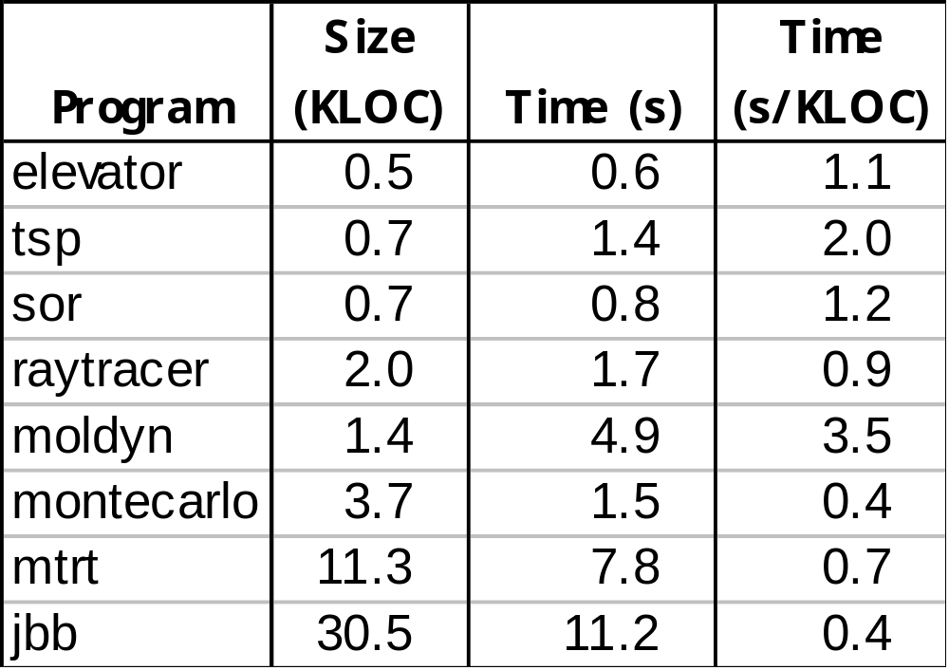
Validation
(excludes Rcc/Sat time)

Slide 58
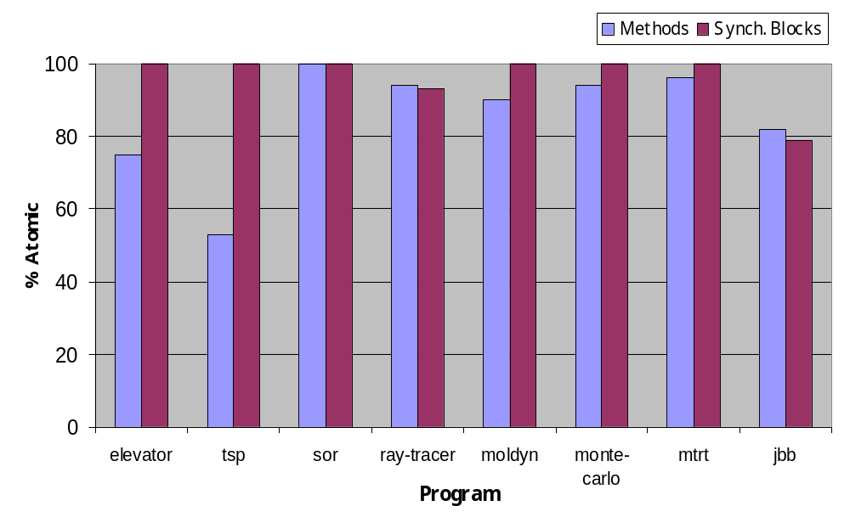
Inferred Atomicities

Slide 59
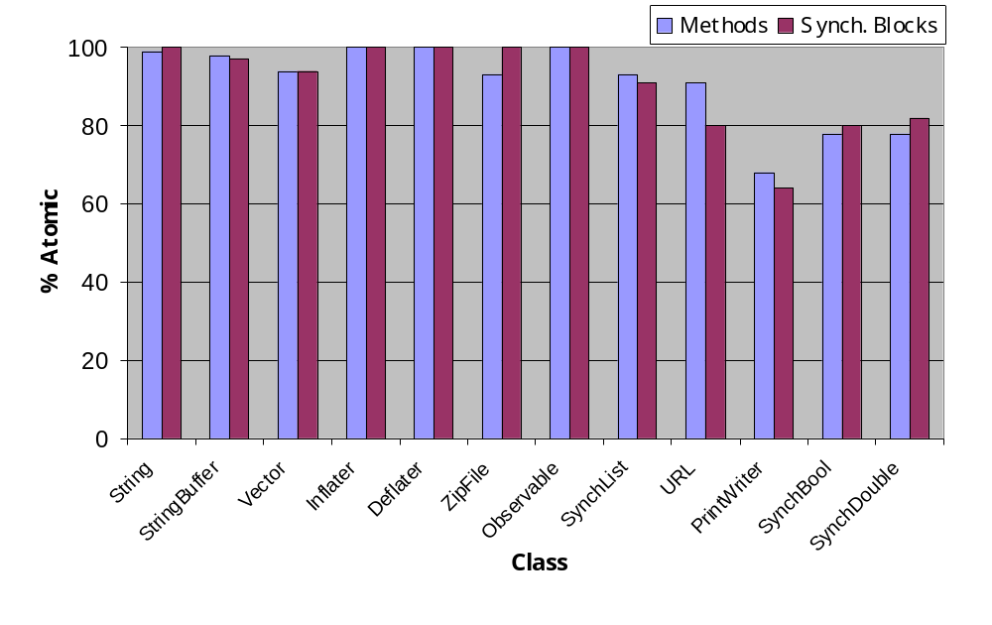
Thread-Safe Classes

Slide 60
Related Work
Reduction
  [Lipton 75, Lamport-Schneider 89, ...]
  other applications:
    model checking [Stoller-Cohen 03, Flanagan-Qadeer 03]
    dynamic analysis [Flanagan-Freund 04, Wang-Stoller 04]
Atomicity inference
  type and effect inference [Talpin-Jouvelot 92,...]
  dependent types [Cardelli 88]
  ownership, dynamic [Sastakur-Agarwal-Stoller 04]

Slide 61
Conclusions And Future Directions
Atomicity a fundamental concept
  improves over race freedom
  matches programmer intuition and practice
  simplifies reasoning about correctness
  enables concise and trustable documentation
Many approaches for verifying atomicity
  static type systems
  dynamic checking (tomorrow)
  ... hybrid checkers ...
  ... model checkers ...

