Slide 1


Slide 2
Atomicity
The method inc() is atomic if concurrent threads do not interfere with its behavior
Guarantees that for every execution
there is a serial execution with same behavior
acq(this)
x
t=i
y
i=t+1
z
rel(this)








acq(this)
x
y
t=i
i=t+1
z
rel(this)








x
y
acq(this)
t=i
i=t+1
rel(this)
z









Slide 3
Tools for Checking Atomicity
Calvin: ESC for multithreaded code
  [Freund-Qadeer 03]

Slide 4
Experience with Calvin
/*@ global_invariant (\forall int i; inodeLocks[i] == null ==>
0 <= inodeBlocknos[i] && inodeBlocknos[i] < Daisy.MAXBLOCK) */
//@ requires 0 <= inodenum && inodenum < Daisy.MAXINODE;
//@ requires i != null
//@ requires DaisyLock.inodeLocks[inodenum] == \tid
//@ modifies i.blockno, i.size, i.used, i.inodenum
//@ ensures i.blockno == inodeBlocknos[inodenum]
//@ ensures i.size == inodeSizes[inodenum]
//@ ensures i.used == inodeUsed[inodenum]
//@ ensures i.inodenum == inodenum
//@ ensures 0 <= i.blockno && i.blockno < Daisy.MAXBLOCK
static void readi(long inodenum, Inode i) {
i.blockno = Petal.readLong(STARTINODEAREA + (inodenum * Daisy.INODESIZE));
i.size = Petal.readLong(STARTINODEAREA + (inodenum * Daisy.INODESIZE) + 8);
i.used = Petal.read(STARTINODEAREA + (inodenum * Daisy.INODESIZE) + 16) == 1;
i.inodenum = inodenum;
// read the right bytes, put in inode
}

Slide 5
Tools for Checking Atomicity
Calvin: ESC for multithreaded code
  [Freund-Qadeer 03]
A type system for atomicity
  [Flanagan-Qadeer 03,Flanagan-Freund-Lifshin 05]

Slide 6
Tools for Checking Atomicity
Calvin: ESC for multithreaded code
  [Freund-Qadeer 03]
A type system for atomicity
  [Flanagan-Qadeer 03,Flanagan-Freund-Lifshin 05]
Atomizer: dynamic atomicity checker
  [Flanagan-Freund 04]
  http://www.soe.ucsc.edu/~cormac/atom.html

Slide 7


Slide 8

Atomizer

Slide 10
Atomizer: Instrumentation Architecture
Instrumented
Source
Code
event stream
T1: begin_atomic
T2: acquire(lock3)
T2: read(x,5)
T1: write(y,3)
T1: end_atomic
T2: release(lock3)
Runtime
Lockset
Reduction
Atomizer
/*# atomic */ void append(...)
{ ... }
javac
+JVM
Warning: method “append”
may not be atomic at line 43

Slide 11
Atomizer: Dynamic Analysis
Lockset algorithm
  from Eraser [Savage et al. 97]
  identifies race conditions
Reduction [Lipton 75]
  proof technique for verifying atomicity, using information about race conditions

Slide 12
Analysis 1: Lockset Algorithm
Tracks lockset for each field
  lockset = set of locks held on all accesses to field
Dynamically infers protecting lock for each field
Empty lockset indicates possible race condition

Slide 13
Lockset Example
Thread 1
synchronized(x) {
synchronized(y) {
o.f = 2;
}
o.f = 11;
}
Thread 2
synchronized(y) {
o.f = 2;
}
First access to o.f:
LockSet(o.f) = Held(curThread)
= { x, y }

Slide 14
Lockset Example
Thread 1
synchronized(x) {
synchronized(y) {
o.f = 2;
}
o.f = 11;
}
Thread 2
synchronized(y) {
o.f = 2;
}
Subsequent access to o.f:
LockSet(o.f) := LockSet(o.f) ∩ Held(curThread)
= { x, y } ∩ { x }
= { x }

Slide 15
Lockset Example
Thread 1
synchronized(x) {
synchronized(y) {
o.f = 2;
}
o.f = 11;
}
Thread 2
synchronized(y) {
o.f = 2;
}
Subsequent access to o.f:
LockSet(o.f) := LockSet(o.f) ∩ Held(curThread)
= { x } ∩ { y }
= { } => race condition

Slide 16
Lockset
any thread
r/w
Shared-read/write
Track lockset
Shared-exclusive
Track lockset
race condition!

Slide 17
Lockset with Thread Local Data
first thread
r/w
Thread
Local
second
thread
r/w
any thread
r/w
Shared-read/write
Track lockset
Shared-exclusive
Track lockset
race condition!

Slide 18
Lockset with Read Shared Data
first thread
r/w
Thread
Local
second
thread
read
second
thread
write
any thread
r/w
Shared-read/write
Track lockset
Shared-exclusive
Track lockset
Read
Shared
any thread
write
any thread
read
race condition!

Slide 19
Lockset for Producer-Consumer
[Gross-Von Praun 01]
first thread
r/w
second thread
r/w
Thread
Local
second thread
r/w
Thread
Local (2)
any thread
write
any
thread
read
any thread
r/w
Shared-read/write
Track lockset
Shared-exclusive
Track lockset
Read
Shared
any thread
write
any thread
read

Slide 20
Atomizer: Dynamic Analysis
Lockset algorithm
  from Eraser [Savage et al. 97]
  identifies race conditions
Reduction [Lipton 75]
  proof technique for verifying atomicity, using information about race conditions

Slide 21
Reduction [Lipton 75]
acq(this)
X
t=i
Y
i=t+1
Z
rel(this)








acq(this)
X
Y
t=i
i=t+1
Z
rel(this)








X
Y
acq(this)
t=i
i=t+1
Z
rel(this)








X
Y
acq(this)
t=i
i=t+1
rel(this)
Z









Slide 22
Performing Reduction Dynamically
R: right-mover
  lock acquire
L: left-mover
  lock release
B: both-mover
  race-free field access
N: non-mover
  access to "racy" fields
acq(lock)
j=bal
bal=j+n
rel(lock)
R B B L
Reducible methods: (R|B)* [N] (L|B)*
R|B
L|B
start
atomic
block
InRight
L|N
InLeft
R|N
Error

Slide 23
java.lang.StringBuffer
public class StringBuffer {
private int count;
public synchronized int length() { return count; }
public synchronized void getChars(...) { ... }
/*# atomic */
public synchronized void append(StringBuffer sb){
int len = sb.length();
...
...
...
sb.getChars(...,len,...);
...
}
}
sb.length() acquires lock on sb, gets length, and releases lock
other threads can change sb
use of stale len may yield StringIndexOutOfBoundsException
inside getChars(...)

Slide 24
java.lang.StringBuffer
public class StringBuffer {
private int count;
public synchronized int length() { return count; }
public synchronized void getChars(...) { ... }
/*# atomic */
public synchronized void append(StringBuffer sb){
int len = sb.length();
...
...
...
sb.getChars(...,len,...);
...
}
}
StringBuffer.append is not atomic:
Start:
at StringBuffer.append(StringBuffer.java:701)
at Thread1.run(Example.java:17)
Commit: Lock Release
at StringBuffer.length(StringBuffer.java:221)
at StringBuffer.append(StringBuffer.java:702)
at Thread1.run(Example.java:17)
Error: Lock Acquire
at StringBuffer.getChars(StringBuffer.java:245)
at StringBuffer.append(StringBuffer.java:710)
at Thread1.run(Example.java:17)

Slide 25
Atomizer Review
Instrumented code calls Atomizer runtime
  on field accesses, sync ops, etc
Lockset algorithm identifies races
  used to classify ops as movers or non-movers
Atomizer checks reducibility of atomic blocks
  warns about atomicity violations

Slide 26
Refining Race Information
Discovery of races during reduction
/*# atomic */
void deposit(int n) {
synchronized (this) {
int j = bal;
// other thread changes bal
bal = j + n;
}
R
B
A
L

Slide 27
Extensions
Redundant lock operations
  acquire is right-mover
  release is left-mover
  Want to treat them as both movers when possible
Write-protected data
  common idiom

Slide 28
Thread-Local Locks
class Vector {
atomic synchronized Object get(int i) { ... }
atomic synchronized void add(Object o) { ... }
}
class WorkerThread {
atomic void transaction() {
Vector v = new Vector();
v.add(x1);
v.add(x2);
...
v.get(i);
}
}

Slide 29
Reentrant Locks
class Vector {
atomic synchronized Object get(int i) { ... }
atomic synchronized Object add(Object o) { ... }
atomic boolean contains(Object o) {
synchronized(this) {
for (int i = 0; i < size(); i++)
if (get(i).equals(o)) return true;
}
return false;
}
}

Slide 30
Layered Abstractions
class Set {
Vector elems;
atomic void add(Object o) {
synchronized(this) {
if (!elems.contains(o)) elems.add(o);
}
}
}

Slide 31
Redundant Lock Operations
Acquire is right-mover
Release is left-mover
Redundant lock operations are both-movers
  acquiring/releasing a thread-local lock
  re-entrant acquire/release
  acquiring/releasing lock A, if lock B always acquired before A

Slide 32
Write-Protected Data
class Account {
volatile int bal;
/*# atomic */ int read() { return bal; }
/*# atomic */ void deposit(int n) {
synchronized (this) {
int j = bal;
bal = j + n;
}
}
}
R
B
N
L

Slide 33
Write-Protected Data
class Account {
int bal;
/*# atomic */ int read() { return bal; }
/*# atomic */ void deposit(int n) {
synchronized (this) {
int j = bal;
bal = j + n;
}
}
}
Lock this held whenever balance is updated
  write must hold lock, and is non-mover
  read without lock held is non-mover
  read with lock held is both-mover
R
B
A
L

Slide 34
Lockset for Write-Protected Data
Track access lockset and write lockset
  access lockset = locks held on every access
  write lockset = locks held on every write
For regularly-protected data
  access lockset = write lockset = { protecting lock }
For write-protected data
  access lockset = Ø
  write lockset = { write-protecting lock }
Read is both-mover if some write lock held
Write is both-mover if access lockset nonempty

Slide 35
Evaluation
12 benchmarks
  scientific computing, web server, std libraries, ...
  200,000+ lines of code
Heuristics for atomicity
  all synchronized blocks are atomic
  all public methods are atomic, except main and run
Slowdown: 1.5x - 40x

Slide 36
Performance
Benchmark | Lines | Base Time (s) | Slowdown
elevator | 500 | 11.2 | -
hedc | 29,900 | 6.4 | -
tsp | 700 | 1.9 | 21.8
sor | 17,700 | 1.3 | 1.5
moldyn | 1,300 | 90.6 | 1.5
montecarlo | 3,600 | 6.4 | 2.7
raytracer | 1,900 | 4.8 | 41.8
mtrt | 11,300 | 2.8 | 38.8
jigsaw | 90,100 | 3.0 | 4.7
specJBB | 30,500 | 26.2 | 12.1
webl | 22,300 | 60.3 | -
lib-java | 75,305 | 96.5 | -

Slide 37
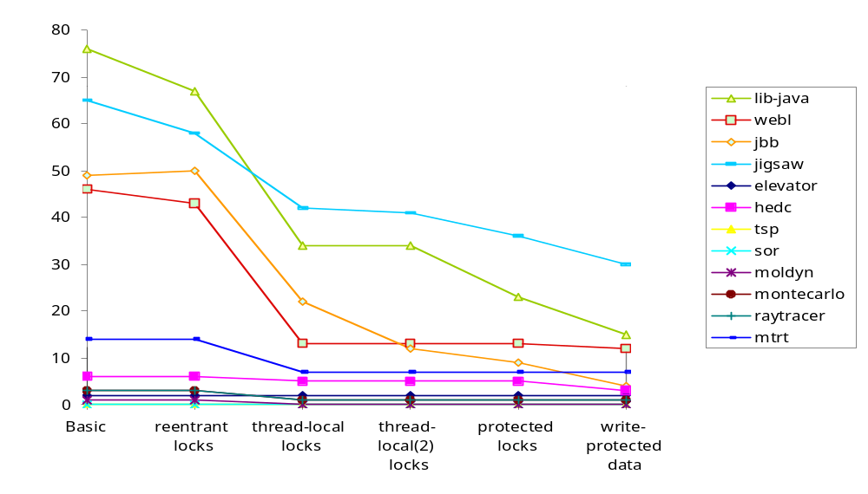
Extensions Reduce Number of Warnings
Total
341
Total
97

Slide 38
Evaluation
Warnings: 97 (from 200KLOC)
At least 7 are real errors
False alarms due to:
  simplistic heuristics for atomicity
    programmer should specify atomicity
  false races
  methods irreducible yet still "atomic"
    eg caching, lazy initialization
No warnings reported in more than 90% of exercised methods

Slide 39
Example Bugs
class PrintWriter {
Writer out;
public void println(String s) {
synchronized(lock) {
out.print(s);
out.println();
}
}
}
class ResourceStoreManager {
synchronized checkClosed() { ... }
synchronized lookup(...) { ... }
public ResourceStore loadResourceStore(...) {
checkClosed();
return lookup(...);
}
}

