Slide 1
Beyond Reduction ...

Slide 2
Busy Acquire
atomic void busy_acquire() {
while (true) {
if (CAS(m,0,1)) break;
}
}
if (m == 0) {
m = 1; return true;
} else {
return false;
}

Slide 3
Busy Acquire
atomic void busy_acquire() {
while (true) {
if (CAS(m,0,1)) break;
}
}
CAS(m,0,1)
CAS(m,0,1)
CAS(m,0,1)
(fails)
(fails)
(succeeds)

Slide 4
Non-Serial Execution:
Serial Execution:
Atomic but not reducible
CAS(m,0,1)
CAS(m,0,1)
CAS(m,0,1)
(fails)
(fails)
(succeeds)
CAS(m,0,1)
(succeeds)

Slide 5
alloc
boolean b[MAX]; // b[i]==true iff block i is free
Lock m[MAX];
atomic int alloc() {
int i = 0;
while (i < MAX) {
acquire(m[i]);
if (b[i]) {
b[i] = false;
release(m[i]);
return i;
}
release(m[i]);
i++;
}
return -1;
}

Slide 6
alloc
acq(m[0])
test(b[0])
rel(m[0])
acq(m[1])
test(b[1])
b[1]=false
rel(m[1])

Slide 7
alloc is not Atomic
There are non-serial executions with no equivalent serial executions

Slide 8
m[0] = m[1] = 0; b[0] = b[1] = false;
t = alloc(); || free(0); free(1);
void free(int i) {
acquire(m[i]);
b[i] = true;
release(m[i]);
}

Slide 9
m[0] = m[1] = 0; b[0] = b[1] = false;
t = alloc(); || free(0); free(1);
Non-Serial Execution:
Serial Executions:
loop for b[0]
free(0)
free(1)
loop for b[1]
t = 1
loop for b[0]
loop for b[1]
free(0)
free(1)
t = -1
free(0)
free(1)
loop for b[0]
t = 0
free(0)
loop for b[0]
free(1)
t = 0

Slide 10
Extending Atomicity
Atomicity doesn't always hold for methods that are "intuitively atomic"
  serializable but not reducible (busy_acquire)
  not serializable (alloc)
Examples
  initialization
  resource allocation
  wait/notify
  caches
  commit/retry transactions

Slide 11
Pure Code Blocks
Pure block: pure { E }
  If E terminates normally, it does not update state visible outside of E
  E is reducible
Example
while (true) {
pure {
acquire(mx);
if (x == 0) { x = 1; release(mx); break; }
release(mx);
}
}

Slide 12
Purity and Abstraction
A pure block's behavior under normal termination is the same as skip
Abstract execution semantics:
  pure blocks can be skipped
acq(m)
test(x)
rel(m)
acq(m)
test(x)
rel(m)
skip

Slide 13
Abstraction
Abstract semantics that admits more behaviors
  pure blocks can be skipped
  hides "irrelevant" details (ie, failed loop iters)
Program must still be (sequentially) correct in abstract semantics
Abstract semantics make reduction possible

Slide 14
Busy Acquire
atomic void busy_acquire() {
while (true) {
pure { if (CAS(m,0,1)) break; }
}
}

Slide 15
Abstract Execution of Busy Acquire
atomic void busy_acquire() {
while (true) {
pure { if (CAS(m,0,1)) break; }
}
}
CAS(m,0,1)
CAS(m,0,1)
CAS(m,0,1)
(Concrete)
skip
skip
CAS(m,0,1)
(Abstract)
(Reduced Abstract)

Slide 16
alloc
atomic int alloc() {
int i = 0;
while (i < MAX) {
pure {
acquire(m[i]);
if (b[i]) {
b[i] = false;
release(m[i]);
return i;
}
release(m[i]);
}
i++;
}
return -1;
}

Slide 17
Abstract Execution of alloc
acq(m[0])
test(b[0])
rel(m[0])
acq(m[1])
test(b[1])
b[1]=false
rel(m[1])
skip
acq(m[1])
test(b[1])
b[1]=false
rel(m[1])
(Abstract)
(Reduced Abstract)

Slide 18
Abstraction
Abstract semantics admits more executions
Can still reason about important properties
  "alloc returns either the index of a freshly allocated block or -1"
  cannot guarantee "alloc returns smallest possible index"
    but what does this really mean anyway???
free(0)
free(1)
skip
acq(m[1])
test(b[1])
b[1]=false
rel(m[1])
(Abstract)

Slide 19
To Atomicity and Beyond ...

Slide 21
Commit-Atomicity
Reduction
  Great if can get serial execution via commuting
Reduction + Purity
  Great if non-serial execution performs extra pure loops
Commit Atomicity
  More heavyweight technique to verify if some corresponding serial execution has same behavior
    can take different steps

Slide 22
Checking Commit Atomicity
Run normal and serial executions of program concurrently, on separate stores
Normal execution runs as normal
  threads execute atomic blocks
  each atomic block has commit point
Serial execution
  runs on separate shadow store
  when normal execution commits an atomic block, serial execution runs entire atomic block serially
Check two executions yield same behavior

Slide 23
Commit-Atomic
Normal execution
commit
atomic block
...
compare
states
...
Serial execution

Slide 24
Preliminary Evaluation
Some small benchmarks
  Bluetooth device driver
    atomicity violation due to error
  Busy-waiting lock acquire
    acquire1: 1 line of code in critical section
    acquire100: 100 lines of code in critical section
Hand translated to PROMELA code
  Two versions, with and without commit-atomic
  Model check with SPIN

Slide 25
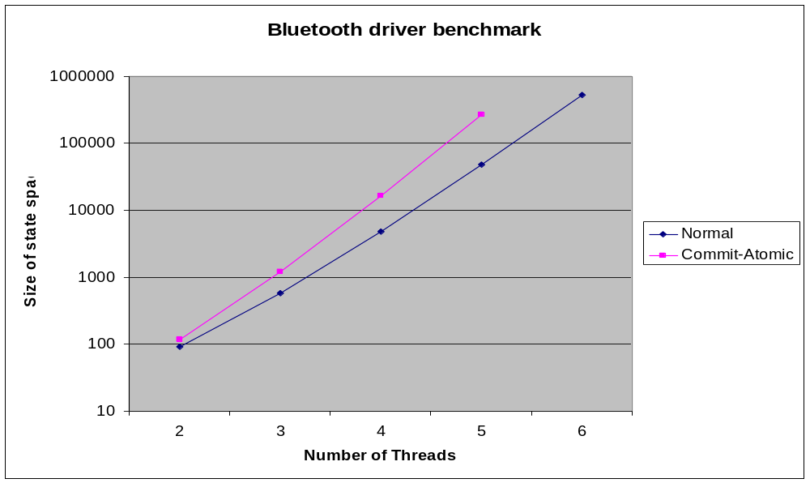
Performance: Bluetooth device driver

Slide 26
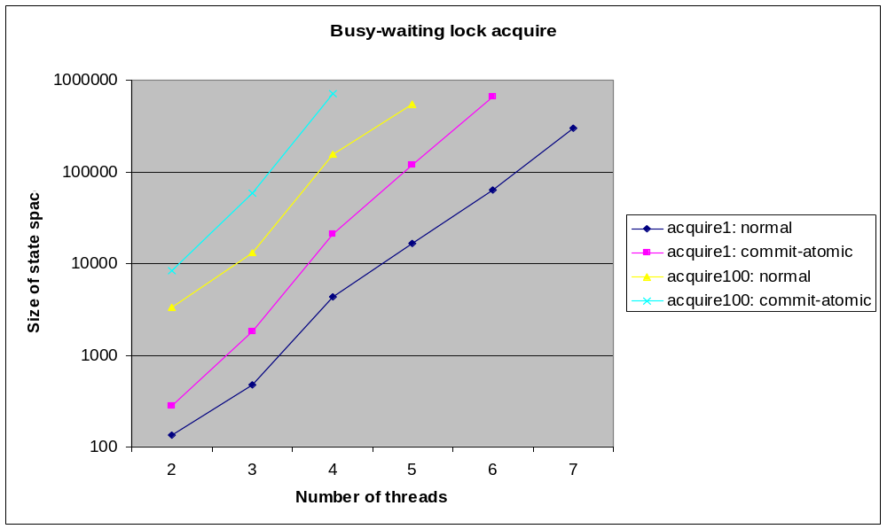
Performance: acquire1 and acquire100

Slide 27
Summary
Atomicity
  concise, semantically deep partial specification
  aka serializability
Reduction
  lightweight technique for verifying atomicity
  can verify with types, or dynamically
  plus purity, for complex cases
Commit-Atomicity
  more general technique

Slide 28
Summary
Atomicity
  concise, semantically deep partial specification
Reduction
  lightweight technique for verifying atomicity
Commit-Atomicity
  more general technique
Future work
  combine reduction and commit-atomic
  generalizing atomicity
    temporal logics for determinism?

