Slide 1
Dynamic Partial-Order Reduction for Model Checking Software
Cormac Flanagan
UC Santa Cruz
Patrice Godefroid
Bell Labs

Slide 2
Motivation
Software model checking is prone to state explosion
Two main causes
  input nondeterminism
  scheduling nondeterminism
Example:
  naive model checking: n! interleavings, 2^{n} states
Partial-order reduction
  explores subset of the state space, without sacrificing soundness
Thread 1
x1 := 1
stop
Thread 2
x2 := 1
stop
. . .
Thread n
xn := 1
stop

Slide 3
Independent transitions
s
B
R
R
B
B and R are independent transitions if
  they commute: B ∘ R = R ∘ B
  neither enables nor disables the other
Example: x := 3 and y := 1 are independent

Slide 4
Persistent transitions
s
B
R
independent
B is a persistent transition if it is independent with every transition R reachable from S without executing B
If B is persistent then it is sound to only explore B
Persistent sets - generalization to many threads

Slide 5
Static partial-order reduction
s
x := 1
y := 2
independent
z := 3
static
analysis
Use static analysis to predict locations red accesses after s
  if static analysis proves that red thread only accesses y and z
  then x := 1 is a persistent transition from s

Slide 6
Static partial-order reduction
s
*p := 1
*q1 := 2
independent
*q2 := 3
static
analysis
Use static analysis to predict locations red accesses after s
Pointers?
  coarse analysis information => limited POR => state explosion

Slide 7
Example: static partial-order reduction
Global Vars
lock m
int t1,t2
int x=0
int n=100
char[] a
Thread 1
lock(m)
t1 := x++
unlock(m)
for( ;t1<n; t1+=2)
a[t1] := ‘b’
Thread 2
lock(m)
t2 := x++
unlock(m)
for( ;t2<n; t2+=2)
a[t2] := ‘r’
Static analysis gives
  t1, t2 are thread-local
  x is protected by m
  but a[t1] and a[t2] may alias
may-alias (according to static analysis)
never alias (in practice)
Static POR gives O(n²) explored states and transitions
  but only two possible terminating states

Slide 8
Dynamic partial-order reduction
Static POR relies on static analysis
  to yield approximate information about run-time behavior
  pointers => coarse information => limited POR => state explosion
Dynamic POR
  while model checker explores the program’s state space,
  it sees exactly which threads access which locations
  use to simulaneously reduce the state space while model-checking
We present a solution for
  safety properties (deadlocks, assertion violations, etc.)
  acyclic state spaces

Slide 9
Dynamic partial-order reduction
backtrack set { }
s
*(0x2FC3) := 3
s’
independent
coarse
static
analysis
precise
dynamic
analysis
*(0x1DA7) := 7
exit()
Execute initial arbitrary execution trace to completion
Examine transitions performed by each thread
  identify and explore other interleavings that may behave differently
  dynamic alias analysis is easy

Slide 10
Dynamic partial-order reduction
backtrack set { red }
s
backtrack set { }
*(0x2FC3) := 3
s’
dependent
precise
dynamic
analysis
*(0x2FC3) := 7
Execute initial arbitrary execution trace to completion
Examine transitions performed by each thread
  identify and explore other interleavings that may behave differently
  dynamic alias analysis is trivial

Slide 11
Dynamic partial-order reduction example
Initial trace
Thread 1
lock(m)
t1 := x++
unlock(m)
for( ;t1<n; t1+=2)
a[t1] := ‘b’
lock(m)
t1 := x++
unlock(m)
a[0]:=‘b’
a[2]:=‘b’
Thread 2
lock(m)
t2 := x++
unlock(m)
for( ;t2<n; t2+=2)
a[t2] := ‘r’
lock(m)
t2 := x++
unlock(m)
a[1]:=‘r’
a[3]:=‘r’

Slide 12
Dynamic partial-order reduction example
Initial trace
backtrack
on red before
lock(m)
Happens-before relation
transitive closure of dependency relation
represent using clock vectors
lock(m)
t1 := x++
unlock(m)
a[0]:=‘b’
not co-enabled
DPOR Algorithm
For each transition R of red thread, add a backtracking point for red before last transition B such that
  B is dependent with R
  B does not happen-before R
  B is co-enabled with R
a[2]:=‘b’
lock(m)
t1 := x++
happens-before
red gets here
t2 := x++
unlock(m)
a[1]:=‘r’
no (dynamic) conflicts on a[]
=> good POR
a[3]:=‘r’

Slide 13
Dynamic partial-order reduction example
Initial trace
backtrack
on red before
lock(m)
backtracked
on blue before
lock(m).
Already done!
lock(m)
lock(m)
t1 := x++
t2 := x++
unlock(m)
unlock(m)
a[0]:=‘b’
a[0]:=‘r’
not co-enabled
not co-enabled
a[2]:=‘b’
a[2]:=‘r’
lock(m)
lock(m)
t1 := x++
happens-before
red gets here
t2 := x++
happens-before
blue gets here
t2 := x++
t1 := x++
unlock(m)
unlock(m)
a[1]:=‘r’
no (dynamic) conflicts on a[]
=> good POR
a[1]:=‘b’
a[3]:=‘r’
a[3]:=‘b’

Slide 14
Dynamic partial-order reduction algorithm
Dynamic POR algorithm for
  safety properties (deadlocks, assertion violations, etc.)
  acyclic state spaces
Dynamically computes a persistent set in each explored state
  compatible and complementary with sleep sets
Complexity: O(m².r)
  m = number of threads
  r = size of reduced state space
  some assumptions on dependence relation

Slide 15
Evaluation
Two (small) benchmarks
  Indexer benchmark
    threads insert messages into shared hash table
    static analysis cannot predict absence of hash table collisions
      all hash table operations are dependent
  Filesystem benchmark
    synchronization idiom from Frangipani
    threads allocate shared disk blocks to inodes
Ten model checking configurations
  no POR vs. static POR vs. dynamic POR (stateless)
  sleep sets vs. no sleep sets
  stateful search vs. stateless search

Slide 16
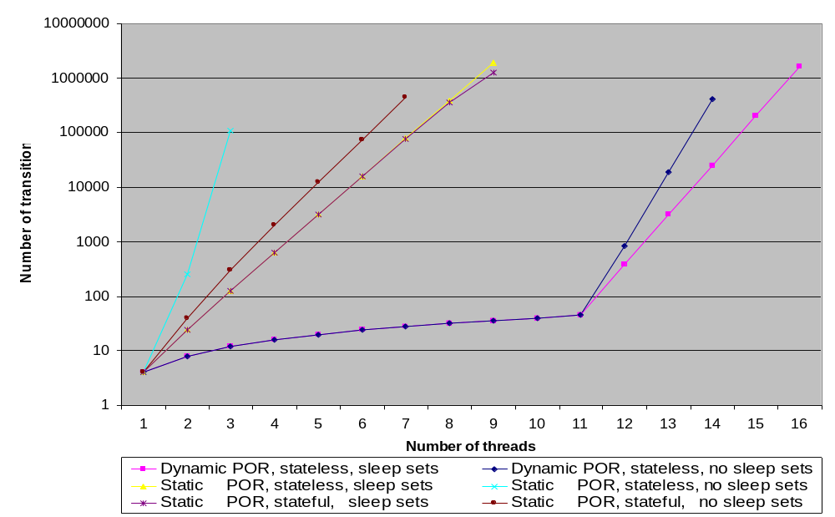
Indexer Benchmark

Slide 17
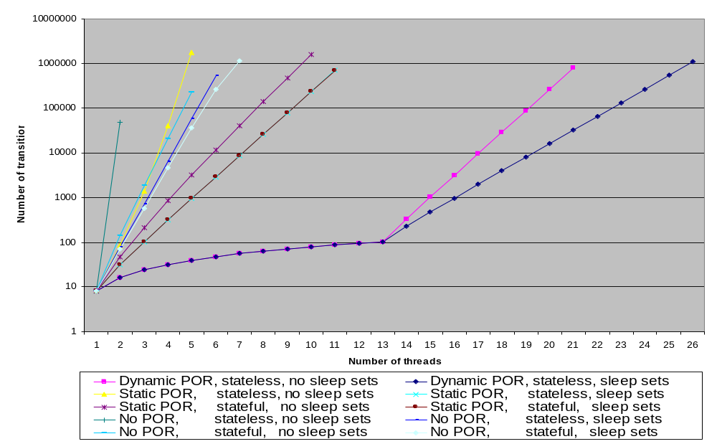
Filesystem Benchmark

Slide 18
Summary
Dynamic partial-order reduction
  tackles state explosion due to scheduling nondeterminism
  no approximate/expensive/complicated static analysis
  supports pointer-rich data structures
  supports dynamic creation of threads/object/channels etc
  compatible and complementary with sleep sets
Future work
  stateful DPOR, handling cycles
  liveness properties and full temporal logic
  incorporate into industrial-strength model checker for multithreaded software (POSIX threads, Java, C# ?)

Slide 19
Dynamic Partial-Order Reduction for Model Checking Software
Cormac Flanagan
UC Santa Cruz
Patrice Godefroid
Bell Labs

