Slide 1
Hybrid Type Checking
Cormac Flanagan
University of California, Santa Cruz

Slide 2
Interface Specifications
Essential for software engineering
  help manage complexity through abstraction
  enable modular software development
Should ideally be
  precise (i.e., formal, machine readable)
  trustworthy (i.e., mechanically checked)
Examples
  printBool expects a boolean
  printDigit expects an integer in the range [0,9]
  find expects an ordered BinaryTree
  eval expects a closed, well-typed expression
  precise preconditions and postconditions

Slide 3
Static Type Checking
well-typed
Accept
Run
Program
w/ basic type
specifications
Type
Checking
Algorithm
ill-typed
Reject
Compile-time type error:
expected Int, got Bool
Traditional type systems
  extremely useful, decidable, but limited expressiveness
Advanced (decidable) type systems
  refinement types
    [Freeman-Pfenning 91, Xi 00, Mandelbaum et al 03, Ou et al 04...]
  more expressiveness (e.g., with linear inequalities)
  but expressiveness still restricted to ensure decidability

Slide 4

Static Type Checking for Expressive Specs
well-typed
Accept
Run
Program
with precise
specifications
Type
Checking
Algorithm
don’t
know
ill-typed
Reject
Compile-time type error:
expected Int, got Bool
Expressive specifications ) type checking undecidable
  can still accept and reject many programs
What to do with remaining undecided cases?

Slide 5
Static Type Checking for Expressive Specs
well-typed
Accept
Run
Program
with precise
specifications
Type
Checking
Algorithm
don’t
know
Interactive Theorem Proving (HARD!)
X
ill-typed
Reject
Compile-time type error:
expected Int, got Bool
Expressive specifications ) type checking undecidable
  can still accept and reject many programs
What to do with remaining undecided cases?
  interactive theorem proving ) powerful but not for mortals

Slide 6
Static Type Checking for Expressive Specs
well-typed
Accept
Run
Program
with precise
specifications
Type
Checking
Algorithm
don’t
know
ill-typed
Reject
Compile-time type error:
expected Int, got Bool
Expressive specifications ) type checking undecidable
  can still accept and reject many programs
What to do with remaining undecided cases?
  interactive theorem proving ) powerful but not for mortals
  reject (or diverge) ) too brittle and unpredictable (ESC/Java)

Slide 7
Static Type Checking for Expressive Specs
well-typed
Accept
Run
Program
with precise
specifications
Type
Checking
Algorithm
don’t
know
ill-typed
Reject
Compile-time type error:
expected Int, got Bool
Expressive specifications ) type checking undecidable
  can still accept and reject many programs
What to do with remaining undecided cases?
  interactive theorem proving ) powerful but not for mortals
  reject (or diverge) ) too brittle and unpredictable (ESC/Java)
  accept ) cannot trust specs since they are not enforced

Slide 8
Static Type Checking for Expressive Specs
well-typed
Accept
Run
Program
with precise
specifications
Type
Checking
Algorithm
don’t
know
ill-typed
Reject
Compile-time type error:
expected Int, got Bool
Expressive specifications ) type checking undecidable
  can still accept and reject many programs
What to do with remaining undecided cases?
  interactive theorem proving ) powerful but not for mortals
  reject (or diverge) ) too brittle and unpredictable (ESC/Java)
  accept ) cannot trust specs since they are not enforced

Slide 9
Dynamic Checking for Expressive Specs
Very easy and straightforward
  can check any decidable safety predicate
  contract languages [Eiffel, JML,...]
  higher-order contracts [Findler-Felleisen 02, ...]
Limitations
  performance overhead
  limited coverage
    specs only checked on tested executions
    may catch errors late in development cycle, or post-deployment

Slide 10
The Case for Hybrid Type Checking
Static checking
  provides full coverage for limited specifications
Dynamic checking
  provides limited coverage of very expressive specifications
Hybrid type checking
  a synthesis of these two prior techniques
  goal: high coverage checking for expressive specs

Slide 11
Hybrid Type Checking for Expressive Specs
well-typed
Accept
Run
Program
with precise
specifications
Hybrid
Type
Checking
Algorithm
Run
don’t
know
Accept
with casts
Run-time type error:
expected Digit, got 12
ill-typed
Reject
Compile-time type error:
expected Int, got Bool
The hybrid type checking algorithm tries to prove that the program is either well-typed or ill-typed
In “don’t know” case, it accepts the program, but inserts sufficient dynamic casts to ensure that the compiled program never violates any specification

Slide 12
Other Combined Static/Dynamic Checkers
For language safety
  static type checking, dynamic bounds checking
  ML, Java, C#, also CCured [Necula et al 02]
For more flexible typing
  Type Dynamic [Abadi et al 89, Henglein 94, Thatte 90]
  Soft typing [Wright and Cartwright 94]
In comparison, goal of this work is to
  enforce more expressive specs
  catch more bugs earlier

Slide 13
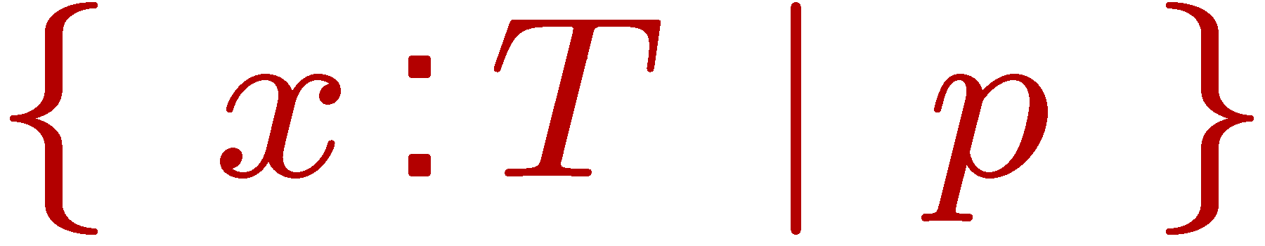



The Language λ^{Η}
Refinement types
  arbitrary (executable) refinement predicate p
Dependent function types
  equivalent to
  + has type
Supports arbitrary preconditions, postconditions
  e.g., simple type
  becomes

Slide 14

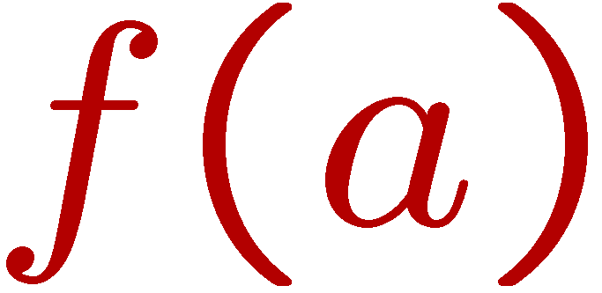
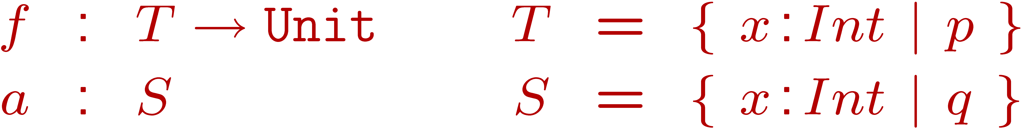
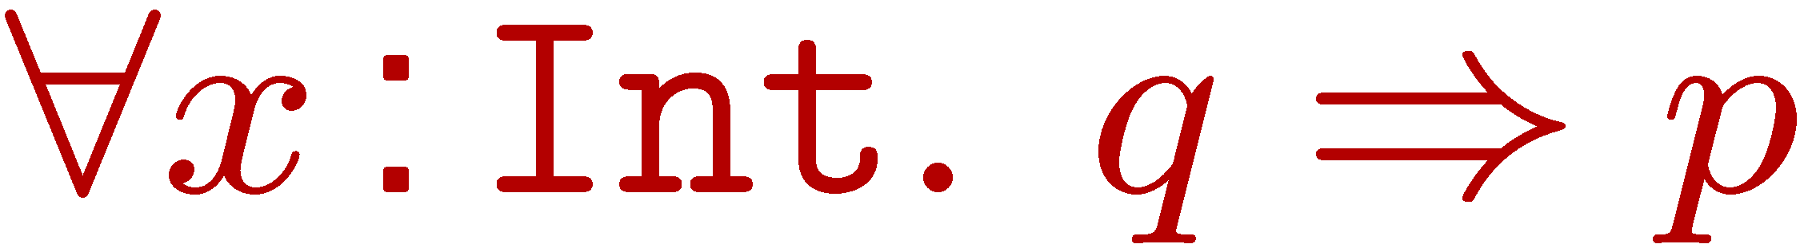
Type Checking for λ^{Η}
Type checking judgement
Consider type checking an application where
Application is well-typed
iff S is a subtype of T
iff
which is undecidable

Slide 15

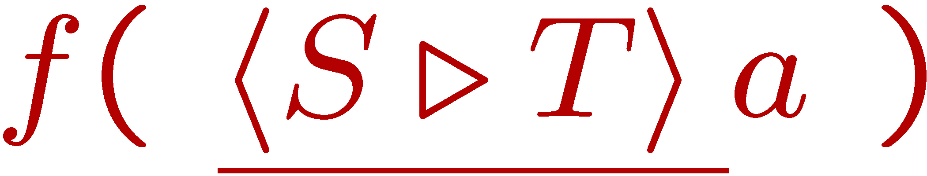

Hybrid Type Checking for λ^{Η}
Need theorem prover for that answers
  Yes, implication holds
  No, implication does not hold
  Maybe, implication may or may not hold
Lift to 3-valued subtyping algorithm for S <: T
  Yes ) application is well-typed
  No ) application is ill-typed
  Maybe ) compile to
Hybrid type checking judgement

Slide 16
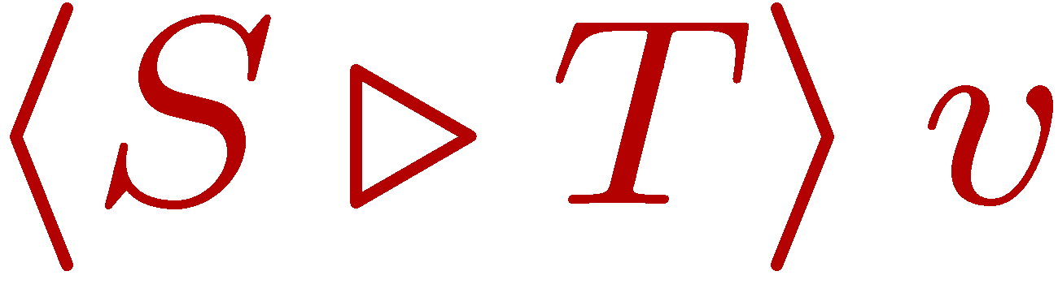
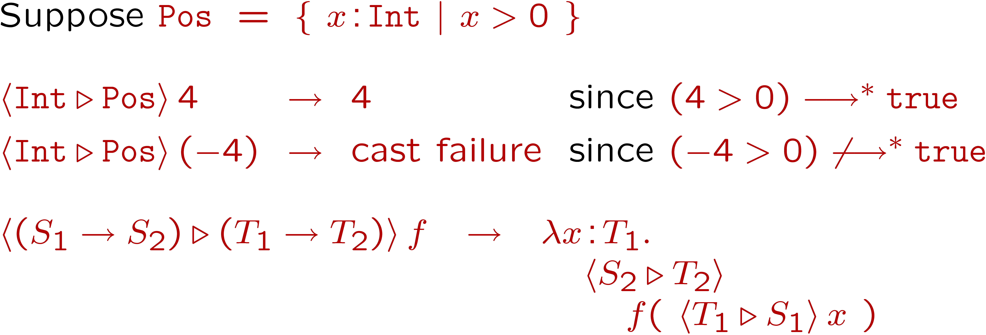
Casts in λ^{Η}
Cast dynamically converts value v from type S to type T (or else fails)
Examples

Slide 17
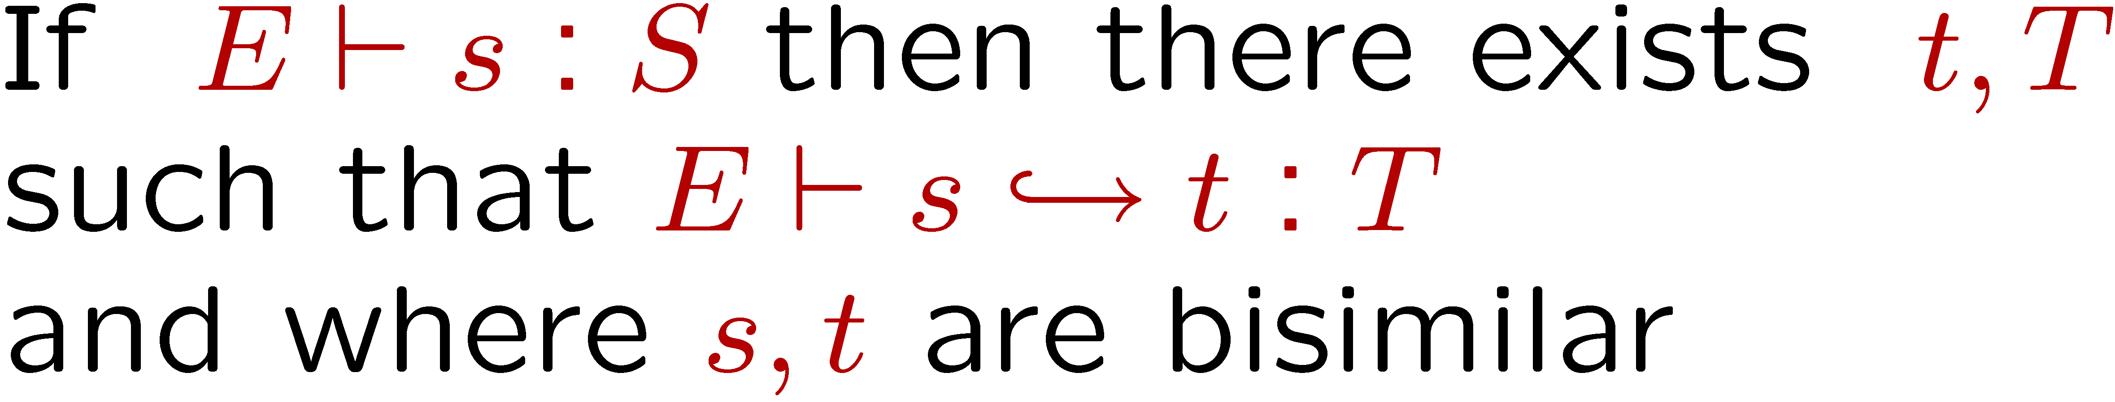
Advantages of Hybrid Type Checking
well-typed
Accept
Run
Program
with precise
specifications
Hybrid
Type
Checking
Algorithm
Run
don’t
know
Accept
with casts
Run-time type error:
expected Digit, got 12
ill-typed
Reject
Compile-time type error:
expected Int, got Bool
Supports expressive, precise specifications
Accepts all well-typed programs
  casts (if any) never fail, compilation semantics-preserving
Generated program always well-typed
Detects many simple errors detected at compile-time
Enforces all specifications
  attempted violations caught, either statically or dynamically

Slide 18
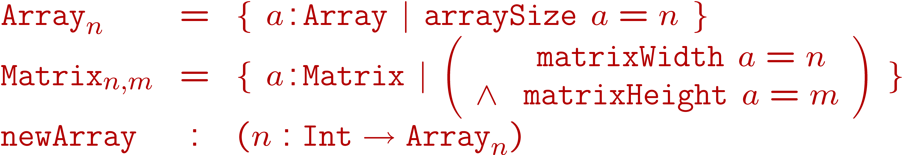
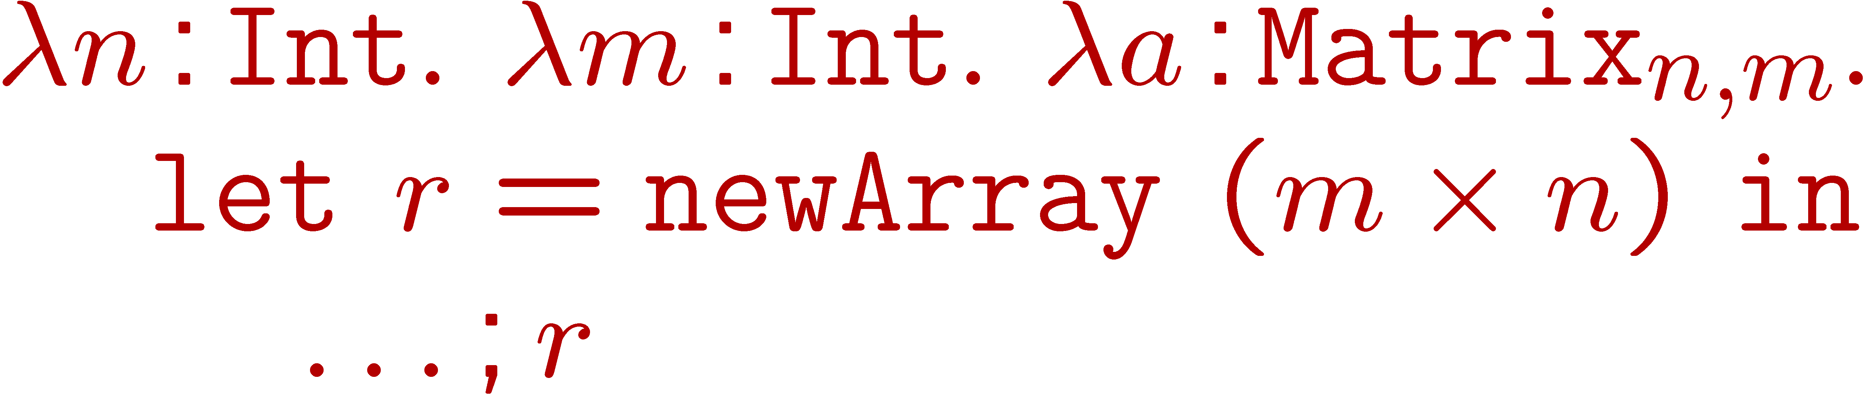
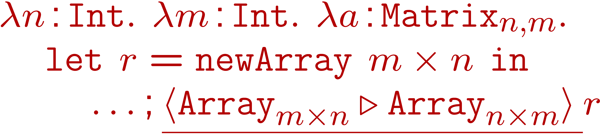
Example: serializeMatrix
Let
Spec
Impl
Well-typed if
  if theorem prover can prove this fact ) accept as is
  otherwise insert cast to verify type of return value

Slide 19
Hybrid Type Checking
Language λ^{H}
Arbitrary executable refinement predicates
vs.
Static Type Checking
Pick any set of predicates D with decidable implication
Generates a language λ^{S} with decidable type checking
Example
  if D = { true }
  then only have trivial refinement types { x:T | true }
  so λ^{S} is just the simply-typed lambda calculus

Slide 20
Hybrid Type Checking
Language λ^{H}
Arbitrary executable refinement predicates
vs.
Static Type Checking
Language λ^{S}
Smaller set D of refinement predicates with decidable implication
Pick any set of predicates D with decidable implication
Generates a language λ^{S} with decidable type checking
Example
  if D = { true }
  then only have trivial refinement types { x:T | true }
  so λ^{S} is just the simply-typed lambda calculus

Slide 21
Hybrid Type Checking
Language λ^{H}
Arbitrary executable refinement predicates
vs.
Static Type Checking
Language λ^{S}
Smaller set D of refinement predicates with decidable implication
Hybrid vs static type checking on λ^{S} programs
HTC can work as well as STC on λ^{S} programs
  essentially can use same reasoning as STC

Slide 22
Hybrid Type Checking
Language λ^{H}
Arbitrary executable refinement predicates
vs.
Static Type Checking
Language λ^{S}
Smaller set D of refinement predicates with decidable implication
Hybrid vs static type checking on λ^{H} programs
For any “reasonable” function erase : λ^{H} ! λ^{S}
there exist some λ^{H} program p
such that HTC(p) “is better than” STC(erase(p))
  i.e., HTC(p) finds more errors statically than STC(erase(p)) or gives fewer static false alarms

Slide 23

Conclusions
Expressive specifications are essential for programming
  ideally should be mechanically checked
  purely static checking of such specifications is undecidable
Hybrid type checking
  pragmatic method for enforcing expressive specifications
  synthesis of static and dynamic checking
Beyond λ^{H}
  should your next program checker be a Hybrid?
  see hybrid imperative objects at FOOL
  Sage programming language (sage.soe.ucsc.edu)
    Pure Type Systems meets hybrid type checking

