Slide 1
Avoiding Exponential Explosion:
Generating Compact Verification Conditions
Cormac Flanagan and James B. Saxe
Compaq Systems Research Center
With help from our ESC colleagues:
Rustan Leino, Mark Lillibridge, Greg Nelson, Shaz Qadeer, Raymie Stata

Slide 2
Software QA via Testing
Useful (the dominant methodology), but ..
Costly
  half of development cost is testing
  finds errors late in development cycle
Incomplete
  often fails to ensure needed reliability
  hard to test all configurations

Slide 3
Software QA via Static Checking
Statically verify many correctness properties
Type systems catch many errors
  e.g. “Cannot multiply a number and a string”
Would like to catch additional errors
  e.g. “Array index out of bounds at line 10”
And verify other correctness properties
  assertions
  object invariants
  lightweight method specifications

Slide 4
Extended Static Checker Architecture
Java method + annotations
VC Generator
Verification Condition
∀x.∀y.(x > y ==> … )
Decision Procedure
Counterexamples
Index out of bounds on line 218
Method does not preserve object invariant on line 223
Notes:
Well, we steal some ideas from the program verification community.
We feed the annotated source program through a verif cond generator. This generator encodes the semantics of the program, together with any correctness properties we wish to prove, as a formula in 1st-order logic, which we call the verification condition. This VC contains things like quantifiers and the usual logical operations such as implications. If you’re familiar with ideas such as axiomatic semantics and weakest liberal preconditions, then that’s the kind of machinery we use in generating this VC.
Now if the source programs does not have any errors, then the VC should be true. To check this, we feed the VC into an automatic theorem prover.
This theorem prover is completely automatic and is hidden inside the checker, so the user never needs to interact with it or even know it’s there. Even though we’re using theorem proving, the overall checker still feels like a type system: you just run it and it spits out results.
These VCs are oftan quite large, but they’re not very deep mathematically, so the automatic theorem prover normally does a good job of either proving them or generating a counter-example. If it proves the VC, then the program passes the checker, and we’re done. If it generates a counter-example, then we do some post-processing on the counter-example to convert it into a nice error message.
You might be thinking that this looks just like a complete program verifier.

Slide 5
Extended Static Checker Architecture
Java method + annotations
Front End
Intermediate representation
assume preconditions
assume object invariants
... translated body ...
assert postconditions
assert object invariants
Guarded Command
VC Generator
Verification Condition
Decision Procedure
Counterexamples
Index out of bounds on line 218
Method does not preserve object invariant on line 223
Notes:
Well, we steal some ideas from the program verification community.
We feed the annotated source program through a verif cond generator. This generator encodes the semantics of the program, together with any correctness properties we wish to prove, as a formula in 1st-order logic, which we call the verification condition. This VC contains things like quantifiers and the usual logical operations such as implications. If you’re familiar with ideas such as axiomatic semantics and weakest liberal preconditions, then that’s the kind of machinery we use in generating this VC.
Now if the source programs does not have any errors, then the VC should be true. To check this, we feed the VC into an automatic theorem prover.
This theorem prover is completely automatic and is hidden inside the checker, so the user never needs to interact with it or even know it’s there. Even though we’re using theorem proving, the overall checker still feels like a type system: you just run it and it spits out results.
These VCs are oftan quite large, but they’re not very deep mathematically, so the automatic theorem prover normally does a good job of either proving them or generating a counter-example. If it proves the VC, then the program passes the checker, and we’re done. If it generates a counter-example, then we do some post-processing on the counter-example to convert it into a nice error message.
You might be thinking that this looks just like a complete program verifier.

Slide 6
private int scanPunctuation(int nextchr) {
try {
boolean possibleFloatingPointNumber = (nextchr == '.');
text[0] = (char)nextchr;
textlen = 1;
m_in.mark(); // All paths out of the try must unmark the stream!!
PunctuationPrefixTree prefix = punctuationTable;
PunctuationPrefixTree lastPunctuation = prefix;
int lastPunctuationLength = 0;
int index = nextchr - '!';
if (index < 0 || PunctuationPrefixTree.CHILDLEN <= index) prefix = null;
else prefix = prefix.children[nextchr - '!'];
nextchr = m_in.read();
if (possibleFloatingPointNumber && Character.isDigit((char)nextchr)) {
m_in.clearMark();
return finishFloatingPointLiteral(nextchr);
}
this.append(nextchr);
if (prefix != null && prefix.code != TagConstants.NULL) {
lastPunctuation = prefix;
lastPunctuationLength = textlen - 1;
m_in.mark();
}
while(prefix != null) {
index = nextchr - '!';
if (index < 0 || PunctuationPrefixTree.CHILDLEN <= index) prefix = null;
else prefix = prefix.children[nextchr - '!'];
nextchr = m_in.read();
this.append(nextchr);
if (prefix != null && prefix.code != TagConstants.NULL) {
lastPunctuation = prefix;
lastPunctuationLength = textlen - 1;
m_in.mark();
}
}
m_in.reset();
textlen = lastPunctuationLength;
endingLoc = m_in.getLocation();
ttype = lastPunctuation.code;
if (ttype != TagConstants.C_COMMENT&& ttype != TagConstants.EOL_COMMENT)
nextchr = m_in.read();
return ttype;
} catch (IOException e) {
m_in.clearMark();
ErrorSet.fatal(m_in.getLocation(), e.toString());
return TagConstants.NULL; // Dummy
}
}

Slide 7
Extended Static Checker Architecture
Java method + annotations
Front End
Guarded Command
Weakest preconditions
Strongest postconditions
VC Generator
Symbolic forward execution
Verification Condition
Exponential in size of GC
Decision Procedure
Counterexamples
Index out of bounds on line 218
Method does not preserve object invariant on line 223
Notes:
Well, we steal some ideas from the program verification community.
We feed the annotated source program through a verif cond generator. This generator encodes the semantics of the program, together with any correctness properties we wish to prove, as a formula in 1st-order logic, which we call the verification condition. This VC contains things like quantifiers and the usual logical operations such as implications. If you’re familiar with ideas such as axiomatic semantics and weakest liberal preconditions, then that’s the kind of machinery we use in generating this VC.
Now if the source programs does not have any errors, then the VC should be true. To check this, we feed the VC into an automatic theorem prover.
This theorem prover is completely automatic and is hidden inside the checker, so the user never needs to interact with it or even know it’s there. Even though we’re using theorem proving, the overall checker still feels like a type system: you just run it and it spits out results.
These VCs are oftan quite large, but they’re not very deep mathematically, so the automatic theorem prover normally does a good job of either proving them or generating a counter-example. If it proves the VC, then the program passes the checker, and we’re done. If it generates a counter-example, then we do some post-processing on the counter-example to convert it into a nice error message.
You might be thinking that this looks just like a complete program verifier.

Slide 8
Guarded Command Language
Statement S
x := e
A ; B
assert e
assume e
A  B
while {I} e do S end
{exceptions}
Variables have arbitrary values in program’s initial state
if e then A else B end
≡ (assume e ; A)
 (assume ¬e ; B)

Slide 9
Weakest Precondition Semantics
Statement S
x := e
A ; B
assert e
assume e
A  B
wp.S.Q
Q(x ← e)
wp.A.(wp.B.Q)
e ∧ Q
e ⇒ Q
wp.A.Q ∧ wp.B.Q

Slide 10
Blow-up from assignment rule
wp.(x := e).Q = Q(x ← e)
Q(x ← e) may contain many copies of e
Sequential composition of assignment statements may yield exponentially large VC, e.g.
  wp.( b=a+a ; c=b+b ; ... ; z=y+y).(z>0)

Slide 11
Blow-up from Choice Statements
wp.(A  B).Q = wp.A.Q ∧ wp.B.Q
The postcondition Q of a choice statement occurs twice in weakest precondition
Copies of Q modified due to assignment statements in A and B
Sequential composition of choice statements may yield exponentially large VC

Slide 12
Key Insight
Assignment statements are the culprit!
  They cause problems both by themselves
  And through their interaction with choice statements
Let’s get rid of them!

Slide 13
Two-Stage VC Generation Alg.
Guarded Command
Passify Translation
Remove Assignments
Passive Form
VC Generator
for Passive Form
Compact
Verification Condition

Slide 14
Basic Passify Translation
To passify an assignment statement
x := e
Introduce a fresh variable, say x’
Replace assignment statement by
assume x’ = e
Subsequently use x’ instead of x

Slide 15
Passify for Choice Statements
To passify a choice statement
A  B
Let A’ and B’ be passive forms of A and B
Suppose x resides in xa after A’
and x resides in xb after B’
Introduce a fresh variable, say x’
Replace the choice statement by
(A’; assume x’=xa)
 (B’; assume x’=xb)
Subsequently use x’ instead of x
Introduce a fresh variable, say x’
Replace assignment statement by
assume x’ = e
Subsequently use x’ instead of x

Slide 16
Two-Stage VC Gen. Results (I)
Guarded Command
Passify Translation
Remove Assignments
At most quadratic
in size of GC
Passive Form
VC Generator
for Passive Form
Compact
Verification Condition

Slide 17
Generating VCs for Passive Form
Execution of a passive statement
  Cannot affect the program state (!)
  Can only choose among the two possible outcomes
    Normal termination
    Going wrong
Semantics of a passive statement S can be completely captured by two outcome predicates
  N.S - initial states from which S may terminate normally
  W.S - initial states from which S may go wrong

Slide 18
Outcome Predicates Semantics
Normal outcome
Wrong outcome
Statement S
assume e
assert e
A  B
A ; B
N.S
e
e
N.A ∨ N.B
N.A ∧ N.B
W.S
false
¬e
W.A ∨ W.B
W.A
∨(N.A ∧ W.B)

Slide 19
Size of Outcome Predicates
The size of N.S is linear in the size of S
The size of W.S is quadratic in the size of S
W.(A;B;C)
= W.A
∨ (N.A ∧ W.B)
∨ (N.A ∧ N.B ∧ W.C)
= let t = N.A in
W.A
∨ (t ∧ W.B)
∨ (t ∧ N.B ∧ W.C)

Slide 20
Two-Stage VC Gen. Results (II)
Guarded Command
Passify Translation
Remove Assignments
At most quadratic
in size of GC
Passive Form
VC Generator
for Passive Form
At most
n^4 (without lets)
quadratic (with lets)
in size of GC
Compact
Verification Condition
¬(W.P)

Slide 21
Results in Practice
Benchmark: ESC/Java front-end, 20 KLOC
Passify increases code size by ~30% on average
For “simple” methods
  VC size 60% - 70% of original
  proof time roughly the same
For “complex” methods
  VC size 0.1% - 10% of original
  proof time 2% - 50% of original
Can now verify all methods in benchmark

Slide 22
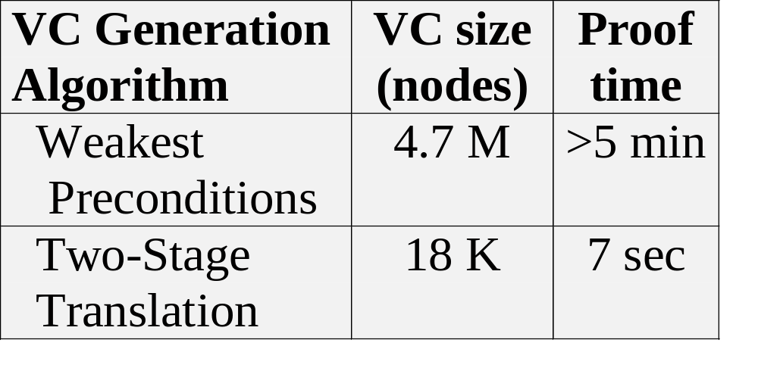
private int scanPunctuation(int nextchr) {
try {
boolean possibleFloatingPointNumber = (nextchr == '.');
text[0] = (char)nextchr;
textlen = 1;
m_in.mark(); // All paths out of the try must unmark the stream!!
PunctuationPrefixTree prefix = punctuationTable;
PunctuationPrefixTree lastPunctuation = prefix;
int lastPunctuationLength = 0;
int index = nextchr - '!';
if (index < 0 || PunctuationPrefixTree.CHILDLEN <= index) prefix = null;
else prefix = prefix.children[nextchr - '!'];
nextchr = m_in.read();
if (possibleFloatingPointNumber && Character.isDigit((char)nextchr)) {
m_in.clearMark();
return finishFloatingPointLiteral(nextchr);
}
this.append(nextchr);
if (prefix != null && prefix.code != TagConstants.NULL) {
lastPunctuation = prefix;
lastPunctuationLength = textlen - 1;
m_in.mark();
}
while(prefix != null) {
index = nextchr - '!';
if (index < 0 || PunctuationPrefixTree.CHILDLEN <= index) prefix = null;
else prefix = prefix.children[nextchr - '!'];
nextchr = m_in.read();
this.append(nextchr);
if (prefix != null && prefix.code != TagConstants.NULL) {
lastPunctuation = prefix;
lastPunctuationLength = textlen - 1;
m_in.mark();
}
}
m_in.reset();
textlen = lastPunctuationLength;
endingLoc = m_in.getLocation();
ttype = lastPunctuation.code;
if (ttype != TagConstants.C_COMMENT&& ttype != TagConstants.EOL_COMMENT)
nextchr = m_in.read();
return ttype;
} catch (IOException e) {
m_in.clearMark();
ErrorSet.fatal(m_in.getLocation(), e.toString());
return TagConstants.NULL; // Dummy
}
}

Slide 23
Current Status of ESC
Scales well to complex methods
Ready for educational/research use? Yes!
  http://research.compaq.com/SRC/esc/
Ready for commercial use? Not really.
  annotation overhead significant
  annotations increase program size by 10%
  requires 1 programmer-hour to annotate 300 lines of code

Slide 24
Future Directions
Annotation Inference
  Houdini annotation inference system
    Infer annotations via whole-program analysis (up to 40 KLOC)
    “Generate and test” strategy leverages ESC
  Loop invariant inference via predicate abstraction
    Infers universally-quantified loop invariants, e.g.
    (\forall int j;
    spot == MAXDIRENTRY && 0 <= j && j < i
    ==> bdisk[addr].dirEntries[j].inum != UNUSED )
Full verification of systems software
  Frangipani distributed file system

