Slide 1
Dynamic Architecture Extraction
Cormac Flanagan
UC Santa Cruz
Stephen Freund
Williams College

Slide 2
The Unstructured Heap
The Heap is one big, unstructured graph
  pointers are the last “goto” of modern programming languages
  any object can point to any other object
  (types help a bit)
Huge problem for
  program understanding
  program verification
  static analysis

Slide 3
What Structure do Heaps Have?
Real heaps have some structure
  trees vs DAGs vs graphs
  sharing/aliasing, uniqueness, containment
  ..., other patterns, ...

Slide 4
Lots of Static Analyses for Heaps
Ownership
  Aldrich / Boyapati / Noble and others
Confined types
  [Vitek-Bokowski, 01]
Shape analysis
  [Sagiv-Reps-Wilhelm, 98]
Aliasing patterns
  [Hackett-Aiken, 06]
Model Extraction
  [Jackson-Waingold, 99]

Slide 5
Our Work
What do heaps really look like “in the wild”
  use dynamic analysis to capture real heaps & dissect them offline
What common structural patterns occur
What graphical languages work well to describe these structures
  aka object model (UML class/object diagrams)
  structure reflects system architecture

Slide 6
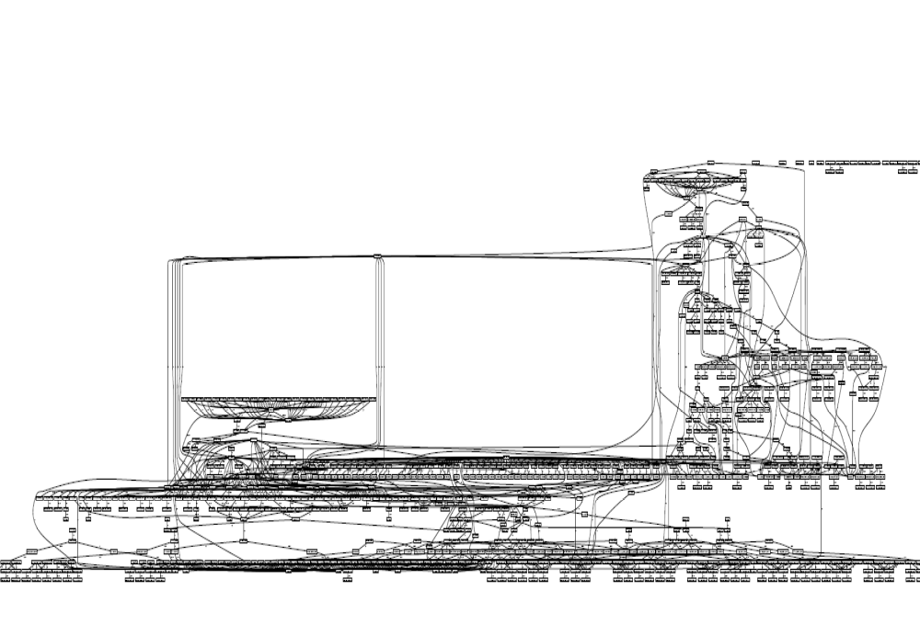

Slide 7
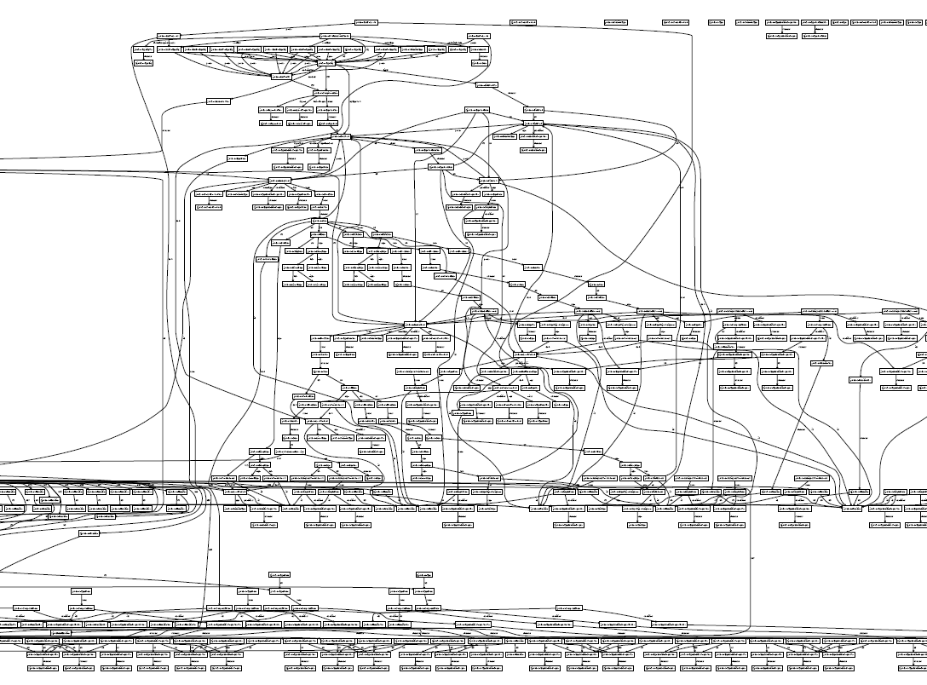

Slide 8
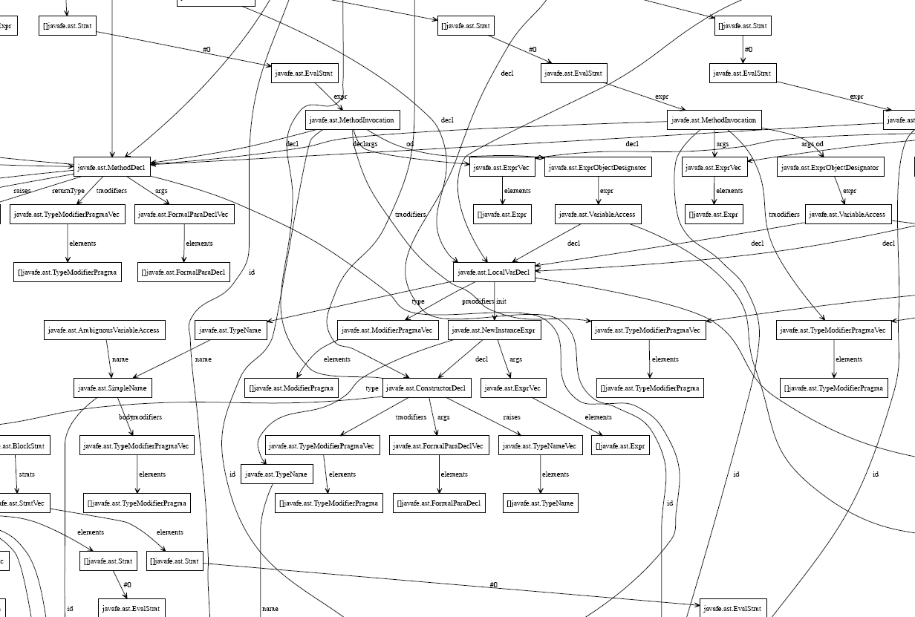

Slide 9
Abstract Graph (aka Object Model)
ClassDecl
TypeDecl
FieldDecl
ConstructDecl
MethodDecl

Slide 10
Aardvark Instrumentation Architecture
Aardvark
Instrumenter
Class files
JVM
Instrumented
Class files
Log of all
- object allocations
- field writes

Slide 11
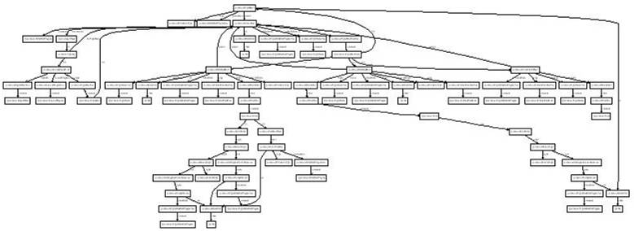
Aardvark Analysis Architecture
Log of all
- object allocations
- field writes
Heap Rebuilder
Object Model Reconstructor
Main
Iterator
HashMap
Key
*
Value
Entry

Slide 12
Aardvark Analysis (for one heap)
Main
LinkedList
Pt
Elem
?
Abstract Graph
(aka Object Model)
Concrete Heap
Object Model Reconstruction
- Project
- Close
- Abstraction
- Subtyping
- Multiplicities
- Uniqueness
- Ownership
- Containment
Main
Iterator
HashMap
Key
*
Value
Entry

Slide 13
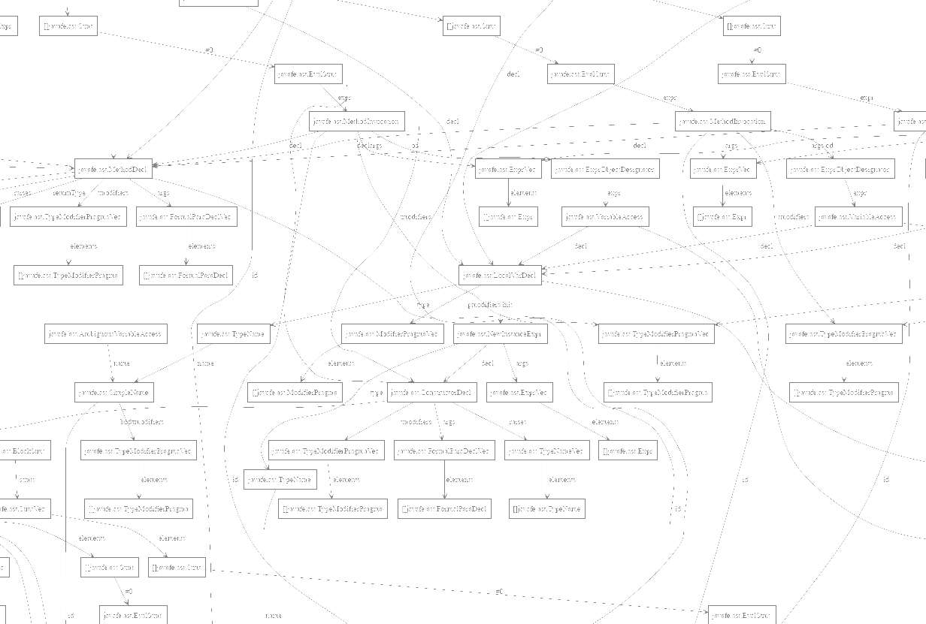
Heap Projections
Much of heap is irrelevant to software engineering task at hand
  so we remove it
Keep objects whose type matches a regexp
    eg javafe.ast.* | javafe.tc.* | java.util.* | [*
Keep objects reachable from certain roots
    eg reachable from javafe.ast.ClassDecl objects

Slide 14
Heap Projections
Much of heap is irrelevant to software engineering task at hand
  so we remove it
Keep objects whose type matches a regexp
    eg javafe.ast.* | javafe.tc.* | java.util.* | [*
Keep objects reachable from certain roots
    eg reachable from javafe.ast.ClassDecl objects

Slide 15
Projected Heap

Slide 16
Closing over Intermediate Objects
Small (projected) heap
Some objects (arrays, ...Vec objects) describe the low-level implementation of ClassDecls
  would like to elide for clarity
  yet preserve connectivity
ClassDecl
TypeDeclElemVec
TypeDeclElem[ ]
FieldDecl
ConstructDecl
FieldDecl
MethodDecl
MethodDecl

Slide 17
Closing over Intermediate Objects
Small (projected) heap
After closing over arrays, *Vec
ClassDecl
TypeDeclElemVec
TypeDeclElem[ ]
FieldDecl
FieldDecl
FieldDecl
MethodDecl
MethodDecl
ClassDecl
FieldDecl
FieldDecl
ConstructDecl
MethodDecl
MethodDecl

Slide 18
Abstraction Merges Similar Objects
ClassDecl
FieldDecl
FieldDecl
ConstructDec
MethodDecl
MethodDecl

Slide 19
Abstraction Merges Similar Objects
ClassDecl
FieldDecl
FieldDecl
ConstructDec
MethodDecl
MethodDecl
Abstract Graph (aka Object Model)
ClassDecl
FieldDecl
ConstructDecl
MethodDecl

Slide 20
Abstraction With Subtyping
ClassDecl
FieldDecl
FieldDecl
ConstructDecl
MethodDecl
MethodDecl
Abstract Graph
ClassDecl
TypeDeclElem
FieldDecl
ConstructDecl
MethodDecl

Slide 21
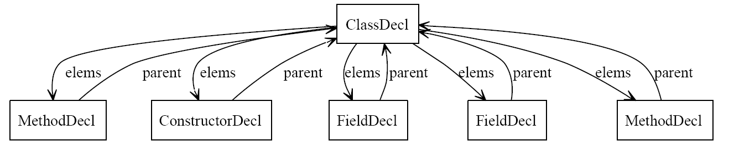
Abstraction, Concretization, and Soundness
α
Abstract Graph
ClassDecl
TypeDecl
ConstructDecl
FieldDecl
MethodDecl

Slide 22
Abstraction, Concretization, and Soundness
α
Abstract Graph
ClassDecl
γ
TypeDecl
ConstructDecl
FieldDecl
MethodDecl
Soundness Theorem: For all heaps H, H ∈ γ(α(H))

Slide 23
Abstraction, Concretization, and Soundness
α
Abstract Graph
Main
γ
Iterator
HashMap
Key
*
Value
Entry
Soundness Theorem: For all heaps H, H ∈ γ(α(H))

Slide 24
Abstraction Loses Information
Which heap does this abstract graph represent?
T
Node
T
Node
T
Node
T
Node
Node
Node
Node
Node
Node
Node
Node
Node
Node
Node
Node
Node
Node
Node
Node

Slide 25
Uniqueness Recovers Information
Which heap does this abstract graph represent?
T
Node
T
Node
T
Node
T
Node
Node
Node
Node
Node
Node
Node
Node
Node
Node
Node
Node
Node
Node
Node
Node

Slide 26
Multiplicities
Which tree does this abstract graph represent?
T
Node
T
Node
T
Node
Node
Node
Node
Node
Node
Node
Node
Node
Node

Slide 27
Multiplicities
Each arrow from A to B has a multiplicity that indicates how many pointers from each A object points to a B object
  “” means each exactly 1
  ? means each 0 or 1
  * means each 0 or more
  + means each 1 or more
Could be more precise, eg { 3..5 }
  but brittle wrt test inputs

Slide 28
Multiplicities
Which tree does this abstract graph represent?
T
Node
?

Slide 29
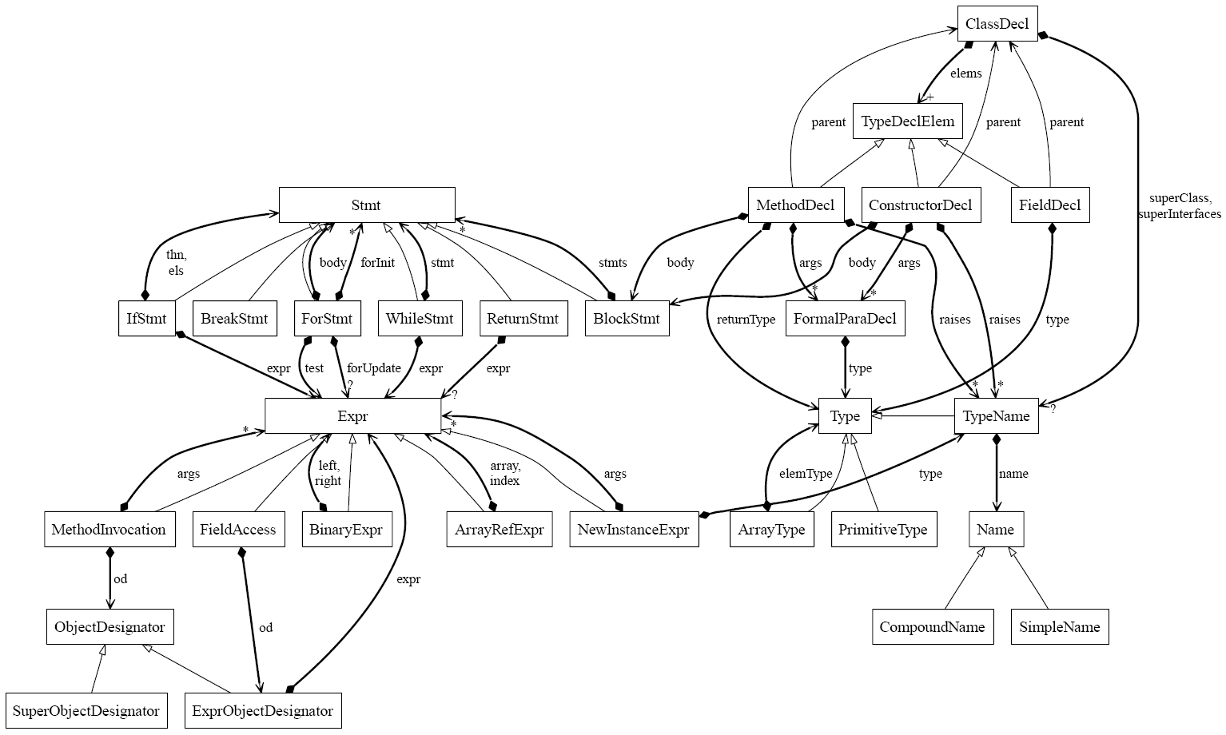
Javafe Object Model

Slide 30
Zooming In ...

Slide 31
Controlled Sharing: Uniqueness is not Enough
LinkedList
Main
LinkedList
Elem
Elem
Elem
Pt
Elem
Pt
Elem
Elem
Pt

Slide 32
Controlled Sharing: Uniqueness is not Enough
LinkedList
Main
LinkedList
Elem
Elem
Elem
Pt
Elem
Pt
Elem
Elem
Pt
Main
LinkedList
Pt
Elem
?

Slide 33
Controlled Sharing: Uniqueness is not Enough
LinkedList
Main
LinkedList
Elem
Elem
Elem
Pt
Elem
Elem
Elem
Pt
Pt
Main
LinkedList
Pt
Elem
?

Slide 34
Ownership for Controlled Sharing
LinkedList
Main
LinkedList
Elem
Elem
Elem
Pt
Elem
Pt
Elem
Elem
Pt
Main
LinkedList
Pt
Elem
?

Slide 35
Beyond Ownership
Main
Iterator
Iterator
Iterator
HashMap
Entry[ ]
HashMap
Entry[ ]
Entry
Entry
Entry
Entry
Entry
Key
Value
Key
Value
Key
Value
Key
Value
Key

Slide 36
Beyond Ownership
Main
Main
Iterator
HashMap
*
Iterator
Iterator
Key
Entry
Value
Iterator
HashMap
Entry[ ]
HashMap
Entry[ ]
Entry
Entry
Entry
Entry
Entry
Key
Value
Key
Value
Key
Value
Key
Value
Key

Slide 37
Beyond Ownership
Main
Main
Iterator
HashMap
*
Iterator
Iterator
Key
Entry
Value
Iterator
HashMap
Entry[ ]
HashMap
Entry[ ]
Entry
Entry
Entry
Entry
Entry
Key
Value
Key
Value
Key
Value
Key
Value
Key

Slide 38
Containment
Main
Iterator
Iterator
Iterator
HashMap
Entry[ ]
HashMap
Entry[ ]
Entry
Entry
Entry
Entry
Entry
Key
Value
Key
Value
Key
Value
Key
Value
Key

Slide 39
Containment
Main
Main
Iterator
HashMap
*
Iterator
Iterator
Key
Entry
Value
Iterator
HashMap
Entry[ ]
HashMap
Entry[ ]
Entry
Entry
Entry
Entry
Entry
Key
Value
Key
Value
Key
Value
Key
Value
Key

Slide 40
Aardvark Analysis (for One Heap)
Main
LinkedList
Pt
Elem
Abstract Graph Seq.
?
Concrete Heap
Object Model Reconstruction
- Project
- Close
- Abstraction
- Subtyping
- Multiplicities
- Uniqueness
- Ownership
- Containment
Main
Iterator
HashMap
Key
*
Value
Entry

Slide 41
Aardvark Analysis (for Heap Sequence)
Main
LinkedList
Pt
Elem
Abstract Graph Seq.
?
Heap Sequence
Object Model Reconstruction
- Project
- Close
- Abstraction
- Subtyping
- Multiplicities
- Uniqueness
- Ownership
- Containment
Main
Main
Main
Main
Iterator
HashMap
Iterator
HashMap
Iterator
HashMap
Key
Iterator
*
HashMap
Entry
*
Value
Key
Entry
*
Value
Key
Entry
*
Value
Key
Entry
Value
Merge
(least upper bound)
Main
Iterator
HashMap
Key
*
Value
Entry

Slide 42
Implementation
Based on bytecode rewriting
  uses BCEL binary instrumenter
Instrumentation overhead 10x-50x
For heap with 380,000 objects (~10Mb)
  15 seconds to rebuild heap from log
  15 seconds to infer object model
Layout using dot
Script driven
  abstraction, projection etc domain-dependent

Slide 43
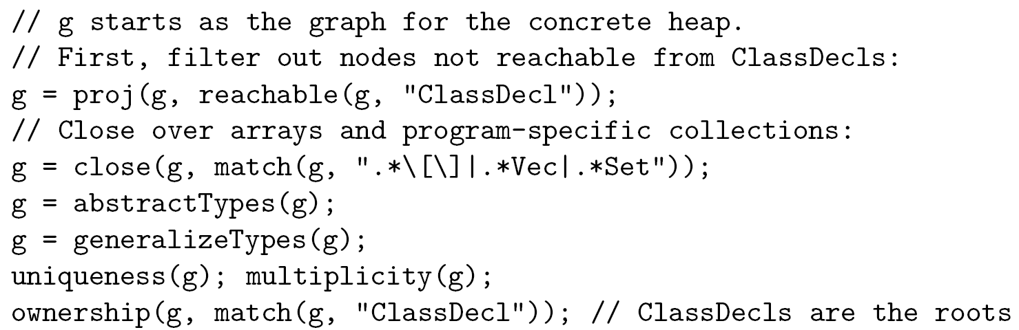
Example Script

Slide 44
Future Work
Inferring additional common invariants
  both structural and data-dependent
Analyzing the stack as well as the heap
Application to large systems
  scalability, performance, incremental analysis
Evolution of object models
Combinations with static analyses
  Eg to verify inferred object model
Low-level languages: C, C++

Slide 45
Aardvark Architecture
Aardvark
Instrumenter
Class files
Instrumented
Class files
Log of all
- object allocations
- field writes
Heap Rebuilder
JVM
Main
Object Model Reconstructor
Iterator
HashMap
Key
*
Value
Entry

