Slide 1
Verifying Commit-Atomicity
Using Model Checking
Cormac Flanagan
University of California,
Santa Cruz

Slide 2
Model Checking of Software Models
Specification
for
filesystem.c
Model
Checker
✓
✗
// filesystem.c
void create(..) {
...
}
void unlink(..) {
...
}
filesystem
model
Model
Construction

Slide 3
Model Checking of Software
Specification
for
filesystem.c
Model
Checker
✓
✗
// filesystem.c
void create(..) {
...
}
void unlink(..) {
...
}

Slide 4
Experience with Calvin Software Checker
Specification
for
filesystem.c
x
Calvin
theorem
proving
✓
expressed in terms of
✗
// filesystem.c
void create(..) {
...
}
void unlink(..) {
...
}
concrete
state

Slide 5
Experience with Calvin Software Checker
?
Specification
for
filesystem.c
abstract
state
x
Calvin
theorem
proving
✓
Abstraction
Invariant
✗
// filesystem.c
void create(..) {
...
}
void unlink(..) {
...
}
concrete
state

Slide 6
The Need for Atomicity
// filesystem.c
void create(..) {
...
}
void unlink(..) {
...
}
Sequential case:
code inspection &
testing mostly ok
// filesystem.c
void create(..) {
...
}
void unlink(..) {
...
}

Slide 7
The Need for Atomicity
// filesystem.c
void create(..) {
...
}
void unlink(..) {
...
}
Sequential case:
code inspection &
testing ok
// filesystem.c
atomic void create(..) {
...
}
atomic void unlink(..) {
...
}
Atomicity
Checker
✓
✗

Slide 8
Atomicity
Serialized execution of inc()
o
X
o
Y
o
acq(L)
t=x
x=t+1
rel(L)
Z
o
o
o
o
o
atomic void inc() {
acq(L);
int t = x;
x = t+1;
rel(L);
}

Slide 9
Atomicity
Serialized execution of inc()
Non-serialized executions of inc()
inc() is atomic if, for every non-serialized execution, there is a serialized execution with the same overall behavior
o
X
o
Y
o
acq(L)
t=x
x=t+1
rel(L)
Z
o
o
o
o
o
acq(L)
X
t=x
Y
x=t+1
Z
rel(L)
o
o
o
o
o
o
o
o
acq(L)
t=x
X
Y
x=t+1
rel(L)
Z
o
o
o
o
o
o
o
o

Slide 10
Verifying Atomicity via Reduction [Lipton 75]
acq(L)
X
t=x
Y
x=t+1
Z
rel(L)
S₀
S₁
S₂
S₃
S₄
S₅
S₆
S₇

Slide 11
Verifying Atomicity via Reduction
acq(L)
X
t=x
Y
x=t+1
Z
rel(L)
S₀
S₁
S₂
S₃
S₄
S₅
S₆
S₇
acq(L)
X
Y
t=x
x=t+1
Z
rel(L)
S₀
S₁
S₂
T₃
S₄
S₅
S₆
S₇

Slide 12
Verifying Atomicity via Reduction
acq(L)
X
t=x
Y
x=t+1
Z
rel(L)
S₀
S₁
S₂
S₃
S₄
S₅
S₆
S₇
acq(L)
X
Y
t=x
x=t+1
Z
rel(L)
S₀
S₁
S₂
T₃
S₄
S₅
S₆
S₇
S₀
X
T₁
acq(L)
S₂
Y
T₃
t=x
S₄
x=t+1
S₅
Z
S₆
rel(L)
S₇

Slide 13
Verifying Atomicity via Reduction
acq(L)
X
t=x
Y
x=t+1
Z
rel(L)
S₀
S₁
S₂
S₃
S₄
S₅
S₆
S₇
acq(L)
X
Y
t=x
x=t+1
Z
rel(L)
S₀
S₁
S₂
T₃
S₄
S₅
S₆
S₇
S₀
X
T₁
acq(L)
S₂
Y
T₃
t=x
S₄
x=t+1
S₅
Z
S₆
rel(L)
S₇
S₀
X
T₁
Y
T₂
acq(L)
T₃
t=x
S₄
x=t+1
S₅
Z
S₆
rel(L)
S₇

Slide 14
Verifying Atomicity via Reduction
acq(L)
X
t=x
Y
x=t+1
Z
rel(L)
S₀
S₁
S₂
S₃
S₄
S₅
S₆
S₇
acq(L)
X
Y
t=x
x=t+1
Z
rel(L)
S₀
S₁
S₂
T₃
S₄
S₅
S₆
S₇
S₀
X
T₁
acq(L)
S₂
Y
T₃
t=x
S₄
x=t+1
S₅
Z
S₆
rel(L)
S₇
S₀
X
T₁
Y
T₂
acq(L)
T₃
t=x
S₄
x=t+1
S₅
Z
S₆
rel(L)
S₇
S₀
X
T₁
Y
T₂
acq(L)
T₃
t=x
S₄
x=t+1
S₅
rel(L)
T₆
Z
S₇

Slide 15
Applications of Reduction for Atomicity
Type systems for concurrency
  extended Java’s type system to verify atomicity
  atomicity violations in standard libraries
Dynamic checkers
  atomicity widespread in Java programs
Model checking
  Bogor

Slide 16
Example Violation: java.lang.StringBuffer
public class StringBuffer {
private int count;
public synchronized int length() { return count; }
public synchronized void getChars(...) { ... }
atomic public synchronized void append(StringBuffer sb){
int len = sb.length();
...
...
...
sb.getChars(...,len,...);
...
}
}
sb.length() acquires lock on sb, gets length, and releases lock
other threads can change sb
use of stale len may yield StringIndexOutOfBoundsException
inside getChars(...)

Slide 17
Limitations of Reduction
begin
atomic
r:=1
assume
r==1
L=0
CAS(L,0,r)
succeeds
assume
r!=1
end
atomic
S₀
S₁
S₂
S₃
S₄
S₅
S₆
S₇
L=0
begin
atomic
r:=1
assume
r=1
CAS(L,0,r)
succeeds
assume
r!=1
end
atomic
S₀
T₁
T₂
T₃
S₄
S₅
S₆
S₇
boolean L; // lock, 0 if not held
atomic void acquire() {
boolean r := 1;
while (r==1) {
CAS(L,0,r);
}
}

Slide 18
Limitations of Reduction
begin
atomic
assume
r==1
CAS(L,0,r)
fails
assume
r==1
CAS(L,0,r)
succeeds
assume
r!=1
end
atomic
r:=1
L=0
S₀
S₁
S₂
S₃
S₄
S₅
S₆
S₇
S₈
S₉
9 instructions
L=0
begin
atomic
r:=1
assume
r=1
CAS(L,0,r)
succeeds
assume
r!=1
end
atomic
S₀
T₁
T₂
T₃
T₄
T₅
T₆
S₉
7 instructions
boolean L; // lock, 0 if not held
atomic void acquire() {
boolean r := 1;
while (r==1) {
CAS(L,0,r);
}
}

Slide 19
Commit-Atomic
Run normal and serial executions of program concurrently, on separate stores
Normal execution runs as normal
  threads execute atomic blocks
  each atomic block has commit point
Serial execution
  runs on separate shadow store
  when normal execution commits an atomic block, serial execution runs entire atomic block serially
Check two executions yield same behavior

Slide 20
Commit-Atomic
Normal execution
commit
atomic block
...
compare
states
...
Serial execution

Slide 21
Preliminary Evaluation
Some small benchmarks
  Bluetooth device driver
    atomicity violation due to error
  Busy-waiting lock acquire
    acquire1: 1 line of code in critical section
    acquire100: 100 lines of code in critical section
Hand translated to PROMELA code
  Two versions, with and without commit-atomic

Slide 22
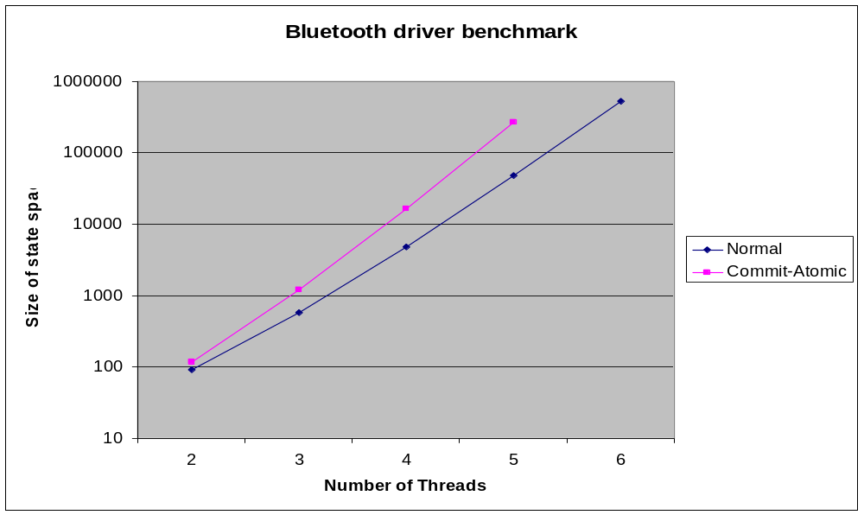
Performance: Bluetooth device driver

Slide 23
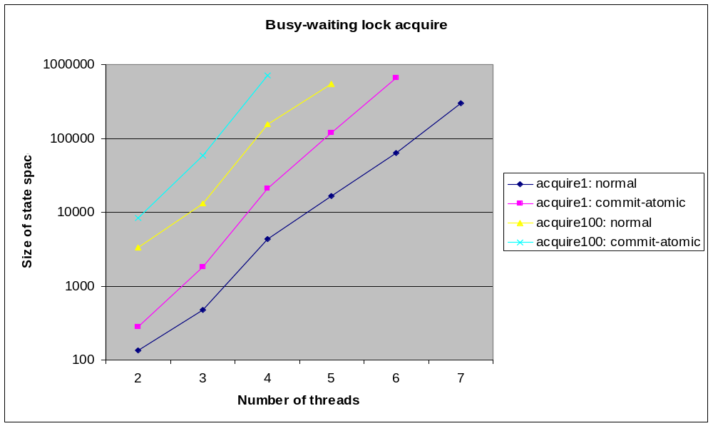
Performance: acquire1 and acquire100

Slide 24
Related Work
Reduction
  [Lipton 75, Lamport-Schneider 89, ...]
  type systems [Flanagan-Qadeer 03]
  model checking [Stoller-Cohen 03, Flanagan-Qadeer 03, Hatcliff et al 04]
  dynamic checking [Flanagan-Freund 04]
  procedure summaries [Qadeer et al 04]
Atomicity a canonical concept
  Strict serializability in databases
  Linearizability for concurrent objects
  Languages: Monitors, Argus [Liskov et al 87], Avalon [Eppinger et al 91]
View consistency
  [Artho-Biere-Havelund 03, von Praun-Gross 03]

Slide 25
Summary
Atomicity
  concise, semantically deep partial specification
Reduction
  lightweight technique for verifying atomicity
Commit-Atomicity
  more general technique
Future work
  combine reduction and commit-atomic
  generalizing atomicity
    temporal logics for determinism?

Slide 26
Future Work: Logics for Determinism?
Software checking: exploits redundancy
  between program and types
  between program and specification
  between different traces of the same program
Do we need temporal logics for determinism?
  that is, a logic where we could specify that some traces behave like other traces
  express many properties like “atomic”

Slide 27
Verifying Commit-Atomicity
Using Model Checking
Cormac Flanagan
University of California,
Santa Cruz

