Slide 1
Atomicity for Reliable
Concurrent Software
Cormac Flanagan
UC Santa Cruz
Shaz Qadeer
Microsoft Research
Joint work with
Stephen Freund

Slide 2
Towards Reliable Multithreaded Software
Multithreaded software
  increasingly common (Java, C#, GUIs, servers)
  decrease latency
  exploit underlying hardware
    multi-core chips
Heisenbugs due to thread interference
  race conditions
  atomicity violations
Need tools to verify atomicity
  dynamic analysis
  type systems

Slide 3
Motivations for Atomicity
Beyond Race Conditions

Slide 4
Race Conditions
class Ref {
int i;
void inc() {
int t;
t = i;
i = t+1;
}
}

Slide 5
Race Conditions
class Ref {
int i;
void inc() {
int t;
t = i;
i = t+1;
}
}
Ref x = new Ref(0);
x.inc();
x.inc();
assert x.i == 2;

Slide 6
Race Conditions
class Ref {
int i;
void inc() {
int t;
t = i;
i = t+1;
}
}
Ref x = new Ref(0);
parallel {
x.inc(); // two calls happen
x.inc(); // in parallel
}
assert x.i == 2;
A race condition occurs if
two threads access a shared variable at the same time
at least one of those accesses is a write

Slide 7
Lock-Based Synchronization
class Ref {
int i; // guarded by this
void inc() {
int t;
synchronized (x) {
t = i;
i = t+1;
}
}
}
Ref x = new Ref(0);
parallel {
x.inc(); // two calls happen
x.inc(); // in parallel
}
assert x.i == 2;
Field guarded by a lock
Lock acquired before accessing field
Ensures race freedom

Slide 8
Limitations of Race-Freedom
class Ref {
int i; // guarded by this
void inc() {
int t;
synchronized (x) {
t = i;
i = t+1;
}
}
}
Ref x = new Ref(0);
parallel {
x.inc(); // two calls happen
x.inc(); // in parallel
}
assert x.i == 2;
Ref.inc()
race-free
behaves correctly in a multithreaded context

Slide 9
Limitations of Race-Freedom
class Ref {
int i;
void inc() {
int t;
synchronized (this) {
t = i;
}
synchronized (this) {
i = t+1;
}
}
...
}
Ref.inc()
race-free
behaves incorrectly in a multithreaded context
Race freedom does not prevent errors due to unexpected interactions
between threads

Slide 10
Limitations of Race-Freedom
class Ref {
int i;
void inc() {
int t;
synchronized (this) {
t = i;
i = t+1;
}
}
void read() { return i; }
...
}
Ref.read()
has a race condition
behaves correctly in a multithreaded context
Race freedom is not necessary to prevent errors due to unexpected interactions
between threads

Slide 11
Race-Freedom
Race-freedom is neither necessary nor sufficient to ensure the absence of errors due to unexpected interactions between threads
Is there a more fundamental semantic correctness property?

Slide 12
Motivations for Atomicity
2. Enables Sequential Reasoning

Slide 13
Sequential Program Execution
inc()
precond.
void inc() {
..
..
}
postcond.

Slide 14
Multithreaded Execution
void inc() {
..
..
}

Slide 15
Multithreaded Execution
void inc() {
..
..
}

Slide 16
Multithreaded Execution
Atomicity
guarantees concurrent threads do not interfere with atomic method
enables sequential reasoning
matches existing methodology

Slide 17
Motivations for Atomicity
3. Simple Specification

Slide 18
Model Checking of
Software Models
Specification
for
filesystem.c
Model
Checker
✓
✗
// filesystem.c
void create(..) {
...
}
void unlink(..) {
...
}
filesystem
model
Model
Construction

Slide 19
Model Checking of Software
Specification
for
filesystem.c
Model
Checker
✓
✗
// filesystem.c
void create(..) {
...
}
void unlink(..) {
...
}

Slide 20
Experience with Calvin Software Checker
Specification
for
filesystem.c
x
Calvin
theorem
proving
✓
expressed in terms of
✗
// filesystem.c
void create(..) {
...
}
void unlink(..) {
...
}
concrete
state

Slide 21
Experience with Calvin Software Checker
?
abstract
state
Specification
for
filesystem.c
x
Calvin
theorem
proving
✓
Abstraction
Invariant
✗
// filesystem.c
void create(..) {
...
}
void unlink(..) {
...
}
concrete
state

Slide 22
The Need for Atomicity
// filesystem.c
void create(..) {
...
}
void unlink(..) {
...
}
Sequential case:
code inspection &
testing mostly ok
// filesystem.c
void create(..) {
...
}
void unlink(..) {
...
}

Slide 23
The Need for Atomicity
// filesystem.c
void create(..) {
...
}
void unlink(..) {
...
}
Sequential case:
code inspection &
testing ok
// filesystem.c
atomic void create(..) {
...
}
atomic void unlink(..) {
...
}
Atomicity
Checker
✓
✗

Slide 24
Motivations for Atomicity
Beyond Race Conditions
Enables Sequential Reasoning
Simple Specification

Slide 25
Atomicity
The method inc() is atomic if concurrent threads do not interfere with its behavior
Guarantees that for every execution
there is a serial execution with same behavior
acq(this)
x
t=i
y
i=t+1
z
rel(this)








acq(this)
x
y
t=i
i=t+1
z
rel(this)








x
y
acq(this)
t=i
i=t+1
rel(this)
z









Slide 26
Atomicity
Canonical property
  (cmp. linearizability, serializability, ...)
Enables sequential reasoning
  simplifies validation of multithreaded code
Matches practice in existing code
  most methods (80%+) are atomic
  many interfaces described as “thread-safe”
Can verify atomicity statically or dynamically
  atomicity violations often indicate errors
  leverages Lipton’s theory of reduction

Slide 27
Reduction [Lipton 75]
acq(this)
X
t=i
Y
i=t+1
Z
rel(this)








acq(this)
X
Y
t=i
i=t+1
Z
rel(this)








X
Y
acq(this)
t=i
i=t+1
Z
rel(this)








X
Y
acq(this)
t=i
i=t+1
rel(this)
Z









Slide 28
Checking Atomicity
atomic void inc() {
int t;
synchronized (this) {
t = i;
i = t + 1;
}
}
R: right-mover lock acquire
L: left-mover lock release
B: both-mover race-free variable access
A: atomic conflicting variable access
acq(this)
t=i
i=t+1
rel(this)
R B B L
A
Reducible blocks have form: (R|B)* [A] (L|B)*

Slide 29
Checking Atomicity (cont.)
atomic void inc() {
int t;
synchronized (this) {
t = i;
}
synchronized (this) {
i = t + 1;
}
}
R: right-mover lock acquire
L: left-mover lock release
B: both-mover race-free variable access
A: atomic conflicting variable access
acq(this)
t=i
rel(this)
acq(this)
i=t+1
rel(this)
R B L R B L
A
A
Compound

Slide 30
java.lang.StringBuffer
/**
... used by the compiler to implement the binary string concatenation operator ...
String buffers are safe for use by multiple threads. The methods are synchronized so that all the operations on any particular instance behave as if they occur in some serial order that is consistent with the order of the method calls made by each of the individual threads involved.
*/
FALSE
/*# atomic */ public class StringBuffer { ... }

Slide 31
java.lang.StringBuffer
public class StringBuffer {
private int count;
public synchronized int length() { return count; }
public synchronized void getChars(...) { ... }
atomic public synchronized void append(StringBuffer sb){
int len = sb.length();
...
...
...
sb.getChars(...,len,...);
...
}
}
sb.length() acquires lock on sb, gets length, and releases lock
other threads can change sb
use of stale len may yield StringIndexOutOfBoundsException
inside getChars(...)

Slide 32
java.lang.StringBuffer
public class StringBuffer {
private int count;
public synchronized int length() { return count; }
public synchronized void getChars(...) { ... }
atomic public synchronized void append(StringBuffer sb){
int len = sb.length();
...
...
...
sb.getChars(...,len,...);
...
}
}
A
A
Compound

Slide 33
Tutorial Outline
Part 1
  Introduction
  Runtime analysis for atomicity
Part 2
  Model checking for atomicity
Part 3
  Type systems for concurrency and atomicity
Part 4
  Beyond reduction – atomicity via “purity”

Slide 35
Part I continued:
Runtime Analysis for Atomicity

Slide 36
Atomizer: Instrumentation Architecture
Instrumented
Source
Code
event stream
T1: begin_atomic
T2: acquire(lock3)
T2: read(x,5)
T1: write(y,3)
T1: end_atomic
T2: release(lock3)
Runtime
Lockset
Reduction
Atomizer
/*# atomic */ void append(...)
{ ... }
javac
+JVM
Warning: method “append”
may not be atomic at line 43

Slide 37
Atomizer: Dynamic Analysis
Lockset algorithm
  from Eraser [Savage et al. 97]
  identifies race conditions
Reduction [Lipton 75]
  proof technique for verifying atomicity, using information about race conditions

Slide 38
Analysis 1: Lockset Algorithm
Tracks lockset for each field
  lockset = set of locks held on all accesses to field
Dynamically infers protecting lock for each field
Empty lockset indicates possible race condition

Slide 39
Lockset Example
Thread 1
synchronized(x) {
synchronized(y) {
o.f = 2;
}
o.f = 11;
}
Thread 2
synchronized(y) {
o.f = 2;
}
First access to o.f:
LockSet(o.f) = Held(curThread)
= { x, y }

Slide 40
Lockset Example
Thread 1
synchronized(x) {
synchronized(y) {
o.f = 2;
}
o.f = 11;
}
Thread 2
synchronized(y) {
o.f = 2;
}
Subsequent access to o.f:
LockSet(o.f) := LockSet(o.f) ∩ Held(curThread)
= { x, y } ∩ { x }
= { x }

Slide 41
Lockset Example
Thread 1
synchronized(x) {
synchronized(y) {
o.f = 2;
}
o.f = 11;
}
Thread 2
synchronized(y) {
o.f = 2;
}
Subsequent access to o.f:
LockSet(o.f) := LockSet(o.f) ∩ Held(curThread)
= { x } ∩ { y }
= { } => race condition

Slide 42
Lockset
any thread
r/w
Shared-read/write
Track lockset
Shared-exclusive
Track lockset
race condition!

Slide 43
Lockset with Thread Local Data
first thread
r/w
Thread
Local
second
thread
r/w
any thread
r/w
Shared-read/write
Track lockset
Shared-exclusive
Track lockset
race condition!

Slide 44
Lockset with Read Shared Data
first thread
r/w
Thread
Local
second
thread
read
second
thread
write
any thread
r/w
Shared-read/write
Track lockset
Shared-exclusive
Track lockset
Read
Shared
any thread
write
any thread
read
race condition!

Slide 45
Atomizer: Dynamic Analysis
Lockset algorithm
  from Eraser [Savage et al. 97]
  identifies race conditions
Reduction [Lipton 75]
  proof technique for verifying atomicity, using information about race conditions

Slide 46
Reduction [Lipton 75]
acq(this)
X
t=i
Y
i=t+1
Z
rel(this)








acq(this)
X
Y
t=i
i=t+1
Z
rel(this)








X
Y
acq(this)
t=i
i=t+1
Z
rel(this)








X
Y
acq(this)
t=i
i=t+1
rel(this)
Z









Slide 47
Performing Reduction Dynamically
R: right-mover
  lock acquire
L: left-mover
  lock release
B: both-mover
  race-free field access
N: non-mover
  access to "racy" fields
acq(lock)
j=bal
bal=j+n
rel(lock)
R B B L
Reducible methods: (R|B)* [N] (L|B)*
R|B
L|B
start
atomic
block
InRight
L|N
InLeft
R|N
Error

Slide 48
Atomizer Review
Instrumented code calls Atomizer runtime
  on field accesses, sync ops, etc
Lockset algorithm identifies races
  used to classify ops as movers or non-movers
Atomizer checks reducibility of atomic blocks
  warns about atomicity violations

Slide 49
Evaluation
12 benchmarks
  scientific computing, web server, std libraries, ...
  200,000+ lines of code
Heuristics for atomicity
  all synchronized blocks are atomic
  all public methods are atomic, except main and run
Slowdown: 1.5x - 40x

Slide 50
Performance
Benchmark | Lines | Base Time (s) | Slowdown
elevator | 500 | 11.2 | -
hedc | 29,900 | 6.4 | -
tsp | 700 | 1.9 | 21.8
sor | 17,700 | 1.3 | 1.5
moldyn | 1,300 | 90.6 | 1.5
montecarlo | 3,600 | 6.4 | 2.7
raytracer | 1,900 | 4.8 | 41.8
mtrt | 11,300 | 2.8 | 38.8
jigsaw | 90,100 | 3.0 | 4.7
specJBB | 30,500 | 26.2 | 12.1
webl | 22,300 | 60.3 | -
lib-java | 75,305 | 96.5 | -

Slide 51
Extensions
Redundant lock operations are both-movers
  re-entrant acquire/release
  operations on thread-local locks
  operations on lock A, if lock B always acquired before A
Write-protected data

Slide 52
Write-Protected Data
class Account {
int bal;
/*# atomic */ int read() { return bal; }
/*# atomic */ void deposit(int n) {
synchronized (this) {
int j = bal;
bal = j + n;
}
}
}
R
B
N
L

Slide 53
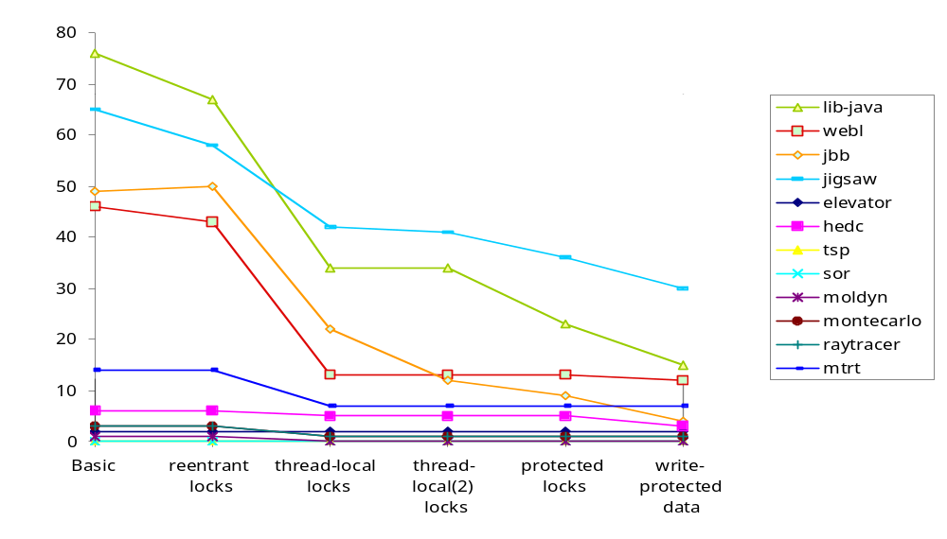
Extensions Reduce Number of Warnings
Total
341
Total
97

Slide 54
Evaluation
Warnings: 97 (down from 341)
Real errors (conservative): 7
False alarms due to:
  simplistic heuristics for atomicity
    programmer should specify atomicity
  false races
  methods irreducible yet still "atomic"
    eg caching, lazy initialization
No warnings reported in more than 90% of exercised methods

Slide 55
java.lang.StringBuffer
public class StringBuffer {
private int count;
public synchronized int length() { return count; }
public synchronized void getChars(...) { ... }
/*# atomic */
public synchronized void append(StringBuffer sb){
int len = sb.length();
...
...
...
sb.getChars(...,len,...);
...
}
}
StringBuffer.append is not atomic:
Start:
at StringBuffer.append(StringBuffer.java:701)
at Thread1.run(Example.java:17)
Commit: Lock Release
at StringBuffer.length(StringBuffer.java:221)
at StringBuffer.append(StringBuffer.java:702)
at Thread1.run(Example.java:17)
Error: Lock Acquire
at StringBuffer.getChars(StringBuffer.java:245)
at StringBuffer.append(StringBuffer.java:710)
at Thread1.run(Example.java:17)

