Slide 1
Atomicity for Reliable
Concurrent Software
Part 3a:
Types for Race-Freedom
and Atomicity

Slide 2
Verifying Race Freedom with Types
class Ref {
int i;
void add(Ref r) {
i = i
+ r.i;
}
}
Ref x = new Ref(0);
Ref y = new Ref(3);
parallel {
synchronized (x,y) { x.add(y); }
synchronized (x,y) { x.add(y); }
}
assert x.i == 6;

Slide 3
Verifying Race Freedom with Types
class Ref {
int i guarded_by this;
void add(Ref r) requires this, r {
i = i
+ r.i;
}
}
Ref x = new Ref(0);
Ref y = new Ref(3);
parallel {
synchronized (x,y) { x.add(y); }
synchronized (x,y) { x.add(y); }
}
assert x.i == 6;
check: this  { this, r }
✓

Slide 4
Verifying Race Freedom with Types
class Ref {
int i guarded_by this;
void add(Ref r) requires this, r {
i = i
+ r.i;
}
}
Ref x = new Ref(0);
Ref y = new Ref(3);
parallel {
synchronized (x,y) { x.add(y); }
synchronized (x,y) { x.add(y); }
}
assert x.i == 6;
check: this  { this, r }
✓
check: this[this:=r] = r  { this, r }
✓
replace this by r

Slide 5
Verifying Race Freedom with Types
class Ref {
int i guarded_by this;
void add(Ref r) requires this, r {
i = i
+ r.i;
}
}
Ref x = new Ref(0);
Ref y = new Ref(3);
parallel {
synchronized (x,y) { x.add(y); }
synchronized (x,y) { x.add(y); }
}
assert x.i == 6;
check: this  { this, r }
✓
check: this[this:=r] = r  { this, r }
✓
replace formals this,r
by actuals x,y
check: {this,r}[this:=x,r:=y]  { x, y }
✓

Slide 6
Verifying Race Freedom with Types
class Ref {
int i guarded_by this;
void add(Ref r) requires this, r {
i = i
+ r.i;
}
}
Ref x = new Ref(0);
Ref y = new Ref(3);
parallel {
synchronized (x,y) { x.add(y); }
synchronized (x,y) { x.add(y); }
}
assert x.i == 6;
check: this  { this, r }
✓
check: this[this:=r] = r  { this, r }
✓
replace formals this,r
by actuals x,y
check: {this,r}[this:=x,r:=y]  { x, y }
✓
check: {this,r}[this:=x,r:=y]  { x, y }
✓
Soundness Theorem:
Well-typed programs are race-free

Slide 7
Basic Type Inference
class Ref {
int i;
void add(Ref r) {
i = i + r.i;
}
}
Ref x = new Ref(0);
Ref y = new Ref(3);
parallel {
synchronized (x,y) { x.add(y); }
synchronized (x,y) { x.add(y); }
}
assert x.i == 6;

Slide 8
Basic Type Inference
static final Object m =new Object();
class Ref {
int i;
void add(Ref r) {
i = i + r.i;
}
}
Ref x = new Ref(0);
Ref y = new Ref(3);
parallel {
synchronized (x,y) { x.add(y); }
synchronized (x,y) { x.add(y); }
}
assert x.i == 6;
Iterative GFP algorithm:
[Flanagan-Freund, PASTE’01]
Start with maximum set of annotations

Slide 9
Basic Type Inference
static final Object m =new Object();
class Ref {
int i guarded_by this, m;
void add(Ref r) {
i = i + r.i;
}
}
Ref x = new Ref(0);
Ref y = new Ref(3);
parallel {
synchronized (x,y) { x.add(y); }
synchronized (x,y) { x.add(y); }
}
assert x.i == 6;
Iterative GFP algorithm:
[Flanagan-Freund, PASTE’01]
Start with maximum set of annotations

Slide 10
Basic Type Inference
static final Object m =new Object();
class Ref {
int i guarded_by this, m;
void add(Ref r) requires this, r, m {
i = i + r.i;
}
}
Ref x = new Ref(0);
Ref y = new Ref(3);
parallel {
synchronized (x,y) { x.add(y); }
synchronized (x,y) { x.add(y); }
}
assert x.i == 6;
Iterative GFP algorithm:
[Flanagan-Freund, PASTE’01]
Start with maximum set of annotations

Slide 11
Basic Type Inference
static final Object m =new Object();
class Ref {
int i guarded_by this, m;
void add(Ref r) requires this, r, m {
i = i + r.i;
}
}
Ref x = new Ref(0);
Ref y = new Ref(3);
parallel {
synchronized (x,y) { x.add(y); }
synchronized (x,y) { x.add(y); }
}
assert x.i == 6;
Iterative GFP algorithm:
[Flanagan-Freund, PASTE’01]
Start with maximum set of annotations
Iteratively remove all incorrect annotations
X
X

Slide 12
Basic Type Inference
static final Object m =new Object();
class Ref {
int i guarded_by this, m;
void add(Ref r) requires this, r, m {
i = i + r.i;
}
}
Ref x = new Ref(0);
Ref y = new Ref(3);
parallel {
synchronized (x,y) { x.add(y); }
synchronized (x,y) { x.add(y); }
}
assert x.i == 6;
Iterative GFP algorithm:
[Flanagan-Freund, PASTE’01]
Start with maximum set of annotations
Iteratively remove all incorrect annotations
Check each field still has a protecting lock
Sound, complete, fast
But type system too basic
X
X

Slide 13
Harder Example: External Locking
class Ref {
int i;
void add(Ref r) {
i = i + r.i;
}
}
Object m = new Object();
Ref x = new Ref(0);
Ref y = new Ref(3);
parallel {
synchronized (m) { x.add(y); }
synchronized (m) { x.add(y); }
}
assert x.i == 6;
Field i of x and y protected by external lock m
Not typable with basic type system
  m not in scope at i
Requires more expressive type system with ghost parameters

Slide 14
Ghost Parameters on Classes
class Ref {
int i;
void add(Ref r) {
i = i + r.i;
}
}
Object m = new Object();
Ref x = new Ref(0);
Ref y = new Ref(3);
parallel {
synchronized (m) { x.add(y); }
synchronized (m) { x.add(y); }
}
assert x.i == 6;

Slide 15
Ghost Parameters on Classes
class Ref<ghost g> {
int i;
void add(Ref r) {
i = i + r.i;
}
}
Object m = new Object();
Ref x = new Ref(0);
Ref y = new Ref(3);
parallel {
synchronized (m) { x.add(y); }
synchronized (m) { x.add(y); }
}
assert x.i == 6;
Ref parameterized by external ghost lock g

Slide 16
Ghost Parameters on Classes
class Ref<ghost g> {
int i guarded_by g;
void add(Ref r) {
i = i + r.i;
}
}
Object m = new Object();
Ref x = new Ref(0);
Ref y = new Ref(3);
parallel {
synchronized (m) { x.add(y); }
synchronized (m) { x.add(y); }
}
assert x.i == 6;
Ref parameterized by external ghost lock g
Field i guarded by g

Slide 17
Ghost Parameters on Classes
class Ref<ghost g> {
int i guarded_by g;
void add(Ref r) requires g {
i = i + r.i;
}
}
Object m = new Object();
Ref x = new Ref(0);
Ref y = new Ref(3);
parallel {
synchronized (m) { x.add(y); }
synchronized (m) { x.add(y); }
}
assert x.i == 6;
Ref parameterized by external ghost lock g
Field i guarded by g
g held when add called

Slide 18
Ghost Parameters on Classes
class Ref<ghost g> {
int i guarded_by g;
void add(Ref<g> r) requires g {
i = i + r.i;
}
}
Object m = new Object();
Ref x = new Ref(0);
Ref y = new Ref(3);
parallel {
synchronized (m) { x.add(y); }
synchronized (m) { x.add(y); }
}
assert x.i == 6;
Ref parameterized by external ghost lock g
Field i guarded by g
g held when add called
Argument r also parameterized by g

Slide 19
Ghost Parameters on Classes
class Ref<ghost g> {
int i guarded_by g;
void add(Ref<g> r) requires g {
i = i + r.i;
}
}
Object m = new Object();
Ref<m> x = new Ref<m>(0);
Ref<m> y = new Ref<m>(3);
parallel {
synchronized (m) { x.add(y); }
synchronized (m) { x.add(y); }
}
assert x.i == 6;
Ref parameterized by external ghost lock g
Field i guarded by g
g held when add called
Argument r also parameterized by g
x and y parameterized by lock m

Slide 20
Type Checking Ghost Parameters
class Ref<ghost g> {
int i guarded_by g;
void add(Ref<g> r) requires g {
i = i + r.i;
}
}
Object m = new Object();
Ref<m> x = new Ref<m>(0);
Ref<m> y = new Ref<m>(3);
parallel {
synchronized (m) { x.add(y); }
synchronized (m) { x.add(y); }
}
assert x.i == 6;
check: {g} [this:=x,r:=y, g:=m]  {m}
✓

Slide 21
Type Inference with Ghosts
HARD
  iterative GFP algorithm does not work
  check may fail because of two annotations
    which should we remove?
  requires backtracking search

Slide 22
Type Inference With Ghosts
class A
{
int f;
}
class B<ghost y>
...
A a = ...;
class A<ghost g>
{
int f guarded_by g;
}
class B<ghost y>
...
A<m> a = ...;
Type
Inference

Slide 23
Boolean Satisfiability
SAT
Solver
t1 = true
t2 = false
t3 = true
t4 = true
(t1 ∨ t2 ∨ t3) ∧
(t2 ∨ ¬t1 ∨ ¬t4) ∧
(t2 ∨ ¬t3 ∨ t4)

Slide 24
Reducing SAT to Type Inference
class A<ghost x,y,z> ...
class B ...
class C ...
A a = ...
B b = ...
C c = ...
Type
Inference
class A<ghost x,y,z>...
class B<ghost x,y,z>...
class C<ghost x,y,z>...
A<p1,p2,p3> a = ...
B<p1,n1,n4> b = ...
C<p2,n3,p4> c = ...
Construct Program From Formula
Construct Assignment From Annotations
SAT
Solver
t1 = true
t2 = false
t3 = true
t4 = true
(t1 ∨ t2 ∨ t3) ∧
(t2 ∨ ¬t1 ∨ ¬t4) ∧
(t2 ∨ ¬t3 ∨ t4)

Slide 25
Restricted Cases
O(2^{n})
...
O(n³)
O(n²)
O(n log n)
O(n)
O(1)
# Params:
3
2
1
0
???

Slide 26
Rcc/Sat Type Inference Tool
class A
{
int f;
..
}
...
A a = ...;
class A<ghost g>
{
int f guarded_by g;
..
}
...
A<m> a = ...;
Construct Formula From Program
Construct Annotations From Assignment
SAT
Solver
t1 = true
t2 = false
t3 = true
t4 = true
(t1 ∨ t2 ∨ t3) ∧
(t2 ∨ ¬t1 ∨ ¬t4) ∧
(t2 ∨ ¬t3 ∨ t4)

Slide 27
Reducing Type Inference to SAT
class Ref {
int i;
void add(Ref r)
{
i = i
+ r.i;
}
}

Slide 28
Reducing Type Inference to SAT
class Ref<ghost g1,g2,...,gn> {
int i;
void add(Ref r)
{
i = i
+ r.i;
}
}

Slide 29
Reducing Type Inference to SAT
class Ref<ghost g> {
int i;
void add(Ref r)
{
i = i
+ r.i;
}
}
Add ghost parameters <ghost g> to each class declaration

Slide 30
Reducing Type Inference to SAT
class Ref<ghost g> {
int i guarded_by ₁;
void add(Ref r)
{
i = i
+ r.i;
}
}
Add ghost parameters <ghost g> to each class declaration
Add guarded_by _{i} to each field declaration
  type inference resolves _{i} to some lock

Slide 31
Reducing Type Inference to SAT
class Ref<ghost g> {
int i guarded_by ₁;
void add(Ref<₂> r)
{
i = i
+ r.i;
}
}
Add ghost parameters <ghost g> to each class declaration
Add guarded_by _{i} to each field declaration
  type inference resolves _{i} to some lock
Add <₂> to each class reference

Slide 32
Reducing Type Inference to SAT
class Ref<ghost g> {
int i guarded_by ₁;
void add(Ref<₂> r)
requires 
{
i = i
+ r.i;
}
}
Add ghost parameters <ghost g> to each class declaration
Add guarded_by _{i} to each field declaration
  type inference resolves _{i} to some lock
Add <₂> to each class reference
Add requires _{i} to each method
  type inference resolves _{i} to some set of locks

Slide 33
Reducing Type Inference to SAT
class Ref<ghost g> {
int i guarded_by ₁;
void add(Ref<₂> r)
requires 
{
i = i
+ r.i;
}
}
Constraints:
₁  { this, g }
₂  { this, g }
  { this, g, r }
₁  
₁[this := r, g:= ₂]  

Slide 34
Reducing Type Inference to SAT
class Ref<ghost g> {
int i guarded_by ₁;
void add(Ref<₂> r)
requires 
{
i = i
+ r.i;
}
}
Constraints:
₁  { this, g }
₂  { this, g }
  { this, g, r }
₁  
₁[this := r, g:= ₂]  
Encoding:
₁ = (b1 ? this : g )
₂ = (b2 ? this : g )
 = { b3 ? this, b4 ? g, b5 ? r }
Use boolean variables
b1,...,b5 to encode
choices for _{1,} _{2,} 

Slide 35
Reducing Type Inference to SAT
class Ref<ghost g> {
int i guarded_by ₁;
void add(Ref<₂> r)
requires 
{
i = i
+ r.i;
}
}
Constraints:
₁  { this, g }
₂  { this, g }
  { this, g, r }
₁  
₁[this := r, g:= ₂]  
Encoding:
₁ = (b1 ? this : g )
₂ = (b2 ? this : g )
 = { b3 ? this, b4 ? g, b5 ? r }
Use boolean variables
b1,...,b5 to encode
choices for _{1,} _{2,} 
₁[this := r, g:= ₂]  

Slide 36
Reducing Type Inference to SAT
class Ref<ghost g> {
int i guarded_by ₁;
void add(Ref<₂> r)
requires 
{
i = i
+ r.i;
}
}
Constraints:
₁  { this, g }
₂  { this, g }
  { this, g, r }
₁  
₁[this := r, g:= ₂]  
Encoding:
₁ = (b1 ? this : g )
₂ = (b2 ? this : g )
 = { b3 ? this, b4 ? g, b5 ? r }
Use boolean variables
b1,...,b5 to encode
choices for _{1,} _{2,} 
₁[this := r, g:= ₂]  
(b1 ? this : g ) [this := r, g:= ₂]  

Slide 37
Reducing Type Inference to SAT
class Ref<ghost g> {
int i guarded_by ₁;
void add(Ref<₂> r)
requires 
{
i = i
+ r.i;
}
}
Constraints:
₁  { this, g }
₂  { this, g }
  { this, g, r }
₁  
₁[this := r, g:= ₂]  
Encoding:
₁ = (b1 ? this : g )
₂ = (b2 ? this : g )
 = { b3 ? this, b4 ? g, b5 ? r }
Use boolean variables
b1,...,b5 to encode
choices for _{1,} _{2,} 
₁[this := r, g:= ₂]  
(b1 ? this : g ) [this := r, g:= ₂]  
(b1 ? r : ₂)  

Slide 38
Reducing Type Inference to SAT
class Ref<ghost g> {
int i guarded_by ₁;
void add(Ref<₂> r)
requires 
{
i = i
+ r.i;
}
}
Constraints:
₁  { this, g }
₂  { this, g }
  { this, g, r }
₁  
₁[this := r, g:= ₂]  
Encoding:
₁ = (b1 ? this : g )
₂ = (b2 ? this : g )
 = { b3 ? this, b4 ? g, b5 ? r }
Use boolean variables
b1,...,b5 to encode
choices for _{1,} _{2,} 
₁[this := r, g:= ₂]  
(b1 ? this : g ) [this := r, g:= ₂]  
(b1 ? r : ₂)  
(b1 ? r : (b2 ? this : g ))  { b3 ? this, b4 ? g, b5 ? r }

Slide 39
Reducing Type Inference to SAT
class Ref<ghost g> {
int i guarded_by ₁;
void add(Ref<₂> r)
requires 
{
i = i
+ r.i;
}
}
Constraints:
₁  { this, g }
₂  { this, g }
  { this, g, r }
₁  
₁[this := r, g:= ₂]  
Encoding:
₁ = (b1 ? this : g )
₂ = (b2 ? this : g )
 = { b3 ? this, b4 ? g, b5 ? r }
Use boolean variables
b1,...,b5 to encode
choices for _{1,} _{2,} 
Clauses:
(b1 ⇒ b5)
(¬b1  b2 ⇒ b3)
(¬b1  ¬b2 ⇒ b4)
₁[this := r, g:= ₂]  
(b1 ? this : g ) [this := r, g:= ₂]  
(b1 ? r : ₂)  
(b1 ? r : (b2 ? this : g ))  { b3 ? this, b4 ? g, b5 ? r }

Slide 40
Overview of Type Inference
Add Unknowns:
class Ref<ghost g> {
int i guarded_by ₁ ;
...
Constraints:
₁  { this, g }
...
SAT problem:
(b1 ⇒ b5)
...
b1,... encodes
choice for _{1,...}
Unannotated Program:
class Ref {
int i;
...
Chaff
SAT solver
Error:
potential race
on field i
unsatisfiable
satisfiable
Annotated Program:
class Ref<ghost g> {
int i guarded_by g;
...
Constraint
Solution:
₁ = g
...
SAT soln:
b1=false
...

Slide 41
Part 3a:
Types for Atomicity

Slide 42
Checking Atomicity
atomic void inc() {
int t;
synchronized (this) {
t = i;
i = t + 1;
}
}
R: right-mover lock acquire
L: left-mover lock release
B: both-mover race-free variable access
A: atomic conflicting variable access
Reducible blocks have form: (R|B)* [A] (L|B)*
composition rules:
right ; mover = right
right ; left = atomic
atomic ; atomic = cmpd

Slide 43
Checking Atomicity (cont.)
atomic void inc() {
int t;
synchronized (this) {
t = i;
}
synchronized (this) {
i = t + 1;
}
}
R: right-mover lock acquire
L: left-mover lock release
B: both-mover race-free variable access
A: atomic conflicting variable access
acq(this)
t=i
rel(this)
acq(this)
i=t+1
rel(this)
R B L R B L
A
A
Compound

Slide 44
java.lang.Vector
interface Collection {
atomic int length();
atomic void toArray(Object a[]);
}
class Vector {
int count;
Object data[];
atomic Vector(Collection c) {
count = c.length(); atomic
data = new Object[count]; mover
...
c.toArray(data); atomic
}
}
X
compound

Slide 45
Conditional Atomicity
atomic void deposit(int n) {
synchronized(this) { right
int j = bal; mover
bal = j + n; mover
} left
}
atomic void depositTwice(int n) {
synchronized(this) {
deposit(n); atomic
deposit(n); atomic
}
}
atomic
X

Slide 46
Conditional Atomicity
if this already held
atomic void deposit(int n) {
synchronized(this) { right mover
int j = bal; mover mover
bal = j + n; mover mover
} left mover
}
atomic void depositTwice(int n) {
synchronized(this) {
deposit(n); atomic
deposit(n); atomic
}
}
atomic
mover

Slide 47
Conditional Atomicity
(this ? mover : atomic) void deposit(int n) {
synchronized(this) { right mover
int j = bal; mover mover
bal = j + n; mover mover
} left mover
}
atomic void depositTwice(int n) {
synchronized(this) {
deposit(n); (this ? mover : atomic)
deposit(n); (this ? mover : atomic)
}
}

Slide 48
Conditional Atomicity Details
In conditional atomicity (x?b₁:b₂), x must be a const (aka final) expression
  (x ? mover : compound) void m() {...}
  atomic void mutate() {
  synchronized(x) {
  x = y;
  m(); // is m() a mover???
  }
  }
Composition rules
a ; (x?b₁:b₂) = x ? (a;b₁) : (a;b₂)

Slide 49
Bohr
Type inference for atomicity
  finds smallest atomicity for each method
Bohr
Unannotated
Java
Program
Rcc/Sat
Program with
Atomicity
Annotations
atomicity
inference
Atomicity
Warnings

Slide 50
Atomicity Inference
Program w/ Locking Annotations
class A<ghost x> {
int f guarded_by this;
int g guarded_by x;
void m() {...}
}
Atomicity
Constraints
Constraint
Solver
Program w/ Atomicity Annotations
class A<ghost x> {
int f guarded_by this;
int g guarded_by x;
atomic void m() {...}
}
Constraints
Solution

Slide 51
class Account {
int bal guarded_by this;
α₁ void deposit(int n) {
synchronized(this) {
int j = this.bal;
j = this.bal + n;
}
}
}
class Bank {
α₂ void double(final Account c) {
synchronized(c) {
int x = c.bal;
c.deposit(x);
}
}
}
Add atomicity
variables

Slide 52
class Account {
int bal guarded_by this;
α₁ void deposit(int n) {
synchronized(this) {
int j = this.bal;
j = this.bal + n;
}
}
}
class Bank {
α₂ void double(final Account c) {
synchronized(c) {
int x = c.bal;
c.deposit(x);
}
}
}
Generate constraints
over atomicity variables
s ≤ α_{i}
Find assignment A
Atomicity expression
s ::= const | mover | atomic
| cmpd | error
| α
    | s₁ ; s₂
    | x ? s₁ : s₂
    | S(l, s)
    | WFA(E, s)

Slide 53
class Account {
int bal guarded_by this;
α₁ void deposit(int n) {
synchronized(this) {
int j = this.bal;
j = this.bal + n;
}
}
}
class Bank {
α₂ void double(final Account c) {
synchronized(c) {
int x = c.bal;
c.deposit(x);
}
}
}
S(this,
((const; this?mover:error);
(const;this?mover:error)))

Slide 54
class Account {
int bal guarded_by this;
α₁ void deposit(int n) {
synchronized(this) {
int j = this.bal;
j = this.bal + n;
}
}
}
class Bank {
α₂ void double(final Account c) {
synchronized(c) {
int x = c.bal;
c.deposit(x);
}
}
}
S(this,
((const; this?mover:error);
(const; this?mover:error)))

Slide 55
class Account {
int bal guarded_by this;
α₁ void deposit(int n) {
synchronized(this) {
int j = this.bal;
j = this.bal + n;
}
}
}
class Bank {
final Account c;
α₂ void double() {
synchronized(this.c) {
int x = this.c.bal;
this.c.deposit(x);
}
}
}
S(this,
((const; this?mover:error);
(const; this?mover:error)))
S(l,b): atomicity of synchronized(l) { e }
where e has atomicity b
S(l, mover) = l ? mover : atomic
S(l, atomic) = atomic
S(l, compound) = compound
S(l, l?b₁:b₂) = S(l,b₁)
S(l, m?b₁:b₂) = m ? S(l,b₁) : S(l,b₂) if l ≠ m

Slide 56
class Account {
int bal guarded_by this;
α₁ void deposit(int n) {
synchronized(this) {
int j = this.bal;
j = this.bal + n;
}
}
}
class Bank {
α₂ void double(final Account c) {
synchronized(c) {
int x = c.bal;
c.deposit(x);
}
}
}
S(this,
((const; this?mover:error);
(const; this?mover:error)))
≤ α₁

Slide 57
class Account {
int bal guarded_by this;
α₁ void deposit(int n) {
synchronized(this) {
int j = this.bal;
j = this.bal + n;
}
}
}
class Bank {
α₂ void double(final Account c) {
synchronized(c) {
int x = c.bal;
c.deposit(x);
}
}
}
S(this,
((const; this?mover:error);
(const; this?mover:error)))
≤ α₁
replace this with
name of receiver
(const; (this?mover:error)[this:=c])
(const;WFA(E, α₁[this := this.a]))))

Slide 58
class Account {
int bal guarded_by this;
α₁ void deposit(int n) {
synchronized(this) {
int j = this.bal;
j = this.bal + n;
}
}
}
class Bank {
α₂ void double(final Account c) {
synchronized(c) {
int x = c.bal;
c.deposit(x);
}
}
}
S(this,
((const; this?mover:error);
(const; this?mover:error)))
≤ α₁
S(a,
((const; c?mover:error);
(const; α₁[this := c]))
≤ α₂
Delayed
Substitution

Slide 59
class Account {
int bal guarded_by this;
α₁ void deposit(int n) {
synchronized(this) {
int j = this.bal;
j = this.bal + n;
}
}
}
class Bank {
α₂ void double(final Account c) {
synchronized(c) {
int x = c.bal;
c.deposit(x);
}
}
}
S(this,
((const; this?mover:error);
(const; this?mover:error)))
≤ α₁
S(c,
((const; c?mover:error);
(const; α₁[this := c])))
≤ α₂

Slide 60
Delayed Substitutions
Given α[x := e]
  suppose α becomes (x?mover:atomic)
  and e does not have const atomicity
  then (e?mover:atomic) is not valid
WFA(E, b) = smallest atomicity b' where
      b ≤ b'
      b' is well-typed and constant in E
WFA(E, (e?mover:atomic)) = atomic

Slide 61
class Account {
int bal guarded_by this;
α₁ void deposit(int n) {
synchronized(this) {
int j = this.bal;
j = this.bal + n;
}
}
}
class Bank {
α₂ void double(final Account c) {
synchronized(c) {
int x = c.bal;
c.deposit(x);
}
}
}
S(this,
((const; this?mover:error);
(const; this?mover:error)))
≤ α₁
S(c,
((const; c?mover:error);
(const; WFA(E, α₁[this:=c]))))
≤ α₂

Slide 62
3. Compute Least Fixed Point
Initial assignment A: α₁ = α₂ = const
Algorithm:
  pick constraint s ≤ α such that A(s) ≤ A(α)
  set A = A[α := A(α) ㄩ A(s)]
  repeat until quiescence

Slide 63
class Account {
int bal guarded_by this;
(this ? mover : atomic) void deposit(int n) {
synchronized(this) {
int j = this.bal;
j = this.bal + n;
}
}
}
class Bank {
(c ? mover : atomic) void double(final Account c) {
synchronized(c) {
int x = c.bal;
c.deposit(x);
}
}
}

Slide 64
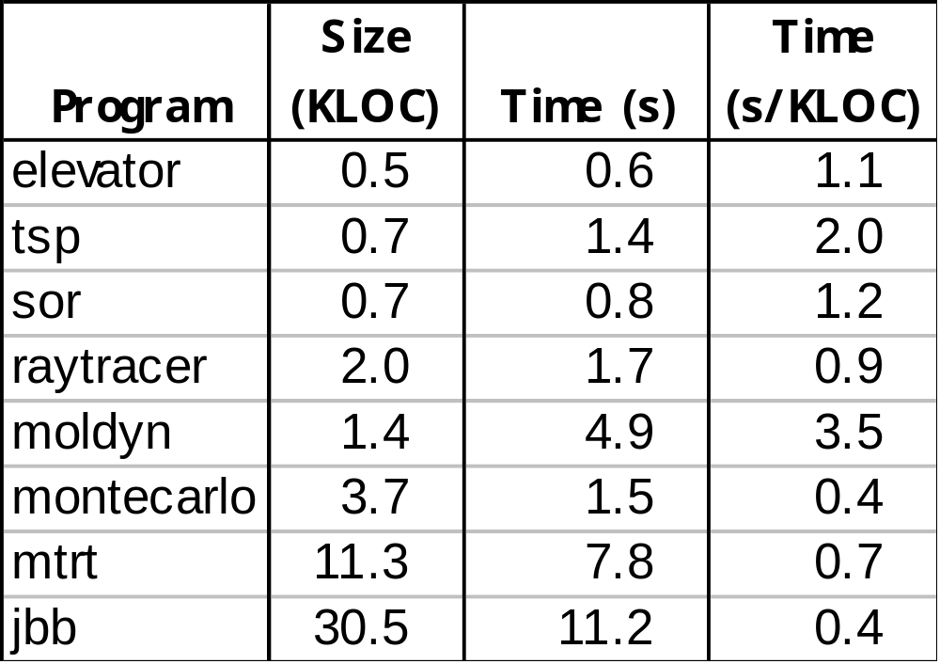
Validation
(excludes Rcc/Sat time)

Slide 65
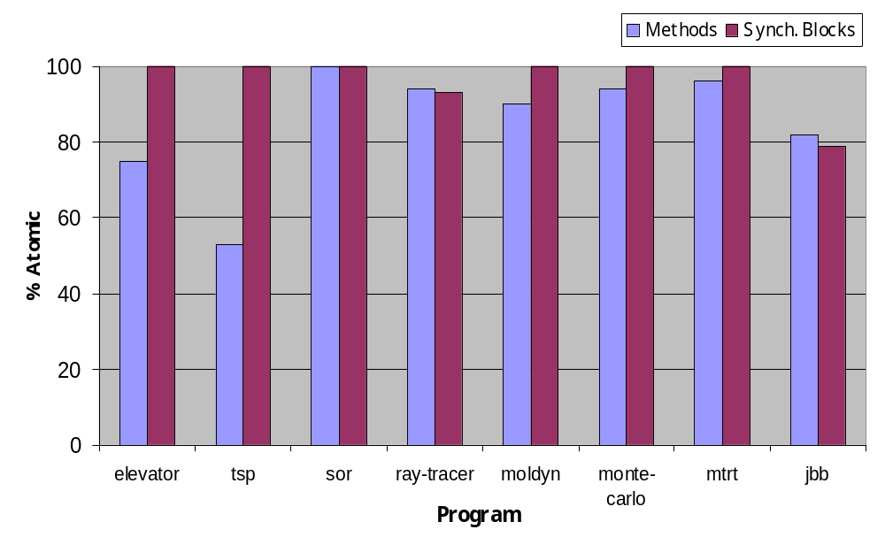
Inferred Atomicities

Slide 66
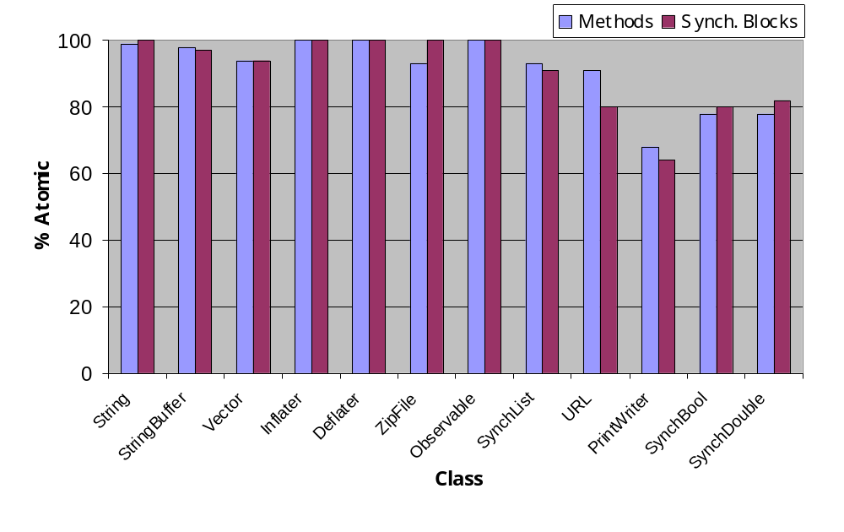
Thread-Safe Classes

Slide 67
Summary
Type inference for rccjava is NP-complete
  ghost parameters require backtracking search
Reduce type inference to SAT
  adequately fast up to 30,000 LOC
  precise: 92-100% of fields verified race free
Type checker and inference for atomicity
  leverages information about race conditions
  over 80% of methods in jbb are atomic

Slide 68
Related Work
Reduction
  [Lipton 75, Lamport-Schneider 89, ...]
  other applications:
    type systems [Flanagan-Qadeer 03, Flanagan-Freund-Qadeer 04]
    model checking [Stoller-Cohen 03, Flanagan-Qadeer 03]
    dynamic analysis [Flanagan-Freund 04, Wang-Stoller 04]
Atomicity inference
  type and effect inference [Talpin-Jouvelot 92,...]
  dependent types [Cardelli 88]
  ownership, dynamic [Sastakur-Agarwal-Stoller 04]

