Slide 1

Types for Atomicity in Multithreaded Software
Cormac Flanagan
Systems Research Center
HP Labs

Slide 2
Moore’s Law
Hardware is getting exponentially cheaper
Computing devices are more pervasive
Software a critical component
Software development is
  difficult & expensive
  hard to ensure reliability

Slide 3
Software Reliability via Testing
The dominant methodology but ..
Costly
  half of development cost is testing
  finds errors late in development cycle
    when they are more expensive to fix
Incomplete
  often fails to ensure needed reliability
  hard to test all inputs & interleavings
    “test coverage problem”

Slide 4
Software Reliability via Static Checking
Static
Checker
Source Code
Error: ...
Dynamic testing checks program for one input
  test coverage problem
Static checkers check program for all inputs
  combats test coverage problem

Slide 5
Software Reliability via Static Checking
Static
Checker
Source Code
Error: ...
lightweight
heavyweight
Type
Systems
lightweight,
simple,
effective
for certain
properties
Type
Systems
lightweight,
simple,
effective
for certain
properties
Program
Analysis
MrSpidey
for
Scheme
Model
Checking
Houdini
infers
ESC specs
Extended
Static
Checking
powerful,
automatic
theorem
proving
Calvin
ESC for
multiple
threads

Slide 6
Multithreaded Programs
Thread 1






Processor 1
Thread 2






Thread 3






Processor 2
Thread 4






Operating systems
Databases, web servers, browsers, GUIs, ...
Modern languages: Java, C#

Slide 7
Multithreaded Program Execution
Thread 1
...
int t1 = hits;
hits = t1 + 1
...
Thread 2
...
int t2 = hits;
hits = t2 + 1
...
t1=hits
hits=t1+1
t2=hits
hits=t2+1
hits=0





✓
hits=2
t1=hits
t2=hits
hits=t1+1
hits=t2+1
✗
hits=0





hits=1
t1=hits
t2=hits
hits=t2+1
hits=t1+1
✗
hits=0





hits=1

Slide 8
Reliable Multithreaded Software
Correctness Problem
  does program behaves correctly for all inputs and all interleavings?
  very hard to ensure with testing
Use static checkers
  type systems target sequential programs
  need type systems for multithreaded programs!

Slide 9
Part I: Race Conditions
A race condition occurs if two threads access a shared variable at the same time, and at least one of the accesses is a write
Thread 1
...
int t1 = hits;
hits = t1 + 1
...
Thread 2
...
int t2 = hits;
hits = t2 + 1
...

Slide 10
Preventing Race Conditions Using Locks
Lock can be held by at most one thread at a time
Race conditions are prevented using locks
  associate a lock with each shared variable
  acquire lock before accessing variable
Thread 1
synchronized(lock) {
int t1 = hits;
hits = t1 + 1
}
Thread 2
synchronized(lock) {
int t2 = hits;
hits = t2 + 1
}
acq t1=hits hits=t1+1 rel acq t2=hits hits=t2+2 rel









hits=2
hits=0
✓

Slide 11
Problem With Current Practice
Locking discipline is not enforced
  inadvertent programming errors cause races
Race conditions are insidious bugs
  non-deterministic, timing dependent
  data corruption, crashes
  difficult to detect, reproduce, eliminate
Linux 2.4 log has 36 synchronization bug fixes

Slide 12
Use Type System to Ensure Race Freedom
Static type system prevents race conditions
Programmer specifies synchronization discipline
  lock protecting each field
  locks held on entry to each method
Type checker checks synchronization discipline
  checks field accessed only when lock held
  checks for all inputs and all interleavings

Slide 13
Synchronized Bank Account
class Account {
private int balance = 0;
private void update(int x) {
balance = x;
}
public void deposit(int n) {
synchronized(this) {
update(balance + n);
}
}
}
Thread 1
acct.deposit(100);
Thread 2
acct.deposit(100);

Slide 14
Annotated Account
class Account {
private int balance = 0 /*# guarded_by this */;
private void update(int x) /*# requires this */ {
balance = x;
}
public void deposit(int n) {
synchronized(this) {
update(balance + n);
}
}
}

Slide 15
Annotated Account
class Account {
private int balance = 0 guarded_by this ;
private void update(int x) requires this {
balance = x;
}
public void deposit(int n) {
synchronized(this) {
update(balance + n);
}
}
}
Annotations explicate locking discipline

Slide 16
Tracking Lock Sets
class Account {
private int balance = 0 guarded_by this;
private void update(int x) requires this {
balance = x;
}
public void deposit(int n) {
synchronized(this) {
update(balance + n);
}
}
}
lockset is {this}
this ∈ lockset ? Yes
lockset is empty
lockset is {this}
{this} ⊆ lockset ? Yes

Slide 17
Handling Aliases Using Substitutions
class Account {
int balance = 0 guarded_by this;
...
}
final Account acct = ... ;
synchronized(acct) {
acct.balance = 100;
}
Aliases!
lockset is { acct }
this ∈ lockset ? No!
this[this := acct]
∈ lockset ? Yes!
acct
Type system tracks locks held at each program point

Slide 18
Race-Free Type System Features
Guarded fields
Lock sets
Aliases
Parameterized classes
Escapes
Dependant types
Subtyping
Thread local analysis
Constant analysis
Arrays, ...

Slide 19
Soundness of the Type System
Soundness Guarantee:
  well-typed programs do not have race conditions
Some good programs have "benign races“
  allow program to escape type system
class Account {
private int balance guarded_by this;
public Account(int n) {
balance = n; //# no_warn
}
}

Slide 20
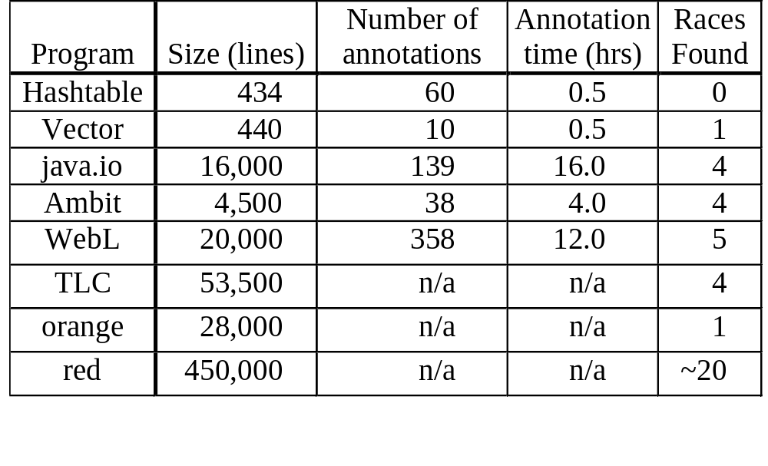
Validation of Race Condition Checker

Slide 21
java.util.Vector
0 1 2
a
b
2
class Vector {
Object elementData[] guarded_by this;
int elementCount guarded_by this;
int lastIndexOf(Object elem) {
return lastIndexOf(elem, elementCount - 1);
}
synchronized int lastIndexOf(Object elem, int n) {
for (int i = n ; i >= 0 ; i--)
if (elem.equals(elementData[i])) return i;
return -1;
}
synchronized boolean remove(int index) { ... }
synchronized void trimToSize() { ... }
}
RACE

Slide 22
java.util.Vector
0 1 2
a
1
class Vector {
Object elementData[] guarded_by this;
int elementCount guarded_by this;
int lastIndexOf(Object elem) {
return lastIndexOf(elem, elementCount - 1);
}
synchronized int lastIndexOf(Object elem, int n) {
for (int i = n ; i >= 0 ; i--)
if (elem.equals(elementData[i])) return i;
return -1;
}
synchronized boolean remove(int index) { ... }
synchronized void trimToSize() { ... }
}
RACE

Slide 23
java.util.Vector
0
a
1
class Vector {
Object elementData[] guarded_by this;
int elementCount guarded_by this;
int lastIndexOf(Object elem) {
return lastIndexOf(elem, elementCount - 1);
}
synchronized int lastIndexOf(Object elem, int n) {
for (int i = n ; i >= 0 ; i--)
if (elem.equals(elementData[i])) return i;
return -1;
}
synchronized boolean remove(int index) { ... }
synchronized void trimToSize() { ... }
}
RACE
IndexOutOfBoundsException

Slide 24
Part II: Beyond Race Conditions

Slide 25
Alternative Bank Account
class Account {
private int balance = 0;
public read() {
int r;
synchronized(this) {
r = balance;
}
return r;
}
}
public void deposit(int n) {
int r = read();
synchronized(this) {
balance = r + n;
}
}
other threads can update balance
Race-freedom is not sufficient!

Slide 26
Fixed Bank Account
class Account {
private int balance = 0;
public read() {
int r;
synchronized(this) {
r = balance;
}
return r;
}
}
public void deposit(int n) {
synchronized(this) {
int r = balance;
balance = r + n;
}
}

Slide 27
Optimized Bank Account
class Account {
private int balance = 0;
public read() {
return balance;
}
}
public void deposit(int n) {
synchronized(this) {
int r = balance;
balance = r + n;
}
}
Race-freedom is not necessary!

Slide 28
Race-Freedom
Race-freedom is neither necessary nor sufficient to ensure the absence of errors due to unexpected interactions between threads
Is there a more fundamental semantic correctness property?

Slide 29
Atomicity
A method is atomic if concurrent threads do not interfere with its behavior
Common concept
  “linearizability” in independent concurrent objects
  “(strict) serializability” in databases
  “thread-safe”, “synchronized”
  java.lang.StringBuffer:
    “String buffers are safe for use by multiple threads. The methods are synchronized so that all the operations on any particular instance behave as if they occur in some serial order that is consistent with the order of the method calls made by each of the individual threads involved. ...”
Fundamental semantic correctness property

Slide 30
Definition of Atomicity
Non-interleaved execution of deposit
x
y
acq(this)
r=bal
bal=r+n
rel(this)
z








public void deposit(int n) {
synchronized(this) {
int r = bal;
bal = r + n;
}
}
Interleaved executions of deposit
acq(this)
x
r=bal
y
bal=r+n
z
rel(this)








acq(this)
x
y
r=bal
bal=r+n
z
rel(this)








deposit is atomic if for every interleaved execution, there is a non-interleaved execution with the same overall behavior

Slide 31
Reduction (Lipton 76)
acq(this)
x
r=bal
y
bal=r+n
z
rel(this)
S₀
S₁
S₂
S₃
S₄
S₅
S₆
S₇
acq(this)
x
y
r=bal
bal=r+n
z
rel(this)
S₀
S₁
S₂
T₃
S₄
S₅
S₆
S₇
green thread holds lock
⇒ red thread does not hold lock
⇒ operation y does not access balance
⇒ operations commute
x
acq(this)
y
r=bal
bal=r+n
z
rel(this)
S₀
T₁
S₂
T₃
S₄
S₅
S₆
S₇
x
y
acq(this)
r=bal
bal=r+n
z
rel(this)
S₀
T₁
T₂
T₃
S₄
S₅
S₆
S₇
green thread holds lock after acquire
⇒ operation x does not modify lock
⇒ operations commute
x
y
acq(this)
r=bal
bal=r+n
rel(this)
z
S₀
T₁
T₂
T₃
S₄
S₅
T₆
S₇

Slide 32
Type System for Atomicity
Assign to each statement an atomicity that characterizes the statement’s behavior
  five atomicities: R, L, B, A, C
  does the statement left or right commute with steps of other threads?
  is the statement atomic?
Leverage Race Condition Checker to check that protecting lock is held when variables accessed

Slide 33
Five Atomicities
r=bal
y
S₂
acq(this)
x
S₀
S₃
S₄
S₁
S₂
R: right commutes
  lock acquire
x
acq(this)
y
r=bal
S₀
T₁
S₂
S₂
T₃
S₄
L: left commutes
  lock release
z
rel(this)
S₂
x
S₃
r=bal
S₄
S₅
S₆
S₇
B: both right + left commutes
  variable access holding lock
A: atomic action, non-commuting
  access unprotected variable
rel(this)
z
S₅
r=bal
T₆
x
S₇
S₂
T₃
S₄
C: compound, non-atomic statement
atomicities for constants, conditional atomicities

Slide 34
Sequentially Composing Atomicities
Use atomicities to perform reduction
Lipton: any sequence R*;A;L* is atomic
R; B ; A; L
;
B
L
R
A
C
S₀
R*
.
x
.
A
.
Y
.
L*
S₅
; A
R
B
B
L
R
A
C
R*
.
.
.
A
R
R
S₀
x
.
A
L*
Y
S₅
A
R
A
C
L
L
L
C
C
C
R;A;L ; R;A;L
A
A
A
C
C
C
; A
A
C
C
C
C
C
C
C
Notes:
animation for ; and *

Slide 35
Atomicities for Conditionals
If E has atomicity ae
and S1 has atomicity a1
and S2 has atomicity a2 then
if (E) S1 else S2
has atomicity
ae ; (a1 ⎣⎦ a2)
C
A
L
R
B

Slide 36
Checking the Alternative Bank Account
class Account {
private int balance = 0 guarded_by this;
public read() {
int r;
synchronized(this) {
r = balance;
}
return r;
}
}
public void deposit(int n) {
int r = read();
synchronized(this) {
balance = r + n;
}
}
B
R
B
L
B
A
R
B
L
A
C
A
read is atomic
deposit is compound, not atomic

Slide 37
Checking the Fixed Bank Account
class Account {
private int balance = 0 guarded_by this;
public read() {
int r;
synchronized(this) {
r = balance;
}
return r;
}
}
public void deposit(int n) {
synchronized(this) {
int r = balance;
balance = r + n;
}
}
B
R
B
L
B
R
B
B
L
A
A
fixed deposit is atomic

Slide 38
Checking the Optimized Bank Account
class Account {
private int balance = 0 guarded_by this;
public read() {
return balance;
}
}
public void deposit(int n) {
synchronized(this) {
int r = balance;
balance = r + n;
}
}
R
B
B
L
A
A
optimized read is also atomic

Slide 39
Checking the Optimized Bank Account
class Account {
private int balance = 0 write_guarded_by this;
public read() {
return balance;
}
}
public void deposit(int n) {
synchronized(this) {
int r = balance;
balance = r + n;
}
}
R
B
B
L
A
A
A
optimized read is also atomic
deposit is still atomic

Slide 40
Soundness Theorem
Suppose an interleaved execution of a well-typed program reaches state S where no thread is executing an atomic method in S
Then there is a non-interleaved execution of the program that also reaches S
See
  Flanagan & Qadeer, TLDI’03
  Flanagan & Qadeer, PLDI’03

Slide 41
Experience with Atomicity Checker
Class | Size (lines) | Annotations per KLOC
 |  | total | guard | req. | atomic | array | esc.
Inflater | 296 | 20 | 17 | 0 | 3 | 0 | 0
Deflater | 364 | 25 | 20 | 0 | 5 | 0 | 0
PrintWriter | 557 | 36 | 5 | 0 | 25 | 0 | 5
Vector | 1029 | 14 | 3 | 1 | 4 | 3 | 3
URL | 1269 | 33 | 10 | 1 | 10 | 0 | 13
StringBuffer | 1272 | 19 | 2 | 4 | 5 | 7 | 1
String | 2399 | 22 | 0 | 0 | 1 | 19 | 1
Total/average | 7366 | 24 | 8 | 1 | 8 | 4 | 3

Slide 42
java.lang.StringBuffer
/**
... used by the compiler to implement the binary string concatenation operator ...
String buffers are safe for use by multiple threads. The methods are synchronized so that all the operations on any particular instance behave as if they occur in some serial order that is consistent with the order of the method calls made by each of the individual threads involved.
*/
FALSE
public atomic class StringBuffer { ... }

Slide 43
java.lang.StringBuffer is not Atomic!
public atomic StringBuffer {
private int count guarded_by this;
public synchronized int length() { return count; }
public synchronized void getChars(...) { ... }
public synchronized void append(StringBuffer sb){
int len = sb.length();
...
...
sb.getChars(...,len,...);
...
}
}
A
A
sb.length() acquires the lock on sb, gets the length, and releases lock
A
A
C
other threads can change sb
use of stale len may yield StringIndexOutOfBoundsException
inside getChars(...)
append(...) is not atomic

Slide 44
Related work
Theory of reduction
  Lipton 76, Doeppner 77, Back 89, Lamport-Schnieder 89, Cohen-Lamport 98, Misra 01
Atomicity in Argus - Liskov et al 95
Linearizability - Herlihy-Wing 90
Static race detection
  Sterling 93, Aiken-Gay 98
Dynamic race detection
  Savage et al 97, von Praun-Gross 01, Choi et al 02
Model checking, systematic testing

Slide 45
Conclusions
Need type systems for multiple threads
Atomicity a fundamental concept
  simplifies reasoning about correctness
Type system detects atomicity violations
  even in well-tested, widely-used libraries
  enables concise, trustable documentation
  supports reliable multithreaded software
  lowers development cost

Slide 46
Types for Atomicity in Multithreaded Software
Cormac Flanagan
Systems Research Center
HP Labs

