Slide 1
RideShare
Elena Makarenko
Cormac McHale

Slide 2
Introduction
The initial idea for our app came from Elena’s experience with similar applications in Russia.
The vision was to create a way for a User to indicate to another User
that they would embark on a Journey from one location to the next.
The two User’s could then car-pool on this Journey.
We hoped that by the end of the project we would have developed a User-Friendly UI that makes use of the modern technologies available to a developer.

Slide 3
Goals
Our main Goal was to build as close to a full CRUD application as possible.
We wanted to develop an App that was visually intuitive.
We wanted to learn and understand how to setup and interact with our own database.
We wanted to make full use of the modern technologies available to a developer so we could learn the best ways of learning and working with the tools available to software developers.

Slide 4
Milestones
Architecture
Choose an architecture (Ionic)
Learn and research
Learn the newest version of architecture (Ionic 4)
Plugins
Choose relevant plugins (Google Maps, Geolocation)
Map Display
Get the Map displaying for the User
Implement API
Learn the plugin API’s to implement and make full use of the available functionality
Database
Choose a database (firebase)
Data
Decide what form of data will be sent to and from the database
CRUD functionality
Get the App and the database communicating effectively
Production
Produce and deploy a working Build of the app

Slide 5
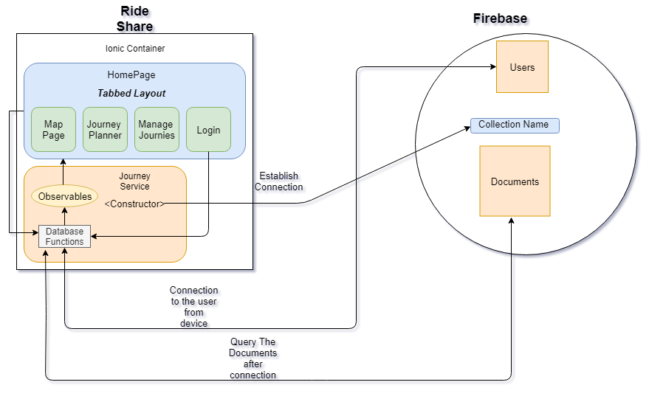
Architecture

Slide 6
Presentation of functionality and features.
We would like to take the time now to show our app works
User Login
User adds a Journey
Different User can view this Journey and who added it
User can then delete this Journey
View updated for the other User afterwards

Slide 7
Issues
https://github.com/cormacmchale/ProfPractice/issues

Slide 8
Wiki –User Guide
https://github.com/cormacmchale/ProfPractice/wiki

Slide 9
Conclusions and future development
From a project to a product
After completing the functionality that we have in the app so far, I can draw some conclusions
With a larger team and more time the following improvements can be made from to the app
Users Car-Pool in groups (Whats app)
E-mail verification implemented correctly
GUI Update (professional)
Adding extra information to Journeys (Time/Date/Bring petrol Money)
Accountability (User rating system)
Draw route you will drive (Maybe Google will release this at some stage)
Private message another User for info
Assigning users to a Journey – i.e (Car full)
Deleting Journeys Automatically after the Start time

