Slide 1

Multimodality Image Registration by Maximization of Mutual Information Using CUDA
Elise Le Khac & Corentin Martens
2015-2016
Notes:
J

Slide 2
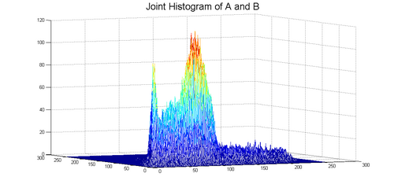
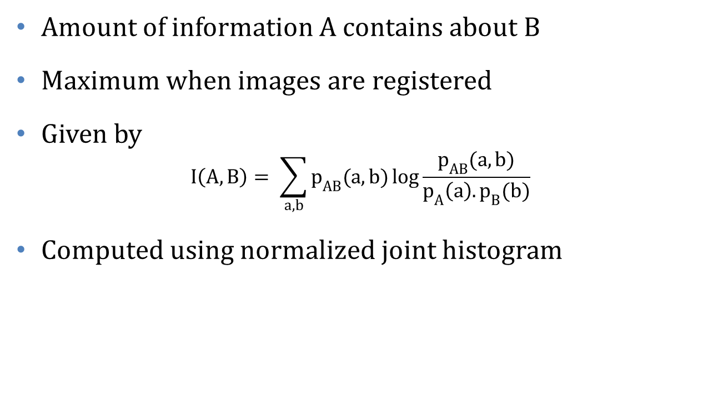
Mutual Information
Amount of information A contains about B
Maximum when images are registered
Given by
$$I\left(A,B\right)= \sum_{a,b}{p_{AB}(a,b)}\log{\frac{p_{AB}(a,b)}{p_{A}\left(a\right).p_{B}(b)}}$$
Computed using normalized joint histogram
Notes:
J

Slide 3
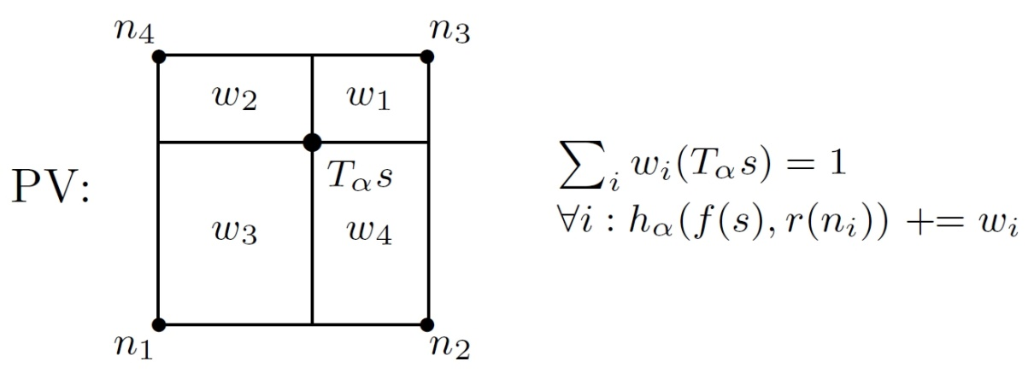

Registration
Construction of joint histogram for each pair $(f\left(s\right), r\left(T_{α}s\right))$ where $T_{α}$ is a rigid body transformation
Need to interpolate $r\left(T_{α}s\right)$
Find $α^{∗}={argmax}_{α}I(α)$ using Powell’s method
Notes:
J

Slide 4
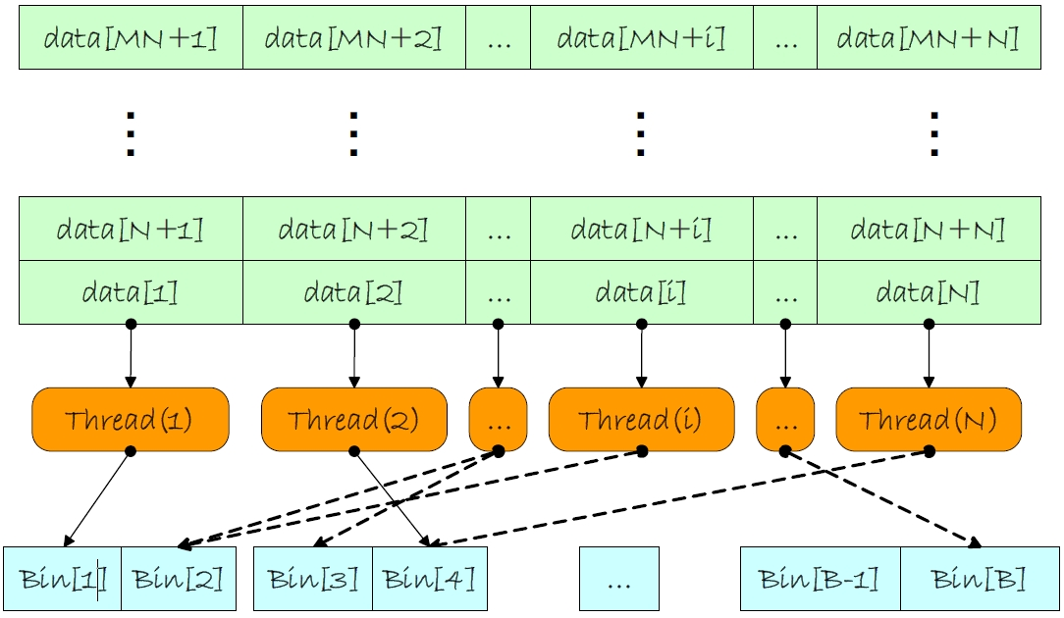

CUDA
Joint to marginal histogram : $J\left(x\right)=\frac{B_{1}(J_{1}\left(x\right)+J_{2}\left(x\right)\left(B_{2}−1\right))}{B_{1}B_{2}−1}$
Notes:
J

