Slide 1
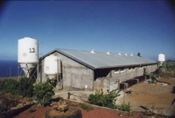
MANAGEMENT OF LIVESTOCK EFFLUENTS IN REUNION ISLAND
Use of a multi-agent system to analyse the economic behaviour of players
S. Farolfi, C. Lepage, M. Tidball & P. Bommel

Slide 2
Presentation
Stockbreeding wastewaters are rich in nitrogen and phosphorus :
  Useful to fertilise fields
  Source of pollution in massive amounts
  Regions referred as “structural exceeded zones” : Grand-Ilet

Slide 3
Presentation
Rules established (92-99) determining quotas
New water law provides charges to livestock producers
Pork breeders face new systems of constraints :
  Large quantities of excess slurry
  No sufficient arable land to spread
  Environmental policy enforcement => pollution fees
  Rapidly evolving context
Transportation of effluents to the sugar-cane farms

Slide 4
Approach
MAS and “standard modelling” in ecological economics
Use of MAS to simulate the incentives policy rules
Previous studies
  Available knowledge (since 1994)
  => Simple model

Slide 5
Approach
Rational and informed stakeholders :
  Maximise its profits
  Knows all the system : other agents, the space and the laws
Analysis of cost functions
Strategic choices
Scientific interest :
  Externality management
  Tests of scenarios for environmental policies
  Effects on the concerned actors

Slide 6
Structure of the MAS model
A space (100 km²)
  Distances and economic implications
  Diffusion, absorption and mineralisation of organic matter according to the vegetation cover
Some agents
  Pork breeders (56, 3 types)
  Sugar-cane producers (6)
  Public institution

Slide 7
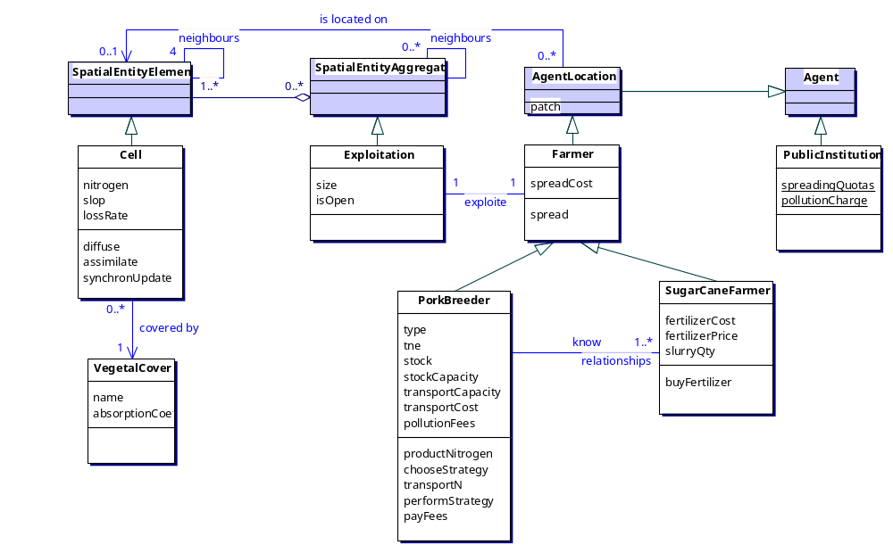
Structure of the MAS model

Slide 8
Dynamic of the MAS
Monthly time-step
Spreading practices and transport of stockbreeding wastewater
  spreading of wastewater on the stockbreeder's farm surface,
  transport of the wastewater exceeding the spreading standard to the sugar-cane farms of the coastal areas
Environmental measures
  Standards (tons/hec/year)
  Taxes
  Subsidies

Slide 9
Dynamic of the agents
sugar-cane farmers of the coastal areas :
  Once a year, the farmers buy and spread mineral nitrogen on the sugarcane (annual demand)
Pork breeders :
  Monthly wastewater production
  4 strategies :
    strat 0: spreading of wastewater on their farm surface,
    strat 1: spreading of wastewater until the standards + on the neighbours + the rest on its own lands
    strat 2:transport the wastewater exceeding the spreading standard to the open nearest sugarcane farms
    strat 3:choose between strat 1 or 2, by comparing the cost he paid to the cost he would pay with the other strategy.

Slide 10
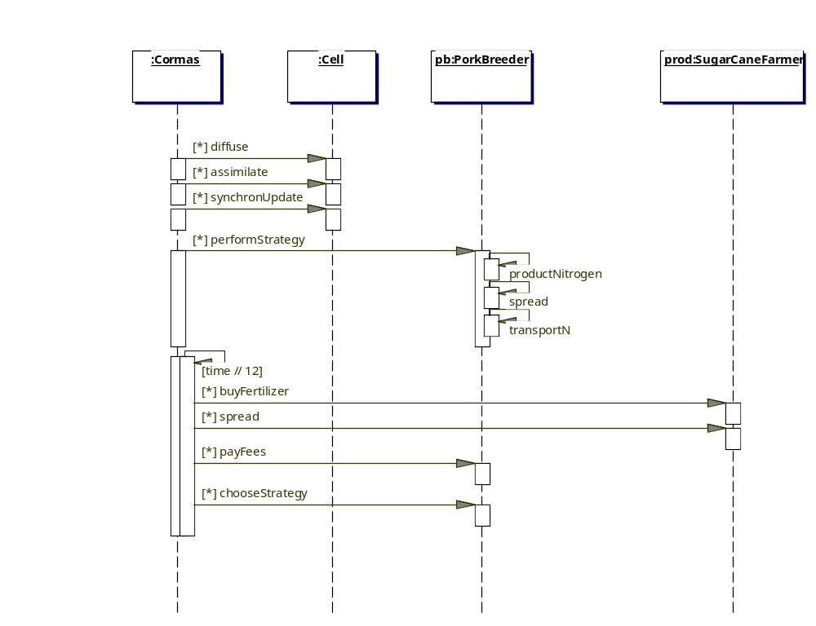
Sequential diagram of the step method

Slide 11
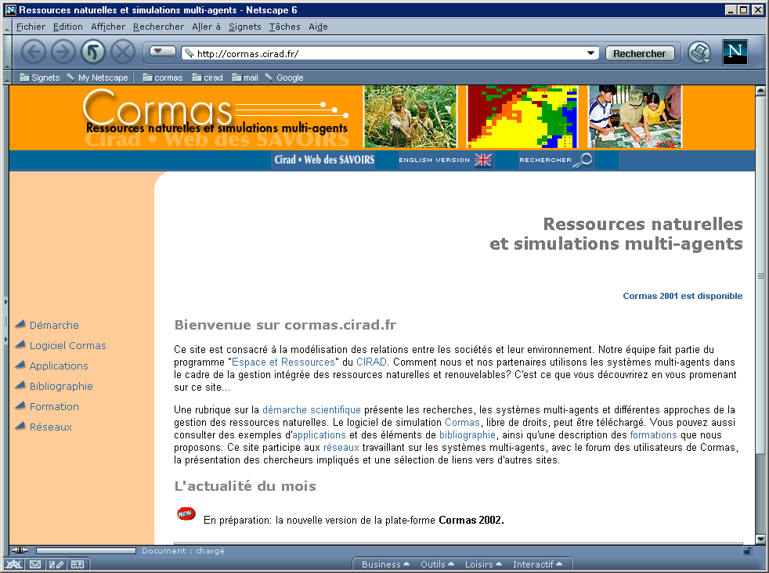
CORMAS : http://cormas.cirad.fr
Common-pool Resources and Multi-Agent Systems

Slide 12
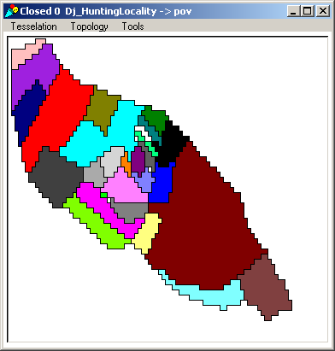
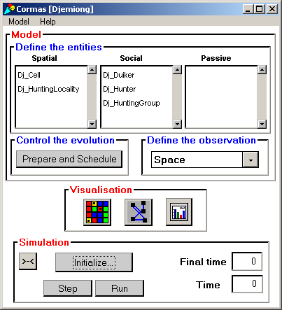
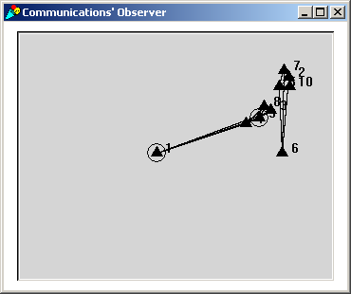
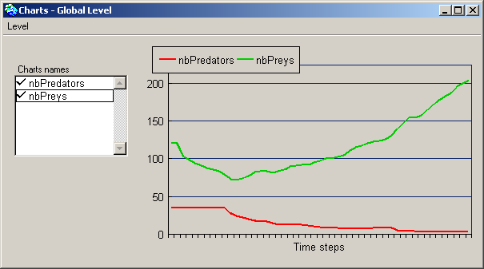
CORMAS : http://cormas.cirad.fr

Slide 13
Results
6 producers, 56 pork breeders, Strategy 3
4 scenarios :
  Scenario 1 :
    Standard = 170 Kg.N / ha
    Pollution tax = 0
    Sugarcane farms areas between 20 to 40 ha
  Scenario 2 :
    Standard = 170 Kg.N / ha
    Progressive pollution tax (every 2 years, + 2 FF for each additional Kg.N )
    Sugarcane farms areas between 20 to 40 ha
  Scenario 3 :
    As scenario 2, except
    Sugarcane farms areas between 40 to 80 ha
  Scenario 4 :
    As scenario 2, except
    Standard = 300 Kg.N / ha

Slide 14
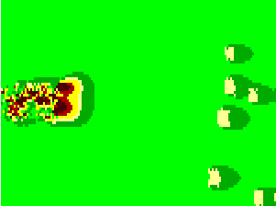
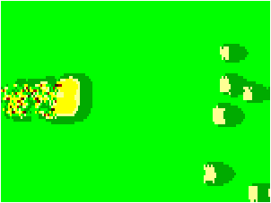
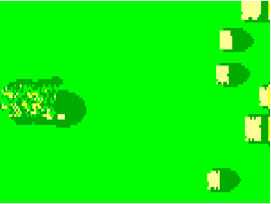

Nitrogen Concentration in the soil after 10 years (120 time-steps)
according to 4 combinations of environmental policies
Standard = 170
Kg.N / ha; pollution tax = 0;
Standard = 170
Kg.N / ha; progressive pollution tax
Sugarcane farms areas between
20 and 40 ha
(every 2 years, + 2 FF for each additional Kg.N )
Sugarcane farms areas between
20 and 40 ha
Grand Ilet
Coastal area
1
2
Idem 2,
Sugarcane farms areas between
40 and 80 ha
Idem 2, Standard = 300
Kg.N / ha
3
4

Slide 15
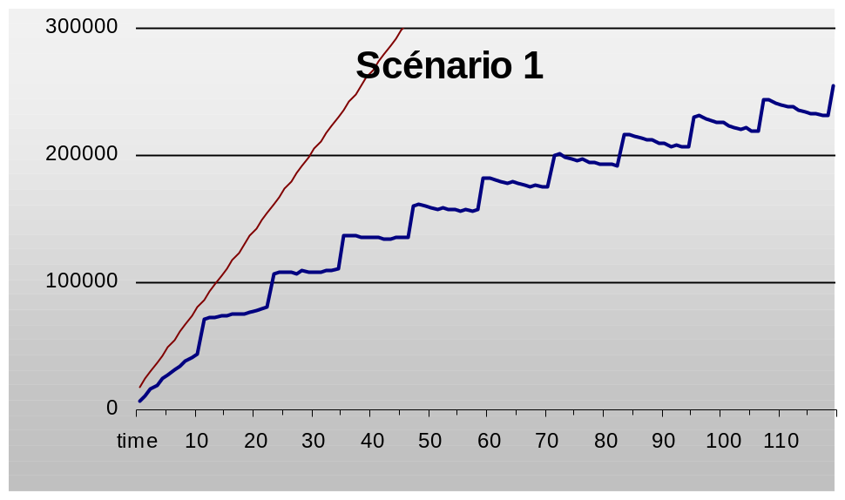
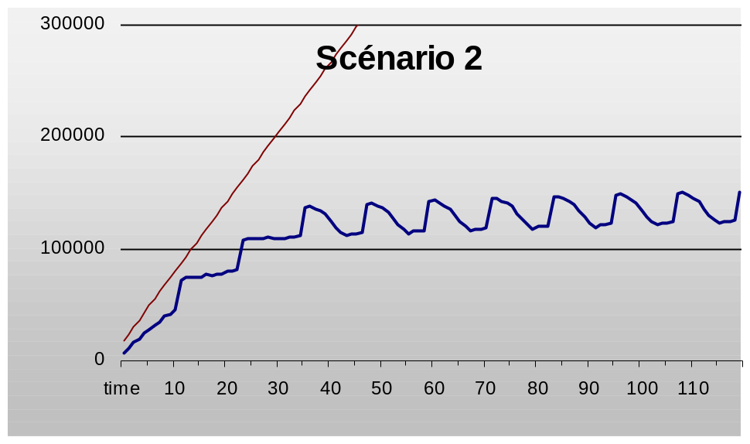
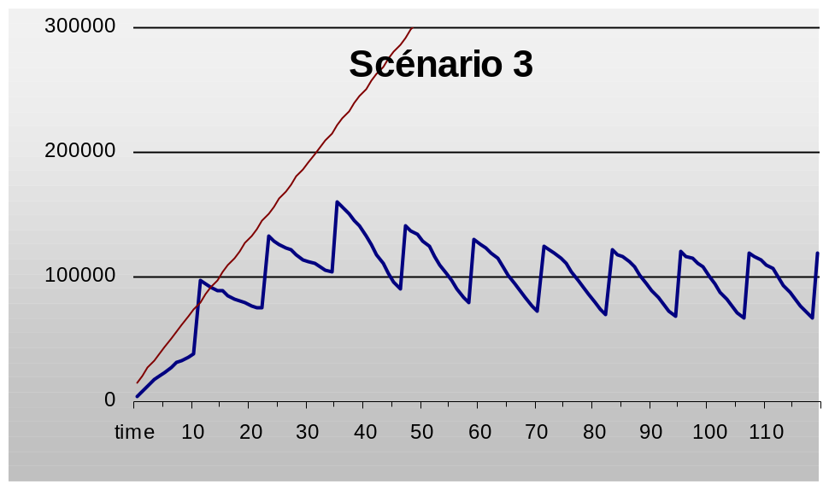
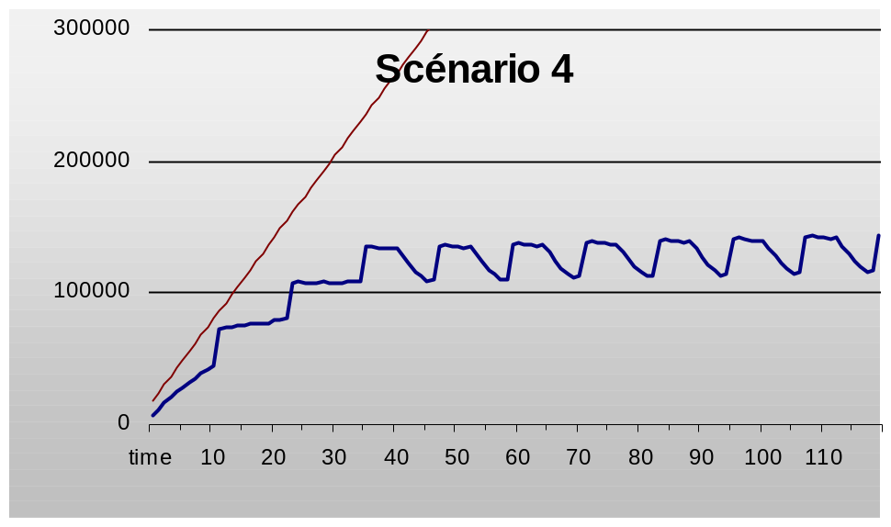
Standard = 170 Kg.N / ha
Pollution tax = 0
Sugarcane farms areas between 20 to 40 ha
Standard = 170 Kg.N / ha
Progressive pollution tax (every 2 years, + 2 FF / Kg.N )
Sugarcane farms areas between 20 to 40 ha
Nitrogen Concentration in the soil
As scenario 2, except
Sugarcane farms areas between 40 to 80 ha
As scenario 2,
Standard = 300 Kg.N / ha

Slide 16
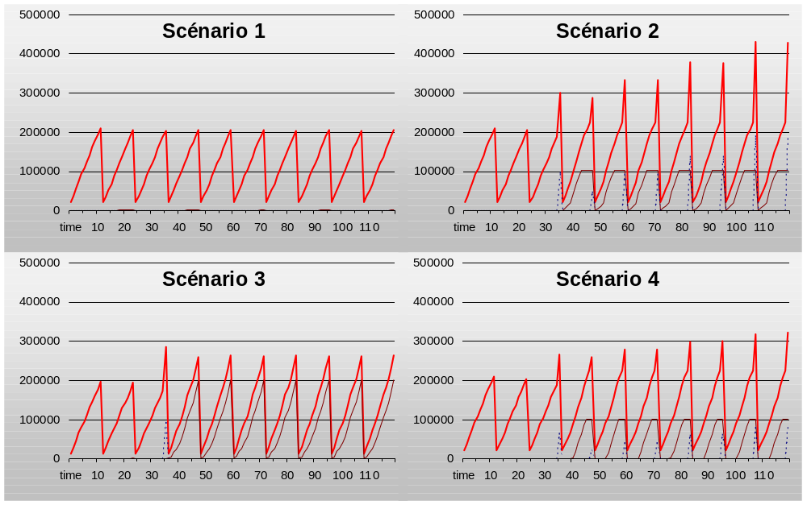
Standard = 170 Kg.N / ha
Pollution tax = 0
Sugarcane farms areas between 20 to 40 ha
Standard = 170 Kg.N / ha
Progressive pollution tax (every 2 years, + 2 FF / Kg.N )
Sugarcane farms areas between 20 to 40 ha
Cost for the pork breeders
As scenario 2, except
Sugarcane farms areas between 40 to 80 ha
As scenario 2,
Standard = 300 Kg.N / ha

Slide 17
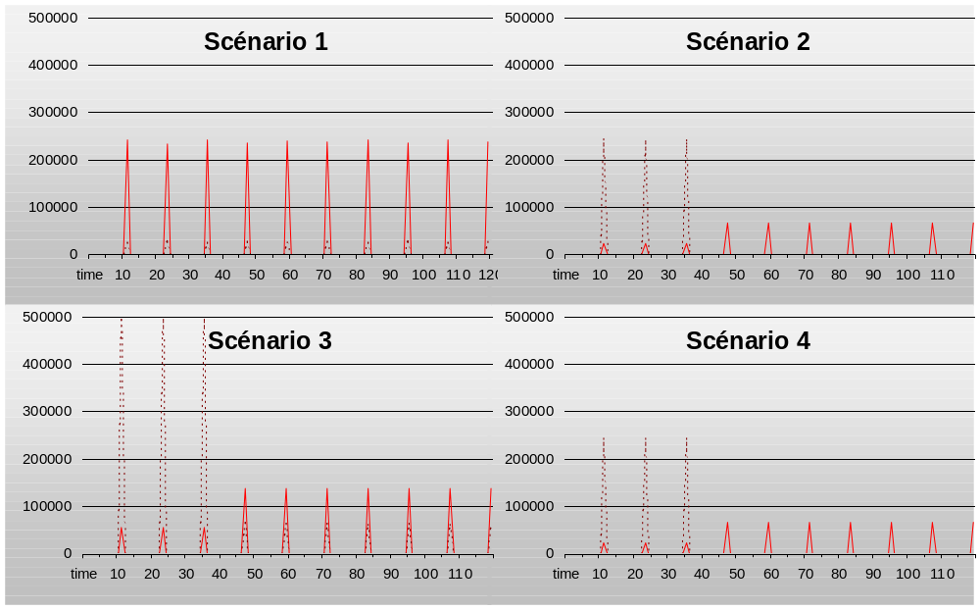
Standard = 170 Kg.N / ha
Pollution tax = 0
Sugarcane farms areas between 20 to 40 ha
Standard = 170 Kg.N / ha
Progressive pollution tax (every 2 years, + 2 FF / Kg.N )
Sugarcane farms areas between 20 to 40 ha
Cost for the suger-cane producers
As scenario 2, except
Sugarcane farms areas between 40 to 80 ha
Spreading Cost
Fertiliser Cost
As scenario 2,
Standard = 300 Kg.N / ha

Slide 18
Conclusion
Advantage of the MAS
  allows to study in the same time economical and ecological consequences of policies
The wastewater tax seems to allow a control of the pollution (=> rational agents)
An exceeded increase of the tax is useless:
  it doesn’t modify the pollution in the environment and
  it increases the social cost
The environmental measures are efficient if there is enough spreadable place on the coast area

Slide 19
Further modelling steps
Introduction of heterogeneous behaviours
  Agents not entirely rational
  Agents partly informed
  Other behaviours
Introduction of collective management alternatives
Coordination processes between agents
How nitrogen evolve in the soil
Improvement of the costs calculation

