Slide 1
Modeling groundwater
management in South Tarawa
with Multi-Agent Systems
RSPAS
Anne Dray, Pascal Perez
September 2002

Slide 2
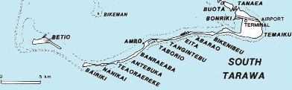
MAIN ISSUE
16 km²
No surface water
resources
Population: 45 000
Pop. growth: 5.3%
Groundwater Lenses ⇨ Wells
Rainwater Tank
Two Reserves ⇨ PUB
 URBANISATION
Conflicts
Landowners Vs Gov.
 POLLUTION
Demand: 100L/d/pop PUB Supply: 1500 m³/d
Sustainability of the groundwater exploitation on South Tarawa?

Slide 3
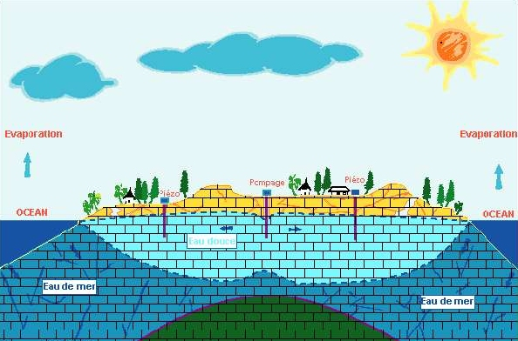
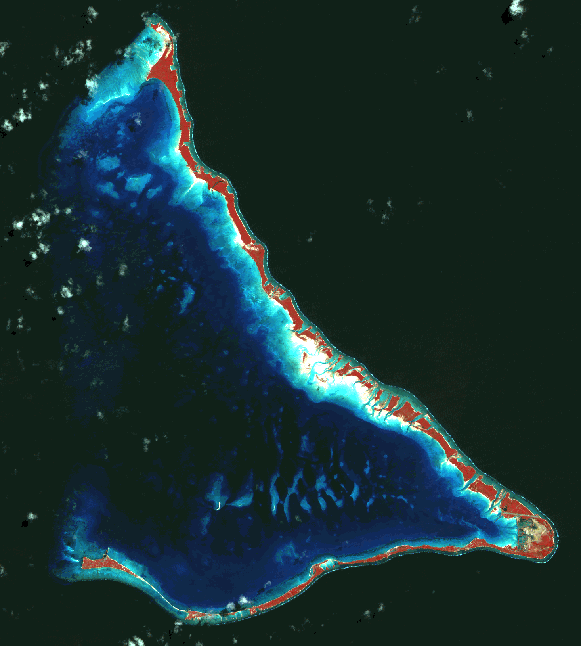
Which TOOL to represent and explore the system ?
TECHNICAL LIMITATIONS
1) Geographical representation
2) Biophysical processes
3) Demographic data

Slide 4


Multi-Agent System
Representations
Goal
Communication
Communication
Action
Perception
Environment

Slide 5
Characteristics of MAS
A Multi Agent Model is often composed of :
    A Cellular Automata (dynamic spatial grid)
    A set of Cognitive Robots (social and environmental agents)
The agents present the following abilities:
Autonomy, Reactivity, Proactivity and social skills.
MAS tend to explore how local micro-rules generate macro behaviour patterns. But individual behaviour has to be constrained by social norms.
Keep It Simple and Stupid (KISS) as a global philosophy. Or, preferably, “Complex enough for understanding, Simple enough for communication”

Slide 6
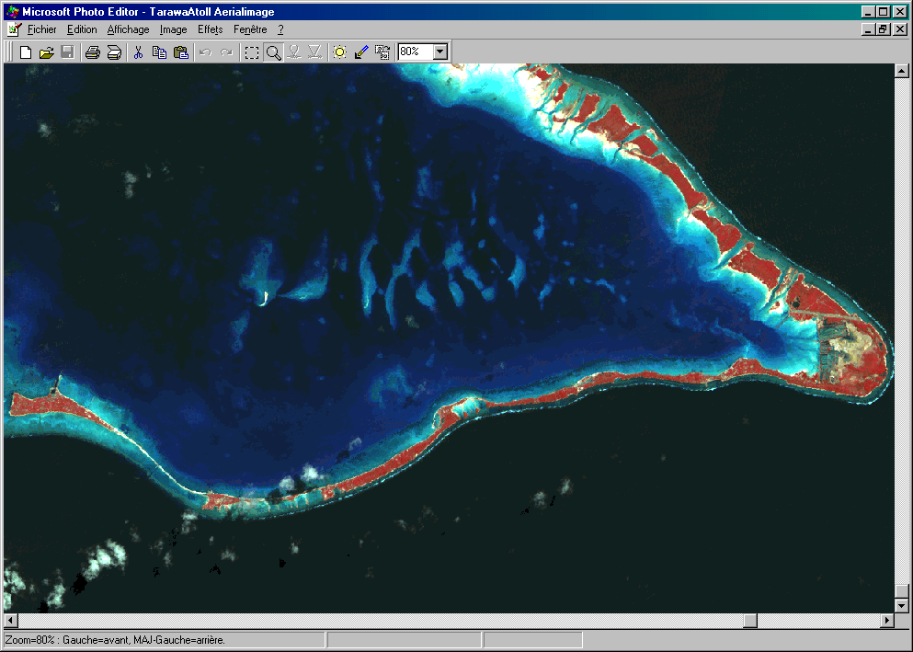
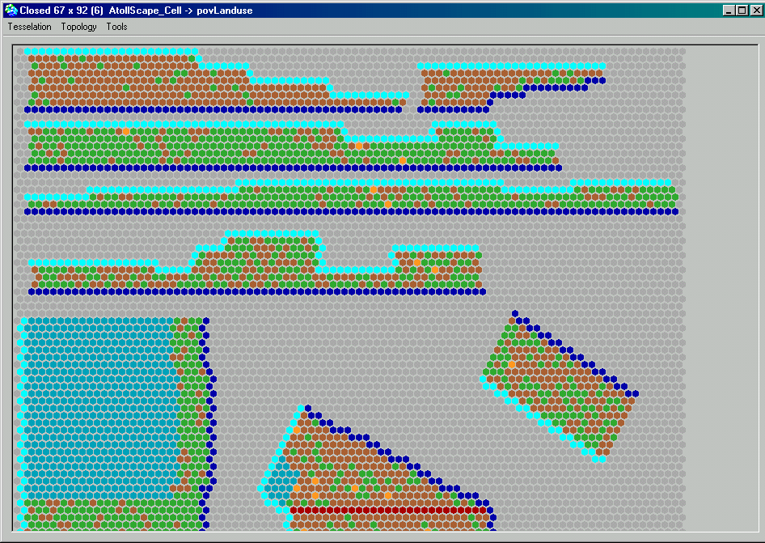
Geographical Representation
BONRIKI
BUOTA
RURAL TARAWA 2
BETIO
TEMAIKU
BAIRIKI
BIKENIBEU
RURAL TARAWA 1

Slide 7


Slide 8
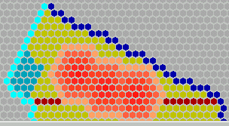
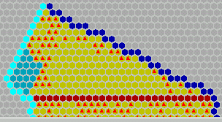
Different point of views
Trees
Crops
Baresoil
Lens
No Lens
Household

Slide 9
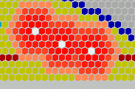
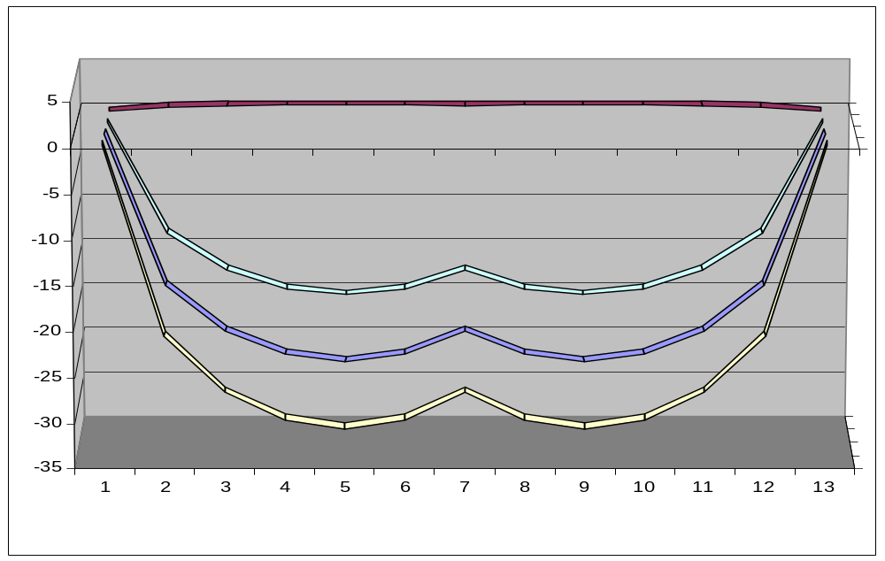
Biophysical Processes : shape of lenses
Centre Lens1
Centre Lens2
q
Q
h
L
H – Δ/2
H
H + Δ /2
x
Volker’s Steady State Equations
H² = (q₀ – Q₀).(L² - x²) with q₀ = f(q) and Q₀ = f(Q)
Δ = [λ^{-1/2}.(L. (q₀ – Q₀)^{-1/2}).(L² - x²)^{1/2}/x].[1 – (L² - x²)^{1/2}/L]^{1/2}

Slide 10
CELL [spatial agent]
LENS [aggregate]
ISLAND [aggregate]
Island
Occupants (lu,wu,hh)
Neighbours
Soil Depth
Soil Water Storage
Actual Evaporation
Deep Drainage
Lens Thickness
Net Recharge
Net Loss
Lens Center
Lens Radius
Reserve
Components (cells)
Center
Lens Mean Recharge
Lens Mean Loss
Components (cells)
Rainfall
Potential Evaporation
Soil Wilting Point
Soil Field Capacity

Slide 11
HOUSEHOLD [social agent]
PUB [social agent]
Patch
Size
Water Equipment
Drink Demand
Domestic Demand
Satisfaction Index
Pumping Buota
Pumping Bonriki
Global Offer
LandUse [passive agent]
WaterUse [passive agent]
Type
Patch
Rain Interception
Maximum Evaporation
Salinity Alert
Type
Patch
Offer
Demand

Slide 12




Main interactions within AtollScape
rain
CLIMATE
rain
evaporation
protest
grow
offer
offer
demand
HH
demand
LU
offer
WU
offer
offer
move
Water balance
demand
PUB
CELL
demand
offer
adjust
LENS
ISLAND
Water balance
demand

Slide 13
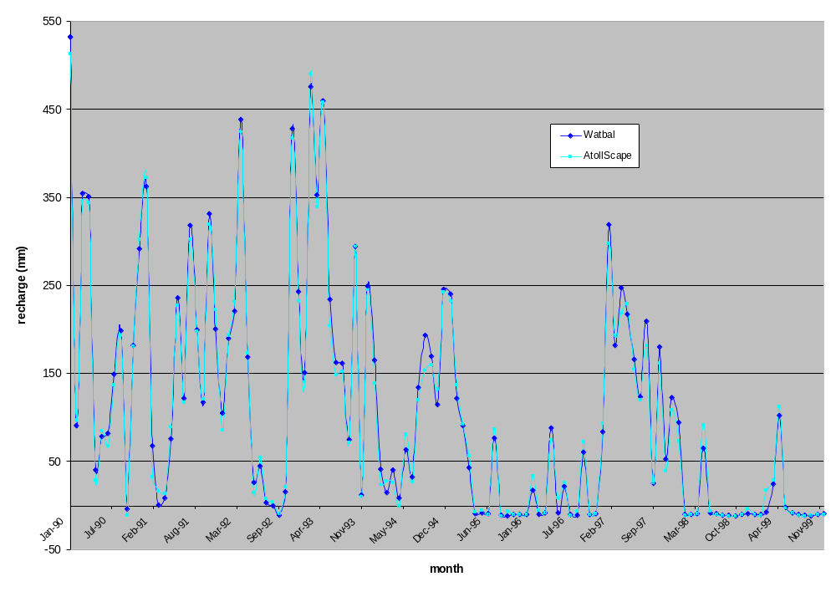
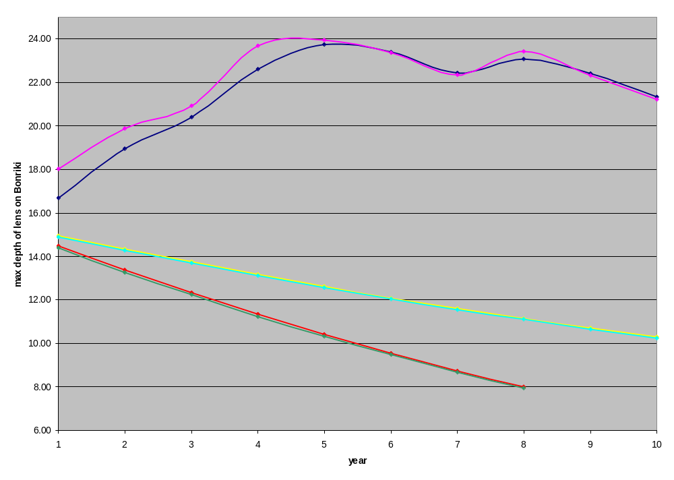
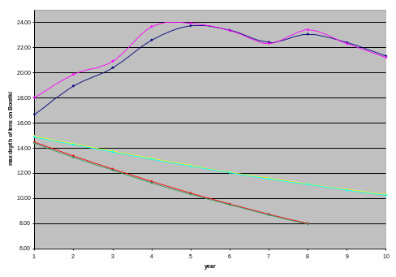
Consistency of the model
Scenario 1990 - 1999 Annual RainFall 2300 mm
1) Water Balance : RECHARGE
3.6 x 10⁶ m³ (White & al., 1999)
3.19 x 10⁶ m³ (AtollScape)
2) Volume of Bonriki lens
Scenario Mean Year Annual RainFall 1300 mm
Scenario with Dry Year Annual RainFall 600 mm
3) Max. depth of Bonriki Lens

Slide 14
CONCLUSION
➢ First DRAFT of AtollScape
➢ Modular Structure allowing further developments
➢ Main focus:
geographical and hydrological representation
first stage of social representation
➢ First Outcomes:
consistency of biophysical dynamics
validity of some key outputs
➢ Perspectives:
link with a GIS
adaptive behaviour of the social agents
sensitivity analysis

Slide 15
CATCHSCAPE: Towards a Fully Integrative Negotiation Support System ?
A Northern Thailand Case study.
by
Nicolas BECU¹, Pascal PEREZ², Andrew WALKER³
¹ Visiting Student, ENGREF, France.
² Visiting Fellow, CIRAD, France.
³ Research Fellow, RSPAS, ANU.
A study sponsored by the French Embassy in Canberra and supported by the ICAM Center (CRES, ANU).

Slide 16
Negotiation rather then Decision Support System.
Assumption 1:
A sustainable resource management comes from a concerted rather then optimal solution.
Assumption 2:
Biophysical, economical and social aspects should be given the same weight and level of accuracy.
Assumption 3:
Complex emerging rules often raise from simple individual behaviors and interactions.
Assumption 4:
As far as human behavior is simulated, predictive modelling becomes highly dubious.

Slide 17
A Northern Thailand Case study.
Location:
Mae Uam Catchment (45 km2, Chiang Mai Prov.)
Characteristics:
5 villages (3 thais and 2 Karens)
2 irrigation schemes.
819 households.
Rice/Soybean/Onion cropping system.
80% forested catchment.
Issue:
Does Upstream Water Management affect the downstream farm sustainability ?
Notes:
So this Multi Agent System approach ha been used to describe one of the IWRAM project subcatchment.
It ’s area is roughly 45km2.
It ’s composed of the …..
The main issue is …..

Slide 18
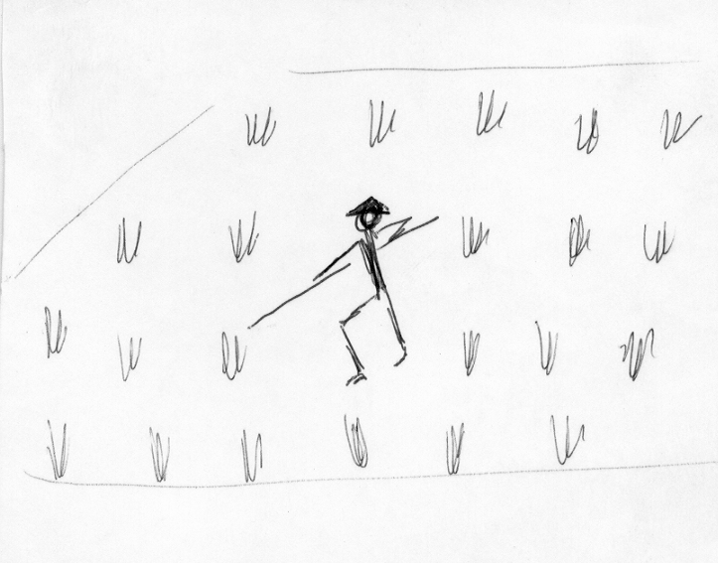
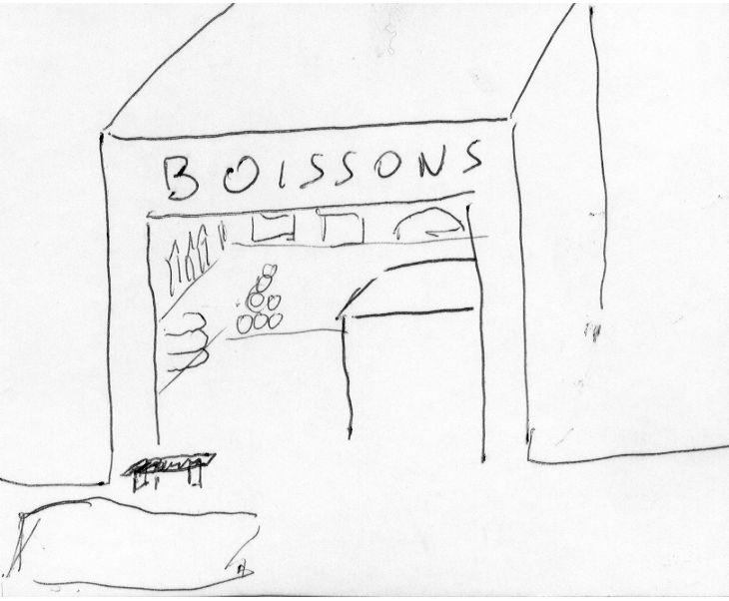
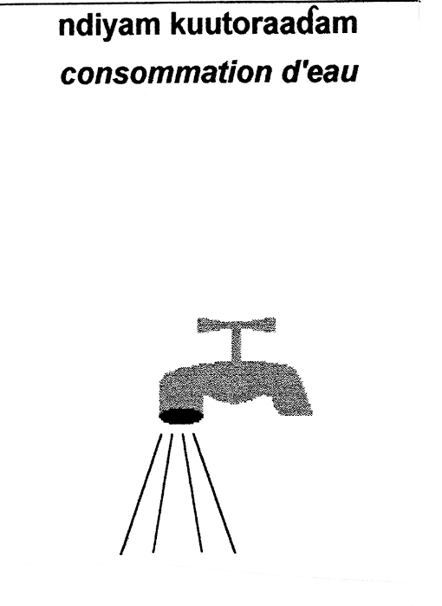

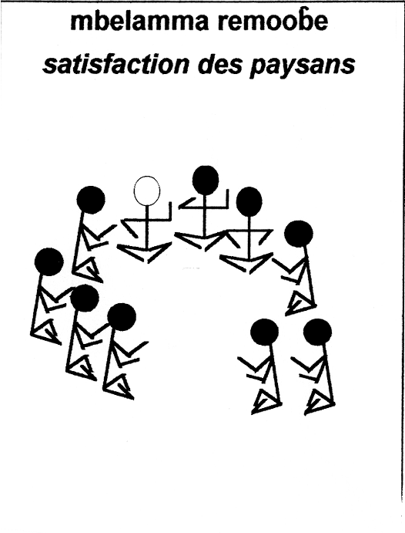
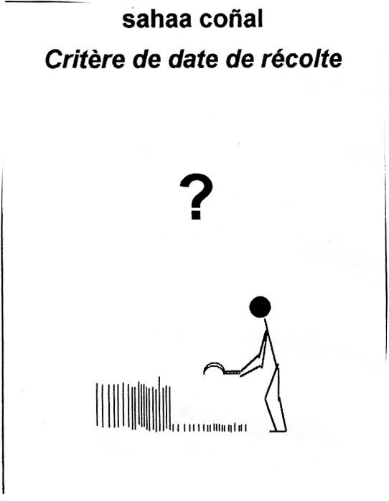
An Agent Oriented view of the Catchment...
village
canal
farmer
river
canal
$ $ $
Notes:
Having choose a Negociation Support System approach, we had to focus on the actors of the system.
This is why we have place the farmers at the center of our catchment representation (click !).
The representation of the catchment by this agent starts with its plots. Some of thembelongs to an irrigated scheme or another.
Thos plots belong to canal, itself managed by a weir manager.
Canals are themselves connected through a river.
But the catchment from the farmer point of vue is not reduced to this limited biophysical structure. The village provides goods, information and regulation.
Finally, the Hh itself constitues the center of decision proces and this for cash, expenditure, off farm activities and labour availability.

Slide 19
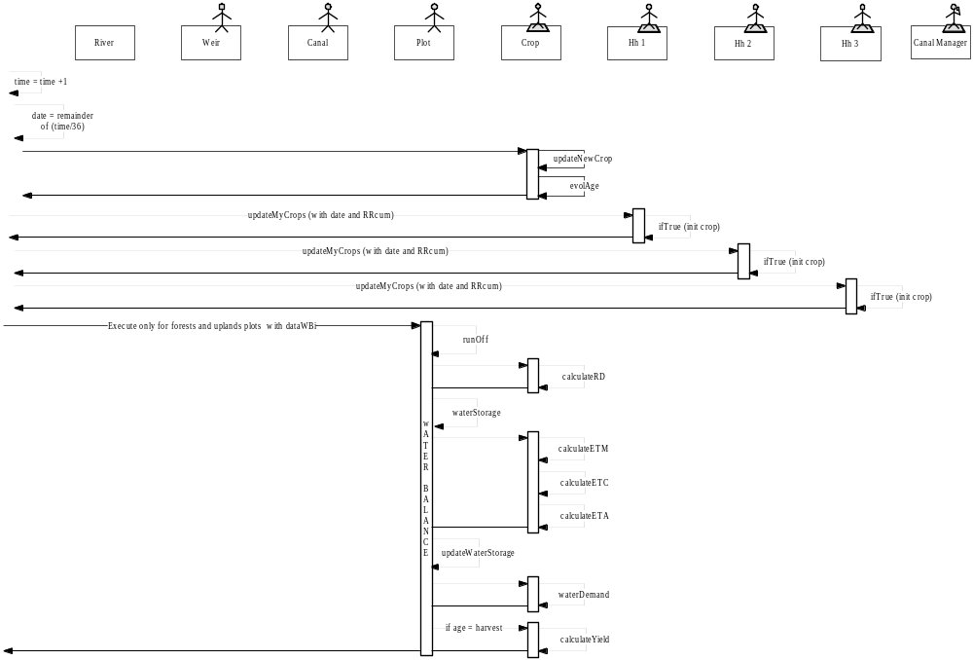
…An Object Oriented modelling structure.
Model steps
1 step = 10 day
Notes:
According to this previous approach, object oriented programming, not only in terms of programming but essentially in ters of structure is the most relevant to describe complex adaptative system.
Any element is an object interacting horizontaly and verticaly with each others.
To stick with indicidual decision making process, we have choose here to implement the model with a 10 day period time step.

Slide 20
Structure of CatchScape
1. Schematic representations
    Spatial representation
    Social representation
2. Biophysical processes
    Crop model
    Hydraulic model
3. Techno-Economic Decisions
    Farming decision
    Labor dynamic
    Land dynamic
4. Social interactions
    Individual behavior
    Negotiations between weir managers
    Restriction and control by a zone committee
4. Social interactions
    Individual behavior
    Negotiations between weir managers
    Restriction and control by a zone committee
Irrigation Management
&
Social control
Notes:
We shall present the strcuture of the model by several simple descriptionsof what constitutes the flesh of CatchScape.

Slide 21
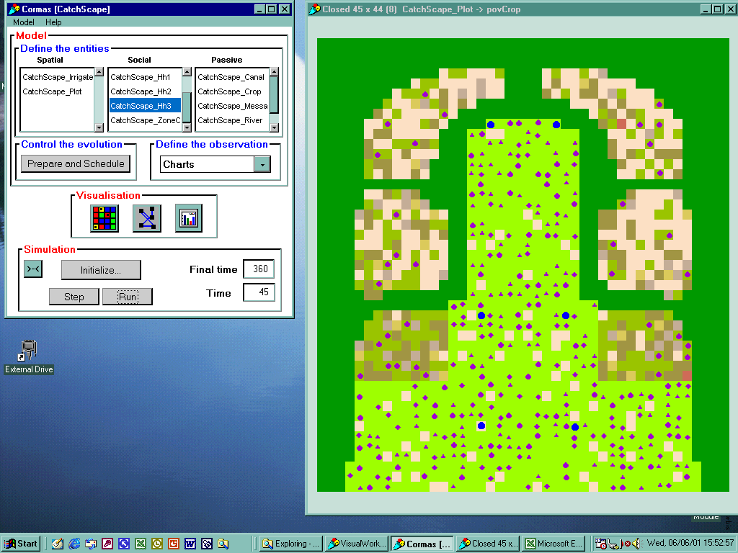
A schematic representation of the catchment...
2/5 scale
Raster mode
Variable grid
Notes:
So, for the sptial representation of the catchment, we ’ve tried to extract the essential features of the existing GIS maps. There are 3 type of land use represnted : forest, paddy an uplan.
Each cell of the grid correspond to a area of 2 rai (+- 3000 m2) which is what we needed because we wanted to describe individual behaviour and 2 rai is the average size of plots in Mae Uam catchment.
In order to make this feasable we ’ve opted for a raster mode and scaled down the map to 2/5. Part of the forest area not interacting strongly with Hh has been represented with a larger unit size (6 ha).

Slide 22
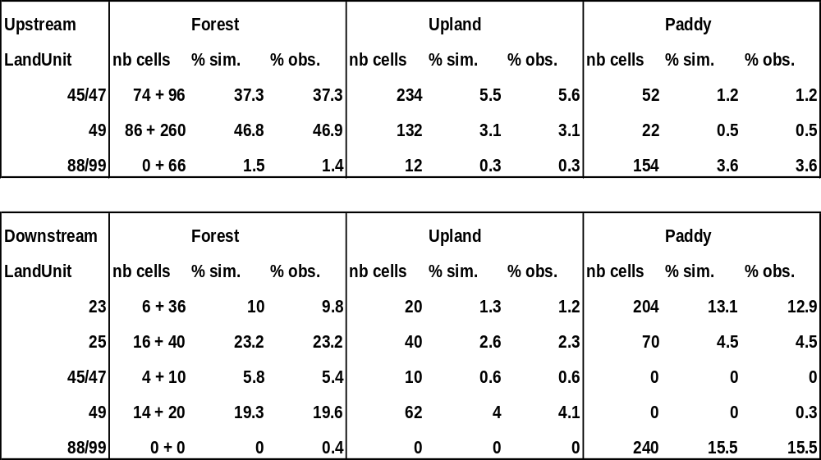
…But the right proportions.
(source: NRCT, GIS map, 1990)
Notes:
Even if it ’s a schematic representation we have keep the right proportions.
So the over lapping proportions of land use and land units are kept….

Slide 23
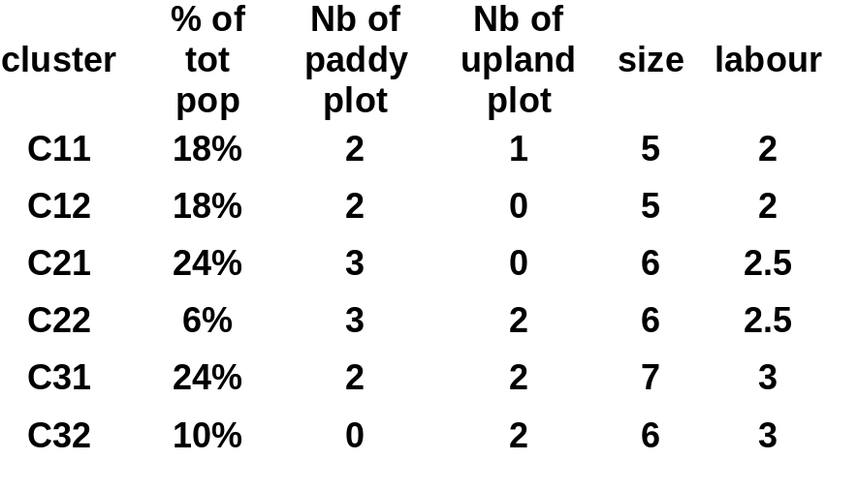
A cluster analysis to characterize households…
(source: IWRAM survey, 1998)
0
1
2
3
Upland Plot
0
C32
1
2
C12
C11
C31
Number of Households:
Mae Uam: 819
Survey: 109
Catchscape: 327
3
C21
C22
Paddy plot
Notes:
To define the agents caracteristics we ’ve applied a cluster analysis to the IWRAM database which has given the following results.
The 6 different clusters are moles to create our different agents. They represenr somehow different systems of production.
Rather then a picture, the different clusters illustrates farm trajectories.

Slide 24
…Agents molded on the different clusters.
Family size
Expenditure
Labor force
Off farm activity
farmer
Plots
Crops
Activities
Costs
Cash
Rice storage
Yield expectation
Labor expectation
Village
Yield memory
Irrigation memory
Notes:
The aggents are defined with a list of attributes corresponding to fix or variable parameters, qualitative or quantitative figures

Slide 25
1. Schematic representations
    Spatial representation
    Social representation
2. Biophysical processes
    Crop model
    Hydraulic model
3. Techno-Economic Decisions
    Farming decision
    Labor dynamic
    Land dynamic
4. Social interactions
    Individual behavior
    Negotiations between weir managers
    Restriction and control by a zone committee

Slide 26
A simplified distributed crop model...
(source: Perez et al., 2000)
AET
RR
RIVER
RO
PLOT
IN
CROP
IR
CANAL
CR
VOL
OUT
SR
ID
DISC
DD
Notes:
This simplified distributed crop model comes from CatchCrop model developped for the IWRAM DSS, but adapeted to an object oriented and distributed modeling.
So, first the object plot define as a small system receiving rainfalla and loosing water through RO and DD and defined by a vriable Soil Water Storage.
On this object plot, a crop object is clicked on and the crop i characterized by its AET, ID and Water Storage within the root zone.
Now this crop may be irrigated by an object canal.
The river object provides water to the canal and the canal ’s out flow returns to the river.

Slide 27
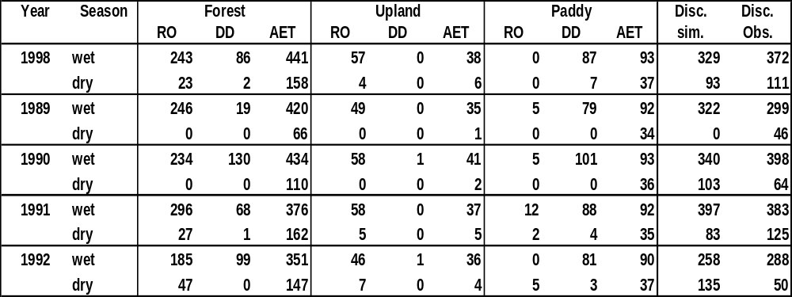
…But validated at the catchment scale.
Paddy: Rice (wet) / Soybean (dry)
Upland: Vegetable (wet) / Vegetable (dry)
Wet season starts on 01/04 ; Dry season starts on 01/11
Observed Discharge comes from IHACRES (Schreider et al., 2000)
Notes:
This very simple model has been validate at the catchment scale.
Here we have the hydrological balance calculated for each land use (forest, uplabd, paddy) during a 5 years period.
The hydrological balance i divided into wet and dry season, starting firts of april and first of november respectively.
The seasonal discharge simulated with the distibuted crop model gives a fairly good estimation of the observed discharge coming from IHACRES hydrological model.

Slide 28

A simple Hydraulic model
Piang System
River
zone 1
Canal 1
Canal 2
Canal 3
Canal 4
zone 2
Upstream flow generated from IHACRES input file
Successive weirs diverting water into canals
Paddy plots connected to the irrigated scheme
Canal 5
Canal 6
Notes:
Concerning the hydraulic model, the upstream flow is generated from IHACRES input file and diverted into canals by a set of successive weirs.
Canals are organized into pairs and 2 zones corresponding to 2 irrigated schemes and roughly correponding to 2 groups of villages as well.
The plots are connected t the canal and the water distribution to the plots is made through a callibrated bamboo pipe called piang system.

Slide 29
1. Schematic representations
    Spatial representation
    Social representation
2. Biophysical processes
    Crop model
    Hydraulic model
3. Techno-Economic Decisions
    Farming decision
    Labor dynamic
    Land dynamic
4. Social interactions
    Individual behavior
    Negotiations between weir managers
    Restriction and control by a zone committee

Slide 30
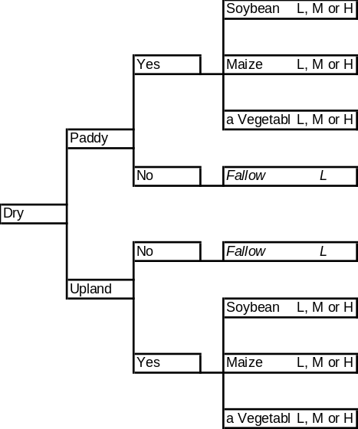
Linear programming to model farming decision …
Linear Programming Analysis
a rational
and optimal
choice
Limited solutions
1
0.9
n crops
*
p ferti
*
i …
Soybean
&
Onion
with high fertility
0.8
0.7
Soybean
0.6
0.5
Onion
0.4
0.3
0.2
0.1
0
0
5000
10000
15000
20000
25000
Cash
Notes:
In order to model the farming decision we ’v e first created a tree of farming options and this tree has then been used to feed a LP analysis.
Infact, this economic analysis gives just a few rational and optimal choices to agents. Coming from this economic approach Onion appear as a dominant solution

Slide 31
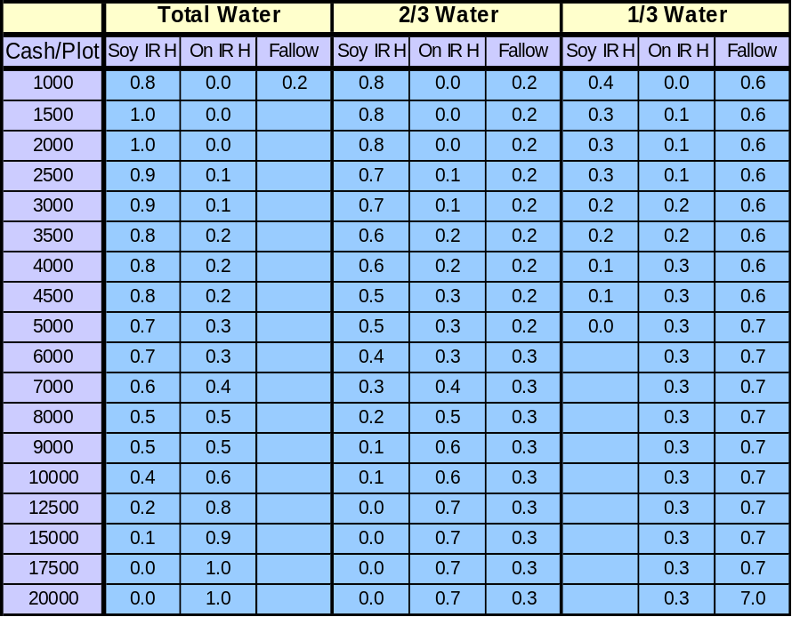
… but adapted to the specificity of the case study
Economic
Decision
Wet
food
plot
Food
Security
season
Food security
and social belief
plot
Economic
Decision
Dry
Notes:
In fact this domination does not accur in reality, thus other mechanisms interfers with this purely economic decision.
In particular the rice production which is a dominant feature during the wet season and driven by a food security strategy.
So according to the season farmers will choose either a economic strategy or a food security assessment.
Finaly the economic decision is based on the cash per plot and expectation on water availability

Slide 32
Labor Allocation (dry season).
Farming decision
farmer
wet
yes
no
Season
dry
Dry income
>
wages
Negative cash
Off-farm decision
yes
Off-farm decision
no
Notes:
Concerning labor dynamic, farmers have to decide to which activity they allocate their labor force.
They are 2 ways to use this labor : farming and off farm activities which occurs only during the dry season.
So, at the beginig of the dry season ……..

Slide 33
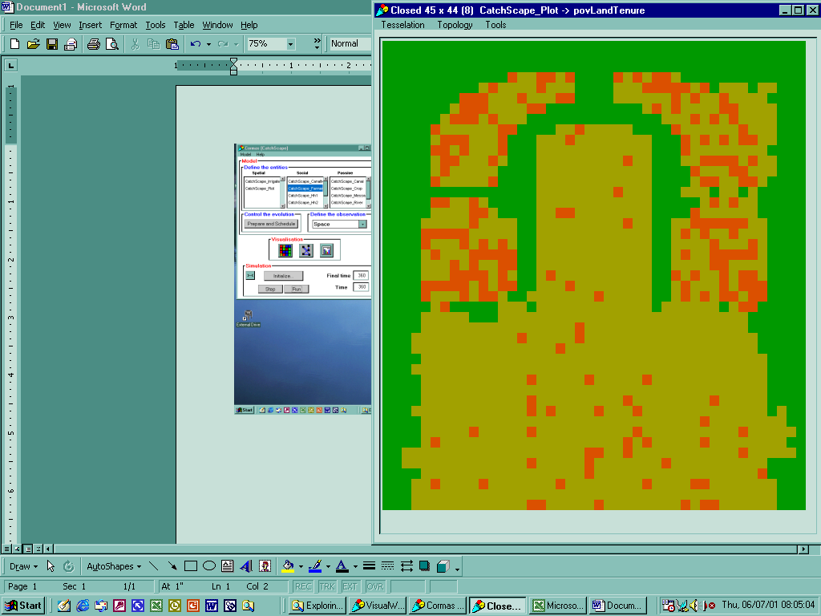
Land Dynamic
1. Buying plots
2. Upland irrigation
3. Forest conversion
0
1
2
3
Upland Plot
0
C32
1
2
C12
C11
C31
3
C21
C22
Paddy plot
Costs (bath / 2 rai plot)
Zone1
Zone2
paddy plot
80,000
160,000
upland plot
60,000
60,000
upland irrigation
60,000
60,000
Notes:
The first land dynamic is the buying of new plots.
According to the cluster analysis, we ’ve found that the maximum plot pattern in Mae Uam is 2 upland and 3 paddy plots. We ’ve define this pattern as a goal for farm trajectories and each Hh t ries to reach it by a way or anather
The second land dynamic is the installation of irrigated equipement on upland plots.
This upland irrigated plots picks up water upstream from the irrigated schemes and according to limitations coming from the zone level.
Forest conversion into upland rainfed plot is the last aspect of land dynamic.

Slide 34
1. Schematic representations
    Spatial representation
    Social representation
2. Biophysical processes
    Crop model
    Hydraulic model
3. Techno-Economic Decisions
    Farming decision
    Labor dynamic
    Land dynamic
4. Social interactions
    Individual behavior
    Negotiations between weir managers
    Restriction and control by a zone committee

Slide 35
Irrigation : a multi-scale and interactive management …
Weir negotiation
Farmer
Water ?
Canal rotation
OK
Upstream priority rule
Two levels of sharing / two levels of negotiation
Negotiation based on an irrigation satisfaction criteria (ISC)
ISC based on farmer’s protest: bottom-up system
Water ?
Notes:
The main social interaction is part of the irrigation management and is divided into 3 level.
The first one is the individual level ……
Farmers are allowed to a dihonest behaviour taking more water then needed.
The seconf level is ……..

Slide 36
… and other social interactions
Zone committee supervision
Zone committee
Exchanged labor
Upland irrigation limitations
Updated price lists
Forest conversion limitations
authorized during planting and harvesting
If it’s not enough, households have to hire workers
Notes:
Other social interactions are coming from :
- the zone committee ……
- the exchange of labor …...

Slide 37
RESULTS
Model validation
Model stability
Global figures validation
Tested scenario
    Basic scenario
    Individual belief (high water expectation)
    Market impact (onion price)
    Social interaction (water thieves)
    Climate stress (Successive dry years)
    Water management (zone conflict)
Notes:
We will first talk about the validation of the model and then present the impact of different parameters that we have tested one after the other into a serie of scenario.

Slide 38
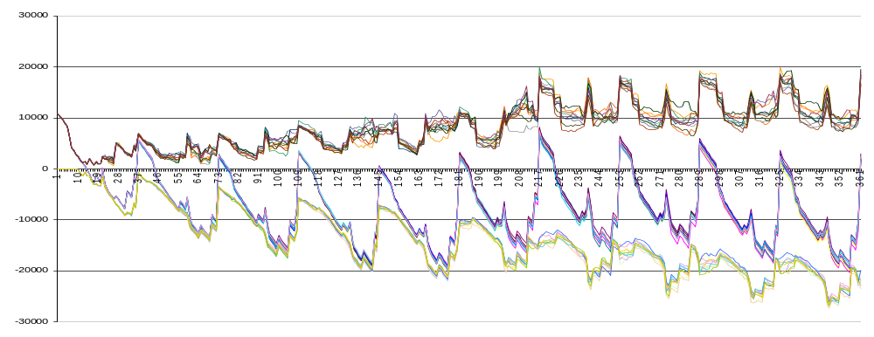
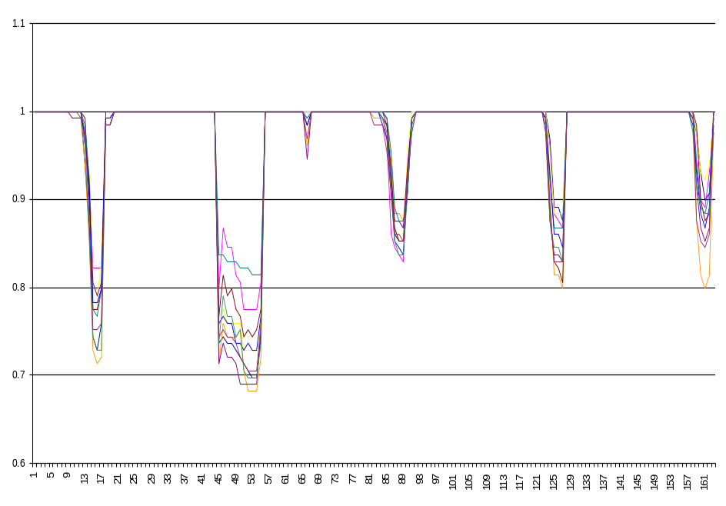
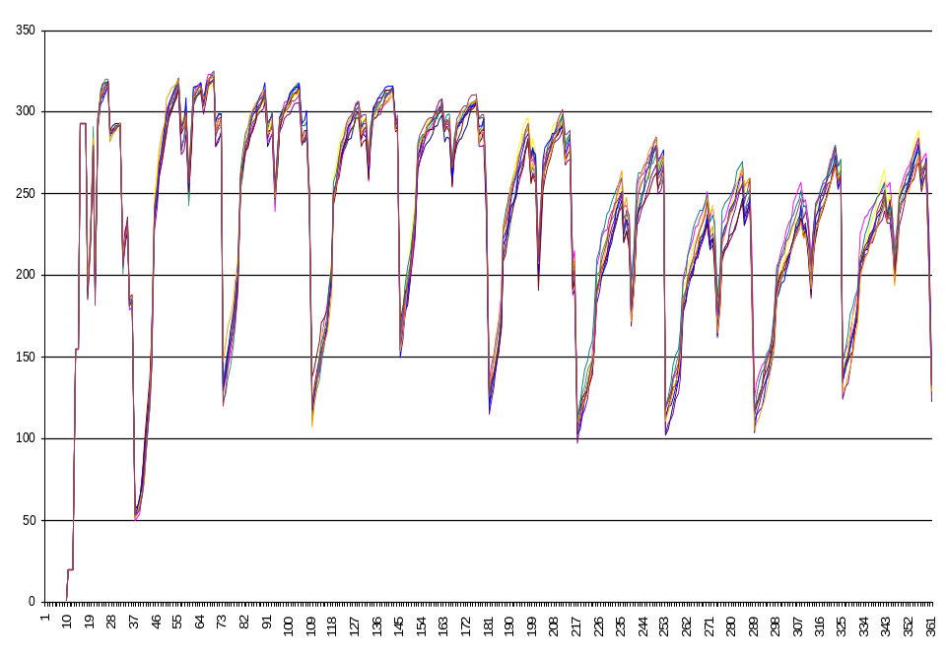
Stability of the model: 10 simulation results
Household’s cash
Water satisfaction
Nb of Hh in deficit
Notes:
As the plots are randomly distributed amongs agent, a ecrtain variability appears in the simulation. Then the convergence of the simulations has to be tested.
Looking at those graph it ’s obvious that the model is quiet stable even if some variable have larger range of variation

Slide 39
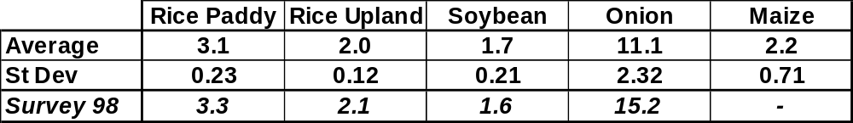
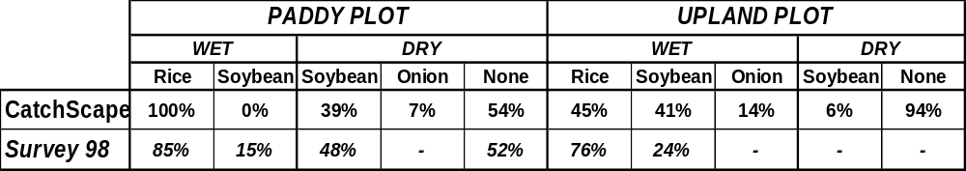
General figures
Average Yields (T/ha)
Cropping patterns
Notes:
Average yields
Cropping pattern : Even if onion was not listed as a significant crop during the survey in 1998…..

Slide 40
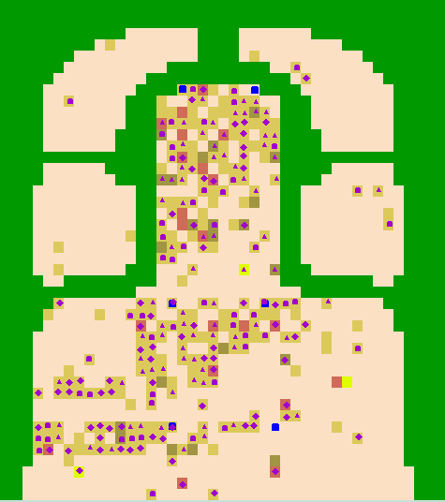
Basic scenario
Average figures
10% Hh: [+10; +35] kBath
45% Hh: [-10; +10] kBath
45% Hh: [-70; -10] kBath
140 Hh in permanent deficit
Bought plot: 0-2
Irrigated upland plot: 11-21
Final cropping pattern:
  Wet: 84% Rice, 12% Soybean, 4% Onion
  Dry: 80% Soybean, 15% Onion, 5%Maize
Upstream canal dominance
Irrigation rotation at the end of the dry season
Starting date: 01 April
5 years hydrology: 1988-1992
8 years market prices
No water thieves
Land market and upland irrigation: ON
Forest conversion: OFF
Cash initialized to last until the next harvest
Plots randomly distributed according to the cluster requirements
Notes:
First scenario that is presented is the basic one that will be used to compare the other scenario

Slide 41
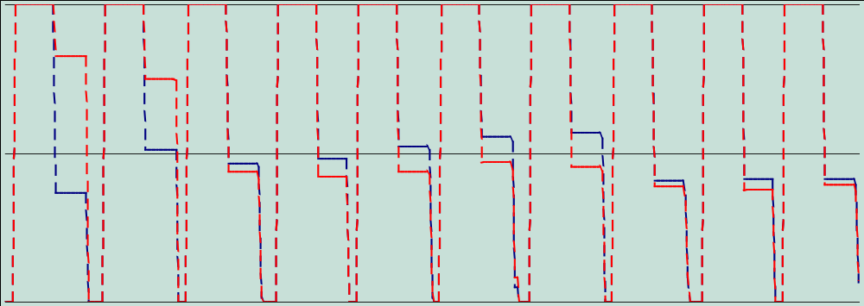
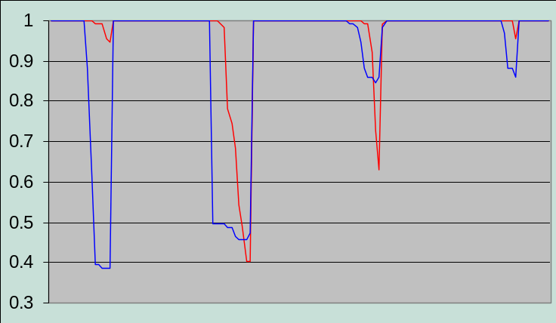
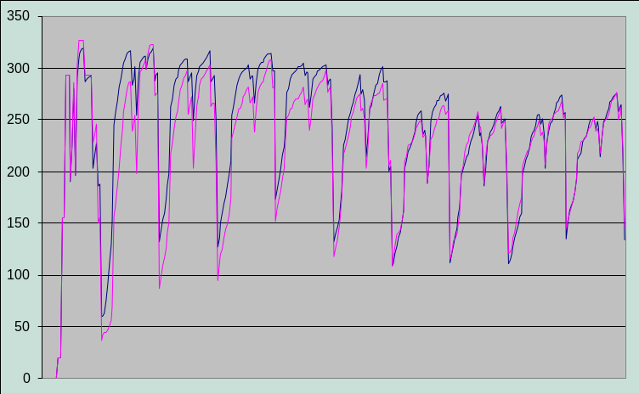
Individual belief:
Water expectations as a learning process
% of cultivated paddy plot
Optimistic
Basic
Irrigation satisfaction (%)
Number of Household in deficit
Canal 1
Canal 6
Optimist
Basic
Notes:
This scenario test the effect of an individual belief.
Indded, farmers in the first years of simulation have to estimate for each of their plots how much water is available at this specific location in the scheme. According to this they choose the next year to crop or not their plot. It ’s a learning process.
Now on this figure we ca …….
CONCLUSION : The learning process implemented in CatchScape is efficient

Slide 42
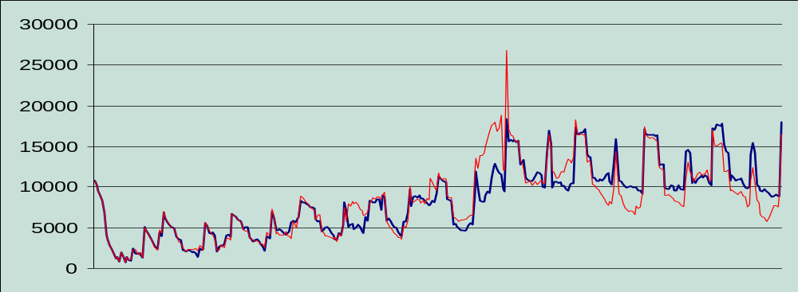
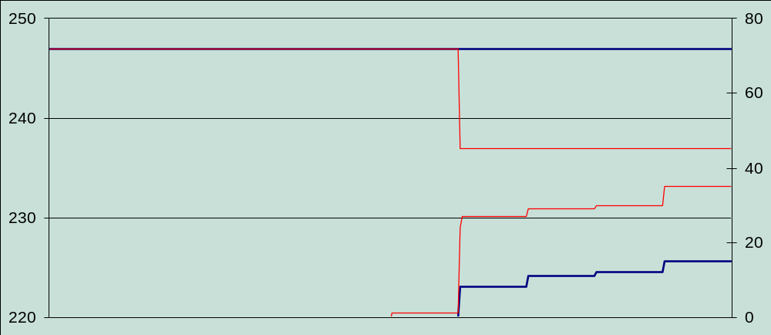
Market impact – Peak price for onion (6th year)
Cash of positive Hh
Peak price
Basic
Available plots
Irrigated upland plots
Peak price
Basic
Notes:
In order to evaluate the market impact on the system we have input a peak price for onion on the 6 th year.
On this chart the impact is quiet clear
CONCLUSION : CatchScape is sensitive to price fluctuation

Slide 43
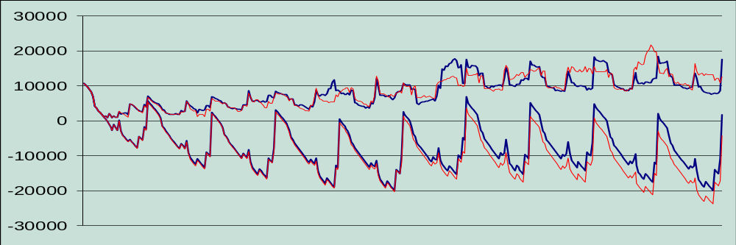
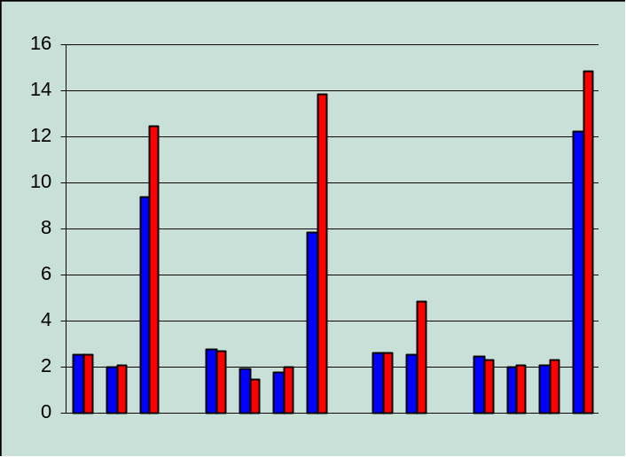
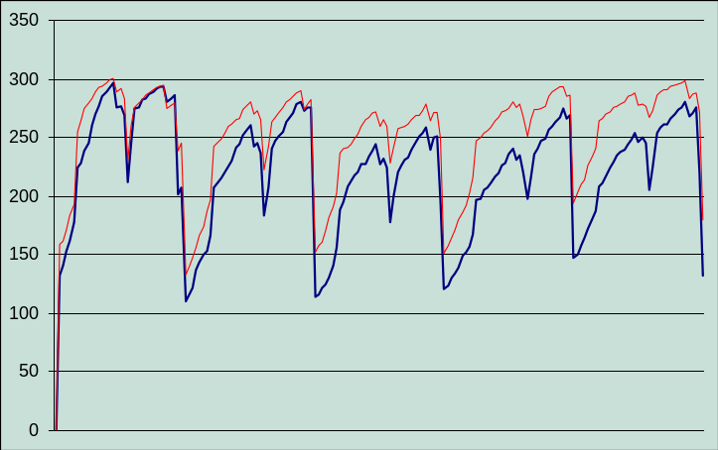
Social interactions: 33% of water thieves
Positive Hh cash
Global cash
Thieves
Basic
Number of Household in deficit
Onion yields
Increase
inequity
Thieves
Basic
Notes:
We have tested the impact of water thives on the glbal wealth of the population.
The presence of water thives decrease the global cash of the population and increase the number of Hh in permanent deficit.
CONCLUSION : Individualism behaviour has a clearly negative impact on the system

Slide 44
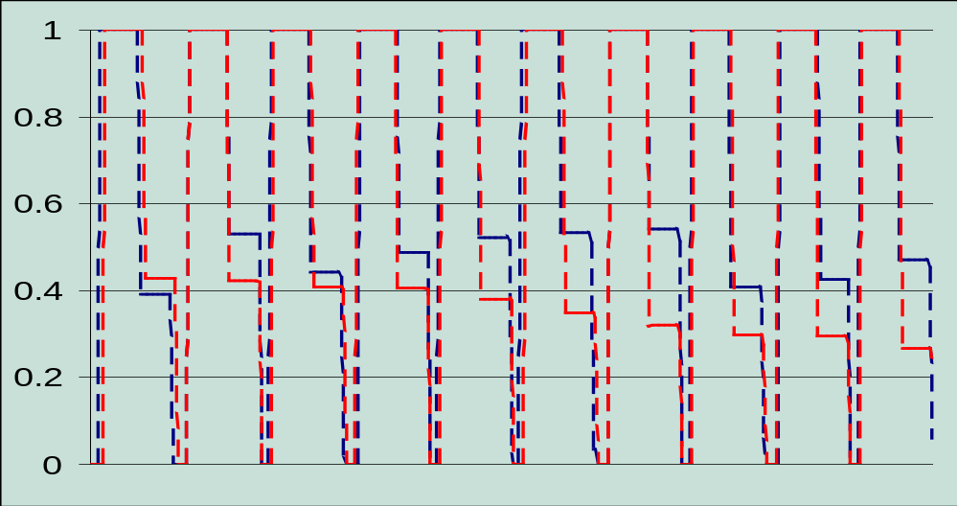
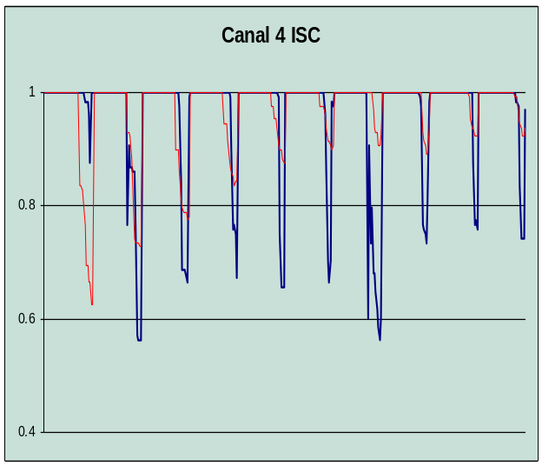
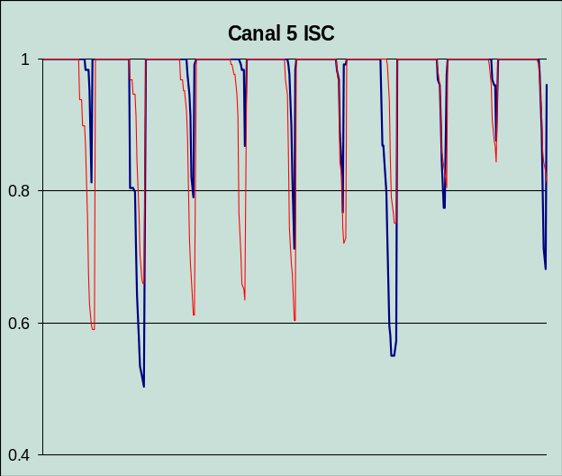
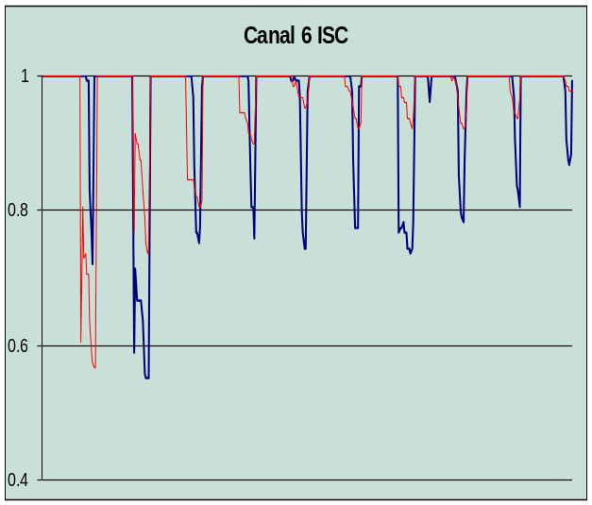
Climate stress: the 1989 dry scenario (x 10 times)
% of cultivated paddy plot
Dry years
Basic
Strong water stress affects more the downstream canal in a pair… but learning process adjust plot density to water availability
Notes:
For the climate effect we have repeated 10 years, the driestyear of our original dhydrological file.
CONCLUSION : Within the model the agents are able to adapt themselves to a new situation

Slide 45
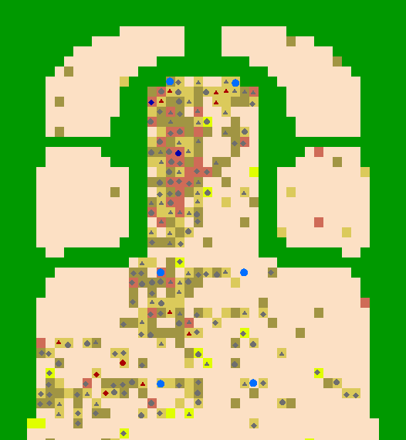
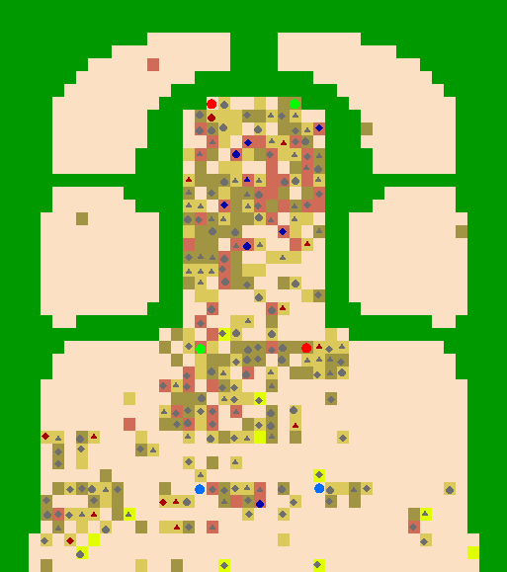
Importance of water management and weir collaboration
A downstrean / upstream conflict
A view of the catchment 10 years later …
… the effect on cultivated plots
Without collaboration
+15/+19%
With collaboration
-8/-12%
-9/-13%
-11/-14%
-4/+10%
-11/+10%
Notes:
In the last scenario we have remove all types of collaboration / negociation between weirs and the effect i that only the first canal take benefice from this scenario
CONCLUSION : This very fragile negociation process secures equity between farmers.

Slide 46
What about the initial question:
Does Upstream Water Management affect the downstream farm sustainability ?
Impact of water management
Without collaboration between weirs, unbalance between upstream and downstream is reinforced.
On another hand, impact of individual behavior has as much effect as weir manager negotiations.
Enhancing factors
The increasing variability of the local climate and the near to subsistence local economy, reinforce the sensitivity of the system.
Back to negotiation
As economic rationality is strongly interlaced with individual belief and social interactions, any attempt to modify the system would have to face the conservative behavior of local communities.
Thus, only concerted proposals with local communities may secure a large and sustainable adoption, especially since emerging conflict are encountered in the catchment.
Notes:
Read………..

Slide 47
What is next ?
Improving CatchScape
Is the upstream impact as strong as simulated ?
Is access to loan an issue or not ?
What are the limitations to forest conversion ?
What are the labor market constraints ?
Towards field negotiation
Validation of our representation of the system with local experts.
Definition of a communication process supporting the negotiation among local communities (role game, black board, panel discussion,…)
Notes:
We have 2 tasks now coming :
- the first one is the imrovements …..
- the second task is …...

Slide 49
L’opération pilote POAS
dans la vallée du fleuve Sénégal
Un accompagnement technique
à la planification décentralisée
Une démarche d'accompagnement
des processus de décision
combinant SIG, jeu de rôles et SMA
P. d’Aquino, F. Bousquet,
A. Bah & Ch. Le Page

Slide 50
Land use in Senegal
Decentralisation -> Rural Councils have to manage the resources
Problems of allocation of space : multiple uses of the same space (agriculture-grazing)
Two years process (GIS, workshops,etc.)
A MAS to facilitate discussions

Slide 51
Land-use workshops
Day 1
  Definition of resources and space, rules, behaviours, spatial representation
Day 2
  Role game
  Problems and scenarios
Day 3
  Simulations

Slide 52
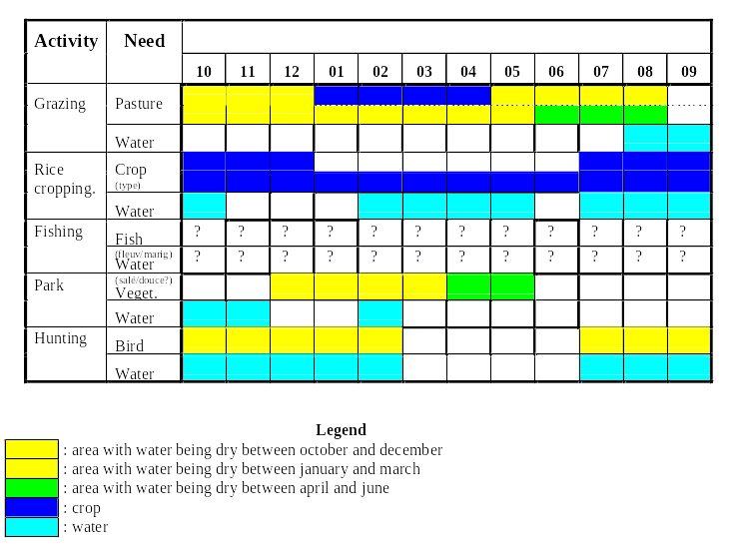
How users see their needs

Slide 53
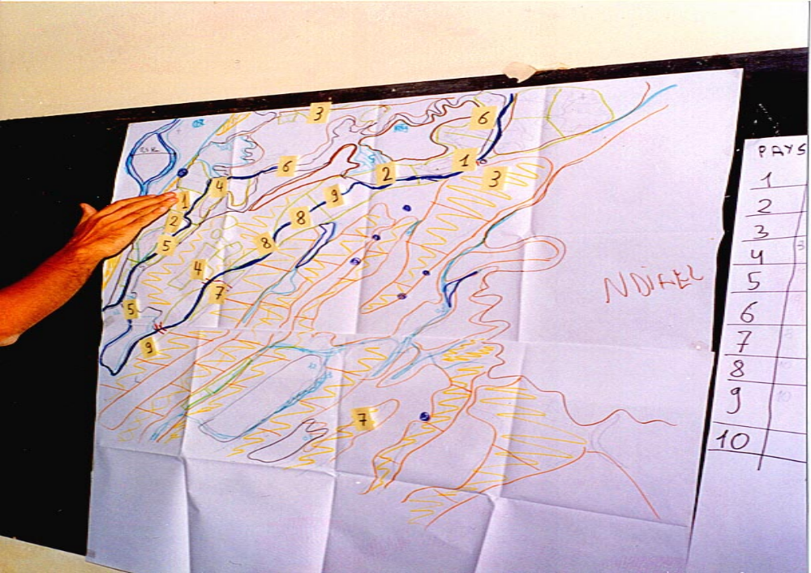
Collectively testing the compatibility in space and time
of these different uses

Slide 54
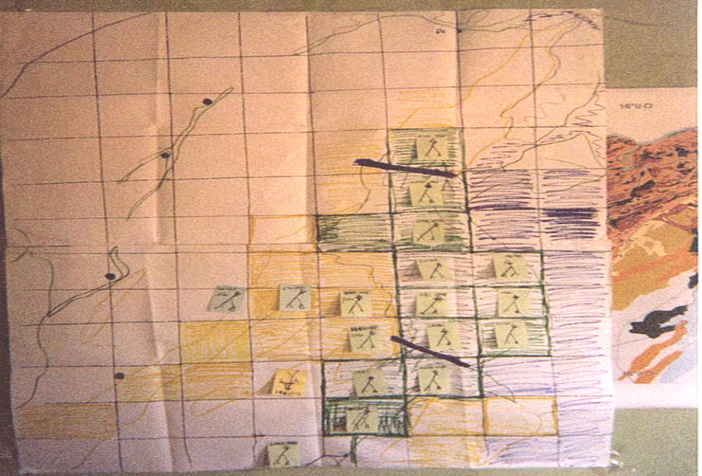
From the role game to the MAS

Slide 55


Agents’ behaviour
Farmer :
- raining season crops on
- dry season crops near permanent water
Herder:
- distance to water < 5km
- does not cross the crops
- better grazing areas = crops residuals and

Slide 56
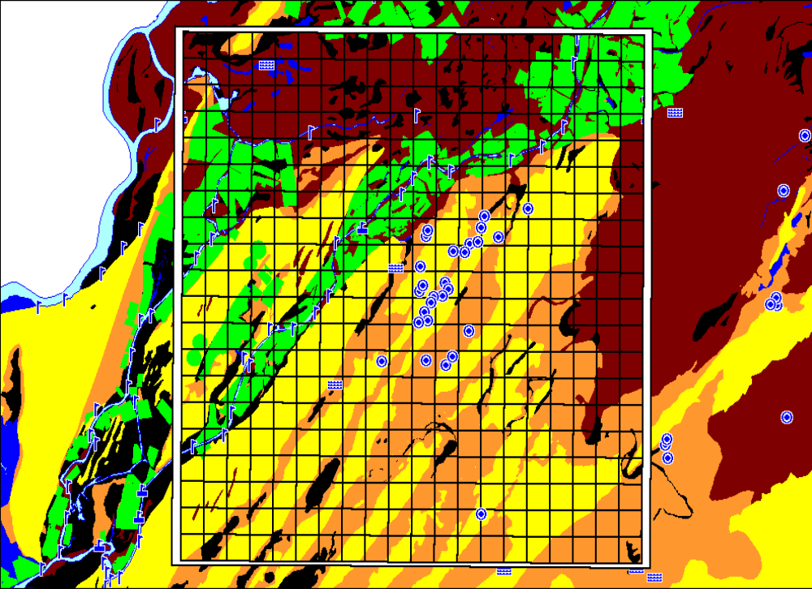
From the role game to the MAS

Slide 57
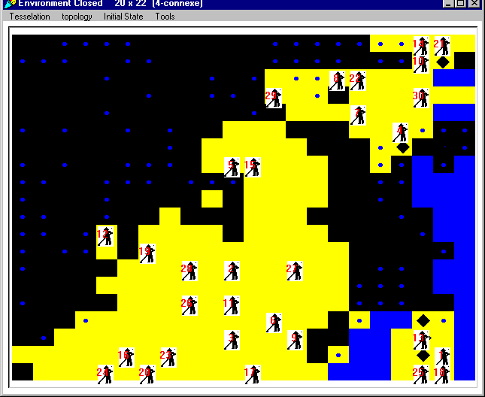



Basic simulation

Slide 58




With channels

Slide 59



Channels and access rules

Slide 60


Slide 61



Slide 62
Outputs
Facilitate discussions on :
  Ngnith village : new water points or new channels, access rules to the water
  Nboudoum village : necessity of grazing management (technical expertise), access to a park
  Ndiaye village : positive impact of agricultural diversification

Slide 63
Key lessons
Model as a common representation (researchers, actors, politicians)
Adaptive (evolving) models for adaptive management
KISS
Transaction costs : high but reduces other transaction costs

Slide 65


Viability of irrigated fields in
Podor (North Senegal)
From the model to its use on the field
with farmers
Olivier Barreteau (Cemagref)
barreteau@irrigation.cemagref.fr
Notes:
Je vais vous présenter mon travail de thèse qui porte sur la mise au point d'un outil de simulation de systèmes irrigués permettant d'étudier l'existence d'un lien entre modes d'organisation et viabilité des systèmes irrigués.
Cette thèse s'est faite au sein de l'UR GREEN du Cirad et a bénéficié sur le terrain de l'appui du centre de l'ISRA de St Louis et en particulier de M. Sidi Seck.
Annoncer le plan

Slide 66


Slide 67
Scientific context
From the fields to the irrigated system
Notes:
Ce travail est centré sur l'étude du système irrigué. De nombreuses définitions de ce type d'objet existent dans la littérature. Certaines sont relatives aux fonctions mises en oeuvre, d'autres aux éléments qui les constituent.
Il faut distinguer dans ce dernier cas les définitions de périmètre irrigué ou d'aménagement hydro-agricole de celles de système irrigué.
Pour nous, un périmètre est une portion d'espace regroupant des points source, des canaux amenant de l'eau à des parcelles en vue d'une production agricole.
Un système irrigué est la réunion d'un périmètre irrigué et d'un groupe d'acteurs, usagers et/ou gestionnaires en interaction entre eux et avec leur environnement.
Ainsi défini un SI est le lieu de nombreuses interactions, directes ou via l'environnement. Ces réseaux d'interactions constituent les modes d'organisation de ces systèmes. C'est à ce niveau qu'apparaissent les modes de coordination, pour appréhender les interactions. Ce sont eux qui sont à l'origine de la dynamique des modes d'organisation.
Cette définition pose le périmètre comme pouvant être un bien en propriété commune. On se place ainsi dans la suite des travaux de Sengupta d'une part et de l'équipe d'Ostrom d'autre part.
Les modes de coordination constituent l'ensemble des moyens mis en oeuvre entre acteurs ou groupes d'acteurs du système. Ils incluent notamment les règles collectives, les réseaux d'échange, et plus généralement les institutions qui se mettent en place dans les systèmes irrigués.

Slide 68
Scientific context
Evaluation of irrigated systems
Damages to the infrastructures
Farmers’debt
“wasting” of water
Viability of irrigated systems?
access to credit
low yields
Weak development of the site
Notes:
Ces systèmes irrigués, qui dans la moyenne vallée du Fleuve Sénégal n'ont pas donné les résultats escomptés donnent lieu à des diagnostics variés selon les points de vue pris par les différents experts ayant participé à leur évaluation.
Il s'agit en particulier de ....
En fait toutes ces questions peuvent se regrouper pour nous dans une question commune qui est celle de la viabilité des systèmes irrigués.
Par viabilité on entend ici capacité du système à continuer à fonctionner sans intervention extérieure non prévue.
En fait on avait initialement retenue une définition de la viabilité proche de celle de Aubin: propriété d'un système dont la trajectoire d'évolution respecte des contraintes de viabilité.
Mais ici l'ensemble des contraintes de viabilité est complexe
C'est pourquoi on évaluera la viabilité a posteriori en fonction de la longévité du système pour un ensemble de conditions initiales données

Slide 69
Question to be addressed
Objective of the study
Relationship between coordination modes and viability of irrigated systems ?
To build a tool to simulate the evolution of irrigated systems
Notes:
Les systèmes irrigués observés sont le lieu de nombreuses interactions. A la suite de thèses antérieures, je pense en particulier à celle de Pierre-Yves Le Gal qui a soulevé l'importance du cadre collectif de gestion dans les systèmes irrigués, nous nous sommes demandés quels sont les liens entre modes de coordination et viabilité des systèmes irrigués.
Pour cela, il se pose alors le problème de l'outil à utiliser pour tester cette hypothèse. Des expérimentations de scénarios de gestion sur des systèmes réels sont lourdes, peu reproductibles et ont des conséquences importantes pour les paysans des périmètres testés. Elles ne sont donc pas envisageables.
Il s'agit de constituer un outil pour simuler l'évolution de systèmes irrigués avec différents scénarios. C'est là un objectif de cette thèse.

Slide 70
A supporting modelling approach
field
Assumptions
questions
discussion of assumptions
new questions
model
simulations
Programme of experiments
Notes:
Pour cela, nous avons mis en oeuvre une démarche de modélisation d'accompagnement.
Une connaissance du terrain permet de poser de premières hypothèses sur le fonctionnement du modèle et d'émettre des questions que l'on aimerait voir traitées par ce modèle.
Ceci nous amène à constituer un modèle et un plan d'expériences qui est appliqué dans une phase de simulations.
Celles-ci renvoient alors sur le terrain soit pour reprendre les hypothèses de représentation du système, soit en posant de nouvelles questions pour améliorer la connaissance du terrain.
Ce cycle a été accompli 3 fois, avec des passages sur le terrain durant chaque fois environ 3 mois.
Mais avant de vous les décrire je vais vous présenter rapidement la méthode employée dans les phases de terrain et de modélisation

Slide 71
1st field stage
field
model
simulations
river
Backers
Pumping station
SAED
Union
Main canal
Bank
filière
GIE
Irrigator
Village
Farmer
Plot
Irrigated fields
Irrigated system
Family
Rice
Notes:
La première phase de terrain a donné lieu à la constitution de cette représentation, à partir des enquêtes mais aussi à partir des connaissances antérieures sur ces sites.
Un intérêt tout spécial avait été donné à ce qui concernait l'eau et aux pratiques agricoles dans les thèmes des entretiens. Ces entretiens ont porté sur les choix faits par les paysans d'aller irriguer ou non, d'irriguer ou non, sur le cadre collectif des irrigations.
Au niveau collectif on s'est essentiellement intéressé à la règle d'allocation de l'eau entre les parcelles d'un même irrigateur. Cette règle va du libre-service absolu à des tours d'eau assez stricts et peut évoluer en cours de campagne.
Au niveau individuel les contraintes de chacun, diversité des sources de revenu, accès à une main d'oeuvre familiale... donnent lieu à une assez grande variabilité de comportement. Pour prendre des exemples extrêmes: certains mettent beaucoup d'eau puis ne reviennent pas pendant 15 jours, d'autres viennent souvent en mettre un peu.
Dans ce contexte, s'il y a un tour d'eau il peut difficilement correspondre aux contraintes de ces deux paysans.
C'est pourquoi quand on observe la réalité des pratiques, il s'agit plutôt de tours d'eau arrangés suite à des accords entre paysans.

Slide 72

A first model
field
model
simulations
Notes:
décrire écoulement de l'eau sur l'interface
c'est un archétype de périmètre irrigué dans la zone de Podor

Slide 73
Dynamics of the first model
field
model
simulations
Flowing of the water
  Among irrigators, upstream irrigators have priority
  Among the plots of a single irrigator, upstream plots have priority in that way :
  V_{r} = T * (1/2^{r}) / (Σ_{k}(1/2^{k}))
    V_{r} : volume received by the r^{st} open plot along the irrigator
    T : volume available in the irrigator
Notes:
La dynamique de l'écoulement de l'eau dans le périmètre modélisé, outre l'évapotranspiration et l'infiltration quotidienne supposée identique dans tout le périmètre et constante durant la simulation, l'eau pompée par la station de pompage en fonction de son état de fonctionnement et de la quantité de gasoil disponible va intégralement dans le canal principal puis est distribuée aux irrigateurs dont le module est ouvert de l'amont vers l'aval en fonction de la quantité d'eau disponible puis pour chaque irrigateur les parcelles dont la buse est ouverte reçoivent une quantité de l'eau évaluée de sorte à reproduire un avantage partiel à l'amont.
En fait si une seule parcelle est ouverte elle reçoit toute l'eau qui transite par l'irrigateur. Si plusieurs parcelles sont ouvertes, cette équation est appliquée qui simule un avantage pour les parcelles à l'amont en leur donnant environ l'équivalent de ce que reçoivent l'ensemble des parcelles situées plus à l'aval.

Slide 74

Simulations of rules for allocating water (1)
field
model
simulations
max (<0)
moy (<0)
min (<0)
Notes:
Ce premier modèle a été utilisé dans un premier temps avec un plan d'expériences croisant une règle collective d'allocation de l'eau variant selon les deux modalités tour d'eau ou libre service et des hypothèses de comportements des paysans : toujours sur la parcelle, prise en compte des contraintes individuelles, prise en compte des possibilités d'échange.
Dans ce dernier cas de comportements individuels, l'intérêt du SMA commence à apparaître puisque nous avons besoin de simuler des communications entre agents autonomes qui font appel aux représentations que se font les uns des autres.
Ces simulations sont obervées du point de vue du taux de parcelles sans eau en cours de campagne.
En abscisse, en ordonnée..
Dans tous les cas les parcelles sont supposées remplies d'eau en début de simulation. d'où les artefacts en début...

Slide 75

Simulations of rules for allocating water (2)
field
max (<0)
model
moy (<0)
simulations
min (<0)
Notes:
La dernière case précédente est divisée en trois selon le nombre de groupes. On constate que l'effet du nombre de groupes au sein desquels se font les échanges est au moins aussi important que la règle d'allocation de l'eau
On s'est donc posé à ce moment là la question d'approfondir les connaissances sur ce type de coordination par échanges de service.
PAUSE plan

Slide 76
Back to the field
field
model
simulations
to study thoroughly and get better knowledge about direct interactions between farmers
  for access to credit
  with the viewpoints of the farmers on the system
  via several levels of organisation
Notes:
Nous nous trouvons donc à commencer un deuxième cycle de notre modélisation d'accompagnement en nous posant plus particulièrement la question des interactions entre les paysans au sein du système irrigué.
Ceci a donné lieu à de nouvelles séries d'entretiens avec les mêmes interlocuteurs que lors du premier passage sur le terrain. Ces séries d'entretien ont d'abord porté sur la perception de ces interactions, les éventuels conflits. Comment percevez vous les conséquences de vos actions pour vos voisins? procédez vous à des échanges avec d'autres paysans? Les conflits ont également été abordés de manière informelle. Puis ils ont porté sur le déroulement de moments particuliers de la campagne où ces interactions sont en oeuvre comme l'accès au crédit, le paiement de la redevance hydraulique et plus généralement la préparation de la campagne.
La recherche de crédit en particulier se fait soit par des groupes d'accès au crédit qui sont les seuls à pouvoir accéder à la banque soit via des prêts auprès d'autres individus en fonction de leur statut social.
Ces différents entretiens ont permis de mettre en évidence différents points de vue des paysans sur l'intérêt de la mise en culture de leur parcelle. Ceci nous a mené à distinguer 4 types de paysans à partir de nos observations: des paysans avec un objectif productif, vivrier, de sécurisation foncière et en attente d'un autre emploi.
Ces coordinations se font également entre niveaux d'organisation différents.
Je vais maintenant décrire quelques cas d'acteurs rencontrés, individuels et collectif.

Slide 77
Yield objective
field
model
simulations
Rice
cfa
Intrants
cfa
cfa
cfa
cfa
Notes:
Le premier exemple concerne un paysan avec un objectif de production pour sa parcelle.
Pour lui, le périmètre c'est sa parcelle et un réseau où il doit s'occuper de conflits entre d'autres paysans. L'eau vient du canal et plus loin encore de la station de pompage.
Les difficultés avec la parcelle, c'est d'avoir le crédit que la banque ne donne plus. Heureusement qu'il y a d'autres ressources pour disposer de liquidités et pallier à ce défaut de crédit. L'eau peut manquer parfois si des paysans plus à l'amont sur l'irrigateur prennent de l'eau sans prévenir hors de leur tour.
Il considère que l'irrigation ça rapporte moins qu'avant mais ça rapporte encore quand même. Alors il essaye d'acheter beaucoup d'engrais et va sur la parcelle dès que c'est nécessaire. S'il faut irriguer il met de l'eau.

Slide 78
Objective: ground investment
field
model
simulations
cfa
cfa
cfa
cfa
cfa
Intrants
cfa
Notes:
Le deuxième exemple concerne un autre paysan du même périmètre, avec un objectif de sécurisation foncière. La répartition de l'eau entre les parcelles le long de l'irrigateur où se trouve sa parcelle ne lui pose aucun problème : sa parcelle est plutôt à l'amont et il préfère éviter les conflits quitte à ne pas avoir l'eau tout à fait au bon moment.
Pour lui, le périmètre c'est sa parcelle et un réseau principal le long duquel il y a quelques difficultés et une station de pompage au loin. La culture du riz coûte cher et ne rapporte pas beaucoup. Il n'en attend rien en fait, il a d'autres sources de revenu et d'autres activités. C'est pourquoi il investit peu d'engrais sur sa parcelle et ne vient y travailler que s'il n'a pas autre chose à faire ailleurs.
Et si on lui demande pourquoi il continue à cultiver sa parcelle, c'est parce qu'un jour il pense qu'elle pourra lui rapporter et il veut en disposer à ce moment là. Or la loi foncière en vigueur actuellement est que la terre est attribuée pour être mise en valeur et peut être retirée sinon. Il la cultive donc pour la conserver mais il fait en sorte qu'elle ne lui coûte pas trop cher même si elle ne lui rapporte rien.
et ce ne sont là que deux exemples...

Slide 79
Viewpoint of the manager
field
model
simulations
Rice
Rice
Rice
Rice
Notes:
Plusieurs types d'acteurs correspondant à des niveaux d'organisation collectif existent. On a déjà parlé des groupements d'allocation de l'eau ou d'accès au crédit. Il existe aussi en particulier un acteur particulier qui a en charge la gestion du système irrigué. Il s'agit dans la plupart des cas d'un groupe de paysans du périmètre même si cela n'a pas toujours été le cas.
Pour certains gestionnaires, le système irrigué est une machine à produire du riz. Il y a une station de pompage et un réseau principal qui délivre de l'eau à des irrigateurs. Ils ne descendent pas plus fin dans la connaissance du système.
Mais les usagers de ces irrigateurs entretiennent mal et ne respectent pas le tour d'eau. Les problèmes viennent des paysans qui ne respectent pas les règles collectives définies aussi bien en matière financière que de respect du tour d'eau ou de choix de culture.
Le gestionnaire doit notamment s'occuper de fixer le montant de la redevance, donne les instructions au pompiste pour le fonctionnement de la station de pompage, est responsable de tous les travaux d'entretien.
Bien souvent son intérêt à une campagne donnée est une production importante voire une superficie cultivée importante, ce qui justifie son rôle.
Ces différents acteurs interagissent sur les mêmes systèmes irrigués et en font évoluer la dynamique en intervenant à différents niveaux d'organisation.

Slide 80
A model of the society
field
model
simulations
Farmers
  a plot
  an objective of development
  a membership of 3 groups
Groups
  are agents themselves
  have a “raison d’être”
Notes:
Ces différents comportements ont donné lieu à une modélisation de la société à qui est attribué le périmètre représenté.
Il s'agit en premier lieu d'agents représentant des paysans. Ils sont décrits en particulier par un lien vers une parcelle et une seule, un objectif de mise en valeur de la parcelle qui contrôle la fréquence de leur passage sur leur parcelle et la quantité d'intrants recherchée.
Chaque agent paysan fait partie de trois groupements différents: un groupement d'allocation de l'eau rassemblant les paysans ayant leur parcelle le long du même irrigateur, un groupement d'accès au crédit et un groupement rassemblant l'ensemble des paysans du système dont le rôle est la gestion de la station de pompage et du réseau principal.
Ces groupements sont également des agents à part entière. Ils sont en particulier décrits par une liste de membres et leur raison d'être et l'objet éventuel qu'ils ont en charge. Ils communiquent entre eux et avec les paysans.
Tous les agents, paysans ou groupement, ont en tant qu'agent une représentation du système et de leurs relations avec les autres agents. Cette représentation inclut pour les paysans la liste des paysans de leur réseau d'affinité sociale au sein desquels se font les échanges.
Ils ont aussi un ensemble de règles sur lequel je vais m'attarder maintenant.

Slide 81


Second model
field
model
simulations
Notes:
La description des règles mises en oeuvre par ces différents agents constitue l'essentiel de la mise en oeuvre de ce modèle. Elles peuvent être choisies au moyen de l'interface.
Dire que c'est à ce niveau que se trouve le moteur de la dynamique
limites quand on veut dépasser une campagne, or pour la viabilité c'est une question importante
C'est pourquoi on a choisi de ne pas développer de plans d'expériences et de phase de simulation sur cette version du modèle qui a juste permis de vérifier qu'on pouvait simuler le déroulement d'une campagne dans son ensemble en prenant en compte un nombre assez important d'interactions entre les paysans. On va donc maintenant retourner au terrain sans passer par la case simulation.
PAUSE

Slide 82
Third field stage
field
model
simulations
Criteria to evaluate the progress of a campaign
Rules for updating the rules (for farmers and groups)
Notes:
Ce constat sur la deuxième version du modèle nous a donc amené à une troisième reprise dans la vallée avec comme question l'évolution d'une campagne à l'autre des ensembles de règles mis en oeuvre par les paysans et par les groupes. Ceci a correspondu à une série d'entretiens sur ce thème, toujours avec les mêmes interlocuteurs. Ces entretiens étaient du type êtes vous satisfait du déroulement de la campagne? pourquoi? et maintenant?
Ceci nous permet de distinguer des critères d'évalution d'une campagne variables d'un paysan à un autre: production, date de récolte, revenu net, endettement. Ainsi qu'entre groupes: production totale, intensité culturale, respect de normes techniques...
Les règles de changement de règles procèdent le plus souvent par imitation d'autres paysans ou groupement, mais parfois innovation locale également.
Certains paysans ne veulent rien changer a priori.

Slide 83
Whole dynamics of the third model
field
model
simulations
Maintenance of irrigation
search / repayment of credit
Crops harvesting and evaluation of the campaign
Notes:
La dynamique du modèle ainsi conçu se fait en plusieurs campagnes elles-mêmes subdivisées en plusieurs phases pour chaque agent
suivre la boucle à la main et raconter une simulation tranquillement
Ceci constitue donc un modèle qui prend en compte les processus que l'on souhaite et qui permet de simuler l'enchaînement de campagnes. Il s'agit maintenant de vérifier qu'il peut être utilisé pour notre objectif.
PAUSE plan

Slide 84
Testing the relevance of the model
field
model
simulations
description of the scenarios
examples of simulations for a particular scenario
protocol for experiments
interpretation of the results
Notes:
Nous avons donc maintenant un modèle qui nous permet en le faisant tourner "à la main" de reproduire l'enchaînement de campagnes sur un système irrigué prenant en compte les interactions entre les paysans et entre les paysans et les groupes.
A ce stade de la construction du modèle, peut-on l'utiliser pour dire des choses sur la viabilité d'un système irrigué, et comment?
Pour cela nous allons commencer par décrire le format des scénarios que l'on peut simuler avec ce modèle puis sur un exemple des sorties de simulation, ensuite je vais présenter le plan d'expériences effectué pour vérifier cette pertinence et enfin présenter les résultats de cet ensemble de simulations: faudra-t-il s'attaquer à un nouveau cycle ou l'étape actuelle est satisfaisante pour notre objectif ?

Slide 85
Testing the relevance of the model format of a scenario
field
model
simulations
S = <C, I, E>
  C : set of initial collective rules
  I : set of initial individual rules
  E : set of environmental parameters
An example
  participatory permission depends on the individual debt
  minority of farmers with a “ground” objective
  ETR + Infiltration = 1.1 cm/day
Notes:
Un scénario est décrit par un triplet constitué d'un ensemble de règles collectives, d'un ensemble de règles individuelles
Cela revient à faire des expérimentations sur un système réel hypothétique et plausible en choisissant un ensemble de règles collectives
Par exemple un scénario particulier...

Slide 86

Testing the relevance of the model
Evolution of
20 simulations
field
model
simulations
Notes:
Si on simule ce scénario, différents indicateurs peuvent être observés. Vu la définition retenue pour la viabilité liée à la longévité du système sans intervention extérieure, nous observerons le nombre de parcelles mises en culture à chaque campagne.
Sur l'exemple précédent, simulé 20 fois, on observe une assez grande variabilité des évolutions simulées de ce point de vue. Cette variabilité est due notamment au grand nombre de paramètres aléatoires utilisés dans les processus mis en oeuvre par le modèle. On peut donc s'inquiéter pour la pertinence du modèle. Il est d'ores et déjà clair qu'une seule simulation d'un scénario ne permettra pas de tenir un discours sur sa viabilité.
Cependant retenons pour la suite la division en deux pôles des simulations: un groupe qui dure longtemps et un groupe qui s'arrête rapidement

Slide 87
Testing the relevance of the model
Experiments protocol
field
model
simulations
100 random scenarios to test
simulations
Temporal evolution : high variability
sets of simulations
Comparison of lasting simulations rates
Notes:
Pour cela nous nous sommes constitués un échantillon de 100 scénarios. L'ensemble des scénarios possibles étant démesurément grand (jusqu'à 105 paramètres pour certains scénarios, 10⁷ années pour tous les simuler), nous avons constitué 100 scénarios de manière aléatoire afin de constituer cet échantillon.
Chacun de ces scénarios aléatoires a alors été simulé et observé de la même manière que le précédent. La même variabilité a été observée. Nous avons alors procédé à 5 séries de 20 simulations pour chaque scénario afin de travailler sur la fréquence des simulations durant un grand nombre de campagnes au sein d'une série et de voir si on pouvait constituer au moyen de cette fréquence une partition de cet ensemble test de 100 scénarios en classes de viabilité.

Slide 88
Testing the relevance of the model
Interpretation of the results
field
model
simulations
Definition of a "viable” simulation
Partition of the scenarios among 3 classes of viability
  non viable : less than 5 %
  slightly viable : between 5 % and 50 %
  viable : more than 50 %
Notes:
Pour cela nous avons tout d'abord dû définir ce qu'était une simulation viable d'un scénario.
Sur l'exemple précédent on peut voir que deux groupes se distinguent assez nettement parmi les 20 simulations de ce scénario: quelques unes durent et les autres s'arrêtent dès le départ. Ce cas s'est répété sur un nombre élevé de scénarios. C'est pourquoi nous avons eu envie de définir une simulation viable comme une simulation qui dépasse un seuil minimum de campagnes enchaînées. Nous y avons ajouté un deuxième seuil sur la proportion de parcelles mises en culture pour éviter de compter des artefacts apparaissant pour certains scénarios où quelques simulations durent un grand nombre de campagnes mais avec un faible nombre de parcelles mises en culture.
Nous avons alors ajusté ces seuils de sorte à avoir une bonne stabilité des classes de viabilité des scénarios qui en résultent.
Nous avons donc défini une simulation comme viable si au moins 25% des parcelles sont mises en culture à au moins une campagne au-delà de la 6ème campagne.
Ainsi la fréquence des simulations viables dans des séries de 20 s'avère un bon indicateur pour constituer une partition de notre ensemble de 100 scénarios aléatoires. Les trois classes obtenues sont les suivantes:

Slide 89
Testing the relevance of the model
Conclusion
field
model
simulations
The content of the model is sufficient
It is able to distinguish the scenarios according to their viability
It is a relevant tool to address the question of the viability of irrigated fields
Notes:
Nous avons donc là un outil a priori pertinent pour un usage en recherche. Il permet de tenir un discours sur la viabilité d'un système irrigué pour un scénario donné en ayant un contenu satisfaisant et en ayant une capacité de discrimination entre les scénarios du point de vue de leur viabilité.
Ceci ne prouve bien sûr pas la validité des théories qui peuvent résulter d'un tel usage, il a seulement la capacité d'appuyer la construction de ces théories.
PAUSE-plan

Slide 90
Use of the model
From coordination modes to the viability of the irrigated fields
explanation for the viability by single rules
explanation for the viability by sets of rules
  crossing over scenarios
Notes:
Il reste maintenant à se servir de ce modèle pour étudier le lien entre modes de coordination et viabilité des systèmes irrigués
Nous avons dans un premier temps voulu tester pour notre ensemble de 100 scénarios si certaines règles prises indépendamment des autres pouvait expliquer la viabilité d'un scénario. Nous avons pour cela utilisé des tests statistiques pour chaque paramètre des scénarios. Il apparaît qu'une seule règle est explicative de la non viabilité. Si une majorité de paysans ne remboursent pas, le système est généralement non viable. C'est déjà là un exemple de discours que l'on peut tenir graâce à l'usage du modèle sur la viabilité des systèmes irrigués. Il n'était certes pas nécessaire de développer cette démarche et cet outil pour arriver à cette conclusion, mais le fait de retrouver ce genre de résultats nous conforte dans la fiabilité accordée au modèle.
On a alors cherché si des ensembles de règles collectives ou individuelles sont explicatifs de la viabilité d'un système irrigué. Pour cela on a croisé des scénarios en reprenant les ensembles de règles C ou I de scénarios viables et en les appliquant à d'autres.
Je vais maintenant m'intéresser plus particulièrement à ces croisements

Slide 91
Use of the model
Example of crossing between scenarios
Sc 1
Start of the pumping station when there are enough ready farmers
Majority of farmers with a "production” objective
ETR + Inf = 1.0 cm/day
C₂₁
C₁₂
Sc 2
minority of farmers with a "production” objective
ETR + Inf = 1.2 cm/day
Start of the pumping station on a fixed date
Notes:
Pour tester cette hypothèse nous avons procédé à des croisements de scénarios. Ces croisements ont été fait avec tous les scénarios viables et un peu viables qui ont été croisés entre eux.
détailler l'exemple
Nous avons obtenu dans certains cas des scénarios non viables.

Slide 92

Results of these crossing-over
Notes:
Les deux graphiques du haut montrent que ce sont là deux scénarios un peu viables, et les deux graphiques du bas montrent que les scénarios issus des croisements des règles collectives, de 62 sur 21 d'une part et de 21 sur 62 d'autre part, sont non viables.
La démarche suivie ne prouve cependant pas qu'il n'existe pas de bons ensembles de règles, mais que s'ils existent ils ne sont pas faciles à identifier.

Slide 93
Interpretation of the results
Viability in the consistency of the individual / collective relationship
It appears essential to negotiate collective rules with the actors of irrigated fields
Back to the field
Notes:
Une explication alternative au choix de bons ensembles de règles pour garantir la viabilité et cohérente avec les résultats de ces simulations serait alors la nécessité d'une cohérence entre les règles collectives et les comportements individuels .
Cette explication est également cohérente avec le terrain. Cela peut en effet expliquer les échecs répétés de toutes les modes d'aménagement qui se sont succédées dans la moyenne vallée du fleuve Sénégal et qui avaient tous comme caractéristique d'avoir une conception extérieure à la vallée.
Dans ce cas cela veut dire que seules des corps de règles collectives négociées avec les paysans des systèmes irrigués ont une chance de déboucher sur des systèmes irrigués viables.

Slide 94


Back to the field : to present the content of the model
With several objectives :
  to validate the model
  towards a use of the model as a negotiation support tool
In the form of a role game

Slide 95
The use of role game
Using games in negotiation processes
a priori complementarity between the game
and the agent-based model
The game as a way be be explicit about the content of the model
Notes:
Pour cela nous avons imaginé une méthode basée sur les jeux de rôles.
L’utilisation de jeux de rôles dans des processus de négociation pour l’aménagement du territoire nous a amenés vers cette méthode.
Elle est complémentaire à l’usage des SMA, car
les SMA lui apportent la capacité à explorer des systèmes complexes (constitution du modèle) et la possibilité de répétition et de contrôle des scénarios
les jeux permettent d’expliciter le contenu du modèle et ainsi de le présenter aux acteurs dont il est issu

Slide 96
A validation method based on role game
Observed world
simulations
Agent-based model
Role game
Notes:
C’est sur ce dernier point que s’appuie notre méthode qui s’appuie sur le processus de modélisation d’accompagnement utilisé dans la constitution et l’usage de nos modèles.
Le jeu de rôles est utilisé d’une part pour comparer son déroulement avec celui de la simulation (validation de la dynamique: étape 3) et d’autre part pour obtenir l’assentiment des joueurs sur la représentatitivité des hypothèses du modèle (étape 1)

Slide 97
SHADOC, the role game
Size reduction
Change in the representation of time
Change in the representation of rules
Notes:
Premier passage du modèle au jeu: le jeu ne peut pas représenter tout le modèle, nécessité de changer certaines représentations, il s’agit de garder les processus que l’on juge essentiels
construction du jeu par affinage avec les acteurs.

Slide 98



Short-term objective cards

Slide 99


Opportunity cards

Slide 100

Whiteboard with the irrigated fields
Notes:
présentation du jeu

Slide 101

The irrigated fields in the game
Diagne
20
Diallo
5
p, 4, c
p, 2, l
Tall
Sow
15
v, 4, c
-5
Djibi
30
Diack
-12
p, 2, l
Baro
Ba
18
5
p, 3, l
f, 4, c

Slide 102

Spatial organisation of the role game

Slide 103

A tool to support coordination

Slide 104

A model equivalent to the game

Slide 105
Perception of the role game played on the field
The game is received seriously
Agreement on its representativeness
Interest as a discussion support tool
Notes:
Une première expérience du jeu a eu lieu avec les paysans et responsables de groupement enquêtés. Il s’agissait aussi d’une restitution du travail effectué.
Les paysans s’y sont bien retrouvés: en se reconnaissant, en veillant à ce que le tableau soit effacé...
dans qqs cas désir de garder le jeu comme support de discussion
problème, l’accord sur lejeu ne prouve rien sur le modèle car il n’y a pas adéquation entre les deux et durée faible: validation des représentations mais pas de la dynamique d’ensemble
nécessité d’aller + loin:
avec un modèle correspondant
et un atelier + long pour distinguer apprentissage et pratique

Slide 106
Conclusions
An agent-based simulation tool to study the viability of irrigated fields
A supporting modelling approach
Going back to the field in the form of a role game
Notes:
En conclusion, j'aimerais faire ressortir trois points de cet exposé.
Nous avons réussi à créer un simulateur basé sur un SMA permettant un travail de recherche sur la viabilité des systèmes irrigués.
Notre démarche, une modélisation d'accompagnement, s'est avérée pertinente pour allier accroissement des connaissances sur le terrain et modélisation. Cette démarche comprend une relation terrain/ modèle et son utilisation dans une simulation.
Enfin un premier usage de ce simulateur nous indique la nécessité de négociations impliquant réellement les différents acteurs d'un système irrigué pour la conception de règles collectives viables.

