Slide 1


Online Learning Resources
Module 1: Introduction to CORMAS
March 2007

Slide 2

Purpose
The purpose of this module
is to help you to become familiar
with CORMAS
by playing with a simple model
called the “Game of Life”

Slide 3

Course outlines
What is the “Game of Life”
What is CORMAS
Loading the “Game of Life” model in CORMAS
Looking at its single CORMAS entity, called “Cell”
How to organize a simulation with CORMAS
How to observe a simulation with CORMAS
How to run a simulation with CORMAS

Slide 4
What is
1
the Game of Life
Proposed by John Conway in 1970

Slide 5
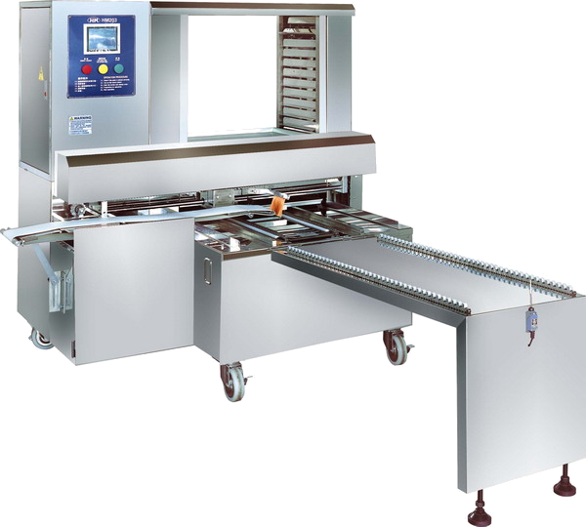

A set of dead and alive computer entities called “cells”
CLASS | INSTANCE
Abstract | Concrete
Template or blueprint | An object which is created from a class
Cell class
We are instances of Cell class
Two alternative states :
« dead » or « alive »
What are we going to do next?
We need to be set initial state
Initial Room
My initial state is alive
My initial state is dead

Slide 6

Initial Room
The cells need to be located
Instances
1 | 2 | 3 | 4
5 | 6 | 7 | 8
9 | 10 | 11 | 12
13 | 14 | 15 | 16

Slide 7
The cells are located
Now their state is given by the background color of their location
1 | 2 | 3 | 4
5 | 6 | 7 | 8
9 | 10 | 11 | 12
13 | 14 | 15 | 16

Slide 8
Cells states are changing according to the states of their neighboring cells
What do you mean exactly by neighboring cells?
1 | 2 | 3 | 4
5 | 6 | 7 | 8
9 | 10 | 11 | 12
13 | 14 | 15 | 16

Slide 9
5 | 6 | 7
9 | 10 | 11
13 | 14 | 15
Look for instance at cell #10
It has exactly 8 neighboring cells:
#5 #6 #7 #9 #11 #13 #14 and #15
1 | 2 | 3 | 4
5 | 6 | 7 | 8
9 | 10 | 11 | 12
13 | 14 | 15 | 16
5 | 6 | 7
9 | 10 | 11
13 | 14 | 15

Slide 10
Hmmmm…
And what will happen to cell #10?
As for any alive cell, we need to consider this rule:
(i) it cannot survive to a too wide isolation
(less than 2 alive neighbors),
(ii) it will also be killed by a too strong concentration
(more than 3 alive neighbors)

Slide 11
Oh! Cell 10 has exactly 3 alive neighbors!
5 | 6 | 7
9 | 10 | 11
13 | 14 | 15
5 | 6 | 7
9 | 10 | 11
13 | 14 | 15

Slide 12
Oh! Cell 10 has exactly 3 alive neighbors!
Right, so next step it will still
be alive!
5 | 6 | 7
9 | 10 | 11
13 | 14 | 15
5 | 6 | 7
9 | 10 | 11
13 | 14 | 15
5 | 6 | 7
9 | 10 | 11
13 | 14 | 15
5 | 6 | 7
9 | 10 | 11
13 | 14 | 15
5 | 6 | 7
9 | 10 | 11
13 | 14 | 15
Next step

Slide 13
Well, it depends on the states
of its neighboring cells!
Let’s look now at cell #7
It is dead!
Does it have any chance to become alive?
1 | 2 | 3 | 4
5 | 6 | 7 | 8
9 | 10 | 11 | 12
13 | 14 | 15 | 16

Slide 14
2 | 3 | 4
6 | 7 | 8
10 | 11 | 12
Cell #7 has exactly
8 neighboring cells:
#2 #3 #4 #6 #8 #10 #11 and #12
1 | 2 | 3 | 4
5 | 6 | 7 | 8
9 | 10 | 11 | 12
13 | 14 | 15 | 16
2 | 3 | 4
6 | 7 | 8
10 | 11 | 12

Slide 15
Well, birth supposes
a certain gathering of population…
In the “Game of Life” this has been set to
exactly 3 alive neighboring cells…
Yes, I know!
But what will happen to it?

Slide 16
Great! Cell 7 has exactly 3 alive neighbors!
2 | 3 | 4
6 | 7 | 8
10 | 11 | 12
2 | 3 | 4
6 | 7 | 8
10 | 11 | 12

Slide 17
Great! Cell 7 has exactly 3 alive neighbors!
Right, so next step it will become alive!
2 | 3 | 4
6 | 7 | 8
10 | 11 | 12
2 | 3 | 4
6 | 7 | 8
10 | 11 | 12
2 | 3 | 4
6 | 7 | 8
10 | 11 | 12
2 | 3 | 4
6 | 7 | 8
10 | 11 | 12
2 | 3 | 4
6 | 7 | 8
10 | 11 | 12
Next step

Slide 18
Summary of rules (transition function)
Alive neighbors < 2 or Alive neighbors > 3
Alive neighbors = 2 or Alive neighbors = 3
Alive neighbors = 3
Alive neighbors = 3
This rules have to be applied to all cells in the same way to determine next generation.
Let’s now have a close look to a bigger spatial grid!

Slide 19
Generation 1:
Numbers of alive cells: 10
Numbers of dead cells: 71

Slide 20
Generation 1:
First of all, we need to calculate numbers of alive neighbors for each of the cells (write numbers below)
0 | 0 | 0 | 0 | 0 | 0 | 0 | 0 | 0 | 0 | 0
0 | 0 | 0 | 0 | 0 | 0 | 0 | 0 | 0 | 0 | 0
0 | 0 | 0 | 1 | 2 | 3 | 2 | 1 | 0 | 0 | 0
0 | 0 | 0 | 2 | 3 | 5 | 3 | 2 | 0 | 0 | 0
0 | 0 | 0 | 3 | 5 | 8 | 5 | 3 | 0 | 0 | 0
0 | 0 | 0 | 2 | 3 | 5 | 3 | 2 | 0 | 0 | 0
0 | 0 | 0 | 2 | 2 | 3 | 2 | 2 | 1 | 1 | 0
0 | 0 | 0 | 0 | 0 | 0 | 0 | 1 | 0 | 1 | 0
0 | 0 | 0 | 0 | 0 | 0 | 0 | 1 | 1 | 1 | 0
0 | 0 | 0 | 0 | 0 | 0 | 0 | 0 | 0 | 0 | 0
0 | 0 | 0 | 0 | 0 | 0 | 0 | 0 | 0 | 0 | 0

Slide 21
Generation 1:
1. There are some dead cells which become alive.
0 | 0 | 0 | 0 | 0 | 0 | 0 | 0 | 0 | 0 | 0
0 | 0 | 0 | 0 | 0 | 0 | 0 | 0 | 0 | 0 | 0
0 | 0 | 0 | 1 | 2 | 3 | 2 | 1 | 0 | 0 | 0
0 | 0 | 0 | 2 | 3 | 5 | 3 | 2 | 0 | 0 | 0
0 | 0 | 0 | 3 | 5 | 8 | 5 | 3 | 0 | 0 | 0
0 | 0 | 0 | 2 | 3 | 5 | 3 | 2 | 0 | 0 | 0
0 | 0 | 0 | 2 | 2 | 3 | 2 | 2 | 1 | 1 | 0
0 | 0 | 0 | 0 | 0 | 0 | 0 | 1 | 0 | 1 | 0
0 | 0 | 0 | 0 | 0 | 0 | 0 | 1 | 1 | 1 | 0
0 | 0 | 0 | 0 | 0 | 0 | 0 | 0 | 0 | 0 | 0
0 | 0 | 0 | 0 | 0 | 0 | 0 | 0 | 0 | 0 | 0
Alive neighbors < 2 or Alive neighbors > 3
Alive neighbors = 2 or
Alive neighbors = 3
Alive neighbors < 3
Alive neighbors = 3
Notes:
To highlight cells which are going to be changed.

Slide 22
Generation 1:
1. There are some dead cells which become alive.
0 | 0 | 0 | 0 | 0 | 0 | 0 | 0 | 0 | 0 | 0
0 | 0 | 0 | 0 | 0 | 0 | 0 | 0 | 0 | 0 | 0
0 | 0 | 0 | 1 | 2 |  | 2 | 1 | 0 | 0 | 0
0 | 0 | 0 | 2 | 3 | 5 | 3 | 2 | 0 | 0 | 0
0 | 0 | 0 |  | 5 | 8 | 5 |  | 0 | 0 | 0
0 | 0 | 0 | 2 | 3 | 5 | 3 | 2 | 0 | 0 | 0
0 | 0 | 0 | 2 | 2 |  | 2 | 2 | 1 | 1 | 0
0 | 0 | 0 | 0 | 0 | 0 | 0 | 1 | 0 | 1 | 0
0 | 0 | 0 | 0 | 0 | 0 | 0 | 1 | 1 | 1 | 0
0 | 0 | 0 | 0 | 0 | 0 | 0 | 0 | 0 | 0 | 0
0 | 0 | 0 | 0 | 0 | 0 | 0 | 0 | 0 | 0 | 0
Alive neighbors < 2 or Alive neighbors > 3
Alive neighbors = 2 or
Alive neighbors = 3
Alive neighbors < 3
Alive neighbors = 3

Slide 23
Generation 1:
2. Some alive become dead.
0 | 0 | 0 | 0 | 0 | 0 | 0 | 0 | 0 | 0 | 0
0 | 0 | 0 | 0 | 0 | 0 | 0 | 0 | 0 | 0 | 0
0 | 0 | 0 | 1 | 2 |  | 2 | 1 | 0 | 0 | 0
0 | 0 | 0 | 2 | 3 | 5 | 3 | 2 | 0 | 0 | 0
0 | 0 | 0 |  | 5 | 8 | 5 |  | 0 | 0 | 0
0 | 0 | 0 | 2 | 3 | 5 | 3 | 2 | 0 | 0 | 0
0 | 0 | 0 | 2 | 2 |  | 2 | 2 | 1 | 1 | 0
0 | 0 | 0 | 0 | 0 | 0 | 0 | 1 | 0 | 1 | 0
0 | 0 | 0 | 0 | 0 | 0 | 0 | 1 | 1 | 1 | 0
0 | 0 | 0 | 0 | 0 | 0 | 0 | 0 | 0 | 0 | 0
0 | 0 | 0 | 0 | 0 | 0 | 0 | 0 | 0 | 0 | 0
Alive neighbors < 2 or Alive neighbors > 3
Alive neighbors = 2 or
Alive neighbors = 3
Alive neighbors < 3
Alive neighbors = 3

Slide 24
Generation 1:
2. Some alive become dead.
0 | 0 | 0 | 0 | 0 | 0 | 0 | 0 | 0 | 0 | 0
0 | 0 | 0 | 0 | 0 | 0 | 0 | 0 | 0 | 0 | 0
0 | 0 | 0 | 1 | 2 |  | 2 | 1 | 0 | 0 | 0
0 | 0 | 0 | 2 | 3 |  | 3 | 2 | 0 | 0 | 0
0 | 0 | 0 |  |  |  |  |  | 0 | 0 | 0
0 | 0 | 0 | 2 | 3 |  | 3 | 2 | 0 | 0 | 0
0 | 0 | 0 | 2 | 2 |  | 2 | 2 | 1 | 1 | 0
0 | 0 | 0 | 0 | 0 | 0 | 0 | 1 |  | 1 | 0
0 | 0 | 0 | 0 | 0 | 0 | 0 | 1 | 1 | 1 | 0
0 | 0 | 0 | 0 | 0 | 0 | 0 | 0 | 0 | 0 | 0
0 | 0 | 0 | 0 | 0 | 0 | 0 | 0 | 0 | 0 | 0
Alive neighbors < 2 or Alive neighbors > 3
Alive neighbors = 2 or
Alive neighbors = 3
Alive neighbors < 3
Alive neighbors = 3

Slide 25
Generation 1:
3. Some alive are still alive.
0 | 0 | 0 | 0 | 0 | 0 | 0 | 0 | 0 | 0 | 0
0 | 0 | 0 | 0 | 0 | 0 | 0 | 0 | 0 | 0 | 0
0 | 0 | 0 | 1 | 2 |  | 2 | 1 | 0 | 0 | 0
0 | 0 | 0 | 2 | 3 |  | 3 | 2 | 0 | 0 | 0
0 | 0 | 0 |  |  |  |  |  | 0 | 0 | 0
0 | 0 | 0 | 2 | 3 |  | 3 | 2 | 0 | 0 | 0
0 | 0 | 0 | 2 | 2 |  | 2 | 2 | 1 | 1 | 0
0 | 0 | 0 | 0 | 0 | 0 | 0 | 1 |  | 1 | 0
0 | 0 | 0 | 0 | 0 | 0 | 0 | 1 | 1 | 1 | 0
0 | 0 | 0 | 0 | 0 | 0 | 0 | 0 | 0 | 0 | 0
0 | 0 | 0 | 0 | 0 | 0 | 0 | 0 | 0 | 0 | 0
Alive neighbors < 2 or Alive neighbors > 3
Alive neighbors = 2 or
Alive neighbors = 3
Alive neighbors < 3
Alive neighbors = 3

Slide 26
Generation 1:
3. Some alive are still alive.
0 | 0 | 0 | 0 | 0 | 0 | 0 | 0 | 0 | 0 | 0
0 | 0 | 0 | 0 | 0 | 0 | 0 | 0 | 0 | 0 | 0
0 | 0 | 0 | 1 | 2 |  | 2 | 1 | 0 | 0 | 0
0 | 0 | 0 | 2 |  |  |  | 2 | 0 | 0 | 0
0 | 0 | 0 |  |  |  |  |  | 0 | 0 | 0
0 | 0 | 0 | 2 |  |  |  | 2 | 0 | 0 | 0
0 | 0 | 0 | 2 | 2 |  | 2 | 2 | 1 | 1 | 0
0 | 0 | 0 | 0 | 0 | 0 | 0 | 1 |  | 1 | 0
0 | 0 | 0 | 0 | 0 | 0 | 0 | 1 | 1 | 1 | 0
0 | 0 | 0 | 0 | 0 | 0 | 0 | 0 | 0 | 0 | 0
0 | 0 | 0 | 0 | 0 | 0 | 0 | 0 | 0 | 0 | 0
Alive neighbors < 2 or Alive neighbors > 3
Alive neighbors = 2 or
Alive neighbors = 3
Alive neighbors < 3
Alive neighbors = 3

Slide 27
Generation 1:
4. Some dead cells are still dead.
0 | 0 | 0 | 0 | 0 | 0 | 0 | 0 | 0 | 0 | 0
0 | 0 | 0 | 0 | 0 | 0 | 0 | 0 | 0 | 0 | 0
0 | 0 | 0 | 1 | 2 |  | 2 | 1 | 0 | 0 | 0
0 | 0 | 0 | 2 |  |  |  | 2 | 0 | 0 | 0
0 | 0 | 0 |  |  |  |  |  | 0 | 0 | 0
0 | 0 | 0 | 2 |  |  |  | 2 | 0 | 0 | 0
0 | 0 | 0 | 2 | 2 |  | 2 | 2 | 1 | 1 | 0
0 | 0 | 0 | 0 | 0 | 0 | 0 | 1 |  | 1 | 0
0 | 0 | 0 | 0 | 0 | 0 | 0 | 1 | 1 | 1 | 0
0 | 0 | 0 | 0 | 0 | 0 | 0 | 0 | 0 | 0 | 0
0 | 0 | 0 | 0 | 0 | 0 | 0 | 0 | 0 | 0 | 0
Alive neighbors < 2 or Alive neighbors > 3
Alive neighbors = 2 or
Alive neighbors = 3
Alive neighbors < 3
Alive neighbors = 3

Slide 28
Generation 2:
Numbers of alive cells: 8
Numbers of dead cells: 73

Slide 29
Generation 2:
First of all we need to calculate numbers of alive neighbors of cells.
0 0 0 0 0 0 0 0 0 0 0 0 0 0 0 0 0 0 0 0 0 0 0 0 0 0 0 0

Slide 30
Generation 2:
1. There are some dead cells which become alive.
0 | 0 | 0 | 0 | 0 | 0 | 0 | 0 | 0 | 0 | 0
0 | 0 | 0 | 0 | 1 | 1 | 1 | 0 | 0 | 0 | 0
0 | 0 | 0 | 1 | 2 | 2 | 2 | 1 | 0 | 0 | 0
0 | 0 | 1 | 2 | 2 | 3 | 2 | 2 | 1 | 0 | 0
0 | 0 | 1 | 2 | 3 | 0 | 3 | 2 | 1 | 0 | 0
0 | 0 | 1 | 2 | 2 | 3 | 2 | 2 | 1 | 0 | 0
0 | 0 | 0 | 1 | 2 | 2 | 2 | 1 | 0 | 0 | 0
0 | 0 | 0 | 0 | 1 | 1 | 1 | 0 | 0 | 0 | 0
0 | 0 | 0 | 0 | 0 | 0 | 0 | 0 | 0 | 0 | 0
0 | 0 | 0 | 0 | 0 | 0 | 0 | 0 | 0 | 0 | 0
0 | 0 | 0 | 0 | 0 | 0 | 0 | 0 | 0 | 0 | 0
Alive neighbors < 2 or Alive neighbors > 3
Alive neighbors = 2 or
Alive neighbors = 3
Alive neighbors < 3
Alive neighbors = 3

Slide 31
Generation 2:
1. There are some dead cells which become alive.
0 | 0 | 0 | 0 | 0 | 0 | 0 | 0 | 0 | 0 | 0
0 | 0 | 0 | 0 | 1 | 1 | 1 | 0 | 0 | 0 | 0
0 | 0 | 0 | 1 | 2 | 2 | 2 | 1 | 0 | 0 | 0
0 | 0 | 1 | 2 | 2 |  | 2 | 2 | 1 | 0 | 0
0 | 0 | 1 | 2 |  | 0 |  | 2 | 1 | 0 | 0
0 | 0 | 1 | 2 | 2 |  | 2 | 2 | 1 | 0 | 0
0 | 0 | 0 | 1 | 2 | 2 | 2 | 1 | 0 | 0 | 0
0 | 0 | 0 | 0 | 1 | 1 | 1 | 0 | 0 | 0 | 0
0 | 0 | 0 | 0 | 0 | 0 | 0 | 0 | 0 | 0 | 0
0 | 0 | 0 | 0 | 0 | 0 | 0 | 0 | 0 | 0 | 0
0 | 0 | 0 | 0 | 0 | 0 | 0 | 0 | 0 | 0 | 0
Alive neighbors < 2 or Alive neighbors > 3
Alive neighbors = 2 or
Alive neighbors = 3
Alive neighbors < 3
Alive neighbors = 3

Slide 32
Generation 2:
2. All alive cells are still alive.
0 | 0 | 0 | 0 | 0 | 0 | 0 | 0 | 0 | 0 | 0
0 | 0 | 0 | 0 | 1 | 1 | 1 | 0 | 0 | 0 | 0
0 | 0 | 0 | 1 | 2 | 2 | 2 | 1 | 0 | 0 | 0
0 | 0 | 1 | 2 | 2 |  | 2 | 2 | 1 | 0 | 0
0 | 0 | 1 | 2 |  | 0 |  | 2 | 1 | 0 | 0
0 | 0 | 1 | 2 | 2 |  | 2 | 2 | 1 | 0 | 0
0 | 0 | 0 | 1 | 2 | 2 | 2 | 1 | 0 | 0 | 0
0 | 0 | 0 | 0 | 1 | 1 | 1 | 0 | 0 | 0 | 0
0 | 0 | 0 | 0 | 0 | 0 | 0 | 0 | 0 | 0 | 0
0 | 0 | 0 | 0 | 0 | 0 | 0 | 0 | 0 | 0 | 0
0 | 0 | 0 | 0 | 0 | 0 | 0 | 0 | 0 | 0 | 0
Alive neighbors < 2 or Alive neighbors > 3
Alive neighbors = 2 or
Alive neighbors = 3
Alive neighbors < 3
Alive neighbors = 3

Slide 33
Generation 2:
2. All alive cells are still alive.
0 | 0 | 0 | 0 | 0 | 0 | 0 | 0 | 0 | 0 | 0
0 | 0 | 0 | 0 | 1 | 1 | 1 | 0 | 0 | 0 | 0
0 | 0 | 0 | 1 | 2 |  | 2 | 1 | 0 | 0 | 0
0 | 0 | 1 | 2 |  |  |  | 2 | 1 | 0 | 0
0 | 0 | 1 |  |  | 0 |  |  | 1 | 0 | 0
0 | 0 | 1 | 2 |  |  |  | 2 | 1 | 0 | 0
0 | 0 | 0 | 1 | 2 |  | 2 | 1 | 0 | 0 | 0
0 | 0 | 0 | 0 | 1 | 1 | 1 | 0 | 0 | 0 | 0
0 | 0 | 0 | 0 | 0 | 0 | 0 | 0 | 0 | 0 | 0
0 | 0 | 0 | 0 | 0 | 0 | 0 | 0 | 0 | 0 | 0
0 | 0 | 0 | 0 | 0 | 0 | 0 | 0 | 0 | 0 | 0
Alive neighbors < 2 or Alive neighbors > 3
Alive neighbors = 2 or
Alive neighbors = 3
Alive neighbors < 3
Alive neighbors = 3

Slide 34
Generation 2:
3. Some dead cells are still dead.
0 | 0 | 0 | 0 | 0 | 0 | 0 | 0 | 0 | 0 | 0
0 | 0 | 0 | 0 | 1 | 1 | 1 | 0 | 0 | 0 | 0
0 | 0 | 0 | 1 | 2 |  | 2 | 1 | 0 | 0 | 0
0 | 0 | 1 | 2 |  |  |  | 2 | 1 | 0 | 0
0 | 0 | 1 |  |  | 0 |  |  | 1 | 0 | 0
0 | 0 | 1 | 2 |  |  |  | 2 | 1 | 0 | 0
0 | 0 | 0 | 1 | 2 |  | 2 | 1 | 0 | 0 | 0
0 | 0 | 0 | 0 | 1 | 1 | 1 | 0 | 0 | 0 | 0
0 | 0 | 0 | 0 | 0 | 0 | 0 | 0 | 0 | 0 | 0
0 | 0 | 0 | 0 | 0 | 0 | 0 | 0 | 0 | 0 | 0
0 | 0 | 0 | 0 | 0 | 0 | 0 | 0 | 0 | 0 | 0
Alive neighbors < 2 or Alive neighbors > 3
Alive neighbors = 2 or
Alive neighbors = 3
Alive neighbors < 3
Alive neighbors = 3

Slide 35
Generation 2:
3. Some dead cells are still dead.
Alive neighbors < 2 or Alive neighbors > 3
Alive neighbors = 2 or
Alive neighbors = 3
Alive neighbors < 3
Alive neighbors = 3

Slide 36
Generation 3:
Numbers of alive cells: 12
Numbers of dead cells: 69

Slide 37
Generation 3:
First of all, we need to calculate numbers of alive neighbors of cells.
0 | 0 | 0 | 0 | 0 | 0 | 0 | 0 | 0 | 0 | 0
0 | 0 | 0 | 0 | 1 | 1 | 1 | 0 | 0 | 0 | 0
0 | 0 | 0 | 1 | 3 | 3 | 3 | 1 | 0 | 0 | 0
0 | 0 | 1 | 3 | 4 | 5 | 4 | 3 | 1 | 0 | 0
0 | 0 | 1 | 3 | 5 | 8 | 5 | 3 | 1 | 0 | 0
0 | 0 | 1 | 3 | 4 | 5 | 4 | 3 | 1 | 0 | 0
0 | 0 | 0 | 1 | 3 | 3 | 3 | 1 | 0 | 0 | 0
0 | 0 | 0 | 0 | 1 | 1 | 1 | 0 | 0 | 0 | 0
0 | 0 | 0 | 0 | 0 | 0 | 0 | 0 | 0 | 0 | 0
0 | 0 | 0 | 0 | 0 | 0 | 0 | 0 | 0 | 0 | 0
0 | 0 | 0 | 0 | 0 | 0 | 0 | 0 | 0 | 0 | 0

Slide 38
Generation 3:
1. There are some dead cells which become alive.
0 | 0 | 0 | 0 | 0 | 0 | 0 | 0 | 0 | 0 | 0
0 | 0 | 0 | 0 | 1 | 1 | 1 | 0 | 0 | 0 | 0
0 | 0 | 0 | 1 | 3 | 3 | 3 | 1 | 0 | 0 | 0
0 | 0 | 1 | 3 | 4 | 5 | 4 | 3 | 1 | 0 | 0
0 | 0 | 1 | 3 | 5 | 8 | 5 | 3 | 1 | 0 | 0
0 | 0 | 1 | 3 | 4 | 5 | 4 | 3 | 1 | 0 | 0
0 | 0 | 0 | 1 | 3 | 3 | 3 | 1 | 0 | 0 | 0
0 | 0 | 0 | 0 | 1 | 1 | 1 | 0 | 0 | 0 | 0
0 | 0 | 0 | 0 | 0 | 0 | 0 | 0 | 0 | 0 | 0
0 | 0 | 0 | 0 | 0 | 0 | 0 | 0 | 0 | 0 | 0
0 | 0 | 0 | 0 | 0 | 0 | 0 | 0 | 0 | 0 | 0
Alive neighbors < 2 or Alive neighbors > 3
Alive neighbors = 2 or
Alive neighbors = 3
Alive neighbors < 3
Alive neighbors = 3

Slide 39
Generation 3:
1. There are some dead cells which become alive.
0 | 0 | 0 | 0 | 0 | 0 | 0 | 0 | 0 | 0 | 0
0 | 0 | 0 | 0 | 1 | 1 | 1 | 0 | 0 | 0 | 0
0 | 0 | 0 | 1 |  | 3 |  | 1 | 0 | 0 | 0
0 | 0 | 1 |  | 4 | 5 | 4 |  | 1 | 0 | 0
0 | 0 | 1 | 3 | 5 | 8 | 5 | 3 | 1 | 0 | 0
0 | 0 | 1 |  | 4 | 5 | 4 |  | 1 | 0 | 0
0 | 0 | 0 | 1 |  | 3 |  | 1 | 0 | 0 | 0
0 | 0 | 0 | 0 | 1 | 1 | 1 | 0 | 0 | 0 | 0
0 | 0 | 0 | 0 | 0 | 0 | 0 | 0 | 0 | 0 | 0
0 | 0 | 0 | 0 | 0 | 0 | 0 | 0 | 0 | 0 | 0
0 | 0 | 0 | 0 | 0 | 0 | 0 | 0 | 0 | 0 | 0
Alive neighbors < 2 or Alive neighbors > 3
Alive neighbors = 2 or
Alive neighbors = 3
Alive neighbors < 3
Alive neighbors = 3

Slide 40
Generation 3:
2. Some alive become dead.
0 | 0 | 0 | 0 | 0 | 0 | 0 | 0 | 0 | 0 | 0
0 | 0 | 0 | 0 | 1 | 1 | 1 | 0 | 0 | 0 | 0
0 | 0 | 0 | 1 |  | 3 |  | 1 | 0 | 0 | 0
0 | 0 | 1 |  | 4 | 5 | 4 |  | 1 | 0 | 0
0 | 0 | 1 | 3 | 5 | 8 | 5 | 3 | 1 | 0 | 0
0 | 0 | 1 |  | 4 | 5 | 4 |  | 1 | 0 | 0
0 | 0 | 0 | 1 |  | 3 |  | 1 | 0 | 0 | 0
0 | 0 | 0 | 0 | 1 | 1 | 1 | 0 | 0 | 0 | 0
0 | 0 | 0 | 0 | 0 | 0 | 0 | 0 | 0 | 0 | 0
0 | 0 | 0 | 0 | 0 | 0 | 0 | 0 | 0 | 0 | 0
0 | 0 | 0 | 0 | 0 | 0 | 0 | 0 | 0 | 0 | 0
Alive neighbors < 2 or Alive neighbors > 3
Alive neighbors = 2 or
Alive neighbors = 3
Alive neighbors < 3
Alive neighbors = 3

Slide 41
Generation 3:
2. Some alive become dead.
0 | 0 | 0 | 0 | 0 | 0 | 0 | 0 | 0 | 0 | 0
0 | 0 | 0 | 0 | 1 | 1 | 1 | 0 | 0 | 0 | 0
0 | 0 | 0 | 1 |  | 3 |  | 1 | 0 | 0 | 0
0 | 0 | 1 |  |  |  |  |  | 1 | 0 | 0
0 | 0 | 1 | 3 |  | 8 |  | 3 | 1 | 0 | 0
0 | 0 | 1 |  |  |  |  |  | 1 | 0 | 0
0 | 0 | 0 | 1 |  | 3 |  | 1 | 0 | 0 | 0
0 | 0 | 0 | 0 | 1 | 1 | 1 | 0 | 0 | 0 | 0
0 | 0 | 0 | 0 | 0 | 0 | 0 | 0 | 0 | 0 | 0
0 | 0 | 0 | 0 | 0 | 0 | 0 | 0 | 0 | 0 | 0
0 | 0 | 0 | 0 | 0 | 0 | 0 | 0 | 0 | 0 | 0
Alive neighbors < 2 or Alive neighbors > 3
Alive neighbors = 2 or
Alive neighbors = 3
Alive neighbors < 3
Alive neighbors = 3

Slide 42
Generation 3:
3. Some alive are still alive.
0 | 0 | 0 | 0 | 0 | 0 | 0 | 0 | 0 | 0 | 0
0 | 0 | 0 | 0 | 1 | 1 | 1 | 0 | 0 | 0 | 0
0 | 0 | 0 | 1 |  | 3 |  | 1 | 0 | 0 | 0
0 | 0 | 1 |  |  |  |  |  | 1 | 0 | 0
0 | 0 | 1 | 3 |  | 8 |  | 3 | 1 | 0 | 0
0 | 0 | 1 |  |  |  |  |  | 1 | 0 | 0
0 | 0 | 0 | 1 |  | 3 |  | 1 | 0 | 0 | 0
0 | 0 | 0 | 0 | 1 | 1 | 1 | 0 | 0 | 0 | 0
0 | 0 | 0 | 0 | 0 | 0 | 0 | 0 | 0 | 0 | 0
0 | 0 | 0 | 0 | 0 | 0 | 0 | 0 | 0 | 0 | 0
0 | 0 | 0 | 0 | 0 | 0 | 0 | 0 | 0 | 0 | 0
Alive neighbors < 2 or Alive neighbors > 3
Alive neighbors = 2 or
Alive neighbors = 3
Alive neighbors < 3
Alive neighbors = 3

Slide 43
Generation 3:
3. Some alive are still alive.
0 | 0 | 0 | 0 | 0 | 0 | 0 | 0 | 0 | 0 | 0
0 | 0 | 0 | 0 | 1 | 1 | 1 | 0 | 0 | 0 | 0
0 | 0 | 0 | 1 |  |  |  | 1 | 0 | 0 | 0
0 | 0 | 1 |  |  |  |  |  | 1 | 0 | 0
0 | 0 | 1 |  |  | 8 |  |  | 1 | 0 | 0
0 | 0 | 1 |  |  |  |  |  | 1 | 0 | 0
0 | 0 | 0 | 1 |  |  |  | 1 | 0 | 0 | 0
0 | 0 | 0 | 0 | 1 | 1 | 1 | 0 | 0 | 0 | 0
0 | 0 | 0 | 0 | 0 | 0 | 0 | 0 | 0 | 0 | 0
0 | 0 | 0 | 0 | 0 | 0 | 0 | 0 | 0 | 0 | 0
0 | 0 | 0 | 0 | 0 | 0 | 0 | 0 | 0 | 0 | 0
Alive neighbors < 2 or Alive neighbors > 3
Alive neighbors = 2 or
Alive neighbors = 3
Alive neighbors < 3
Alive neighbors = 3

Slide 44
Generation 3:
4. Some dead are still dead.
0 | 0 | 0 | 0 | 0 | 0 | 0 | 0 | 0 | 0 | 0
0 | 0 | 0 | 0 | 1 | 1 | 1 | 0 | 0 | 0 | 0
0 | 0 | 0 | 1 |  |  |  | 1 | 0 | 0 | 0
0 | 0 | 1 |  |  |  |  |  | 1 | 0 | 0
0 | 0 | 1 |  |  | 8 |  |  | 1 | 0 | 0
0 | 0 | 1 |  |  |  |  |  | 1 | 0 | 0
0 | 0 | 0 | 1 |  |  |  | 1 | 0 | 0 | 0
0 | 0 | 0 | 0 | 1 | 1 | 1 | 0 | 0 | 0 | 0
0 | 0 | 0 | 0 | 0 | 0 | 0 | 0 | 0 | 0 | 0
0 | 0 | 0 | 0 | 0 | 0 | 0 | 0 | 0 | 0 | 0
0 | 0 | 0 | 0 | 0 | 0 | 0 | 0 | 0 | 0 | 0
Alive neighbors < 2 or Alive neighbors > 3
Alive neighbors = 2 or
Alive neighbors = 3
Alive neighbors < 3
Alive neighbors = 3

Slide 45
Generation 4:
Numbers of alive cells: 12
Numbers of dead cells: 69

Slide 46
Generation 4:
First of all, we need to calculate numbers of alive neighbors of cells.
0 | 0 | 0 | 0 | 0 | 0 | 0 | 0 | 0 | 0 | 0
0 | 0 | 0 | 1 | 2 | 3 | 2 | 1 | 0 | 0 | 0
0 | 0 | 1 | 2 | 2 | 2 | 2 | 2 | 1 | 0 | 0
0 | 0 | 2 | 2 | 4 | 3 | 4 | 2 | 2 | 0 | 0
0 | 0 | 3 | 2 | 3 | 0 | 3 | 2 | 3 | 0 | 0
0 | 0 | 2 | 2 | 4 | 3 | 4 | 2 | 2 | 0 | 0
0 | 0 | 1 | 2 | 2 | 2 | 2 | 2 | 1 | 0 | 0
0 | 0 | 0 | 1 | 2 | 3 | 2 | 1 | 0 | 0 | 0
0 | 0 | 0 | 0 | 0 | 0 | 0 | 0 | 0 | 0 | 0
0 | 0 | 0 | 0 | 0 | 0 | 0 | 0 | 0 | 0 | 0
0 | 0 | 0 | 0 | 0 | 0 | 0 | 0 | 0 | 0 | 0

Slide 47
Generation 4:
1. There are some dead cells which become alive.
0 | 0 | 0 | 0 | 0 | 0 | 0 | 0 | 0 | 0 | 0
0 | 0 | 0 | 1 | 2 | 3 | 2 | 1 | 0 | 0 | 0
0 | 0 | 1 | 2 | 2 | 2 | 2 | 2 | 1 | 0 | 0
0 | 0 | 2 | 2 | 4 | 3 | 4 | 2 | 2 | 0 | 0
0 | 0 | 3 | 2 | 3 | 0 | 3 | 2 | 3 | 0 | 0
0 | 0 | 2 | 2 | 4 | 3 | 4 | 2 | 2 | 0 | 0
0 | 0 | 1 | 2 | 2 | 2 | 2 | 2 | 1 | 0 | 0
0 | 0 | 0 | 1 | 2 | 3 | 2 | 1 | 0 | 0 | 0
0 | 0 | 0 | 0 | 0 | 0 | 0 | 0 | 0 | 0 | 0
0 | 0 | 0 | 0 | 0 | 0 | 0 | 0 | 0 | 0 | 0
0 | 0 | 0 | 0 | 0 | 0 | 0 | 0 | 0 | 0 | 0
Alive neighbors < 2 or Alive neighbors > 3
Alive neighbors = 2 or
Alive neighbors = 3
Alive neighbors < 3
Alive neighbors = 3

Slide 48
Generation 4:
1. There are some dead cells which become alive.
0 | 0 | 0 | 0 | 0 | 0 | 0 | 0 | 0 | 0 | 0
0 | 0 | 0 | 1 | 2 |  | 2 | 1 | 0 | 0 | 0
0 | 0 | 1 | 2 | 2 | 2 | 2 | 2 | 1 | 0 | 0
0 | 0 | 2 | 2 | 4 |  | 4 | 2 | 2 | 0 | 0
0 | 0 |  | 2 |  | 0 |  | 2 |  | 0 | 0
0 | 0 | 2 | 2 | 4 |  | 4 | 2 | 2 | 0 | 0
0 | 0 | 1 | 2 | 2 | 2 | 2 | 2 | 1 | 0 | 0
0 | 0 | 0 | 1 | 2 |  | 2 | 1 | 0 | 0 | 0
0 | 0 | 0 | 0 | 0 | 0 | 0 | 0 | 0 | 0 | 0
0 | 0 | 0 | 0 | 0 | 0 | 0 | 0 | 0 | 0 | 0
0 | 0 | 0 | 0 | 0 | 0 | 0 | 0 | 0 | 0 | 0
Alive neighbors < 2 or Alive neighbors > 3
Alive neighbors = 2 or
Alive neighbors = 3
Alive neighbors < 3
Alive neighbors = 3

Slide 49
Generation 4:
2. All alive cells are still alive.
0 | 0 | 0 | 0 | 0 | 0 | 0 | 0 | 0 | 0 | 0
0 | 0 | 0 | 1 | 2 |  | 2 | 1 | 0 | 0 | 0
0 | 0 | 1 | 2 | 2 | 2 | 2 | 2 | 1 | 0 | 0
0 | 0 | 2 | 2 | 4 |  | 4 | 2 | 2 | 0 | 0
0 | 0 |  | 2 |  | 0 |  | 2 |  | 0 | 0
0 | 0 | 2 | 2 | 4 |  | 4 | 2 | 2 | 0 | 0
0 | 0 | 1 | 2 | 2 | 2 | 2 | 2 | 1 | 0 | 0
0 | 0 | 0 | 1 | 2 |  | 2 | 1 | 0 | 0 | 0
0 | 0 | 0 | 0 | 0 | 0 | 0 | 0 | 0 | 0 | 0
0 | 0 | 0 | 0 | 0 | 0 | 0 | 0 | 0 | 0 | 0
0 | 0 | 0 | 0 | 0 | 0 | 0 | 0 | 0 | 0 | 0
Alive neighbors < 2 or Alive neighbors > 3
Alive neighbors = 2 or
Alive neighbors = 3
Alive neighbors < 3
Alive neighbors = 3

Slide 50
Generation 4:
2. All alive cells are still alive.
0 | 0 | 0 | 0 | 0 | 0 | 0 | 0 | 0 | 0 | 0
0 | 0 | 0 | 1 | 2 |  | 2 | 1 | 0 | 0 | 0
0 | 0 | 1 | 2 |  |  |  | 2 | 1 | 0 | 0
0 | 0 | 2 |  | 4 |  | 4 |  | 2 | 0 | 0
0 | 0 |  |  |  | 0 |  |  |  | 0 | 0
0 | 0 | 2 |  | 4 |  | 4 |  | 2 | 0 | 0
0 | 0 | 1 | 2 |  |  |  | 2 | 1 | 0 | 0
0 | 0 | 0 | 1 | 2 |  | 2 | 1 | 0 | 0 | 0
0 | 0 | 0 | 0 | 0 | 0 | 0 | 0 | 0 | 0 | 0
0 | 0 | 0 | 0 | 0 | 0 | 0 | 0 | 0 | 0 | 0
0 | 0 | 0 | 0 | 0 | 0 | 0 | 0 | 0 | 0 | 0
Alive neighbors < 2 or Alive neighbors > 3
Alive neighbors = 2 or
Alive neighbors = 3
Alive neighbors < 3
Alive neighbors = 3

Slide 51
Generation 4:
3. Some dead cells are still dead.
0 | 0 | 0 | 0 | 0 | 0 | 0 | 0 | 0 | 0 | 0
0 | 0 | 0 | 1 | 2 |  | 2 | 1 | 0 | 0 | 0
0 | 0 | 1 | 2 |  |  |  | 2 | 1 | 0 | 0
0 | 0 | 2 |  | 4 |  | 4 |  | 2 | 0 | 0
0 | 0 |  |  |  | 0 |  |  |  | 0 | 0
0 | 0 | 2 |  | 4 |  | 4 |  | 2 | 0 | 0
0 | 0 | 1 | 2 |  |  |  | 2 | 1 | 0 | 0
0 | 0 | 0 | 1 | 2 |  | 2 | 1 | 0 | 0 | 0
0 | 0 | 0 | 0 | 0 | 0 | 0 | 0 | 0 | 0 | 0
0 | 0 | 0 | 0 | 0 | 0 | 0 | 0 | 0 | 0 | 0
0 | 0 | 0 | 0 | 0 | 0 | 0 | 0 | 0 | 0 | 0
Alive neighbors < 2 or Alive neighbors > 3
Alive neighbors = 2 or
Alive neighbors = 3
Alive neighbors < 3
Alive neighbors = 3

Slide 52
Generation 5:
Numbers of alive cells: 12
Numbers of dead cells: 69

Slide 53
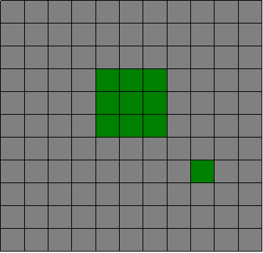
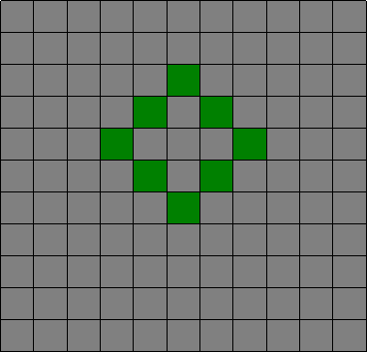
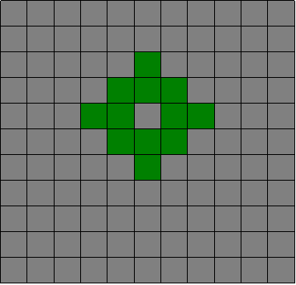
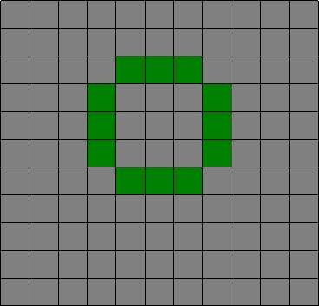
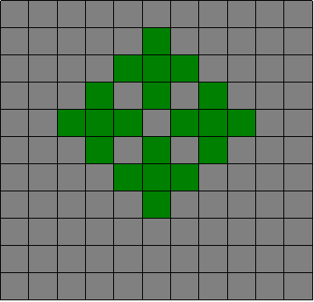
The Game of Life allows to observe the evolution of “patterns” that emerge from a simple set of transition rules applied by each cell
Time
Step 1
Step 2
Step 3
Step 4
Step 5

Slide 54
alive
dead
Alive neighbors < 2 or Alive neighbors > 3
Alive neighbors = 2 or Alive neighbors = 3
Alive neighbors < 3
Alive neighbors = 3

Slide 55
You need a tool to play with it!
I will show you CORMAS!
Why is it called
a “game”…
It is not that fun!!!

Slide 56
CORMAS is a computer toolkit that enables to create and to run models like the Game of Life
CORMAS ???
What is it ???

Slide 57
What is CORMAS
2
For several years now, multi-agent simulation software have been available.
User groups (ecologists, sociologists, etc.)
are organized around generic tools
that facilitate the construction of models
and offer facilities ("virtual laboratories")
for monitoring and analysing simulation trials
The Green research unit, from Cirad,
is particularly interested in models for resource management. Hence Cormas, the multi-agent simulation software
that we have developed, is oriented towards the representation of interactions between people using renewable resource
see http://cormas.cirad.fr/indexeng.htm

Slide 58
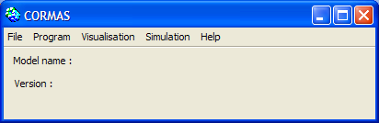
CORMAS at a glance
Cormas has been developed with VisualWorks, a programming environment based on the
object-oriented language Smalltalk
If you never installed CORMAS on your computer, please do it now
and then launch it!

Slide 59
CORMAS main interface
Run the current model
Design the current model
Create, load and save models

Slide 60
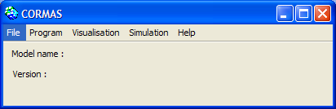
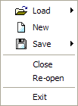

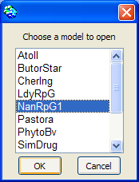
Loading an existing model

Slide 61
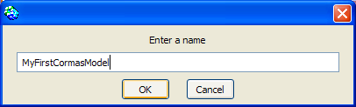
Creating a new model

Slide 62

Saving the current model

Slide 63
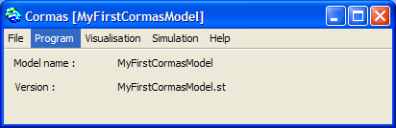
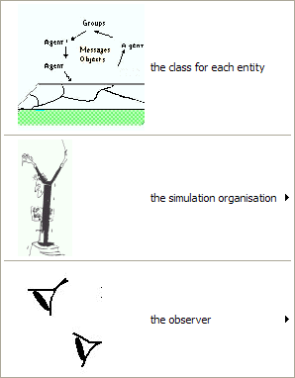
Designing the current model
Implement classes from your
UML class diagram
Write initialisation and scheduling
of simulation scenarios
Specify means
to visualize simulation scenarios

Slide 64
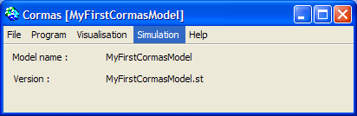

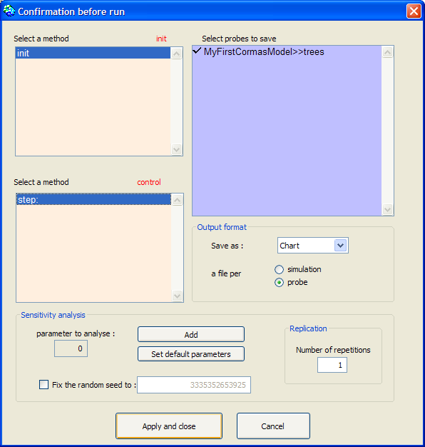
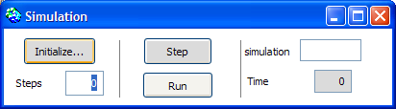
Running the current model

Slide 65
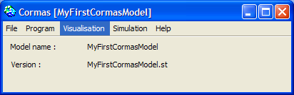
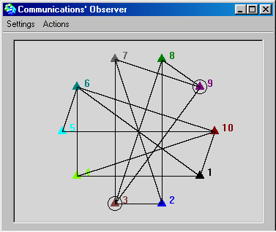
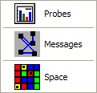
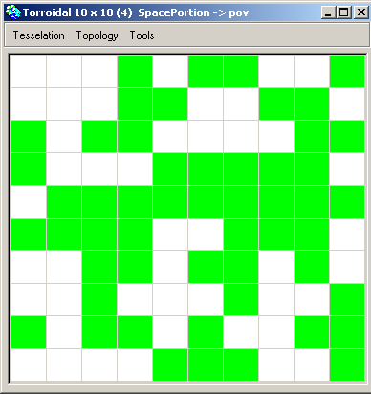

Observing the simulation run

Slide 66
Sure! We need first to get the model from CORMAS website!
Hmmmm… It looks good!
Shall we play
the “Game of Life” now?
Follow me please.

Slide 67

Loading Conway model
3
Go to http://cormas.cirad.fr/en/applica/conway.htm
Download the model
Unzip the model into “/cormas/models”
New folder for the model is created
Load the model into CORMAS

Slide 68
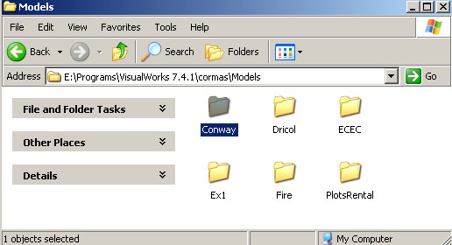

Getting Conway model

Slide 69

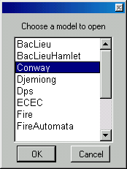
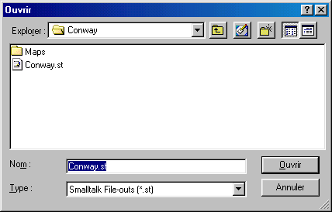
Loading Conway Model

Slide 70
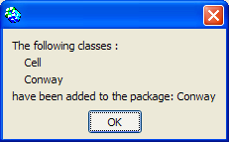
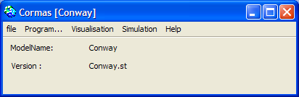
Loading Conway model
Just validate this one
As you can see, the current model is « Conway »
As you may have several versions of the same model, the name of the current version is indicated

Slide 71
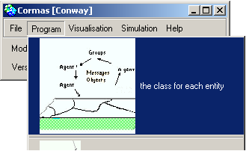
“Cell” entity of Conway model
4
1
2

Slide 72
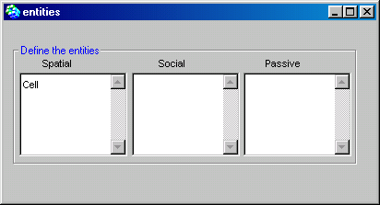
Entities window opens
There are 3 kinds of entities in CORMAS
Spatial entities -> any portion of space
Social entities -> any active agent (like stakeholders)
Passive entities -> any other entity
(especially message for peer to peer communication)

Slide 73
Looking at the “Cell” entity
Double click
on it
In the Conway model
there is only 1 spatial entity
which has been named “Cell”

Slide 74
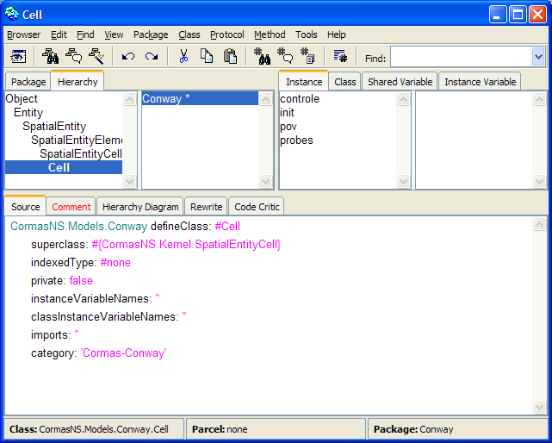
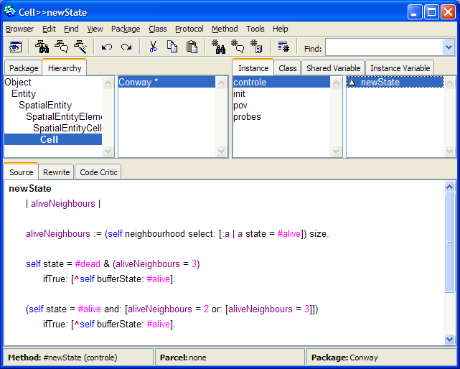
What is « Cell » exactly?
A refined Cormas
spatial entity
highlight the method’s name
With a very specific
behaviour given as
a Smalltalk method

Slide 75
Can you read Smalltalk?
Look at the “Game of Life” code…
newState
| aliveNeighbours |
aliveNeighbours := (self neighbourhood select: [:a | a state = #alive]) size.
self state = #dead & (aliveNeighbours = 3)
ifTrue: [^self bufferState: #alive].
(self state = #alive and: [aliveNeighbours = 2 or: [aliveNeighbours = 3]])
ifTrue: [^self bufferState: #alive].
^self bufferState: #dead
Alive neighbors < 2 or Alive neighbors > 3
Alive neighbors = 2 or
Alive neighbors = 3
Alive neighbors < 3
Alive neighbors = 3

Slide 76



How to organize a simulation
5
We need to create scenarios
in order to tell the model
how to perform
Action, cells!
Cut!
Good job!
Thanks, you are so nice Cell #1…
This is for you, Cell #2
Scenario

Slide 77
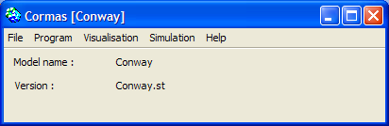
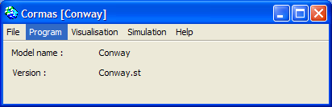
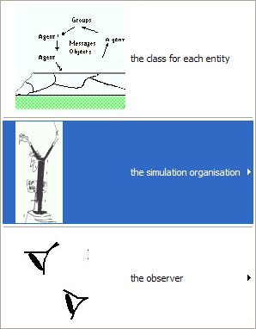
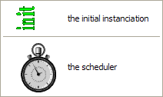
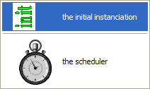
Scripts to initialize a simulation
1
3
2

Slide 78
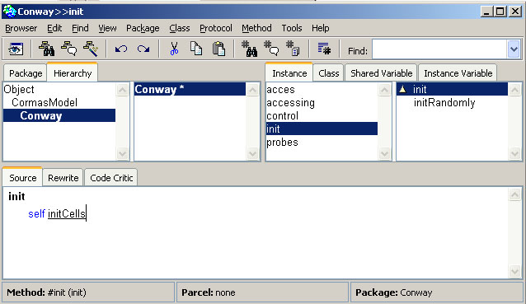
Scripts to initialize a simulation
List of methods
to initialize a scenario

Slide 79
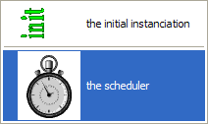
Scripts to run a simulation step
1
3
2

Slide 80
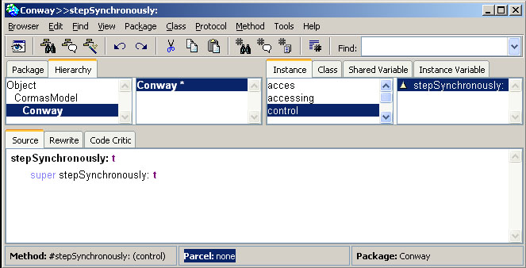
Scripts to run a simulation step
List of methods
to schedule a scenario

Slide 81
How to observe a simulation
6

Slide 82
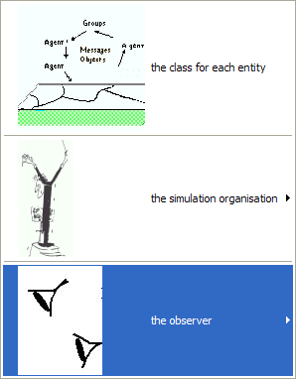
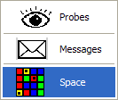
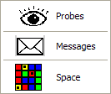
6.1 Defining ways to observe

Slide 83
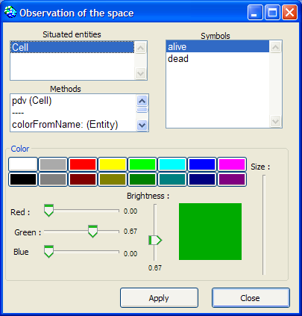
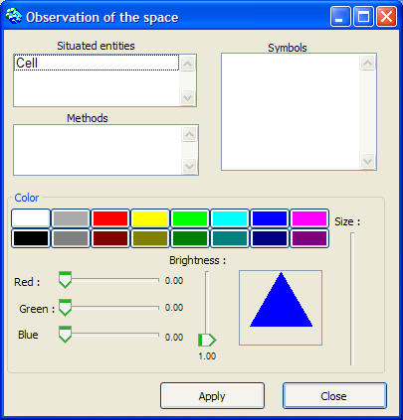
6.1 Defining ways to observe
1 state => 1 color
Select
a state value
1
2
Select
“Cell”
Choose a color for the selected state value
3
Save the
new settings
by clicking on”Apply”
4

Slide 84
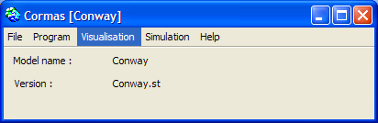
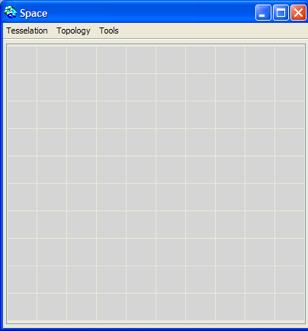
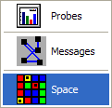
6.2 Opening the spatial grid

Slide 85
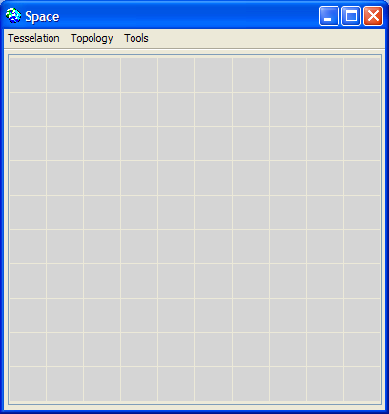
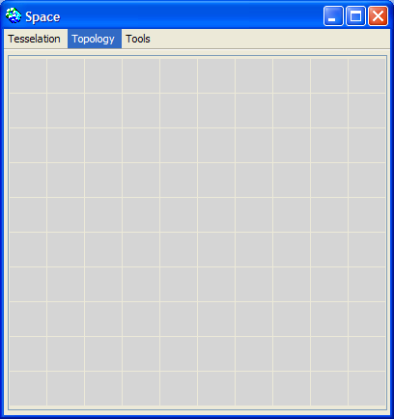

6.3 Adjusting the spatial grid
By default, the Cormas spatial grid
is a 10 * 10 regular matrix
made of squared cells
The grid size,
the boundaries type,
the cell shape and the number of neighbors
can be adjusted from the “topology” menu

Slide 86





Cell shape and neighborhood
4-connex:
when we consider the cells only north, south, east, and west.
Example :
The cell in red has 4 neighbors which are in green.
8-connex:
when we consider the cells NOT only north, south, east, and west but ALSO
northEast, southEast, northW, southW
Example :
The cell in red has 8 neighbors which are in green.
Game of Life

Slide 87
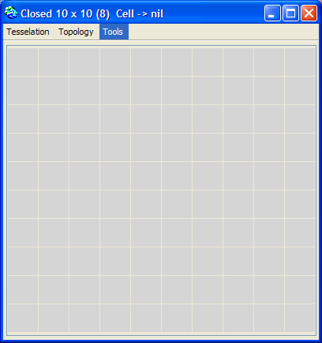

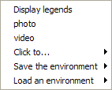


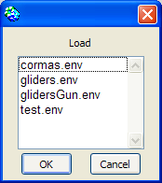

6.4 Loading a predefined grid
The creation of a specific spatial grid
(size, boundaries, cell shape and neighborhood, initial state value of each cell) can be achieved through the loading of an external file

Slide 88


How to run a simulation
7
Go to CORMAS Window
Simulation Window opens

Slide 89
Simulation panel window
Intialize...
to open the simulation builder window

Slide 90
Simulation panel window
Steps
to enter the number of steps to be “Run”

Slide 91
Simulation panel window
Step
to run just one time step
of simulation

Slide 92
Simulation panel window
Run
to run n time steps in a raw
(n is indicated in “Steps”)

Slide 93
Simulation panel window
simulation
the current simulation iteration (used for sensitivity analysis)

Slide 94
Simulation panel window
Time
the current value
of the simulation time step

Slide 95
Initializing a simulation
Click here.
Chapter 2 : Conway Model <number>/101

Slide 96

Scenario builder window overview
List of output data
List of init methods
List of control methods
Format of
output data
Tools for
sensitivity analysis

Slide 97

Building a scenario (1/4)
1
Select 1 “init” method

Slide 98

Building a scenario (2/4)
2
Select 1 “control” method

Slide 99

Building a scenario (3/4)
3
Activate the effective recording of some probes

Slide 100

Building a scenario (4/4)
4
Process the initialization
and record the scenario settings

Slide 101








Running the Game of Life
The observation has
to be activated.
Right-click on the spatial grid to select “pdv”
Now it’s time to see
what’s happening
at each step of simulation!

Slide 102
The End
Congratulation, you have done Module 1!
For more information please contact us at cormas-webmaster@cirad.fr

