Slide 1
Microprocessors and Assembly Language Lecture 5 Hamed Farbeh farbeh@aut.ac.ir Fall 2022
Notes:
مباحث اسمبلی در این لکچر برای آشنایی بیشتر است و در امتحان نخواهد بود.

Slide 2
Copyright Notice
Parts (text & figures) of this lecture are adopted from:
Cortex™-M3 Revision r2p1 Technical Reference Manual
ARMv7-M Architecture Reference Manual
Atmel | SMART ARM-based MCU DATASHEET, SAM3X / SAM3A Series, Atmel-11057C-ATARM-SAM3X-SAM3A-Datasheet_23-Mar-15

Slide 3
Interrupts(2)

Slide 4
Getting A GPIO Interrupt to Work
To get a GPIO interrupt working, you must:
Write an ISR, inside of which you
Associate the ISR with make sure to clear any flags that need clearing
respond to the interrupt with the desired action
the right interrupt vector
Configure which GPIO event you want to trigger the interrupt
only change from 0 to 1, only change from 1 to 0, any change (0 to 1 or 1 to 0), steady at 1, or steady at 0
Enable the interrupt for the pin inside the GPIO
Enable the interrupt inside the interrupt controller
Make sure the CPU has all interrupts enabled

Slide 5
Interrupt Priorities
CPU can only handle one interrupt at a time
Sometimes two or more events that result in interrupts happen at the same time
which one should go first? The interrupt controller picks the highest priority interrupt for the CPU to handle
The interrupt controller usually provides a configuration called a priority that allows the user, through their code, to specify which interrupts are higher priority and which are lower priority. Most also provide a default setting for each interrupt.

Slide 6
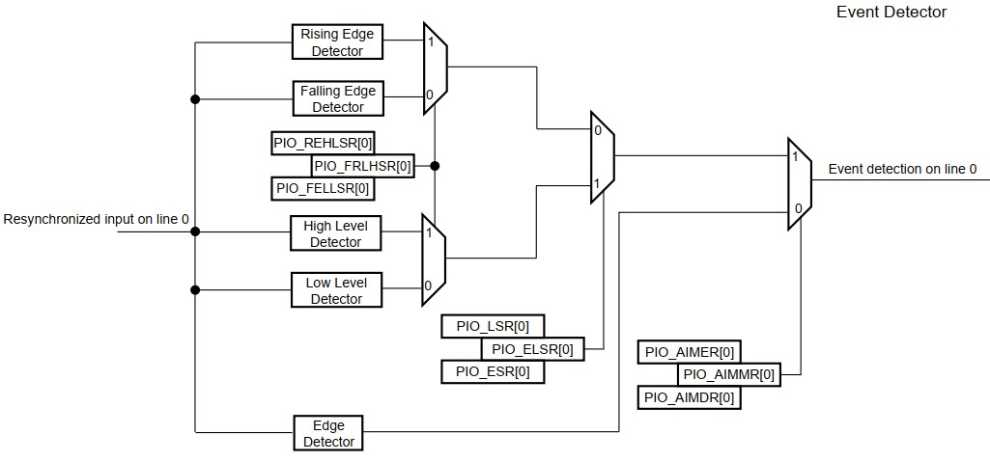
Event Detector

Slide 7
Event Detector
The configuration required is described below:
Interrupt Mode Configuration
Edge or Level Detection Configuration
Falling/Rising Edge or Low/High Level Detection Configuration

Slide 8
Event Detector - An Example
If generating an interrupt is required on the following:
Rising edge on PIO line 0
Falling edge on PIO line 1
Rising edge on PIO line 2
Low Level on PIO line 3
High Level on PIO line 4
High Level on PIO line 5
Falling edge on PIO line 6
Rising edge on PIO line 7
Any edge on the other lines
The configuration required is:

Slide 9
Event Detector - An Example
Interrupt Mode Configuration
All the interrupt sources are enabled by writing 32’hFFFF_FFFF in PIO_IER
Then the Additional Interrupt Mode is enabled for line 0 to 7 by writing 32’h0000_00FF in PIO_AIMER
Edge or Level Detection Configuration
Lines 3, 4 and 5 are configured in Level detection by writing 32’h0000_0038 in PIO_LSR
The other lines are configured in Edge detection by default, if they have not been previously configured. Otherwise, lines 0, 1, 2, 6 and 7 must be configured in Edge detection by writing 32’h0000_00C7 in PIO_ESR

Slide 10
Event Detector - An Example
Falling/Rising Edge or Low/High Level Detection Configuration
Lines 0, 2, 4, 5 and 7 are configured in Rising Edge or High Level detection by writing 32’h0000_00B5 in PIO_REHLSR
The other lines are configured in Falling Edge or Low Level detection by default, if they have not been previously configured. Otherwise, lines 1, 3 and 6 must be configured in Falling Edge/Low Level detection by writing 32’h0000_004A in PIO_FELLSR

Slide 11
Interrupts Handling
As we saw in the previous lecture, NVIC handles interrupts
void NVIC_EnableIRQ (IRQn_Type IRQn)
enables the specified device specific interrupt IRQ
uint32_t NVIC_GetEnableIRQ (IRQn_Type IRQn)
gets status of specific enable IRQ
void NVIC_DisableIRQ (IRQn_Type IRQn)
disables the specified device specific interrupt IRQ
void NVIC_SetPendingIRQ (IRQn_Type IRQn)
uint32_t NVIC_GetPendingIRQ (IRQn_Type IRQn)
void NVIC_ClearPendingIRQ (IRQn_Type IRQn)
uint32_t NVIC_GetActive (IRQn_Type IRQn)
https://www.keil.com/pack/doc/cmsis/Core/html/group__NVIC__gr.html#details

Slide 12
Interrupts Handling
Functions to access the NVIC
void NVIC_SetPriority (IRQn_Type IRQn, uint32_t priority)
The number of priority levels is configurable and depends on the implementation of the chip designer. To determine the number of bits implemented for interrupt priority-level registers, write 0xFF to one of the priority-level register, then read back the value. For example, if the minimum number of 3 bits have been implemented, the read-back value is 0xE0
Writes to unimplemented bits are ignored
For Cortex-M3, Cortex-M4, and Cortex-M7
Dynamic switching of interrupt priority levels is supported
Supports 0 to 255 priority levels
Priority-level registers have a maximum width of 8 bits and a minimum of 3 bits
https://www.keil.com/pack/doc/cmsis/Core/html/group__NVIC__gr.html#details

Slide 13
Interrupts Handling
Functions to access the NVIC
uint32_t NVIC_GetPriority (IRQn_Type IRQn)
gives the priority of a specific interrupt
uint32_t NVIC_GetVector (IRQn_Type IRQn)
allows to read the address of an interrupt handler function
void NVIC_SetVector (IRQn_Type IRQn, uint32_t vector)
allows to change the address of an interrupt handler function
void NVIC_SystemReset (void)
requests a system reset by setting the SYSRESETREQ flag
https://www.keil.com/pack/doc/cmsis/Core/html/group__NVIC__gr.html#details

Slide 14
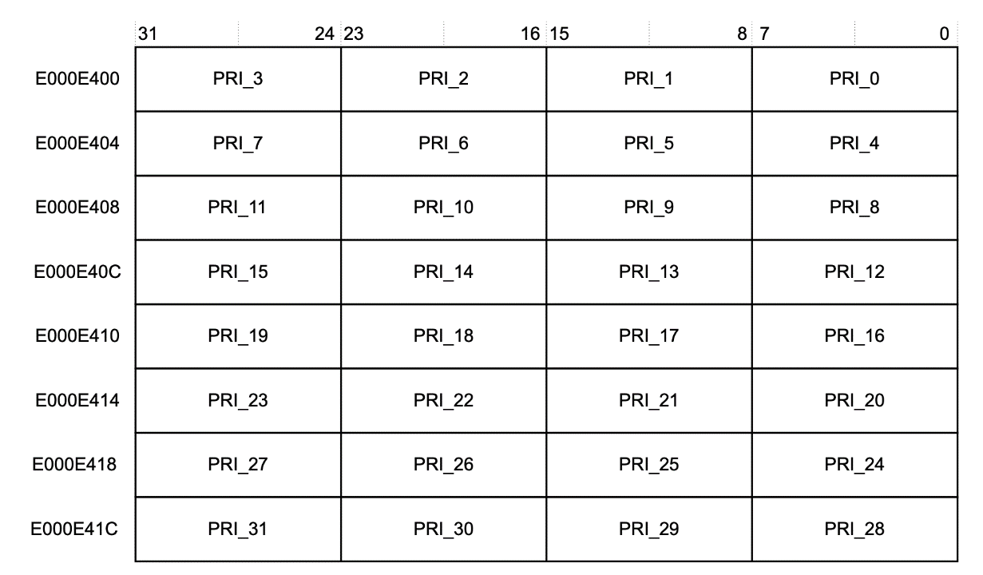
Setting Priority with assembly
You can use the Interrupt Priority Registers to assign a priority from 0 to 255 to each of the available interrupts. 0 is the highest priority, and 255 is the lowest.
The priority registers are stored with the Most Significant Bit (MSB) first.
This figure shows the fields of Interrupt Priority Registers 0-7. We use these addresses to write the priority numbers.

Slide 15
Setting Priority with assembly
To configure the priority of an interrupt, we can take advantage of the fact that the interrupt priority registers are byte-addressable.
For example, to set IRQ #4 priority level to 0xC0 (192 in decimal) , we can use the following code:
LDR R0, =0xE000E400
MOV R1, #0xC0 ; Priority level
STRB R1, [R0, #4] ; Set IRQ #4 priority (Byte write)

Slide 16

Interrupts Handling
The vector table contains the interrupts field and the ISR numbers associated with them
The symbol __Vectors is the address of the vector table in the startup code
Register SCB->VTOR holds the start address of the vector table
SCB: System Control Block, some of its registers:
ICSR: Interrupt Control and State Register
VTOR: Vector Table Offset Register
AIRCR: Application Interrupt and Reset Control Register
SCR: System Control Register
https://www.keil.com/pack/doc/cmsis/Core/html/group__NVIC__gr.html#details

Slide 17
Vector Table
At the beginning of the vector table, the initial stack value and the exception vectors of the processor are defined
__Vectors DCD __initial_sp ; Top of Stack initialization
DCD Reset_Handler ; Reset Handler
DCD NMI_Handler ; NMI Handler
DCD HardFault_Handler ; Hard Fault Handler
DCD MemManage_Handler ; MPU Fault Handler
DCD BusFault_Handler ; Bus Fault Handler
DCD UsageFault_Handler ; Usage Fault Handler
DCD SecureFault_Handler ; Secure Fault Handler
DCD 0 ; Reserved
DCD 0 ; Reserved
DCD 0 ; Reserved
DCD SVC_Handler ; SVCall Handler
DCD DebugMon_Handler ; Debug Monitor Handler
DCD 0 ; Reserved
DCD PendSV_Handler ; PendSV Handler
DCD SysTick_Handler ; SysTick Handler
https://www.keil.com/pack/doc/cmsis/Core/html/group__NVIC__gr.html#details

Slide 18
Vector Table
Device Specific Vectors
Following the processor exception vectors, the vector table contains also the device specific interrupt vectors
__Vectors DCD __initial_sp ; Top of Stack initialization
DCD Reset_Handler ; Reset Handler
…
DCD SysTick_Handler ; SysTick Handler
; device specific interrupts
DCD WWDG_IRQHandler ; Window Watchdog
DCD PVD_IRQHandler ; PVD through EXTI Line detect
DCD TAMPER_IRQHandler ; Tamper
All device specific interrupts should have a default interrupt handler function that can be overwritten in user code
Remapping interrupt vectors by updating VTOR register
An example: https://www.keil.com/pack/doc/cmsis/Core/html/using_VTOR_pg.html
https://www.keil.com/pack/doc/cmsis/Core/html/group__NVIC__gr.html#details

Slide 19
interrupt handler function
All device specific interrupts should have a default interrupt handler function that can be overwritten in user code. Below is an example for this default handler function.
Default_Handler PROC
EXPORT WWDG_IRQHandler [WEAK]
EXPORT PVD_IRQHandler [WEAK]
EXPORT TAMPER_IRQHandler [WEAK]
:
:
WWDG_IRQHandler
PVD_IRQHandler
TAMPER_IRQHandler
:
:
B .
ENDP
The user application may simply define an interrupt handler function by using the handler name
void WWDG_IRQHandler(void)
{
...
}
https://www.keil.com/pack/doc/cmsis/Core/html/group__NVIC__gr.html#details
Notes:
هر وقفه ای که مرتبط با اینتراپت میشه، باید یک ابنتراپت هندلر به طور پیشفرض داشته باشه.و کاربر بتونه اون اون تابع رو اوررایت کنه

Slide 20
Overriding a Handler
We can override a handler in assembly as below;
Note: The handler is assumed to be of IRQHandler_PIOB type in this example
1 PIOB_IRQHandler PROC
2 EXPORT PIOB_IRQHandler
3 {Handler body}
4 ENDP
The PIOB_IRQHandler procedure is defined, then the new handler is exported using the EXPORT PIOB_IRQHandler command. In the {Handler body} part, the content of the procedure we want to override in the new handler is written. In the last line the procedure is ended using ENDP.

Slide 21
interrupt handler function
#include "LPC17xx.h"
uint32_t active; /* Variable to store interrupt active state */
void TIMER0_IRQHandler(void) { /* Timer 0 interrupt handler */
if (LPC_TIM0->IR & (1 << 0)) { /* Check if interrupt for match channel 0 occured */
LPC_TIM0->IR |= (1 << 0); /* Acknowledge interrupt for match channel 0 occured */
}
active = NVIC_GetActive(TIMER0_IRQn); /* Get interrupt active state of timer 0 */
}
int main (void) {
/* Set match channel register MR0 to 1 millisecond */
LPC_TIM0->MR0 = (((SystemCoreClock / 1000) / 4) - 1); /* 1 ms? */
LPC_TIM0->MCR = (3 << 0); /* Enable interrupt and reset for match channel MR0 */
NVIC_EnableIRQ(TIMER0_IRQn); /* Enable NVIC interrupt for timer 0 */
LPC_TIM0->TCR = (1 << 0); /* Enable timer 0 */
while(1);
}
https://www.keil.com/pack/doc/cmsis/Core/html/group__NVIC__gr.html#details

Slide 22
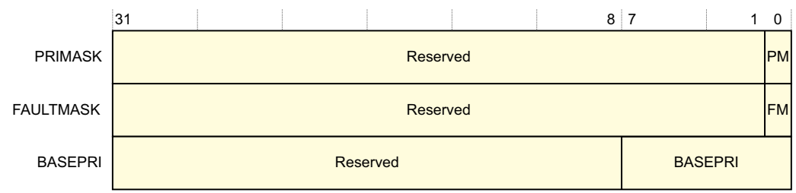
Masking Exception
PRIMASK: Exception mask register (CPU core)
Register to mask out configurable exceptions
A 1-bit register (So it has two modes)
Setting PRIMASK to 1 raises the execution priority to 0
CMSIS-CORE API
void __enable_irq() // clears PM flag
void __disable_irq() // sets PM flag
uint32_t __get_PRIMASK() // returns value of PRIMASK
void __set_PRIMASK(uint32_t x) // sets PRIMASK to x
BASEPRI: Mask exception from a defined level
An 8-bit register
BASEPRI changes the priority level required for exception preemption
A value of zero disables masking by BASEPRI
FAULTMASK
A 1-bit register
Raises the execution priority to -1 (the priority of HardFault)
Returning from any exception except NMI clears FAULTMASK to 0
REF: ARMv7-M Architecture Reference Manual
Notes:
Hardfault was an hardware exception
So the Faultmask makes the priority to -1 and makes the exception be treated as a hardware interrupt

Slide 23
CMSIS
CMSIS: Cortex Microcontroller Software Interface Standard
Is a vendor-independent hardware abstraction layer for microcontrollers that are based on Arm® Cortex® processors
Defines generic tool interfaces and enables consistent device support
Provides simple software interfaces to the processor and the peripherals
Simplifies software re-use
Reduces the learning curve for microcontroller developers,
Reduces the time to market for new devices
Has been created to help the industry in standardization
Enables consistent software layers and device support across a wide range of development tools and microcontrollers
The CMSIS recommends the following conventions for identifiers:
CAPITAL names to identify Core Registers, Peripheral Registers, and CPU Instructions.
CamelCase names to identify function names and interrupt functions.
Namespace_ prefixes avoid clashes with user identifiers and provide functional groups (i.e. for peripherals, RTOS, or DSP Library)
http://www.keil.com/pack/doc/CMSIS/General/html/index.html

Slide 24
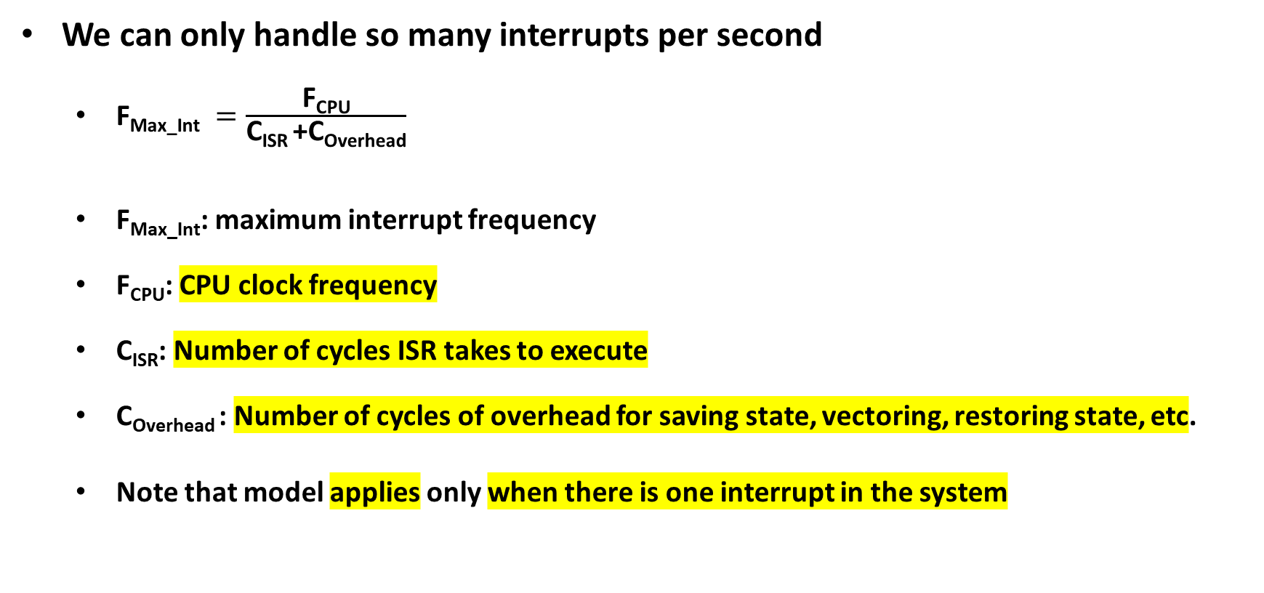
Maximum Interrupt Rate
We can only handle so many interrupts per second
$\text{F}\text{Max}\text{_}\text{Int} =\frac{\text{F}\text{CPU}}{\text{C}\text{ISR} \text{+}\text{C}\text{Overhead}}$
F_{Max_Int}: maximum interrupt frequency
F_{CPU}: CPU clock frequency
C_{ISR}: Number of cycles ISR takes to execute
C_{Overhead} : Number of cycles of overhead for saving state, vectoring, restoring state, etc.
Note that model applies only when there is one interrupt in the system

Slide 25
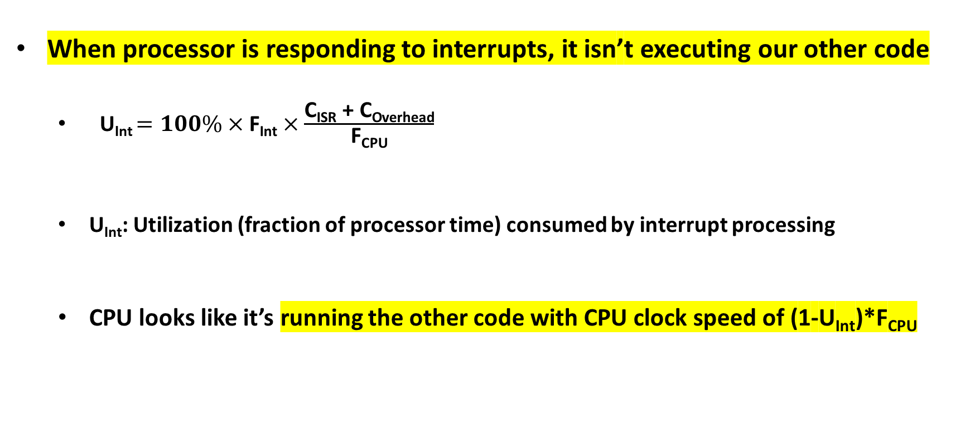
Maximum Interrupt Rate (cont’d)
When processor is responding to interrupts, it isn’t executing our other code
U_{Int} $=100\%×\text{F}\text{Int}×\frac{\text{C}\text{ISR} \text{+ }\text{C}\text{Overhead}}{ \text{F}\text{CPU} }$
U_{Int}: Utilization (fraction of processor time) consumed by interrupt processing
CPU looks like it’s running the other code with CPU clock speed of (1-U_{Int})*F_{CPU}
Notes:
درواقع داریم فرکانس وقفه رو تقسیم بر فرکانس ماکسیمم وقفه میکنیم، تا بهره وری را به دست اوریم

Slide 26
Sharing Data Safely between ISRs and other Threads
Volatile data: can be updated outside of the program’s immediate control
In computer programming, particularly in the C, C++, C#, and Java programming languages, the volatile keyword indicates that a value may change between different accesses, even if it does not appear to be modified. This keyword prevents an optimizing compiler from optimizing away subsequent reads or writes and thus incorrectly reusing a stale value or omitting writes. Volatile values primarily arise in hardware access (memory-mapped I/O), where reading from or writing to memory is used to communicate with peripheral devices, and in threading, where a different thread may have modified a value. [Wikipedia]
Non-atomic shared data: can be interrupted partway through read or write, is vulnerable to race conditions
Where should we use volatile and where should we use Non-atomic shared?

Slide 27
Non-Atomic Shared Data
void GetDateTime(DateTimeType * DT){
DT->day = TimerVal.day;
DT->hour = TimerVal.hour;
DT->minute = TimerVal.minute;
DT->second = TimerVal.second;
}
Want to keep track of current time and date
Use 1 Hz interrupt from timer
System
TimerVal structure tracks time and days since some reference event
TimerVal’s fields are updated by periodic 1 Hz timer ISR
void DateTimeISR(void){
TimerVal.second++;
if (TimerVal.second > 59){
TimerVal.second = 0;
TimerVal.minute++;
if (TimerVal.minute > 59) {
TimerVal.minute = 0;
TimerVal.hour++;
if (TimerVal.hour > 23) {
TimerVal.hour = 0;
TimerVal.day++;
… etc.}

Slide 28
Non-Atomic Shared Data
Problem
An interrupt at the wrong time will lead to half-updated data in DT
Failure Case
TimerVal is {10, 23, 59, 59} (10th day, 23:59:59)
Task code calls GetDateTime(), which starts copying the TimerVal fields to DT: day = 10, hour = 23
A timer interrupt occurs, which updates TimerVal to {11, 0, 0, 0}
GetDateTime() resumes executing, copying the remaining TimerVal fields to DT: minute = 0, second = 0
DT now has a time stamp of {10, 23, 0, 0}
The system thinks time just jumped backwards one hour!
Fundamental problem – “race condition”
Preemption enables ISR to interrupt other code and possibly overwrite data
Must ensure atomic (indivisible) access to the object

Slide 29
Examining the Problem More Closely
Must protect any data object which both
requires multiple instructions to read or write (non-atomic access),
and
is potentially written by an ISR
void GetDateTime(DateTimeType * DT){
uint32_t m;
m = __get_PRIMASK();
__disable_irq();
DT->day = TimerVal.day;
DT->hour = TimerVal.hour;
DT->minute = TimerVal.minute;
DT->second = TimerVal.second;
__set_PRIMASK(m);}
Notes:
کد داره میگه اگر وقفه ای اومد، دیسیبلش کن کاراتو انجام بده بعدش بیا اینیبلش کن
یچیزی مثل لاک توی سیستم عامل

Slide 30
The End!

