Slide 1
Microprocessors and Assembly Language Lecture 9 Hamed Farbeh farbeh@aut.ac.ir Fall 2022

Slide 2
Copyright Notice
Parts (text & figures) of this lecture are adopted from:
Arm Assembly Language Programming and Architecture, Volume 1, 1st edition, Muhammad Ali Mazidi, Sarmad Naimi, and Sepehr Naimi, MicroDigitalEd, 2013
Design of Microprocessor-Based Systems (AKA Embeded Systems Design and Implementation), Prabal Dutta, University of Michigan
Cortex™-M3 Revision r2p1 Technical Reference Manual
ARMv7-M Architecture Reference Manual

Slide 3
Universal Asynchronous Receiver/Transmitter (UART)

Slide 4
Introduction to UART
Remember when printers, mice, and modems had thick cables with those huge clunky connectors? The ones that literally had to be screwed into your computer? Those devices were probably using UARTs to communicate with your computer. While USB has almost completely replaced those old cables and connectors, UARTs are definitely not a thing of the past. You’ll find UARTs being used in many DIY electronics projects to connect GPS modules, Bluetooth modules, and RFID card reader modules to your Raspberry Pi, Arduino, or other microcontrollers.

Slide 5
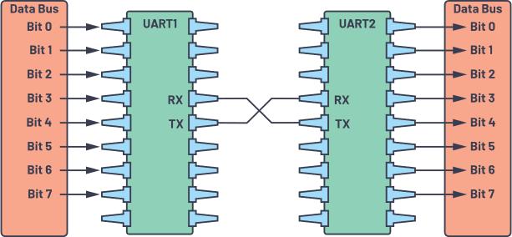
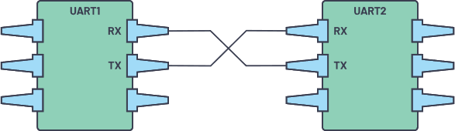
Introduction to UART
UART stands for Universal Asynchronous Receiver/Transmitter. It’s not a communication protocol like SPI and I2C, but a physical circuit in a microcontroller, or a stand-alone IC. A UART’s main purpose is to transmit and receive serial data.

Slide 6
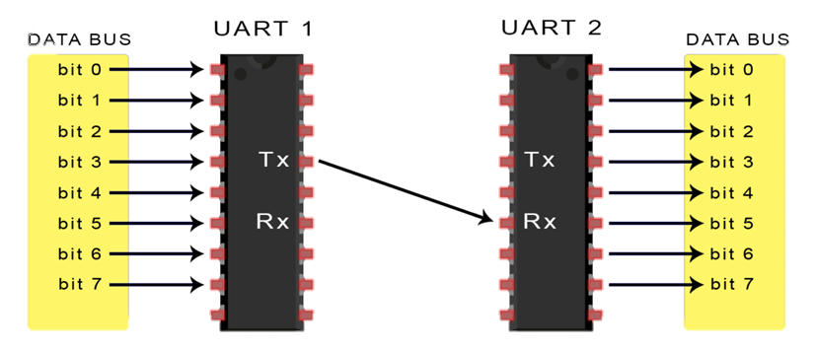
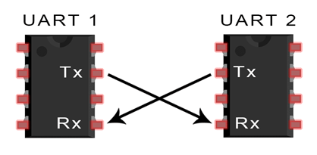
Basics of UART Communication
Asynchronous serial communication
Uses two wires to transmit data between devices
Data flows from the Tx pin of the transmitting UART
to the Rx pin of the receiving UART
No clock signal to synchronize the output of bits from the transmitting UART
to the sampling of bits by the receiving UART
http://www.circuitbasics.com/basics-uart-communication/

Slide 7
UART Communication Details
The transmitting UART adds start and stop bits
to the data packet being transferred
These bits define the beginning and end of the data packet
so the receiving UART knows when to start reading the bits
The receiving UART detects a start bit
Then, starts to read the incoming bits
at a specific frequency known as the baud rate
Baud rate: a measure of the speed of data transfer
expressed in bits per second (bps)
The baud rate between the transmitting and receiving UARTs can only differ by about 10%
http://www.circuitbasics.com/basics-uart-communication/

Slide 8
UART Communication Details
Data Transmission
In UART, the mode of transmission is in the form of a packet. The piece that connects the transmitter and receiver includes the creation of serial packets and controls those physical hardware lines. A packet consists of a start bit, data frame, a parity bit, and stop bits.

Slide 9

UART Communication Details
START BIT
The transmitting UART pulls the line from high to low for one clock cycle
The UART data transmission line is normally held at a high voltage level when it’s not transmitting data. To start the transfer of data, the transmitting UART pulls the transmission line from high to low for one (1) clock cycle. When the receiving UART detects the high-to-low voltage transition, it begins reading the bits in the data frame at the baud rate frequency

Slide 10

UART Communication Details
Data Frame
The data frame contains the actual data being transferred. It can be five (5) bits up to eight (8) bits long if a parity bit is used. If no parity bit is used, the data frame can be nine (9) bits long. In most cases, the data is sent with the least significant bit first.

Slide 11

UART Communication Details
Parity
Parity describes the evenness or oddness of a number. The parity bit is a way for the receiving UART to tell if any data has changed during transmission. Bits can be changed by electromagnetic radiation, mismatched baud rates, or long-distance data transfers.

Slide 12
UART Communication Details
Parity
After the receiving UART reads the data frame, it counts the number of bits with a value of 1 and checks if the total is an even or odd number. If the parity bit is a 0 (even parity), the 1 or logic-high bit in the data frame should total to an even number. If the parity bit is a 1 (odd parity), the 1 bit or logic highs in the data frame should total to an odd number.
When the parity bit matches the data, the UART knows that the transmission is free of errors. But if the parity bit is a 0, and the total is odd, or the parity bit is a 1, and the total is even, the UART knows that bits in the data frame have changed.

Slide 13

UART Communication Details
Stop Bits
To signal the end of the data packet, the sending UART drives the data transmission line from a low voltage to a high voltage for one (1) to two (2) bit(s) duration.

Slide 14
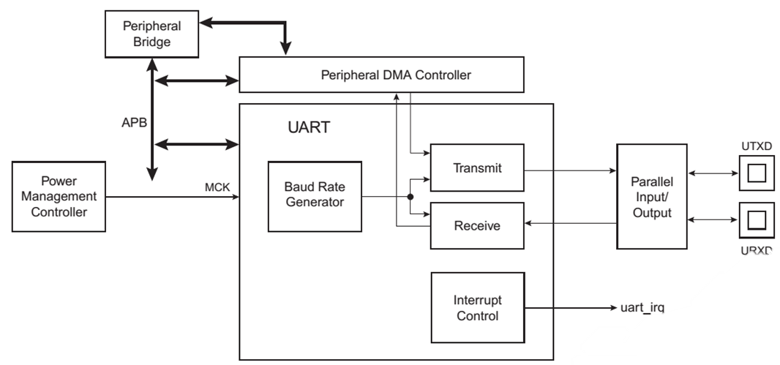
UART in SAM3X8E
Independent Receiver and Transmitter
with a Common Programmable Baud Rate Generator
Even, Odd, Mark or Space Parity Generation
Parity, Framing and Overrun Error Detection
Interrupt Generation
Ch. 34: Atmel | SMART ARM-based MCU DATASHEET, SAM3X / SAM3A Series, Atmel-11057C-ATARM-SAM3X-SAM3A-Datasheet_23-Mar-15

Slide 15
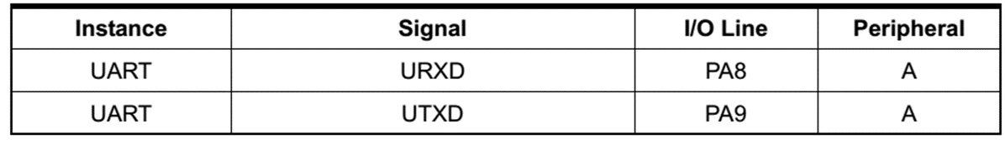
UART in SAM3X8E
The UART pins are multiplexed with PIO lines
The programmer must first configure the PMC to enable the UART clock
PMC: Power Management Controller
Only 8-bit character is supported (with parity)
Ch. 34: Atmel | SMART ARM-based MCU DATASHEET, SAM3X / SAM3A Series, Atmel-11057C-ATARM-SAM3X-SAM3A-Datasheet_23-Mar-15

Slide 16
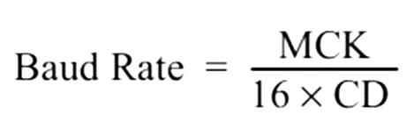
Baud Rate Generator in SAM3X8E
The baud rate clock
Is the master clock divided by 16 times the value (CD) written in UART_BRGR (Baud Rate Generator Register)
If UART_BRGR is set to 0, the baud rate clock is disabled and the UART remains inactive
The maximum allowable baud rate is Master Clock divided by 16
The minimum allowable baud rate is Master Clock divided by (16 x 65535)
Ch. 34: Atmel | SMART ARM-based MCU DATASHEET, SAM3X / SAM3A Series, Atmel-11057C-ATARM-SAM3X-SAM3A-Datasheet_23-Mar-15

Slide 17
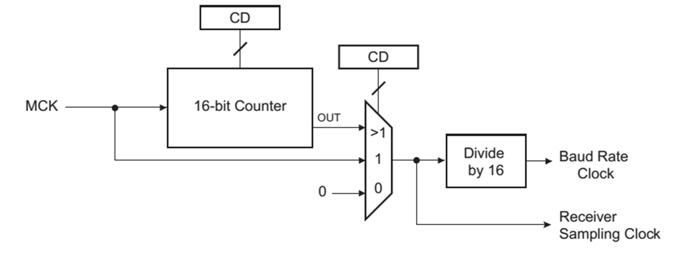
Baud Rate Generator in SAM3X8E
Ch. 34: Atmel | SMART ARM-based MCU DATASHEET, SAM3X / SAM3A Series, Atmel-11057C-ATARM-SAM3X-SAM3A-Datasheet_23-Mar-15

Slide 18
UART Receiver in SAM3X8E
Receiver Reset, Enable and Disable
After the device reset, the UART receiver is disabled
To enable: RXEN = 1 in the control register (UART_CR)
If enabled: the receiver starts looking for a start bit
To disable: RXDIS = 1 in the control register (UART_CR)
If the receiver is waiting for a start bit, it is immediately stopped
If the receiver has already detected a start bit and is receiving the data, it waits for the stop bit before actually stopping its operation
To reset: RSTRX =1 in the control register (UART_CR)
The receiver immediately stops its current operations and is disabled, whatever its current state!
Ch. 34: Atmel | SMART ARM-based MCU DATASHEET, SAM3X / SAM3A Series, Atmel-11057C-ATARM-SAM3X-SAM3A-Datasheet_23-Mar-15

Slide 19
Start Detection and Data Sampling
A low level (space) on URXD is interpreted as a valid start bit
if it is detected for more than 7 cycles of the sampling clock
Sampling clock = 16 x baud rate
The receiver samples the URXD at the theoretical midpoint of each bit
When a valid start bit has been detected
It is assumed that each bit lasts 16 cycles of the sampling clock (1-bit period): the bit sampling point is eight cycles (0.5-bit period) after the start of the bit
The first sampling point is, therefore 24 cycles (1.5-bit periods) after the falling edge of the start bit was detected
Each subsequent bit is sampled 16 cycles (1-bit period) after the previous one
Ch. 34: Atmel | SMART ARM-based MCU DATASHEET, SAM3X / SAM3A Series, Atmel-11057C-ATARM-SAM3X-SAM3A-Datasheet_23-Mar-15

Slide 20
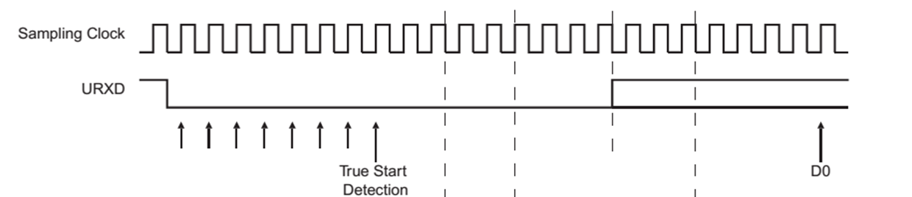
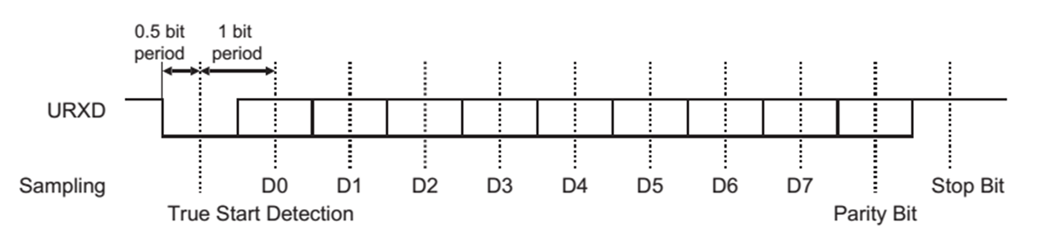
Start Detection and Data Sampling
Ch. 34: Atmel | SMART ARM-based MCU DATASHEET, SAM3X / SAM3A Series, Atmel-11057C-ATARM-SAM3X-SAM3A-Datasheet_23-Mar-15

Slide 21
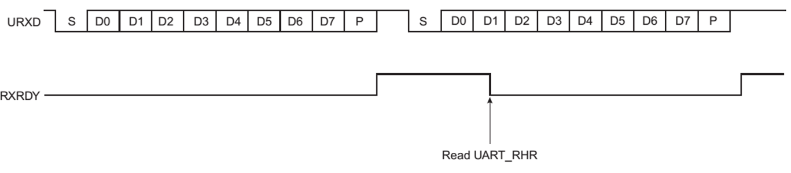
Receiver Ready
When a complete character is received
Is transferred to the receive holding register (UART_RHR )
The RXRDY status bit in UART_SR (Status Register) is set
The bit RXRDY is automatically cleared when the UART_RHR is read
Ch. 34: Atmel | SMART ARM-based MCU DATASHEET, SAM3X / SAM3A Series, Atmel-11057C-ATARM-SAM3X-SAM3A-Datasheet_23-Mar-15

Slide 22
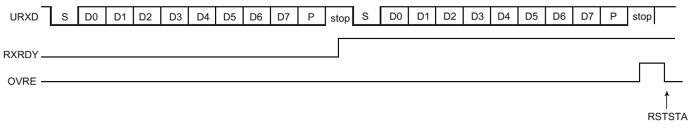
Receiver Overrun
If UART_RHR has not been read by the software (or the Peripheral Data Controller or DMA Controller) since the last transfer
and a new character is received
the OVRE status bit in UART_SR is set
OVRE is cleared when the software writes the control register UART_CR with the bit RSTSTA (Reset Status) at 1
Ch. 34: Atmel | SMART ARM-based MCU DATASHEET, SAM3X / SAM3A Series, Atmel-11057C-ATARM-SAM3X-SAM3A-Datasheet_23-Mar-15

Slide 23
Transmitter
The UART transmitter is disabled after the device reset
To enable: TXEN = 1 in the control register UART_CR
The transmitter waits for a character to be written in the Transmit Holding Register (UART_THR) before actually starting the transmission
To disable: TXDIS = 1 in the control register UART_CR
If the transmitter is not operating, it is immediately stopped
If a character is being processed into the Shift Register and/or a character has been written in the Transmit Holding Register, the characters are completed before the transmitter is stopped
To reset: RSTTX = 1 in the UART_CR
Ch. 34: Atmel | SMART ARM-based MCU DATASHEET, SAM3X / SAM3A Series, Atmel-11057C-ATARM-SAM3X-SAM3A-Datasheet_23-Mar-15

Slide 24

Transmitter Control
When enabled, the bit TXRDY is set in the UART_SR
The transmission starts when
The programmer writes in the UART_THR and
The written character is transferred from UART_THR to the Shift Register
The TXRDY bit remains high until a second character is written in UART_THR
Ch. 34: Atmel | SMART ARM-based MCU DATASHEET, SAM3X / SAM3A Series, Atmel-11057C-ATARM-SAM3X-SAM3A-Datasheet_23-Mar-15

Slide 25
Transmitter Control
As soon as the first character is completed
The last character written in UART_THR is transferred into the shift register and TXRDY rises again
Showing that the holding register is empty
When both the Shift Register, and UART_THR are empty
All the characters written in UART_THR have been processed
The TXEMPTY bit rises after the last stop bit has been completed
Ch. 34: Atmel | SMART ARM-based MCU DATASHEET, SAM3X / SAM3A Series, Atmel-11057C-ATARM-SAM3X-SAM3A-Datasheet_23-Mar-15

Slide 26
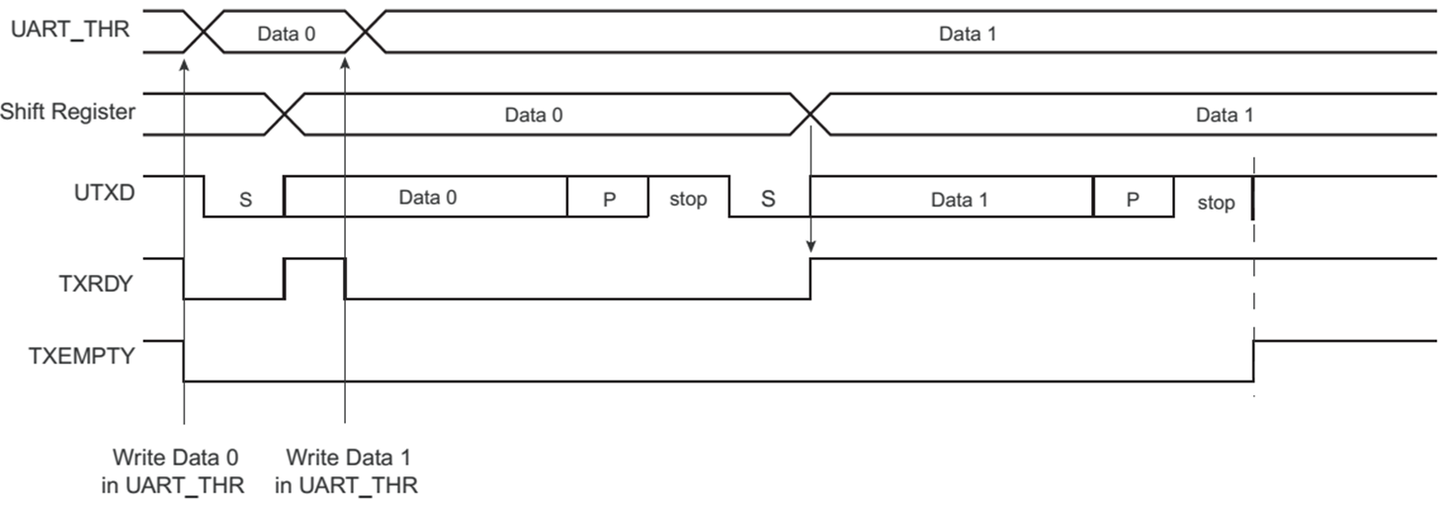
Transmitter Control
Ch. 34: Atmel | SMART ARM-based MCU DATASHEET, SAM3X / SAM3A Series, Atmel-11057C-ATARM-SAM3X-SAM3A-Datasheet_23-Mar-15

Slide 27
Steps of UART Transmission(Summary)
First: The transmitting UART receives data in parallel from the data bus.
Second: The transmitting UART adds the start bit, parity bit, and the stop bit(s) to the data frame.
Third: The entire packet is sent serially starting from start bit to stop bit from the transmitting UART to the receiving UART. The receiving UART samples the data line at the preconfigured baud rate.
Fourth: The receiving UART discards the start bit, parity bit, and stop bit from the data frame.
Fifth: The receiving UART converts the serial data back into parallel and transfers it to the data bus on the receiving end.

Slide 28
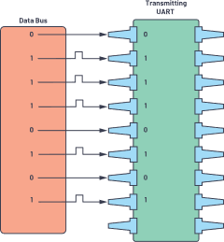
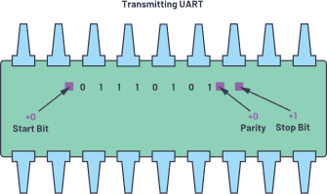
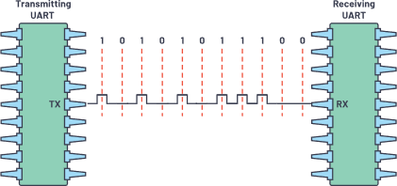
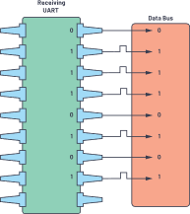
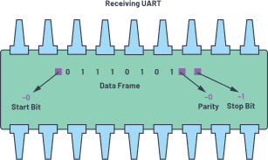
Steps of UART Transmission(Summary)
27

Slide 29
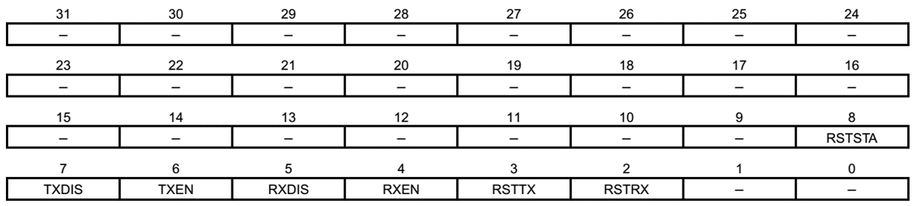
UART Registers
UART Control Register: UART_CR
RSTRX: Reset Receiver
RSTTX: Reset Transmitter
RXEN: Receiver Enable
RXDIS: Receiver Disable
TXEN: Transmitter Enable
TXDIS: Transmitter Disable
RSTSTA: Reset Status Bits (Resets the status bits PARE, FRAME and OVRE in the UART_SR)
Ch. 34: Atmel | SMART ARM-based MCU DATASHEET, SAM3X / SAM3A Series, Atmel-11057C-ATARM-SAM3X-SAM3A-Datasheet_23-Mar-15

Slide 30
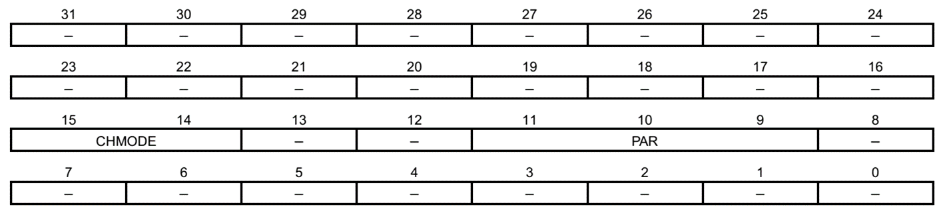
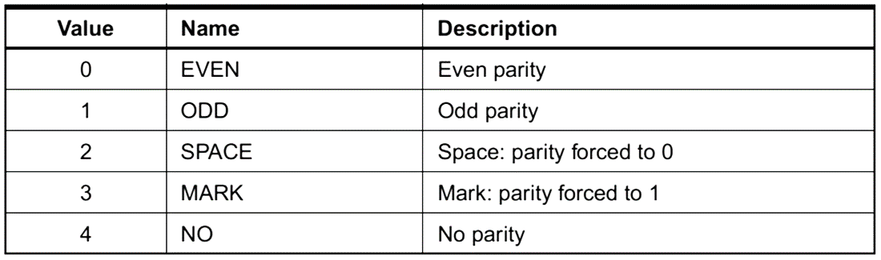
UART Registers
UART Mode Register: UART_MR
Ch. 34: Atmel | SMART ARM-based MCU DATASHEET, SAM3X / SAM3A Series, Atmel-11057C-ATARM-SAM3X-SAM3A-Datasheet_23-Mar-15

Slide 31
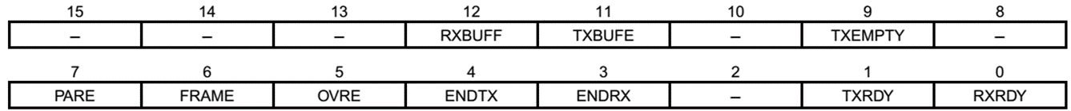
UART Registers
UART Interrupt Enable Register: UART_IER
RXRDY: Enable RXRDY Interrupt
TXRDY: Enable TXRDY Interrupt
ENDRX: Enable End of Receive Transfer Interrupt
ENDTX: Enable End of Transmit Interrupt
OVRE: Enable Overrun Error Interrupt
FRAME: Enable Framing Error Interrupt
PARE: Enable Parity Error Interrupt
TXEMPTY: Enable TXEMPTY Interrupt
TXBUFE: Enable Buffer Empty Interrupt
RXBUFF: Enable Buffer Full Interrupt
Ch. 34: Atmel | SMART ARM-based MCU DATASHEET, SAM3X / SAM3A Series, Atmel-11057C-ATARM-SAM3X-SAM3A-Datasheet_23-Mar-15

Slide 32
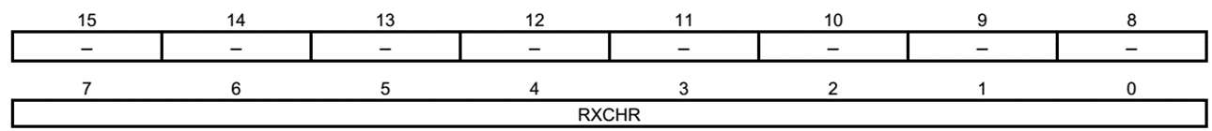
UART Registers
UART Receiver Holding Register: UART_RHR
Read-only
RXCHR: Received Character
Last received character if RXRDY is set
UART Transmit Holding Register: UART_THR
Write-only
TXCHR: Character to be Transmitted
Next character to be transmitted after the current character if TXRDY is not set
Ch. 34: Atmel | SMART ARM-based MCU DATASHEET, SAM3X / SAM3A Series, Atmel-11057C-ATARM-SAM3X-SAM3A-Datasheet_23-Mar-15

Slide 33
UART Registers
UART Baud Rate Generator Register: UART_BRGR
CD: Clock Divisor
0 = Baud Rate Clock is disabled
1 to 65,535 = MCK / (CD x 16)
Ch. 34: Atmel | SMART ARM-based MCU DATASHEET, SAM3X / SAM3A Series, Atmel-11057C-ATARM-SAM3X-SAM3A-Datasheet_23-Mar-15

Slide 34
The End!

