Slide 1
Computer graphics

Slide 2
Slide?

Slide 3
Slide????

Slide 4

Look computer graphics!

Slide 5
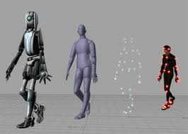
Computer Graphics?

Slide 6
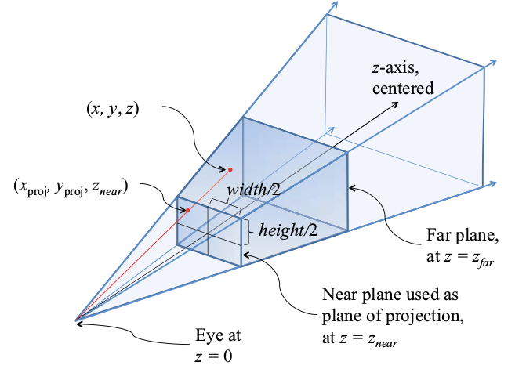
Computer graphics!

