Slide 1
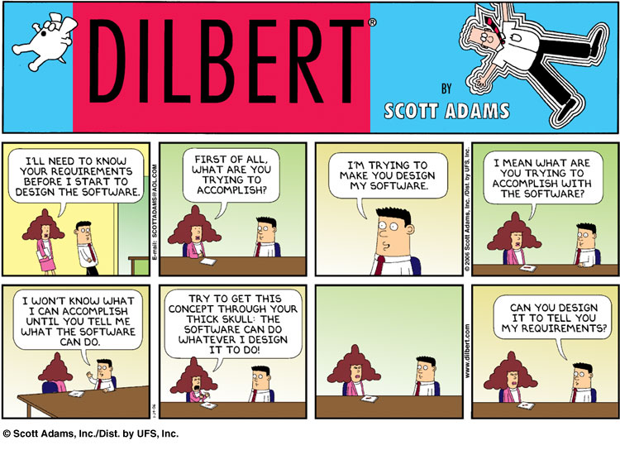
User Interface Design

Slide 2
UI Design: Wed Aug 31 (Day 5)
Dr. Jillian Aurisano
Plan for today:
Reminders, course logistics
Finish design lightning presentations
Intro user centered design
Needs finding / requirements gathering
Concrete tasks vs essential goals
One method: interview
Do an interview activity
Notes:
So welcome to engineering visual interfaces for data science. I'm Dr Aurisano.
Thanks for finding the class on Zoom. Hopefully we will be in person again soon.
If anyone out there is comfortable turning on their cameras, that is lovely- then I feel like I am talking to students, rather than to myself.
Here’s our plan for today:
First I’m going to introduce myself, so you know a bit about me
Then we are going to get to know each other, in Zoom breakout rooms. This will give us a chance to make sure that Zoom breakout rooms work, and we all know how to access them.
Then, I am going to walk through the structure, and plan for the course. I want to make sure everyone knows how the course will work, and what to expect, and also a bit about why the course is designed this way.
Then I am going to introduce the class, and what the class is about. Since this is a new class, and one of just a few classes in human centered computing here at UC, I wanted to give an overview of the topic.
Then I have an introductory activity, which we will do in breakout rooms, and which I think will help motivate the discussion on Wednesday, and getting into the meat of the class.

Slide 3
Course logistics
Assignment 1 turned in
Shift in schedule:
This week- user centered design, continuing to build our project ideas
Next week- sketching week
Then 2 technical weeks
New project schedule:
Project 1 out week 3 (next week), due Week 7 (5 weeks)
Project 2 out week 8, due week 11 (4 weeks)
Project 3 out week 12, due week 15 (4 weeks)

Slide 4
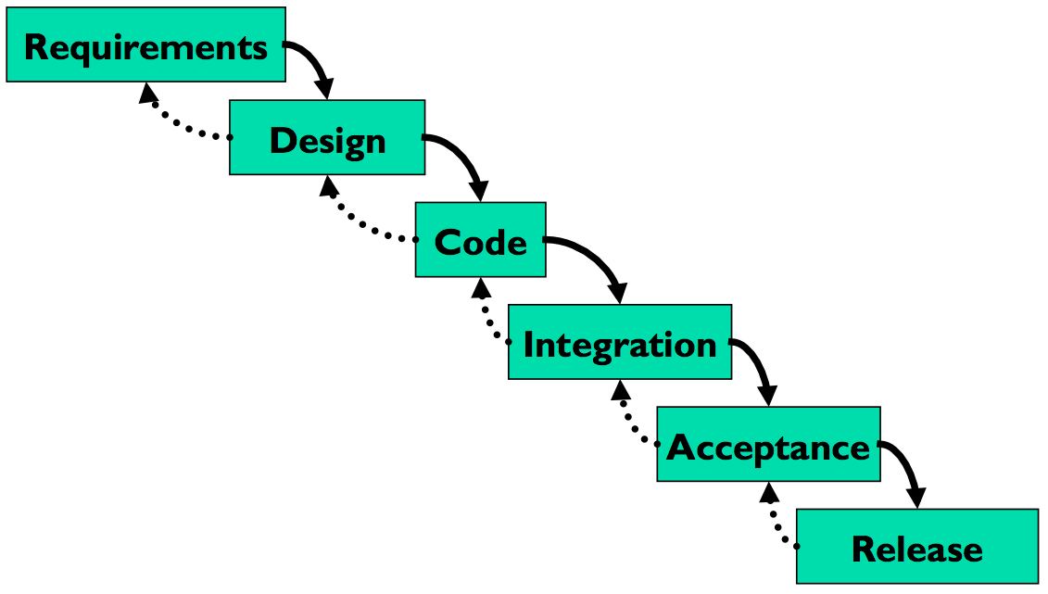
Traditional software development process
Waterfall model
Anyone encountered this in class before?
Can you describe it?
Is this a good model for user-centered design?
Where is the user?

Slide 5
Not enough user engagement in the process
User only included in the first step: capturing requirements and the last step- acceptance and release
You can go back up the waterfall
But integrating user feedback in not considered at all stages
What can go wrong?
Don’t find out until the end if user’s like it
Then you are too far along to make many changes
Or have to throw out well written code, because it isn’t useful

Slide 6
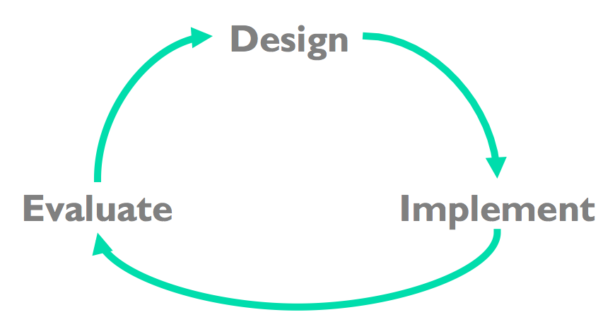
Hence, User-Centered Design is iterative
Iterative design
Early focus on users and tasks
Constant evaluation to inform new design choices
We will get into this but first….

Slide 7
How do we enter the cycle?
Needs finding, understanding out users

Slide 8
Before we design: Needs-finding
Need-finding or Analyzing User Requirements
We need to understand our users
Who are they?
What are their goals?
What should the design help them do?

Slide 9
Know your user
Things to learn
Age, gender, culture, language
Education (literacy? numeracy?)
Physical limitations
Computer experience (typing? mouse?)
Motivation, attitude
Domain experience
Application experience
Work environment and other social context
Relationships and communication patterns with other people
Pitfall
describing what you want your users to be, rather than what they actually are
“Users should be literate in English, fluent in spoken Swahili, right-handed, and color-blind”

Slide 10
Know your user
There can be multiple classes of user
Primary users, Secondary users
Or other divisions (expert users, novice users….)
These distinctions can help you think about different sets of goals, or different expectations or levels of experience

Slide 11
How to go deeper than a user profile? Do a user analysis, working with real users
Requirements gathering, establishing design requirements
What is it that our design is going to support
Not about systems requirements (yet)
Not about design of the UI (yet)
All about what people need
Methods:
Observation (we will cover later….)
Surveys (we will discuss later…)
Interviews- we will begin working on today

Slide 12
Why not think first about the system or UI design?
Pitfall: Begin with the system you want to build
System: “Notify the user about an appointment”
User need first: “Get notified about my appointments so I don’t miss them”
Pitfall: Begin with UI design goals
UI design idea: “The system bell will ring to notify the user about an appointment…”
User needs first: I need to be alerted in a way that it can be detected by me even if I am not looking at a device
Why does this matter?
Solution focus BEFORE you fully understand the needs and have tested alternate designs

Slide 13
Concrete tasks vs essential goals
Sometimes users may express something they want, good to ask yourself:
is this based on what they currently do? (Concrete task they perform)
Is it based on what is behind this current practice (essential goal)
Example:
User : ”I need to save the file to disk” (Concrete task)
Requirement: I need to preserve my work.
Why:
As before, be open to alternate solutions not based on current practices
What might we come up with instead??

Slide 14
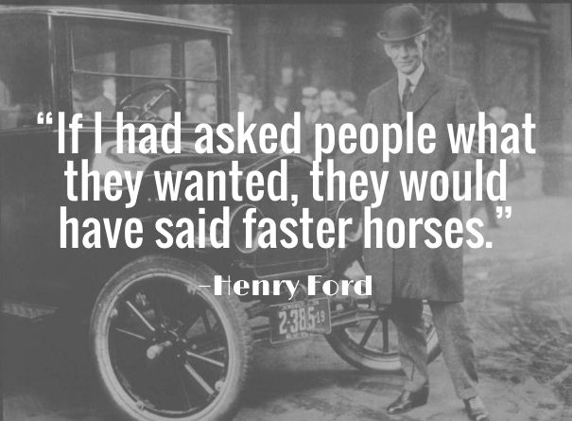

Slide 15
Need finding pitfall: Expecting the users to tell you what to design
You can’t just ask the users what you should be designing
Ask them what they need to get done
Ask about their goals
Ask about their problems

Slide 16
Take note:
User analysis is different than market analysis
Not- will users use my product
Not- is there a market for this product
Not- what will people pay
These are important questions, but often approached with different techniques

Slide 17
What is the end result?
Purpose :
The requirements analysis must produce a readable and clear, documented set of user requirements that informs the design activity
Focus:
Requirements should be expressed at a level of detail which is appropriate for leaving room for alternative design exploration (within the frame established by the requirements)

Slide 18
NO: user sees a pop-up asking to register, he enters username and password, click on submit and the pop-up close, showing a page with the top navigation bar and in the center a dashboard with all the personalized information displayed in a grid metaphor….
YES:
What user needs to do ultimately: The users’ goal is to access their assignments and lecture notes, so they can keep up in their class
What problems do they face: The user struggles to find what they need, and it delays their work
What do they want?
The users wants to have personalized info in the app, saved for every time they use it
User needs to be able to see their high priority tasks quickly as soon as they start using it, and not have to scroll through lots of options
User wants to have it be a familiar layout, without too many options
….

Slide 19
How can we do need finding?
Observation (we will learn some methods later)
Surveys (we will discuss later)
Interviews- we will begin working on today
(Note- interviews and observations can ALSO be used for evaluation….)

Slide 20
Interview Guidance: how to do it
Attitude:
YES: Learning, understanding, identifying, discovering, unveiling, clarifying (= open to change)
NO: confirming, demonstrating, re-assuring, achieving consensus, discussing opinions (= closed to change)
Key test of a good user interview:
What are 3-4 things you have learned that you did not know before
Focus your questions on the experience
Not projection, prediction, extrapolation, “thoughts”
NO: Is this a useful application?
YES: Is this application valuable to the work you do right now? How? Why?

Slide 21
Interview Guidance: how to do it
Focus on immediate experience
Capture current behavior
NO: Is this product <interesting> for you?
YES: If it were available right now, would you use it?
Why? How?
Non-judgmental attitude
Do not convey in any way that you are expecting a certain answer…
NO: Don’t you think this feature would be better if available also as a iPad application?
YES: Is there any other way you’d like to use a feature like this in your current work? How? Why?

Slide 22
User interview guidance
Keep each question focused on a single topic
Avoid using AND / OR in your questions (linking more statements together)
NO: How would you use this app at school or at work, for example?
YES:
How would you use this app at school?
How would you use this app at work?
Provide a way out from your options
What do you often use to get the news? Smartphone or tablet? Or something else?
Even in close-ended questions, give the possibility of expressing things outside the available options
NO: which of the following feature is most important to you? [what if no one is important?]
YES: Rate from 1 to 5 how important each feature is for you, where 1 is least important, 5 is most important. Put 0 if a feature is irrelevant for you.

Slide 23
User Interview Guidance
Avoid binary questions
Do not force black/white commitments on the “whole”
Elicit “analytical” feedback on specific elements
NO: Is this product useful?
YES: What, if anything, do you find useful about this product? Why?

Slide 24
Activity: Lets try to do an interview
First planning
Then we will go into small groups and interview each other
And then reflect

