Slide 1
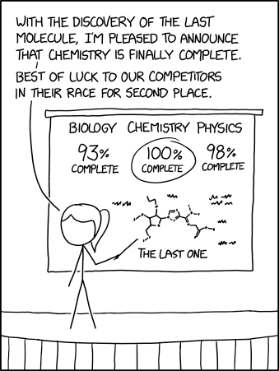
User interface design
xkcd

Slide 2
UI Design: Monday Sept 12
Dr. Jillian Aurisano
Plan for today:
Announcements/Course logistics
Project- questions?
Assignment turn in
The web, technical perspective
HTML, CSS, SVG
Coding activity
Notes:
So welcome to engineering visual interfaces for data science. I'm Dr Aurisano.
Thanks for finding the class on Zoom. Hopefully we will be in person again soon.
If anyone out there is comfortable turning on their cameras, that is lovely- then I feel like I am talking to students, rather than to myself.
Here’s our plan for today:
First I’m going to introduce myself, so you know a bit about me
Then we are going to get to know each other, in Zoom breakout rooms. This will give us a chance to make sure that Zoom breakout rooms work, and we all know how to access them.
Then, I am going to walk through the structure, and plan for the course. I want to make sure everyone knows how the course will work, and what to expect, and also a bit about why the course is designed this way.
Then I am going to introduce the class, and what the class is about. Since this is a new class, and one of just a few classes in human centered computing here at UC, I wanted to give an overview of the topic.
Then I have an introductory activity, which we will do in breakout rooms, and which I think will help motivate the discussion on Wednesday, and getting into the meat of the class.

Slide 3
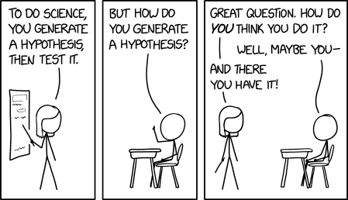
Questions about the project?

Slide 4
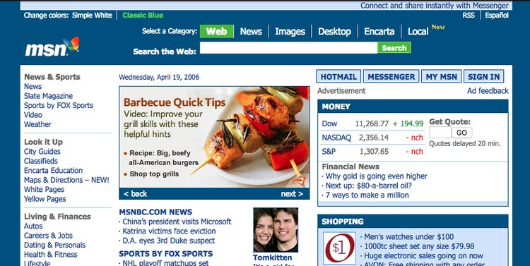
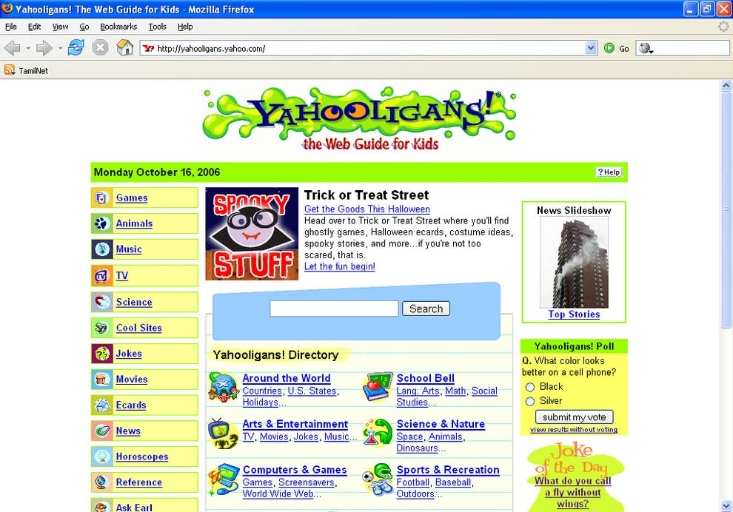
Why develop visualization applications for the web?
In this class we aren’t really creating web pages
We are creating web applications- programs that can respond to complex inputs from users, present graphics, and dynamically update.
About 15-20 years ago, it wasn’t possible.
Lots of GUI toolkits for C++, Java
Harder to get interactive applications to people

Slide 5
Why develop visualization applications for the web?
But- this has changed!
Web browser is a great platform for creating powerful, interactive applications
Easy to make interactive applications that people can access

Slide 6
Components of our web applications?
HTML- defines the content of the page, and all the elements needed to display the content in the page
“Index.html”
Stylesheet- ‘CSS’
Style/style.css
Defines a set of rules for the appearance, behavior of elements on the page
This is where you can set fonts, or sizing or background colors
Can also do this in html or in javascript, but sometimes easier to put in one place
Javascript files
Link to these in html
Scripts that run, respond to user inputs, load data…

Slide 7
Today:
HTML to layout elements on a webpage, and add user interface elements (checkboxes, buttons, sliders, input forms).
CSS for some styling
SVG to create shapes and drawings

Slide 8
Let’s step back for a minute….
What exactly happens when we write html, css and javascript code and it is “served” and “runs” in a browser?

Slide 9
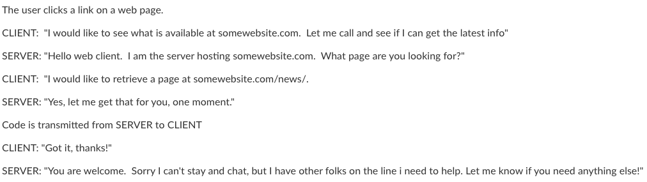
What happens when you go to a webpage?

Slide 10
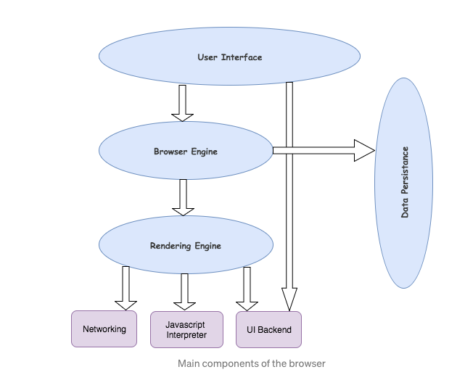
What happens when the web browser client gets this code?
Browser UI
Browser Engine
Rendering Engine: takes the html and decides what to ’paint’ on the screen’
Javascript Interpreter: interprets the javascript code. Think of a virtual machine….

Slide 11
Let’s imagine we were inventing user interface libraries for the internet
There is no html. There is no javascript.
We wanted there to be a way for developers to create user interfaces
Ability to create visual elements- like basic shapes
Let’s also add some pre-constructed visual elements that developers often need- like buttons and text entry boxes. They can re-use these.
2 camps:
Camp 1: Let’s just tell the developer to put these elements in the window. We’ll give them a coordinate system. They can place them freely, manage these elements themselves. This gives the developer maximal control
Camp 2: Let’s have developers place elements within a hierarchical view tree and let them group things, and specify some general layout rules, but we will lay the elements out for them.
Which camp should win?

Slide 12
The view tree camp has mostly won….
Virtually every GUI system has some kind of view tree. The view tree is a powerful structuring idea, which is loaded with responsibilities in a typical GUI.
Layout
Automatic layout algorithm traverses the tree to calculate positions and sizes of views
The DOM in HTML is a view tree

Slide 13
What does the rendering engine do?
Parses html
Creates a tree of elements (content tree)
Parses css style rules and applies them to elements in the tree
Render tree, which decides the order in which things are displayed
Layout algorithm, which positions elements based on the rules
Painting function, which decides which pixels to fill in within the browser window
All this happens behind the scenes….
I have a brief overview of this in Tutorial 0….

Slide 14
Let’s look at a page
What is in a page
Web developers tools

Slide 15
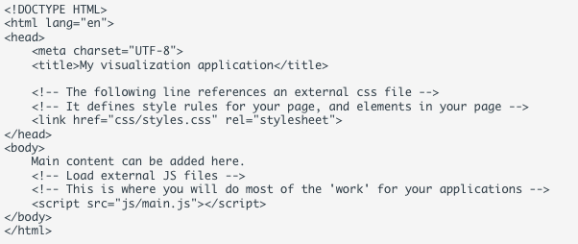
Let’s start
Html biolerplate

Slide 16
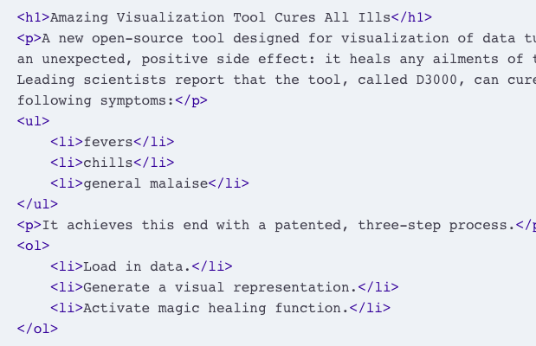
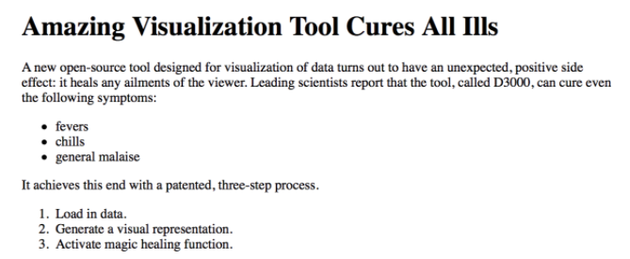
HTML
HTML can contain hierarchically organized elements
Text
Lists
Tables
Images
UI elements: buttons, checkboxes….
https://www.w3schools.com/html/default.asp

Slide 17
HTML: Identifiers and classes
As you create elements, you can add identifiers and classes
Allow you to later modify or apply style rules to selected elements.
There are 2 ways to do this:
classes, which reference a set of elements, and
ids, which uniquely reference one element

Slide 18
SVG
Important to understand how d3 uses the svg canvas and elements
SVG stands for 'scalable vector graphics’.
Allows developers to add graphical elements to their page- shapes, lines, etc.
D3, the visualization library we will use in this class, uses svg extensively to map data to graphical elements on the page.
You can also use svg independent of d3.

Slide 19
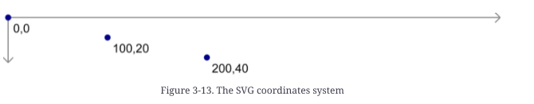
SVG: Coordinate system
Elements are placed within a canvas, with a coordinate system that goes from
Coordinate system goes from
Upper left is 0,0.
Lower right is width, height
How do you place something in the center of your svg?

Slide 20
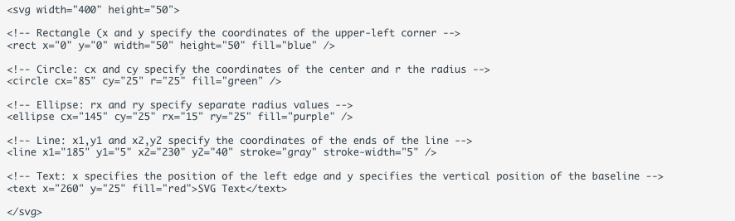

SVG examples

Slide 21
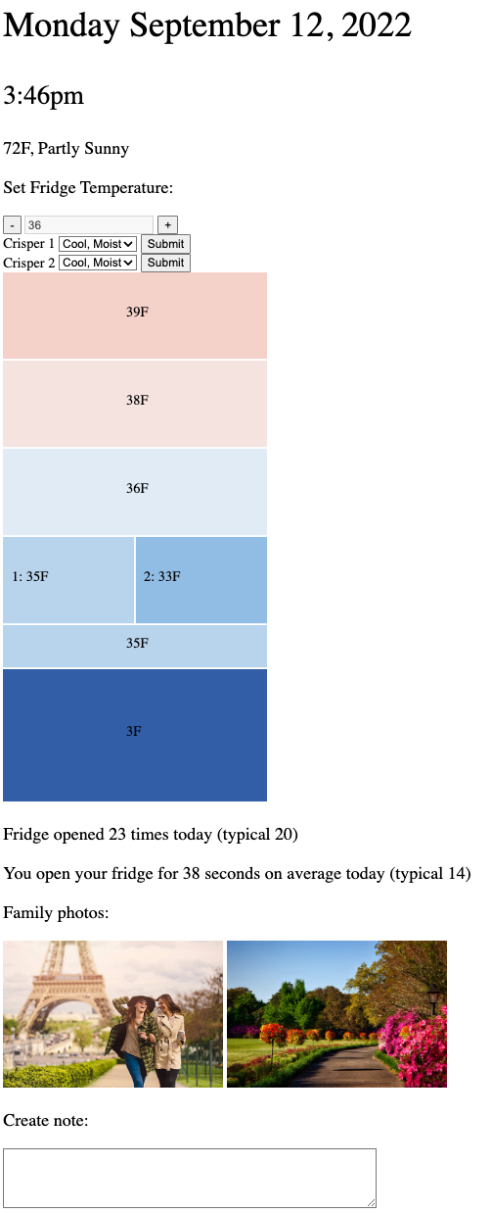
Now we are going to do an activity
Smart fridge UI
Not nicely designed and no nice layout
No styling
Just basic addition of elements to a page

Slide 22
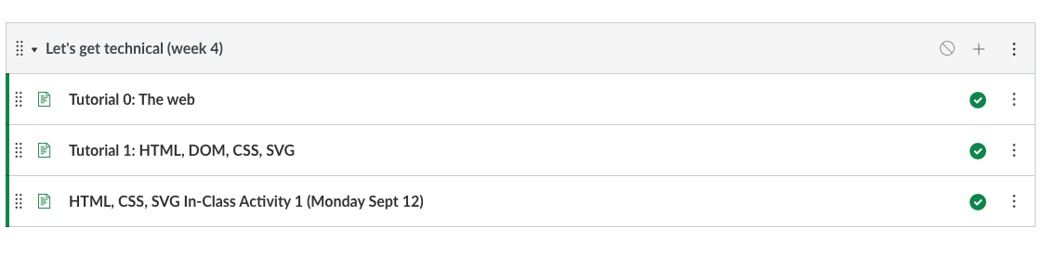
Find the materials

