Slide 1
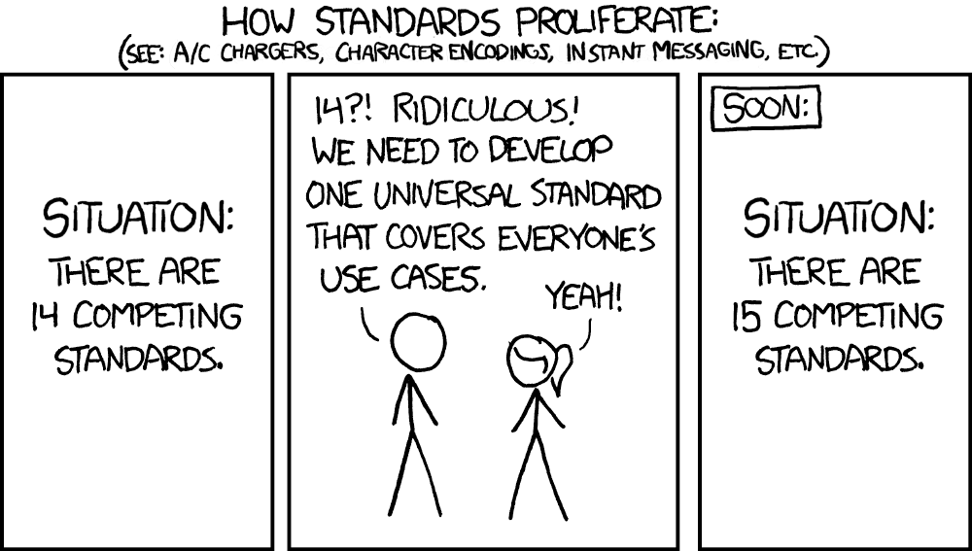
User interface design
xkcd

Slide 2
UI Design: Friday Sept 23
Dr. Jillian Aurisano
Plan for today:
Announcements/Course logistics
Javascript - classes, modules
Coding activity
Notes:
So welcome to engineering visual interfaces for data science. I'm Dr Aurisano.
Thanks for finding the class on Zoom. Hopefully we will be in person again soon.
If anyone out there is comfortable turning on their cameras, that is lovely- then I feel like I am talking to students, rather than to myself.
Here’s our plan for today:
First I’m going to introduce myself, so you know a bit about me
Then we are going to get to know each other, in Zoom breakout rooms. This will give us a chance to make sure that Zoom breakout rooms work, and we all know how to access them.
Then, I am going to walk through the structure, and plan for the course. I want to make sure everyone knows how the course will work, and what to expect, and also a bit about why the course is designed this way.
Then I am going to introduce the class, and what the class is about. Since this is a new class, and one of just a few classes in human centered computing here at UC, I wanted to give an overview of the topic.
Then I have an introductory activity, which we will do in breakout rooms, and which I think will help motivate the discussion on Wednesday, and getting into the meat of the class.

Slide 3
Announcements
Tell me which smart object you plan to do for the first project today
Can be the one you worked on in your group
Reminder- Clarification of expectations for sketching
See announcement
Sketches for the design brainstorming (10-plus-10) method should not be complex or detailed. Just high-level brainstorming.
To help keep this from taking lots of time – let’s try a modified 10 minutes-plus-5 minutes method. Sketch for 10 minutes, pick something to delve deeper into, and sketch for 5 mintues.
3 design challenges x 15 minutes

Slide 4
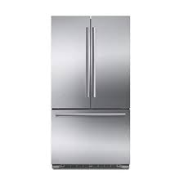
Announcements
Project clarification
Webpage
webpage
Implement UI here
External controls for simulating the fridge behavior here

Slide 5
Announcements
Project clarification
Webpage
webpage
Implement UI here
Mock phone UI
External controls for simulating the fridge behavior here

Slide 6
Project debugging times
If I schedule project coding and debugging times, would people come?
Example- Friday Sept 30, Friday Oct 7 in the evening?
I may send out a poll to gauge interest
Maybe we can order pizza =)

Slide 7
Project goals
Level 1 (C goals)
Create a basic UI that shows a moment in time in this object’s usage.
Basic interactive controls that allow the user to input their preferences and settings
Basic display of the status of the smart object
Level 2 and 3 : there are options
Simulating the behavior of the object
Single use (eg .Opening and closing the fridge, how would UI update)
Over the course of a day (replay the day, showing the UI updating)
Enabling complex inputs
Mock secondary device
Consider different user profiles, and their data

Slide 8
Consider our smart fridge
Suppose the UI conveys the state of the fridge
Current temperatures in different compartments
How full is each compartment
How often it has been opened and closed that day
How long on average is it left open
Potentially other information….
Suppose we are simulating one event:
Someone opens the fridge,
The temperature in each compartment is recorded
It is open for 237 seconds,
They take something off shelf #3, so this shelf goes from 30% full to 15% full,
and then they close the fridge
The new temperatures in the fridge are logged

Slide 9
Consider our smart fridge
Suppose the UI conveys the state of the fridge
Current temperatures in different compartments
How full is each compartment
How often it has been opened and closed that day
How long on average is it left open
Potentially other information….
Suppose we are simulating an event:
Someone opens the fridge,
The temperature in each compartment is recorded
It is open for 237 seconds,
They take something off shelf #3, so this shelf goes from 30% full to 15% full,
and then they close the fridge?
The new temperatures in the fridge are logged
What do we need to do in our smart fridge html, css, javascript code to simulate this single event and update the view?
Brainstorm in a team of 2-3 people for 5-10 minutes
Write pseudo code, diagram it
See Discord for Google Drive file
We will reconvene to discuss

Slide 10
What did we come up with?
…

Slide 11
Consider our smart fridge
So, now we have the capacity to respond to one event
What if want to simulate the usage of the fridge over a mock day
They open the fridge at 6am….
And again at 6:25am…
And again at 10:02 am….
I want to replay this day and see how the UI updates.
How would you do it?
Discuss with your group 5-10 minutes
Write Pseudo code or diagram it
Refer back to the tutorial on events (set interval, set timer) and objects/arrays

Slide 12
What did we come up with?
…

Slide 13
Let’s continue to refine our smart fridge
Goals:
Basic UI
Buttons and controls
Put these elements into div’s and use flexbox or css grid for layout
Capture events on these elements and update the page (eg. Set the fridge temp, add a photo on click)
Make an array of data that represents fridge opening events
If you have time… try to do some of this:
Create a function ’open fridge’ to read from these array and update the fridge UI ( with all that this entails). Invoke this function somehow (easiest right now is a keypress event)
Create a function to simulate a day of usage of the fridge
Submit what you have- I just want to see everyone trying and learning!

