Slide 1
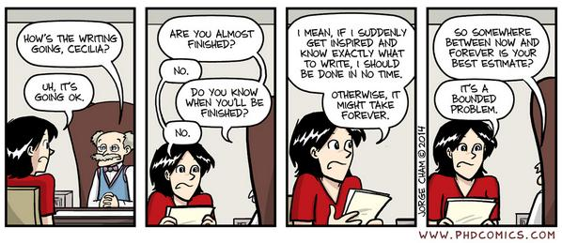
User interface design

Slide 2
UI Design: Friday Oct 14th
Dr. Jillian Aurisano
Plan for today:
Announcements/Course logistics
Wrapping up our discussion of people
Time to work on the project
I’ll also be available after class in Mantei 435
Notes:
So welcome to engineering visual interfaces for data science. I'm Dr Aurisano.
Thanks for finding the class on Zoom. Hopefully we will be in person again soon.
If anyone out there is comfortable turning on their cameras, that is lovely- then I feel like I am talking to students, rather than to myself.
Here’s our plan for today:
First I’m going to introduce myself, so you know a bit about me
Then we are going to get to know each other, in Zoom breakout rooms. This will give us a chance to make sure that Zoom breakout rooms work, and we all know how to access them.
Then, I am going to walk through the structure, and plan for the course. I want to make sure everyone knows how the course will work, and what to expect, and also a bit about why the course is designed this way.
Then I am going to introduce the class, and what the class is about. Since this is a new class, and one of just a few classes in human centered computing here at UC, I wanted to give an overview of the topic.
Then I have an introductory activity, which we will do in breakout rooms, and which I think will help motivate the discussion on Wednesday, and getting into the meat of the class.

Slide 3
Project code due tonight at 11:59pm Documentation due Sunday at 11:59pm
Just submit!!!! It will be ok!

Slide 4
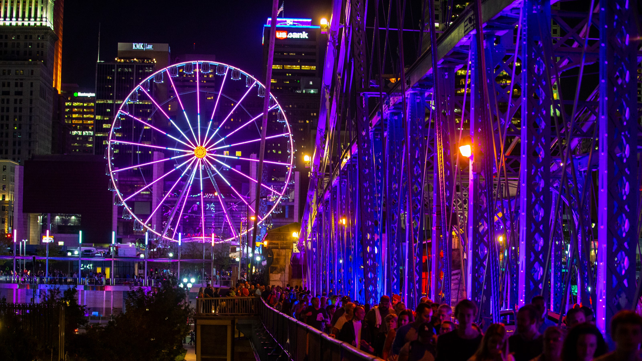

Go outside
Take a walk outside for a bit on Saturday to enjoy the beautiful weather
Get a pumpkin spice <something>. You deserve it!
Go to Blink- it is cool!

Slide 5
Coming up
Presentations: On Zoom
Canvas info….
Next Friday will be an asynchronous class. Details to follow.

Slide 6
How we pay attention

Slide 7
Attention is selective
We do not attend to everything
Remember the gorilla?? The door experiment??
If we are focused on something, we miss other things
When we are focused, we filter out other stimuli that are not related to the thing we are focused on
Certain stimuli tend to more easily attract attention
Food, sex, danger
Using someone’s name
If you need to attract the user’s attention, consider more ‘heavy handed’ attention grabbing techniques
Color, animation…

Slide 8
Expectation of frequency impacts attention
If we expect something to occur frequently, it is likely to be something we notice
If we do not expect something to occur, we are more likely to miss it
Example:
Airport screening
They expect to see water bottles forgotten in backpacks- easy for screeners to spot
Much easier to miss rare but dangerous items
If something is rare but important- need to use heavy handed approaches to grab their attention

Slide 9
Sustained attention lasts 10 minutes
We can sustain active attention for about 7-10 minutes
Assuming we find it interesting and engaging
Following a short break, or a period of mental wandering, we’re often ready to reengage
When designing tasks or activities, we should try to keep these focused activities under 7 minutes in total
OR add breaks where we give users the opportunity to paus
Example: signing up for a service with lots of info they need to enter, try to make it less than 7 minutes.

Slide 10
Multi-tasking
How many people in here think they are great multi-taskers?
How many feel like terrible multi-taskers?

Slide 11
People can’t multitask
We can only consciously focus on one activity at a time
Or carry out one practiced physical task whilst engaging in a mental task (walk and talk)
Though there is a decrease in our level of competency when we do these two activities at once
Which validates my experience of walking into walls while talking to people
We can consciously switch between activities reasonably quickly, which feels like multitasking , but it isn’t really multi-tasking
If our users are multi-tasking, we should assume that they will make more errors than normal and account for this in our design

Slide 12
How we make mistakes

Slide 13
Assume something will go wrong
We all make mistakes
Systems should be designed with this in mind
Expect that mistakes/errors will occur and be prepared to respond appropriately

Slide 14
We make predictable errors
Common types of performance errors (mistakes while completing a task)
Commission errors: additional, unnecessary steps were taken
Omission errors: Necessary steps have been omitted
Wrong-action errors: The right action was taken, but it was incorrect (wrong password
Motor control errors- mistakes controlling the device can also be made
Accidentally pressing the wrong button
We need to identify possible sources of error (good use of user testing) and design with this in mind

Slide 15
We make more errors when under stress
Performance typically increases with mental or physical arousal
Up to a point
Beyond this, when stress is too high, performance decreases
The amount or stress or arousal that is needed for optimal performance depends on the difficulty of the task
Simple or boring tasks, we need to raise the level of arousal
Challenging tasks, do the opposite

Slide 16
Error recovery strategies
Systematic exploration- explore options systematically and with a plan
Trial and error- pick something promising and try it. Repeat
Rigid Exploration- keep doing the same thing over and over again….

Slide 17
Take away on our discussions of people

Slide 18
Our brains impose order on what we see
Our perceptual systems take in the world, but our brain does lots of work to impose structure and order on this content
What that means for designers- we can use this when we design visual elements
Gestalt principles
Selection of color
Use of layout and hierarchy

Slide 19
Cognitively we have limitations
We have many limitations
We are easily influenced by irrelevant anchors, impacting our behavior
Our minds frequently wander
Out attention only lasts a few minutes
We can’t really multi-task (but we think we can)
Our working memory has a limited capacity and this content fades easily
We make predictable errors (more on this later)
We should design software that considers and works around these limitations

Slide 20
We want choice, but we are overwhelmed by choice
Choice is associated with control, we don’t want to give up choices
Too many choices can be overwhelming
We are willing to compromise and pick a good enough choice quickly

Slide 21
Big goal as designers
Our interfaces should augment human capabilities
Display the information we can’t remember
Help us focus and notice our errors
Motivate us, when we lack motivation
Influence us to set goals and modify our behaviors in good ways
Help us be better!

Slide 22
Credit for all the ”people” slides
Philip Hanna
User experience design course
https://www.youtube.com/channel/UCfUy39PpDwDE2yk7ztgRuuQ

