Slide 1
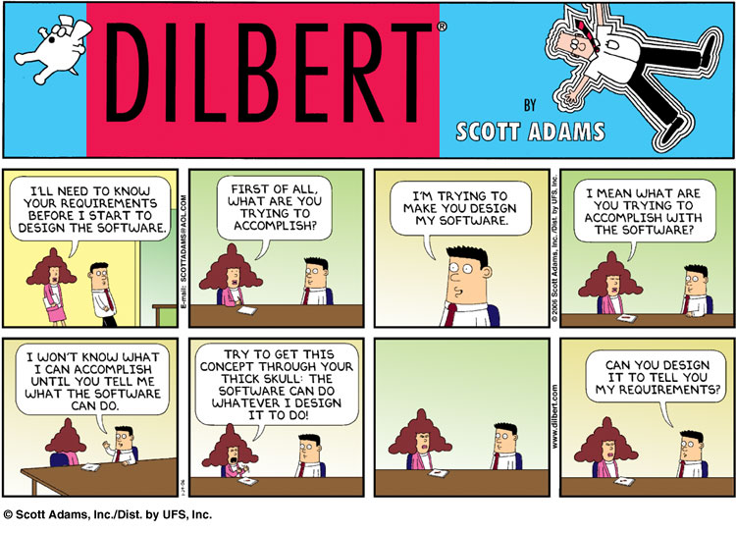
User Interface Design

Slide 2
UI Design: Friday Sept 2 (Day 6)
Dr. Jillian Aurisano
Plan for today:
Announcements/Course logistics
Continue interviews (10 minutes)
Presentation and reflection (10 minutes)
Revise your project design goals and requirements in your teams, based on interviews (10 minutes)
Present what changed (10 minutes)
If time, user centered design, leading into sketching next week
Notes:
So welcome to engineering visual interfaces for data science. I'm Dr Aurisano.
Thanks for finding the class on Zoom. Hopefully we will be in person again soon.
If anyone out there is comfortable turning on their cameras, that is lovely- then I feel like I am talking to students, rather than to myself.
Here’s our plan for today:
First I’m going to introduce myself, so you know a bit about me
Then we are going to get to know each other, in Zoom breakout rooms. This will give us a chance to make sure that Zoom breakout rooms work, and we all know how to access them.
Then, I am going to walk through the structure, and plan for the course. I want to make sure everyone knows how the course will work, and what to expect, and also a bit about why the course is designed this way.
Then I am going to introduce the class, and what the class is about. Since this is a new class, and one of just a few classes in human centered computing here at UC, I wanted to give an overview of the topic.
Then I have an introductory activity, which we will do in breakout rooms, and which I think will help motivate the discussion on Wednesday, and getting into the meat of the class.

Slide 3
Announcements / Course logistics
Monday is Labor day- have a nice day off!
Next week: sketching week
Then: 2 technical weeks
Project 1: I’ll post next week
Please put all your notes and what you learn from interviews in the Google doc, so I can reference them in designing the project
There will also be a sketching practice assignment based on in-class work next week.

Slide 4
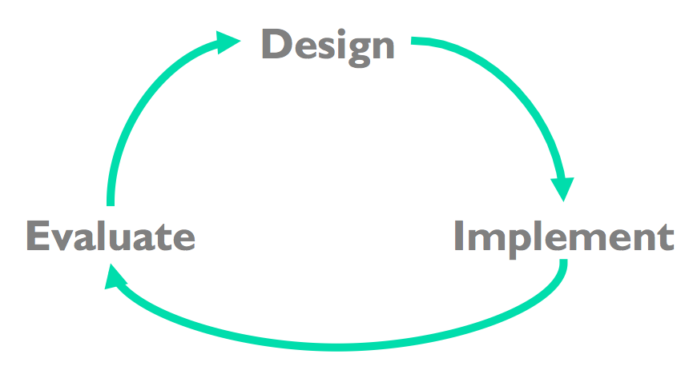
Hence, User-Centered Design is iterative
Iterative design
Early focus on users and tasks
Constant evaluation to inform new design choices
We will get into this but first….

Slide 5
How do we enter the cycle?
Needs finding, understanding out users

Slide 6
Needs finding: User Interviews
Goal:
learn something new
be open to changing your ideas and plans
develop a specific list of needs, that you will use to ideate - creating lots of alternate solutions to the problems you identify or the user’s needs
How:
Word questions in ways that are open, non-judgmental, not leading to a particular solution, but that will help you learn something

Slide 7
1. Continue interviews from last time

Slide 8
2. Presentation and reflection
What went well?
What was difficult?
Did you learn something?
What would you do differently if doing this interview again?

Slide 9
3. Reconvene groups, and use the interviews to refine design requirements
Google doc: refined design requirements- posted on Discord
Refine your design requirements:
Record the needs and problems and goals you captured from your interviews
Look back over the initial brainstorming and think about what needs you were addressing in your initial ideas, incorporate them
Create a list from these needs that will help us do design alternatives next week
Specific + problem focused, rather than solution focused
The user wants to be able to understand ….
The user has trouble with ….
The user should be able to ….
Ok to note disagreements- some users want to be able to …. Others want ….

Slide 10
4. Present

Slide 11
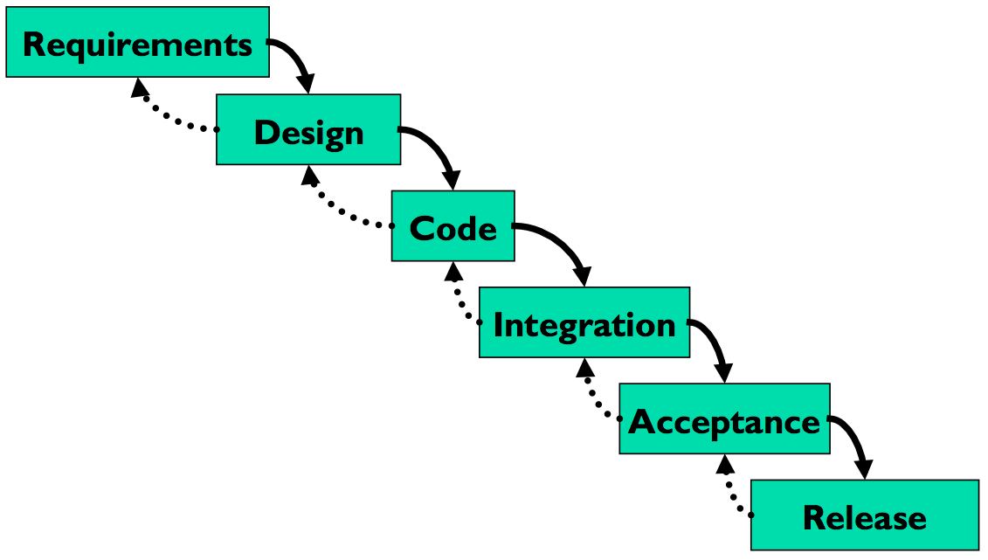
Traditional software development process
Waterfall model
Anyone encountered this in class before?
Can you describe it?
Is this a good model for user-centered design?

Slide 12
Traditional software development process
Waterfall model
Anyone encountered this in class before?
Can you describe it?
Is this a good model for user-centered design?
Where is the user?

Slide 13
Not enough user engagement in the process
User only included in the first step: capturing requirements and the last step- acceptance and release
You can go back up the waterfall
But integrating user feedback in not considered at all stages
What can go wrong?
Don’t find out until the end if user’s like it
Then you are too far along to make many changes
Or have to throw out well written code, because it isn’t useful

Slide 14
Hence, User-Centered Design is iterative
Iterative design
Early focus on users and tasks
Constant evaluation to inform new design choices

Slide 15
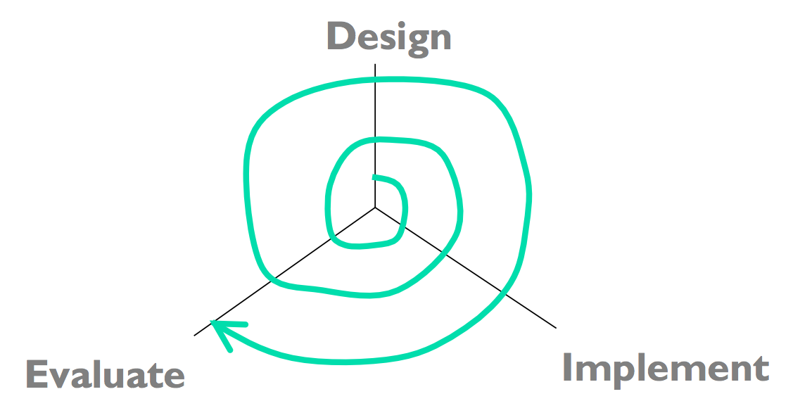
From low fidelity, low cost to the real thing
Early investment in design iterations
Early iterations are done in inexpensive forms, as you the design becomes clear, begin to ‘firm up’ the designs and implement them well
As you go outward in this figure, also increasing fidelity or accuracy
Example- early implementation step is a paper sketch, then a mock-up, then a lightweight prototype
Evaluations are done on inexpensive versions, still gain insight
$
$$
$$$
$$$$

Slide 16
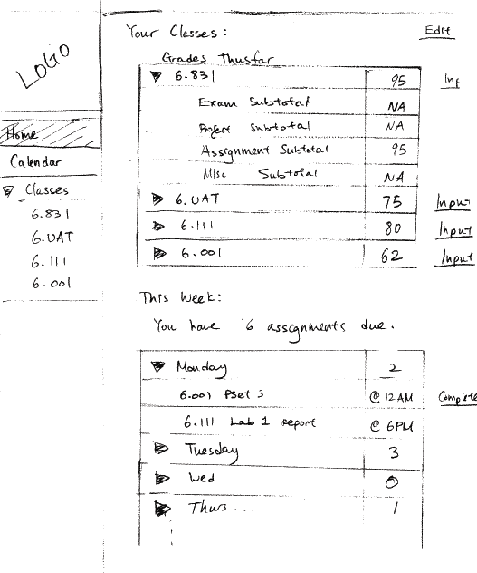
Early design iterations: pen and paper

Slide 17
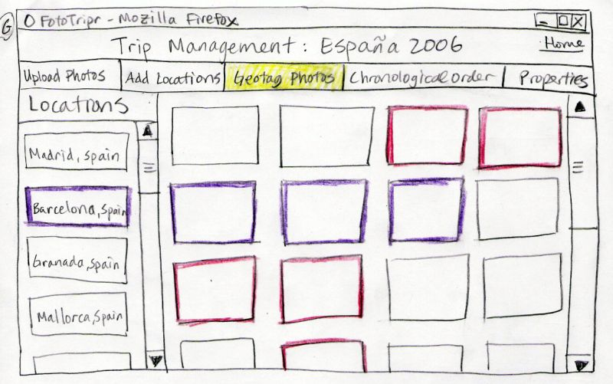
Early prototyping: sketches

Slide 18
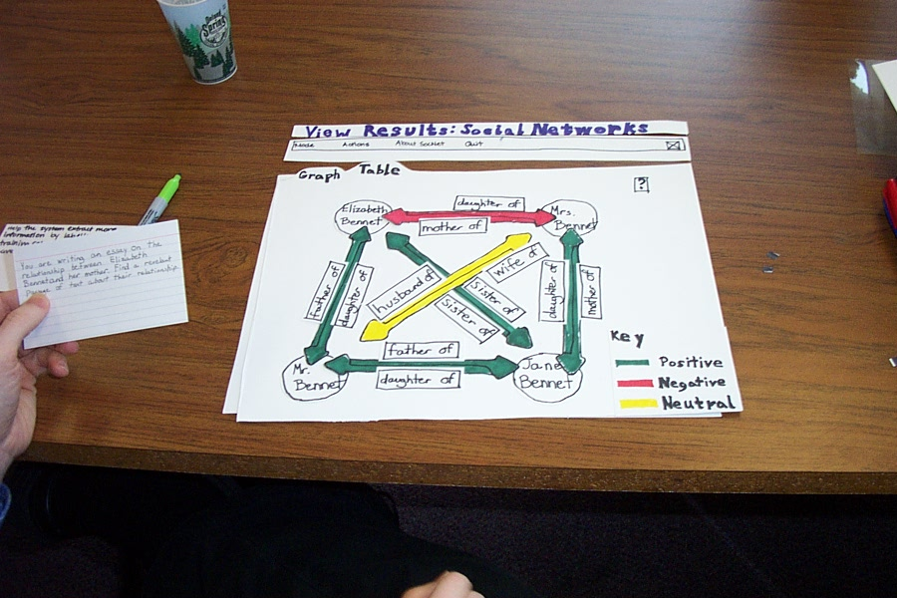
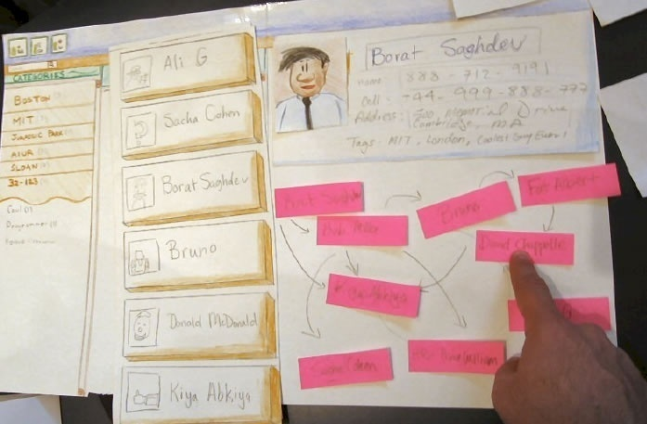
Early prototyping
Paper prototypes

Slide 19
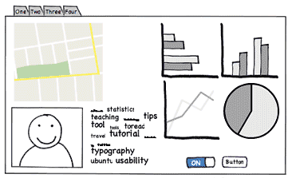
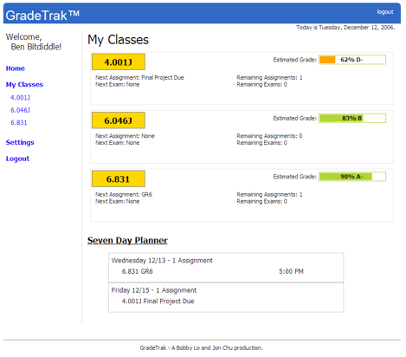
Early prototyping
Computer mock-ups

Slide 20
Why early prototyping?
It is cheap
It is quick
You can still test it!
Note- may not be easy… but we will practice

Slide 21
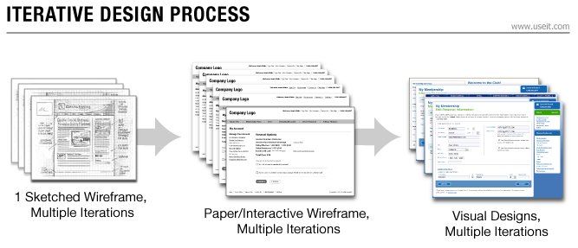
Iterate, iterate, iterate
Early iterations use cheap prototypes
Parallel design is feasible: build & test multiple prototypes to explore design alternatives
Use richer implementations in later iterations, after UI risk has been mitigated
More iterations generally mean better UI
Only mature iterations are seen by the world (a.k.a users)

Slide 22
So, we have some design goals
How do we start exploring alternative approaches?
SKETCHING!

